Slide 1
Artificial Intelligence
College of Engineering & Technology
Computer Techniques Engineering Department
Artificial Intelligence – Stage 3
Lecture 7
Propositional Logic

Slide 2
Propositional Logic
In this lecture we cover
The syntax of propositional logic.
The semantic of propositional logic.
The logical inference in propositional logic.

Slide 3
Propositional Logic - Syntax
The syntax of propositional logic defines the allowable sentences.
Atomic sentences consists of a single proposition symbol.
Each symbol stands for a proposition that can be true or false.
There are two proposition symbols with fixed meaning:
True is always-true proposition
False is always-false proposition.
Complex sentences are constructed from simpler sentences using parentheses and logical connectives.

Slide 4
Propositional Logic – Logical Connectives
$¬ \left(not\right)a sentence such as ¬W is called a negation of W$
$∧$ (and) a sentence whose main connective is $∧such as P∧W is called a conjunction.$
$∨\left(or\right)a sentece using ∨such as W∨P is a disjunction$.
$⇒\left(implies\right)a sentence such as \left( W∧P \right)⟹Z is called an implication.$
$⇔\left(if and only if\right)the sentece W⟺Z is biconditional.$

Slide 5
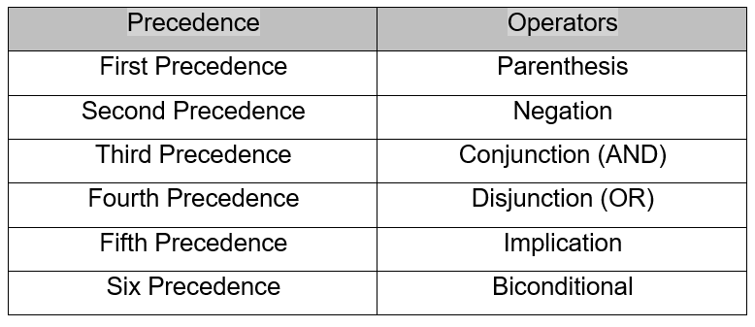
Propositional Logic – Operator Precedence

Slide 6
Propositional Logic – Semantics
The semantics defines the rules for determining the truth of sentence with respect to a particular model.
In propositional logic, a model simply fixes the truth value (true or false) for every proposition symbol.
If the sentence in the KB use the proposition symbols $P_{1,2}$,$P_{2,2} and P_{3,1} then one possilbe model is$
$$m1=\{ P_{1,2}=False, P_{2,2}=False, P_{3,1}=True\}$$

Slide 7
Propositional Logic – Semantics
With three proposition symbols, there are $2^{3}=8 possible models.$
The semantics for propositional logic must specify how to compute the truth value of any sentence, given a model.
All sentences are constructed from atomic sentences and five connectives.
So wee need to specify how:
To compute the truth of atomic sentences and how to compute the truth of sentences formed with each of the five connectives.

Slide 8
Propositional Logic – Semantics
$¬P$is true iff P is false in m.
$P∧Q$ is true iff both P and Q are true in m.
$P∨Q$ is true iff either P or Q is true in m.
$P ⇒Q$ is true unless P is true and Q is false in m.
$P ⟺Q$ is true iff P and Q are both true or both false in m.

Slide 9
Propositional Logic – Semantics
$$the truth tables for the five connectives are given below$$

Slide 10
Propositional Logic – Logical Equivalence
Two sentence α and β are logically equivalent if they are true in the same set of models.
We write this α ≡ β
True tables can be used to show that P ˄ Q and Q ˄ P are logically equivalent.

Slide 11
Propositional Logic – Logical Equivalence
P | Q | P ˄ Q | Q ˄ P
T | T | T | T
T | F | F | F
F | T | F | F
F | F | F | F

Slide 12
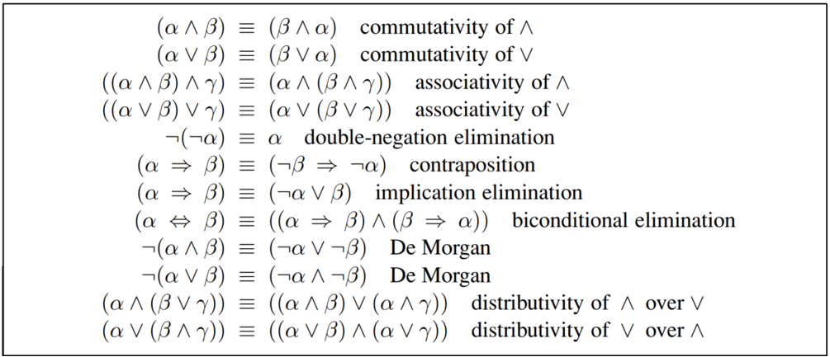
Propositional Logic – Logical Equivalence

Slide 13
Propositional Logic – Validity/contradiction
A sentence is valid if it is true in all models.
For example the sentence P˅ ¬P is valid.
Valid sentence is also know as tautologies
Contradiction is a statement that is always false.
P˄ ¬P

Slide 14
Propositional Logic – Satisfiability
A sentence is satisfiable if it is true in
Or satisfied by some model.
Satisfiability can be checked by enumerating the possible models until on is found that satisfies the sentence.

Slide 15
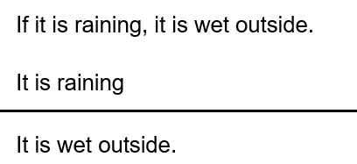
Propositional Logic – Inference and Proofs
Proofs using truth table:

Slide 16
Propositional Logic – Inference and Proofs
Translating it into symbolic from suing propositional variables.

Slide 17
Propositional Logic – Inference and Proofs
The argument is valid if the conclusion follow logically from the two premises.
First we construct a truth table that includes all of the premises and the conclusion.
Verify that there is no case in which:
Premises are true and the conclusion false

Slide 18
Propositional Logic – Inference and Proofs
P | Q | P$⇒$ Q | Q
T | T | T | T
T | F | F | F
F | T | T | T
F | F | T | F
To determine validity, look at every row in which both premises (‘P $⟹$ Q’, ‘P’) are true. For those rows (the first row only, in this case), is there a case in which the conclusion (‘Q’) is not true? There is not. Therefore, the argument is valid.

Slide 19
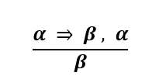
Propositional Logic – Inference rules
Inference rules are applied to drive a proof.
A chain of conclusions that leads to the desired goal.
Modus Ponens:
The notation means that, whenever any sentence of the form $α ⇒ β$ and α are given, then the sentence β can be inferred.

Slide 20
Propositional Logic – Inference rules
And-Elimination:
And-Elimination, which says that, from a conjunction, any of the conjuncts can be inferred.

Slide 21
Propositional Logic – Inference rules
Considering the possible truth values of α and β, on can show easily that Modus Ponens and And-Elimination are sound once and for all.
These rules can then be used in any particular instances where then apply, generating sound inferences without the need for enumerating models.
All the logical equivalences above, can be used as inference rules.

Slide 22
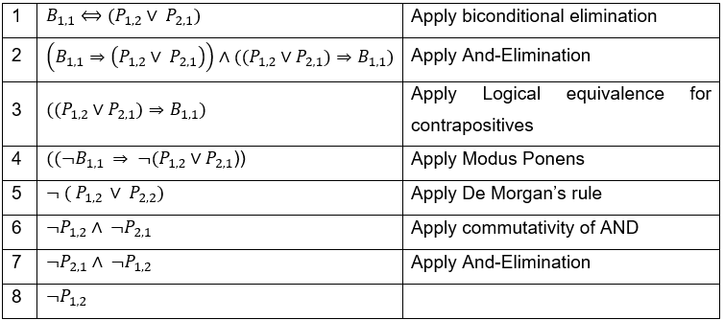
Propositional Logic – Inference rules
Let us see how their inference rules can be used. Let start with $B_{1,1} ⇔(P_{1,2}⋁P_{2,1})$ to infer $¬P_{1,2}$.

Slide 23
Propositional Logic – proof by resolution
Proof by resolution: the inference rules covered so far are sound.
How about completeness
Algorithm using inference rules are complete in the sense that they will find any reachable goal, but if the available inference rules are inadequate, then the goal is not reachable.

Slide 24
Propositional Logic – proof by resolution
For example, if we removed the biconditional elimination rule, the proof in the preceding section would not got through.
Alternatively
resolution, that yields a complete inference algorithm.

Slide 25
Propositional Logic – proof by resolution
The resolution rule applies only to clauses (that is, disjunction of literals).
every sentence of propositional logic is logically equivalent to a conjunction of clauses.
A sentence expressed as a conjunction of clauses is said to be in conjunctive normal form or CNF.
We now describe a procedure for converting to CNF.

Slide 26
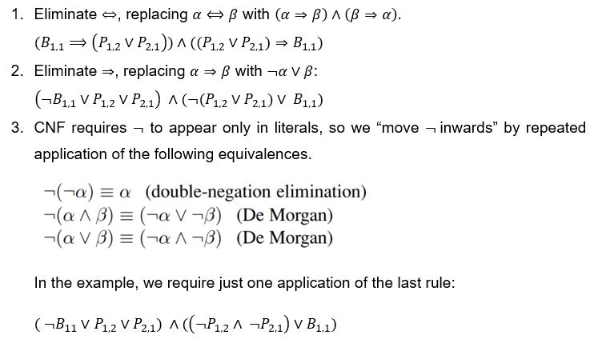
Propositional Logic – Inference rules
converting the sentence $B_{1,1}⟺(P_{1,2}∨ P_{2,1})$ into CNF. The steps are as follows:

Slide 27
Propositional Logic – proof by resolution
converting the sentence $B_{1,1}⟺(P_{1,2}∨ P_{2,1})$ into CNF. The steps are as follows:
The original sentence is now in CNF, as a conjunction of three clauses.

Slide 28
Propositional Logic – Resolution Algorithm
Inference procedures based on resolution work by using the principle of proof by contradiction.
That is, to show that $KB⊨ α$, we show that ($KB∧ ¬α)$ is unsatisfiable.
A resolution algorithm first is convert ($KB∧ ¬α)$ into CNF.
the resolution rule is applied to the resulting clauses.
The process continues until one of two things happens.
There are no new clauses that can be added.
Two clauses resolve to yield the empty clause.

