Slide 1


Department of Anesthesia Techniques
Title of the lecture:- Protein Synthesis
Prof. Dr. Younis A. Alkhafaji
Younis.Abdulridha@uomus.edu.iq
Lecture – 9 –
Protein Synthesis
Protein synthesis is the process of creating protein molecules.
♣ The creation of proteins by cells that uses DNA, RNA, and various enzymes. It
generally includes transcription, translation, and post-translational events, such as
protein folding, modifications, and proteolysis.
♣ Consists of 2 parts — Transcription & Translation
♣ Begins in the nucleus with mRNA copying DNA’s instructions for
proteins (transcription)
♣ Completed in the cytoplasm when tRNA enters ribosomes to read mRNA codons
and link together amino acids (translation)
♣ Central dogma of molecular biology: DNA → RNA.

Slide 2
Department of Anesthesia Techniques
Title of the lecture:- Bone & Cartilage
Prof. Dr. Younis A. Alkhafaji
Younis.Abdulridha@uomus.edu.iq
Lecture – 9
Steps in Transcription
1. Transcription is the first part of protein synthesis
2. After DNA helicase (enzyme) uncoils the DNA molecule
3. RNA polymerase (enzyme) binds to a region of DNA called the promoter which has
the start codon AUG to code for the amino acid methionine
4. The two DNA strands separate, but only one will serve as the template and be copied
5. Free nucleotides are joined to the template by RNA polymerase in the 5’ to 3’
direction to form the mRNA strand
6. mRNA sequence is built until the enzyme reaches an area on DNA called the termination
Signal.
7. DNA → RNA. It is the transfer of genetic instructions in DNA to mRNA. During
transcription, a strand of mRNA is made to complement a strand of DNA.
8. RNA polymerase breaks loose from DNA and the newly made mRNA
9. Eukaryotic mRNA is completely transcribed before leaving the nucleus through
nuclear pores for translation in ribosomes, but prokaryotic RNA isn’t????

Slide 3
Department of Anesthesia Techniques
Title of the lecture:- Bone & Cartilage
Prof. Dr. Younis A. Alkhafaji
Younis.Abdulridha@uomus.edu.iq
Lecture – 9
Steps in Translation
Translation is the second part of protein synthesis
⸭ RNA → Protein. It is the process in which the genetic code in mRNA is read to
make a protein.
⸭ mRNA brings the copied DNA code from the nucleus to the cytoplasm
⸭ At initiation step mRNA attaches to one end of a ribosome at this point, the
tRNA molecule carries the first amino acid of the polypeptide and attaches to the
start codon.
⸭ Every three nucleotides represent a codon, which codes for a particular amino acid.
The first codon of the mRNA (AUG – the “start” codon).

Slide 4
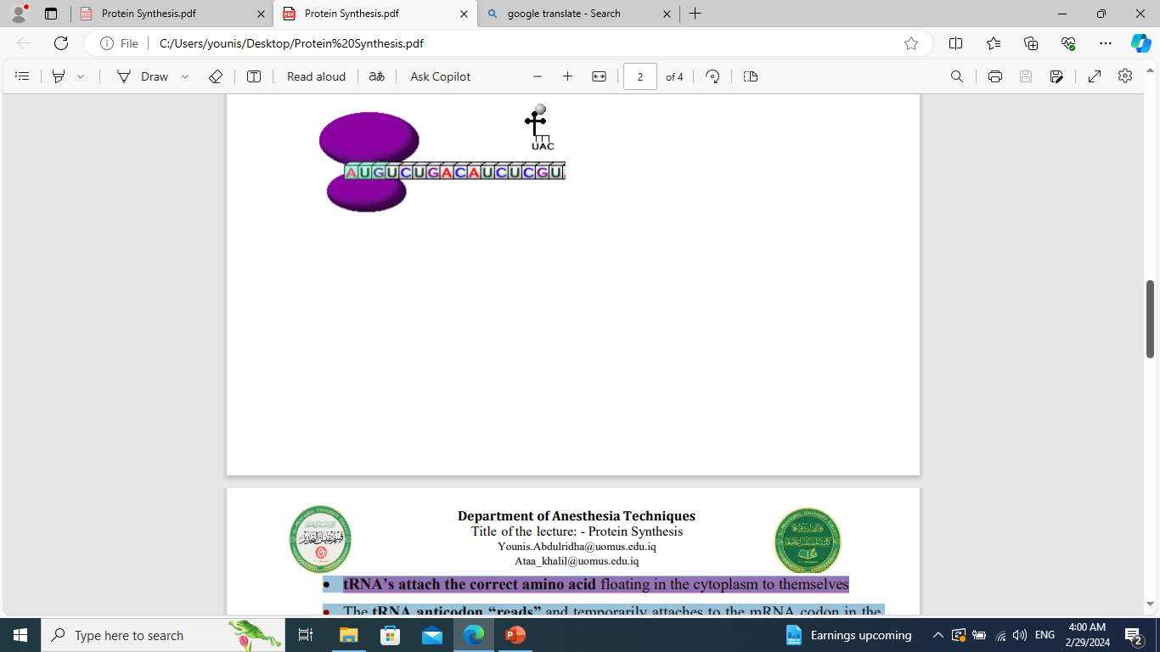
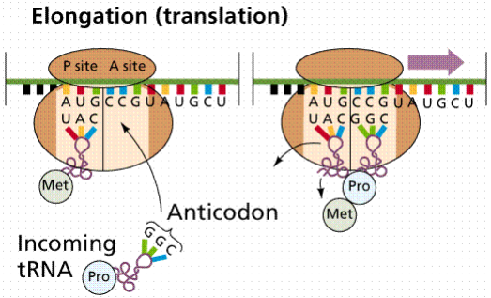
Department of Anesthesia Techniques
Title of the lecture:- Bone & Cartilage
Prof. Dr. Younis A. Alkhafaji
Younis.Abdulridha@uomus.edu.iq
Lecture – 9
► tRNA’s attach the correct amino acid floating in the cytoplasm to themselves
► The tRNA anticodon “reads” and temporarily attaches to the mRNA codon in the
ribosome
► At Elongation: Two amino acids at a time are linked together by peptide
bonds to make polypeptide -chains (protein subunits)

Slide 5
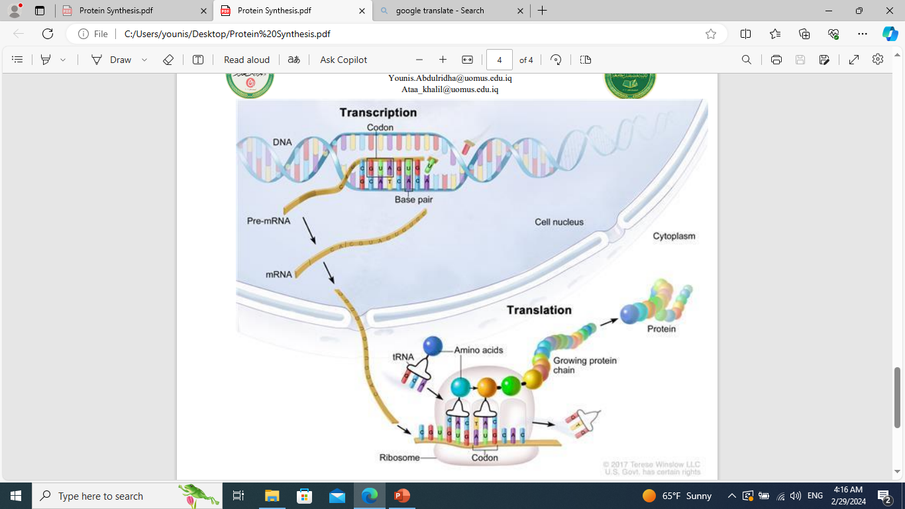
Department of Anesthesia Techniques
Title of the lecture:- Bone & Cartilage
Prof. Dr. Younis A. Alkhafaji
Younis.Abdulridha@uomus.edu.iq
Lecture – 9
⁂ At Termination Ribosomes move along
the mRNA strand until they reach a stop
codon (UAA, UGA, or UAG).
⁂ tRNA’s break loose from amino acid,
leave the ribosome, and return to cytoplasm
to pick up another amino acid.

Slide 6


