Slide 1
Immune system 1

Slide 2
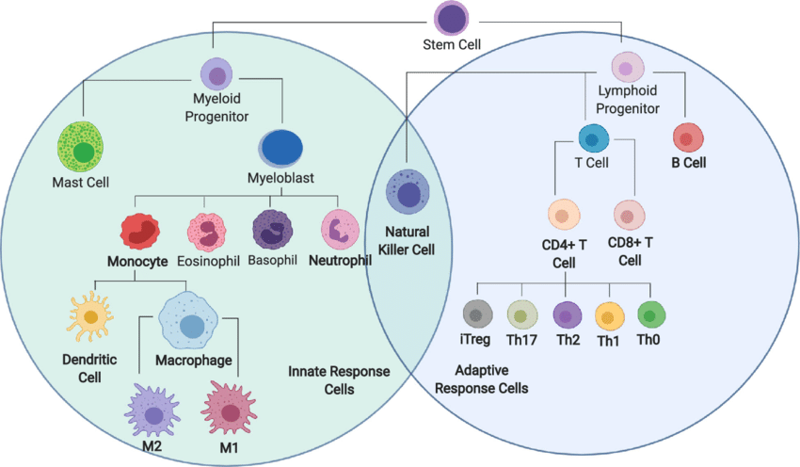

Slide 3
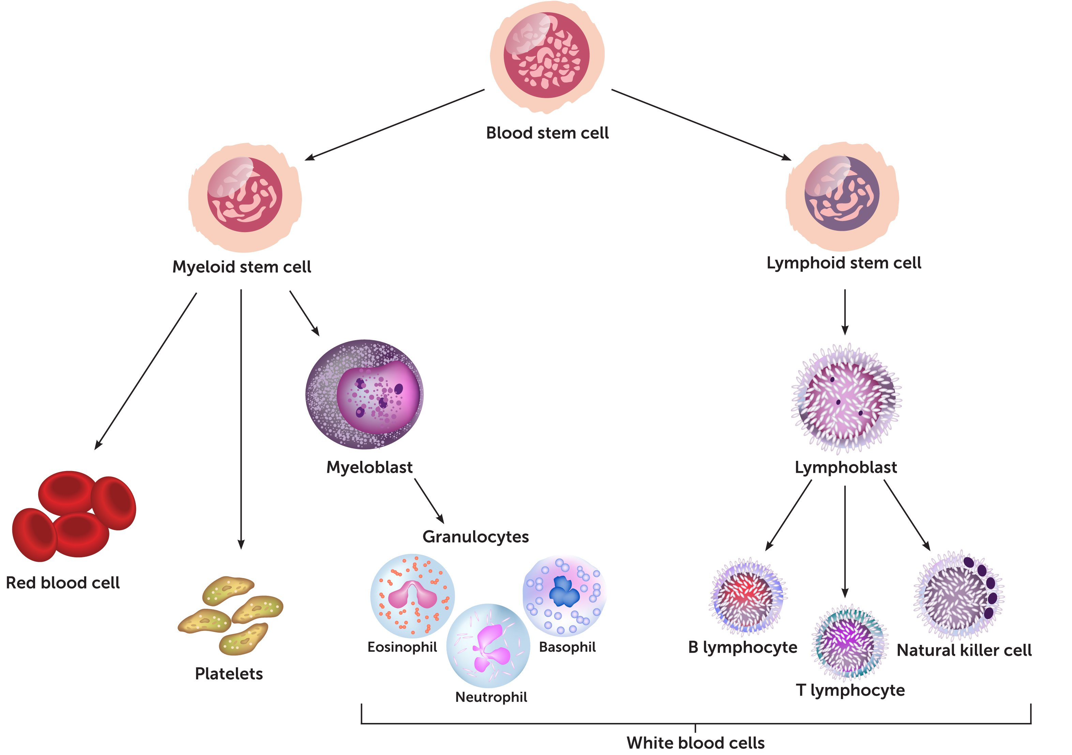
Immune system 7
Immunological cells- Chart:

Slide 4
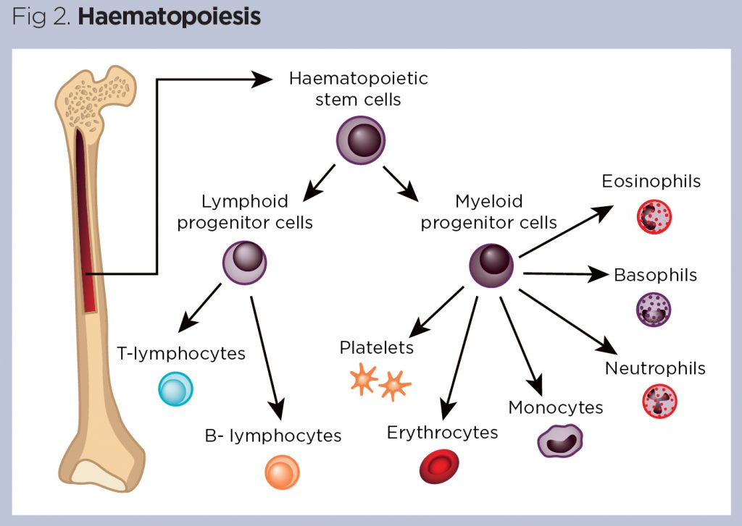
Cells of the immune system

Slide 5
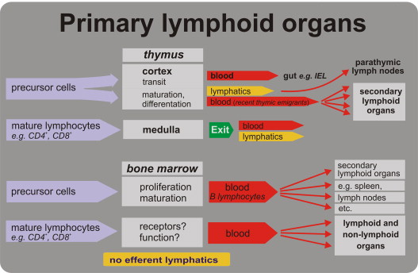
Immune system 8

Slide 6
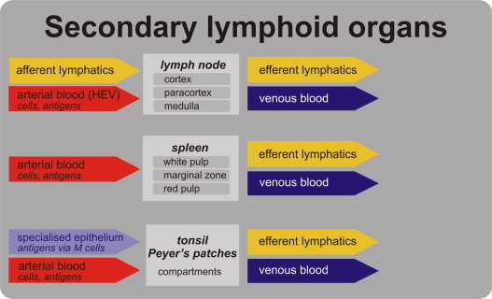
Immune system 9
Secondary lymphoid organs

Slide 7
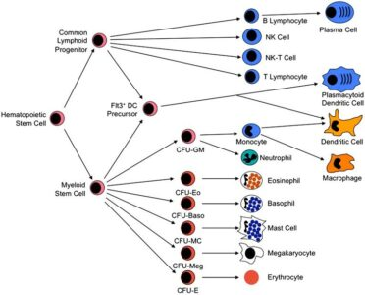

Slide 8
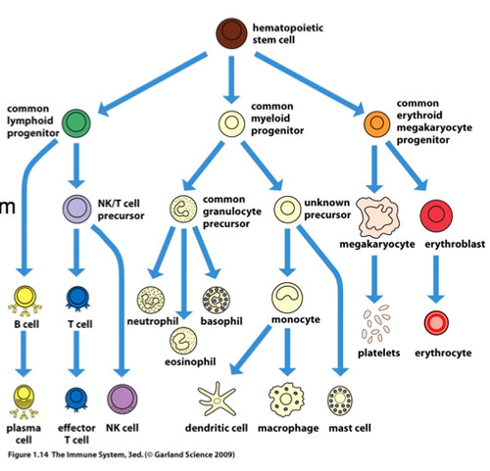

Slide 9


Slide 10
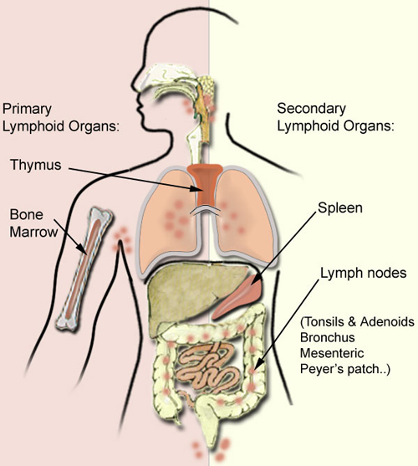
Lymphoid organs:

Slide 11
Immune system 10
Immunological cells;
Lymphocytes:
There are three types of lymphocytes which are:
1. B-cells , its final maturation stage is plasms cells . They are the main effector
cells in the humoral immunity. They are responsible of production of the antibodies
2. T-lymphocytes which are the active cells in both humoral and cell mediated
immunity. It consists of different types which are:
- T- helper cells.
- T- suppressor cells.
- T- cytotoxic cells.
3. Natural killers which are active against cancer and virally infected cells.

Slide 12
Immune system 11
Immunological cells:
Monocytes:
They are the main phagocytic cells. They are either circulating or resident in different organs and tissues . In blood they are either macrophages or monocytes.
In tissues have different names which are:
In liver called kupffer cells.
In lung they are called alveolar macrophages.
In the brain called microglial cells.
In kidneys they are called mesengeal cells.
In skin and mucous membranes called dendritic cells.
In bones they are called osteoclast.
The main functions of the macrophages are:
Phagocytosis.
Antigen presentation to B and T-cells.
Cytokines secretion

Slide 14
Immune system 10
Immunological cells;
Lymphocytes:
There are three types of lymphocytes which are:
1. B-cells , its final maturation stage is plasms cells . They are the main effector
cells in the humoral immunity. They are responsible of production of the antibodies
2. T-lymphocytes which are the active cells in both humoral and cell mediated
immunity. It consists of different types which are:
- T- helper cells.
- T- suppressor cells.
- T- cytotoxic cells.
3. Natural killers which are active against cancer and virally infected cells.

Slide 15
Immune system 12
Immunological cells:
The granulocytes:
There are three types of granulocytes which are:
- Neutrophils.
- Eosinophils.
- Basophils.
(Mast cells)
They have lobulated nucleous with two to five lobules.
They have granulated cytoplasm. The granules are colored according to the type of cells.

Slide 16
Immune system 10
Immunological cells;
Lymphocytes:
There are three types of lymphocytes which are:
1. B-cells , its final maturation stage is plasms cells . They are the main effector
cells in the humoral immunity. They are responsible of production of the antibodies
2. T-lymphocytes which are the active cells in both humoral and cell mediated
immunity. It consists of different types which are:
- T- helper cells.
- T- suppressor cells.
- T- cytotoxic cells.
3. Natural killers which are active against cancer and virally infected cells.

Slide 17
Immune system 13
The neutrophils:
The neutrophils has lobulated nucleous with 3to 5 lobes.
Their cytoplasmic granules are neutrally reacted with pink color.
They are active phagocytic cells.
They are active against bacterial infection.
They are the first cells migrate to the site of infection with a life span of few days.

Slide 18
Immune system 13
The eosinophils:
They have also lobulated nucleous.
Their cytoplasm contains granules with acidic reaction . they are
stained orange in color.
They are active against parasitic infection . They secrete toxic materials from their cytoplasmic granules which kill the parasites.
They are also present in case of allergic reaction.

Slide 19
Immune system 2
Body defense Mechanisms:
There are three general types of defense mechanisms in the body.
They are as following:
1. Barrier system.
2. Innate immune system.
3. Adaptive immune system (Acquired).
See the slide.

Slide 20
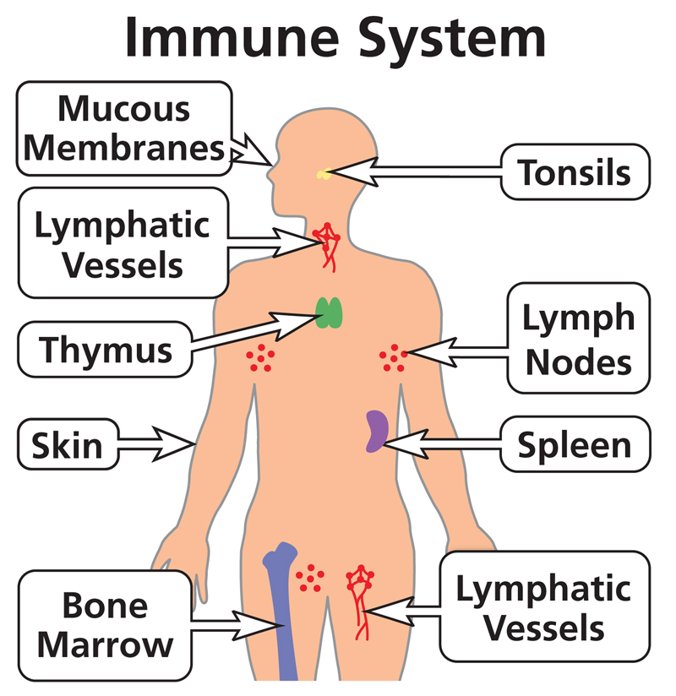
Immune system 3

