Slide 1
Al-Mustaqbal University. College of Engineering and Engineering Technologies. Biomedical Engineering Department.
Subject: laboratory instrumentation
Class (code): 4th
Lecture: 6
By: Zainab Sattar Jabbar M.SC. IN BME
BME

Slide 2
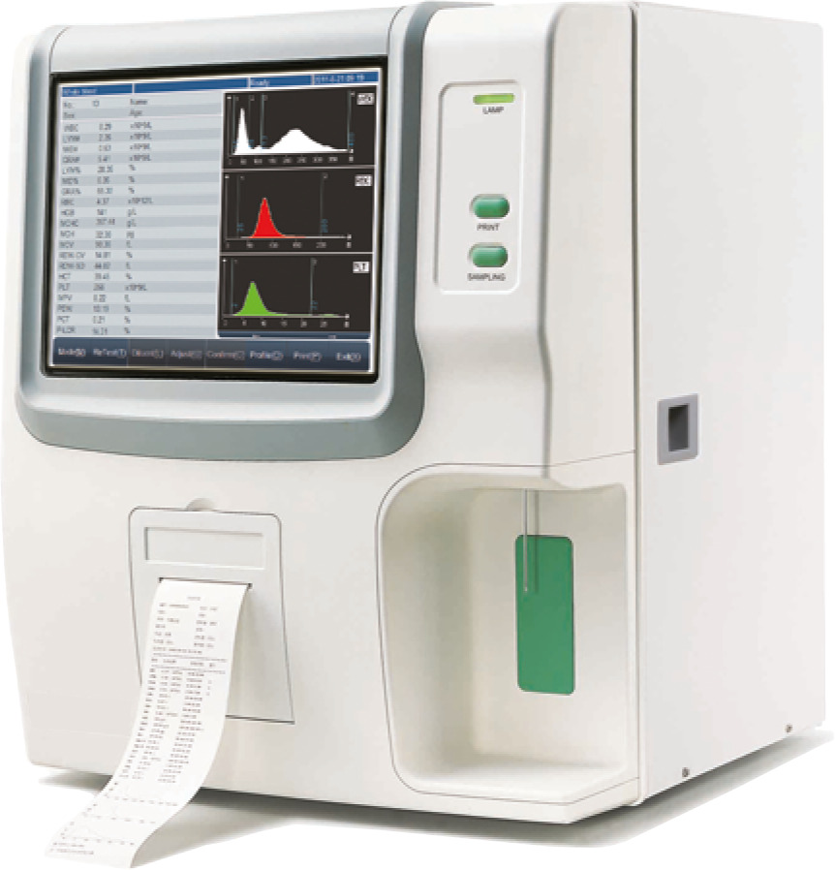
Haematology Analyzer

Slide 3
Purpose
Haematology analysers are computerized, highly sophisticated machines that are designed to count the number of different types of red and white blood cells, blood platelets, haemoglobin in a blood sample.
They are used widely in clinical and research areas to count and characterize blood cells for disease detection and monitoring.
Specialized analysers provide for measurement of cell morphology and can even detect small cell populations to diagnose rare blood conditions.

Slide 4
Uses
Changes in the normal functioning of an organism are often due to the characteristic variations in the composition of blood. These variations could be due to the change in the number, size, or shape of the different blood cells or because of some changes in the chemical composition of the blood serum. Therefore, the determination of the number and size of blood cells per unit volume often provides valuable information for disease diagnosis.
The blood constitutes 5–10% of the total body weight. Blood is a tissue consisting of corpuscles suspended in a fluid called plasma in the proportion of 45 parts of corpuscles (cells) to 55 parts of plasma. The percentage of cells in the blood is called the haematocrit value or packed cell volume (PCV).

Slide 5
Principle
Haematology technology has come a long way in a relatively short period of time. In the early 1950s, complete blood counts were performed manually by a technician sitting in front of a microscope.
Today, the automated analysers are capable of processing hundreds of samples per hour.
The integrated software controls the instrument operations; displays, stores, and recalls data; and allows the user to easily perform quality control and calibration procedures.

Slide 6
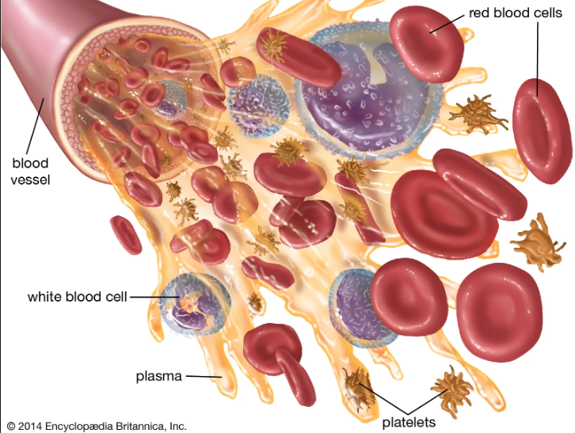
Blood
Red Blood Cells: The function of red blood cells is to transport oxygen and carbon dioxide.
White Blood Cells: form part of the body’s defences against infections and foreign substances.
Platelets: play an important role in the blood coagulation process.

Slide 7
Methods of Counting of Blood Cells
Microscopic Method
The most common and routinely applied method of counting blood cells even today, particularly in small laboratories, is the microscopic method in which the diluted sample is visually examined under a microscope and the cells counted.
The method is time consuming and suffers from several common drawbacks. The increasing number of examinations carried out in large series in busy laboratories necessitated the development of automatic instruments for counting the blood particles, with the errors of counting significantly reduced compared to that of a counting chamber.

Slide 8
Power Methods of Counting of Blood Cells
2. Electrical Conductivity Method
The most popular method for counting blood cells is electrical
conductivity method. Due to its reliability, it is used in almost every haematology analyser.
Blood cell counters, which operate on this principle of conductivity change, which occurs each time a cell passes through an orifice, are generally known by the name Coulter counters.

Slide 9
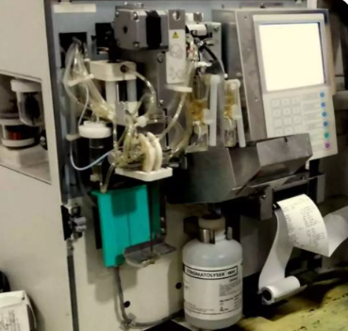
Components of a cell counter
3 Basic components
Hydraulics:
Includes aspirating unit, dispencers, diluters, mixing chambers, aperture baths & hemoglobinometer
Pneumatics :
Vacuums & pressure for operating valves
Electronics :
Analyzer and computing circuit.

Slide 10
Electrical Conductivity Method
The underlying principle of the measurement is that the blood is a poor conductor of electricity, whereas certain diluents are good conductors. Blood is diluted and suspension is drawn through a small aperture. The technique involves counting and sizing cells by detecting and measuring changes in electrical resistance as the cells are made to pass through a small aperture. Two electrodes, one inside the aperture tube and one in the beaker outside the aperture tube, are placed as shown in Figure. These electrodes provide a current path through the electrolyte and the aperture when an electric field is applied across them.

Slide 11
Electrical Conductivity Method
Constant current is passed through the aperture from one side to the other. A known volume of dilution is then drawn through the small aperture automatically by using a pressure gradient that is generated by a small oil displacement pump. When a cell passes through the aperture, a momentary increase in the electrical resistance takes place across the aperture, which is measured between the two electrodes. This change in impedance can be measured as a voltage pulse or a current pulse. The amplitude of the voltage pulse is proportional to the ratio of cell volume per aperture volume. The resulting signal pulses between the electrodes are amplified. Using counter and pulse height analyser circuits, the number of particles and volume of each particle passing through the aperture can be measured. The number of pulses indicates particle count, and the pulse height is proportional to the volume of the sensed particle.

Slide 12
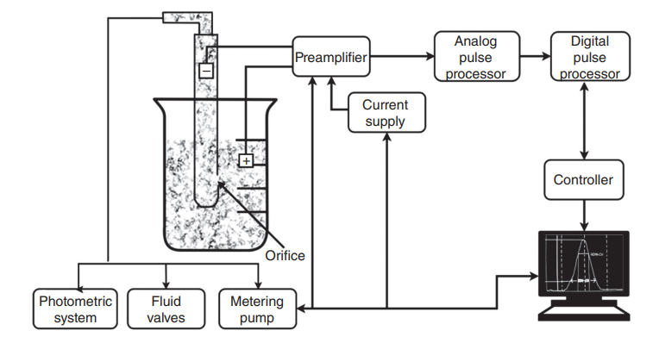

Slide 13
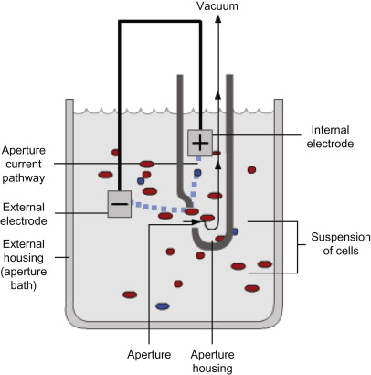
Electrical Impedance
First introduced by Wallace Coulter
Blood cells are poor conductor of electricity
2 chambers filled with a conductive buffered electrolyte solution
Separated by a small aperture
DC current between two electrodes

Slide 14
Electrical Impedance
Diluant displacement causes potential difference
Voltage pulse displayed on an osciloscope
No. of impulse = No. of cells
Height = vol. of cells
Freq dist curve & size dist histograms
Requisite - High dilution

Slide 15
Components
The hematology analyzer is broken down into five key components:
Power source
Control unit
Collecting system
Data storage
Processing system

Slide 16
Thank you

