Slide 1
Al-Mustaqbal University. College of Engineering and Engineering Technologies. Biomedical Engineering Department.
Subject: laboratory instrumentation
Class (code): 4th
Lecture: 7
By: Zainab Sattar Jabbar M.SC. IN BME
BME

Slide 2
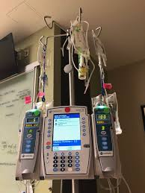
Infusion Pump

Slide 3
Introduction
It is estimated that 80% of hospitalized patients receive intravenous (IV) therapy and infusion devices are used extensively in clinical settings and patients’ homes as an essential tool for providing perioperative care, critical care and pain management. The infusion of fluids uses a variety of designs providing the ability to feed, hydrate, medicate or replace blood loss.

Slide 4
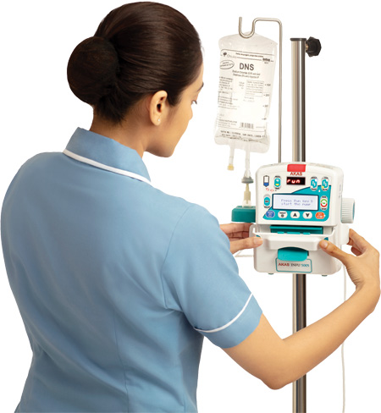
Purpose
An infusion pump is an electronic device used to control the administration of intravenous (IV) fluids to deliver measured amounts in a predetermined and consistent manner. They are extensively used in the clinical settings and patients’ homes to infuse fluids and deliver medication such as insulin or hormones, antibiotics, chemotherapy drugs, nutrients, pain relief, and even for feeding.

Slide 5
Types of pumps
There are two basic types of powered infusion devices:
The syringe pump in which a mechanism pushes the syringe plunger down its barrel at a predetermined rate to deliver the fluid into the patients.
The peristaltic pump based infusion devices that essentially involves a rhythmic squeezing of the infusion set tubing, thus displacing fluid along the tube from bag or bottle to the patient.

Slide 6
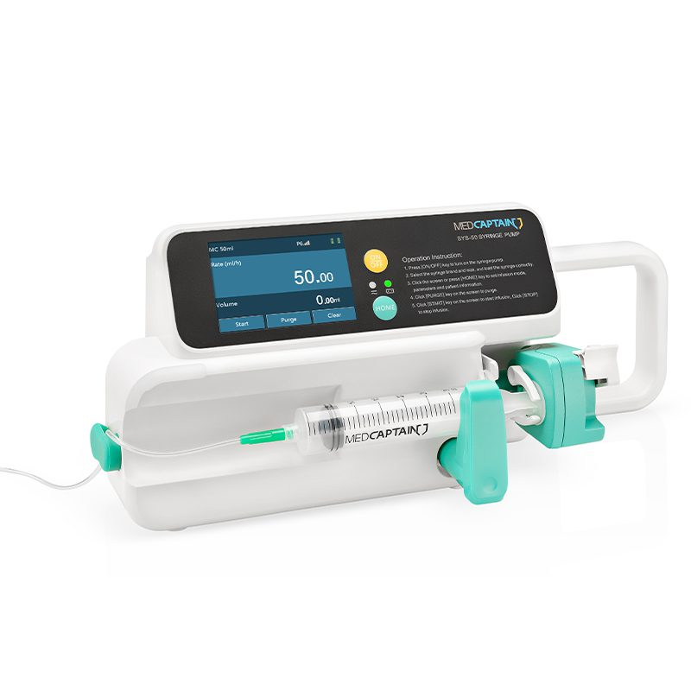
Infusion Pump, Syringe
Syringe pumps are highly accurate, low volume devices, particularly suitable for infusing at low flow rates.
They are mostly designed to be programmed at a typical infusion rate of 0.1–99.9 ml/h.
In construction, a syringe infusion pump is very simple. The rate of advance of the syringe plunger is controlled via program parameters that are entered via a keypad and displayed on the LCD.

Slide 7
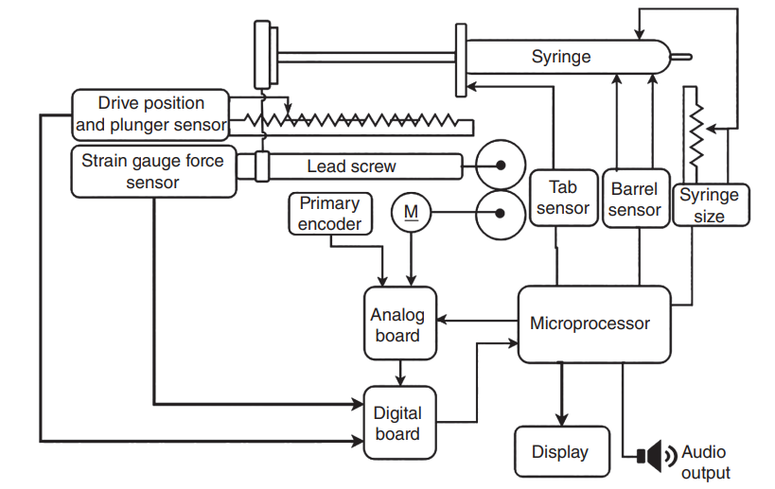
Block diagram of a syringe pump

Slide 8
Details of the syringe drive system
Syringe position is captured by three sensors.
The barrel sensor is made of two switches, both of which must be closed to detect the barrel presence. The progress of the infusion is monitored by a number of sensors. There are three separate sensors to monitor the advancement of the plunger.
The primary encoder measures the movement of the rotor of the DC motor that drives the lead screw. The second encoder monitors the rotation of the lead screw. The third encoder monitors the plunger drive potentiometer that determines if the plunger drive mechanism is advancing properly.
The occlusion pressure is determined indirectly by measuring the pressure applied to the plunger by measuring the reaction force on the lead screw using a strain gauge force measuring system.

Slide 9
Power Details of the syringe drive system
The barrel of the syringe is securely fixed on a rigid base. A stepper motor, through a gear‐reducing mechanism and a lead screw, applies force to the plunger of the syringe containing the drug.
These pumps are usually of a reciprocating type wherein the plunger or piston delivers a fixed volume of fluid on each stroke.
The control of the motor drive mechanism is carried out using a microcontroller with the program held in the memory. The motor and gear arrangement slowly pushes the plastic syringe piston/plunger and drives the fluid into the patient at a predetermined rate. The microcomputer controls the speed (flow rate), the distance (volume infused), and the force (pressure) with which the syringe plunger is pushed.

Slide 10
Details of the syringe drive system

Slide 11
Applications of syringe pump
The syringe pump finds applications where there is a requirement of precise dosing of medicine at the rate programmed by the operator.
Since syringe pump can operate at low flow settings and flow resolution, they are especially suitable for neonatal, infant, and critical care applications in which small volumes of concentrated drugs are to be delivered over an extended period. Syringe pumps find applications in intensive care unit, radiology department, emergencies, and operating theatres.

Slide 12
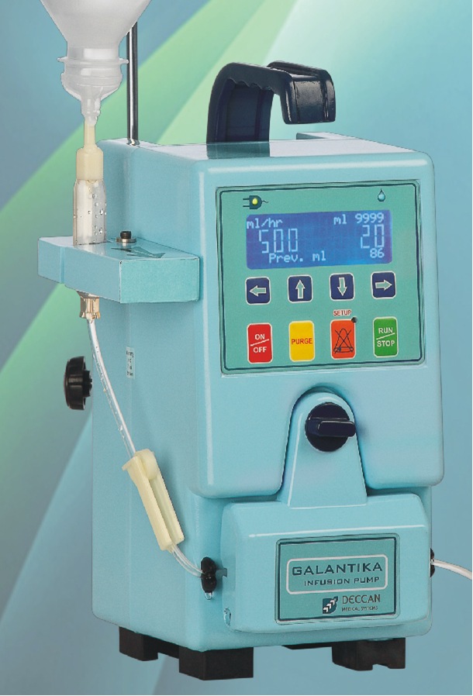
Infusion Pump, Volumetric
Volumetric infusion pumps are designed for applications that require delivery of larger volumes of fluid at medium to high flow rates.
They are used to accurately administer intravascular drugs, fluids, whole blood, and blood products. They can administer up to 2000ml of fluid, normally from a bag or bottle, at flow rates of 0.1–2000ml/h.
The infusion of fluids uses a variety of designs providing the ability to feed, hydrate, medicate, or replace blood loss.

Slide 13
Infusion Pump, Volumetric
Any infusion device typically consists of three major components: the fluid reservoir, a catheter system for transferring the fluids into the body, and a device that integrates electronics with a suitable mechanism to generate and regulate fluid flow.
In these pumps, the drop sensor is attached to the fluid administration set drip chamber. An improvement over drop rate counter pump is the volumetric pump that uses a stepper or DC motor to provide the driving force for the fluid by mechanized displacement of the contents in the volumetric chamber. The system consists of IV bag that is placed higher than the pump and patient.
The pump utilizes a linear peristaltic action or uses a special cassette, known as a piston cassette, to control the infusion fluid. A set of rollers pinch the flexible tubing to push the fluid towards the patient. Peristaltic action is a continuous rippling wave motion that can be linear or rotary.

Slide 14
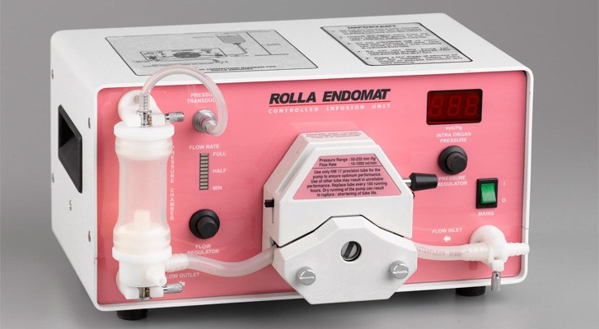

Slide 15
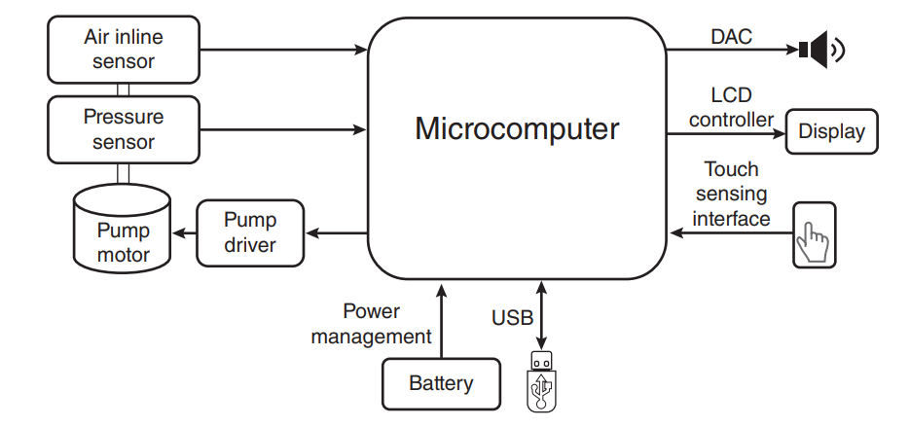
Block diagram of a volumetric infusion pump

Slide 16
Applications of volumetric pump
Volumetric pumps are mostly indicated for the infusion of general fluids, medications, parenteral nutrition, blood transfusion, and drug therapy.
They are used in hospital and clinical environments, other than domestic purposes. They are specially used in intensive care unit (ICU), emergencies, and operating theatres and are indicated for use, both on adults and paediatrics.

Slide 17
What are the major problems of infusion pumps &syringe pumps?
Software problems
Alarm errors
Broken components
Battery failures

Slide 18
Thank you

