Slide 1
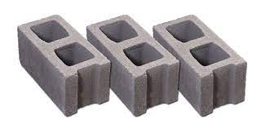
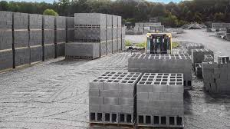
Constructional Technology
AL-USTAQABAL UNVERSTY COLLEGE
Asst.lec.Fatin Hashim
Concrete Block Production
What is the Concrete Block?
The materials used in the construction of concrete blocks are generally powder cement, water, and aggregate consisting of a mixture of sand and gravel ranging in size from 1 to 4 mm. The amount of concrete block types will vary depending on the area to be used. For example, if it is to be used in general construction works, less water and more aggregates should be used
Standard concrete block, or "gray block," is widely known as one of the most practical, long-lasting, and cost-effective materials used in building. Due to its strength, durability, and excellent fire rating, concrete block provides a sensible alternative to many other building materials.
Concrete Block Types :
Concrete Block can be considered in six different groups in terms of their properties:
1-Hollow Blocks: They are usually used in the construction industry. Lightweight aggregates are used in the mixture of hollow blocks. One-quarter of the hollow blocks consist of cavities. In order to reach the maximum load capacity, the ratio of these gaps should not change.
2-Autoclaved Aerated Concrete Blocks: This type of block is larger in size, they are lighter. The use of these blocks reduces the total steel and concrete used in the structure by ten percent to fifteen percent. It outperforms bricks in terms of cost-benefit, working time, and fire resistance.
3-Concrete Brick: It is often preferred for building a hard wall. They are made of concrete.

Slide 2
4-Solid Concrete Blocks: These are large and dense blocks produced from dense aggregates. They are used in the construction of structures that will carry very heavy loads. Its strength is very high. Also, the cost is high.
5-Lintel Blocks: It is used in the construction of lintels which should be on the door and window openings in buildings. They act as a permanent formwork system for beams. It is widely preferred for its versatile functions.
6-Pavement Blocks: They are usually rectangular or square. They are used on pavements and at the intersection of pavement with the road. It is frequently used in car parks, walkways, and parks.
Concrete Block Types And Uses:
There are many concrete blocks types and uses for many different purposes, such as starting a construction project, renovating the house, or arranging a garden. Each type has important functions in its field of use. They perform well in residential, public projects, and industrial applications.Concrete blocks, which are used to build long-lasting and robust buildings, must go through the right production processes in order to comply with international standards.

Slide 3
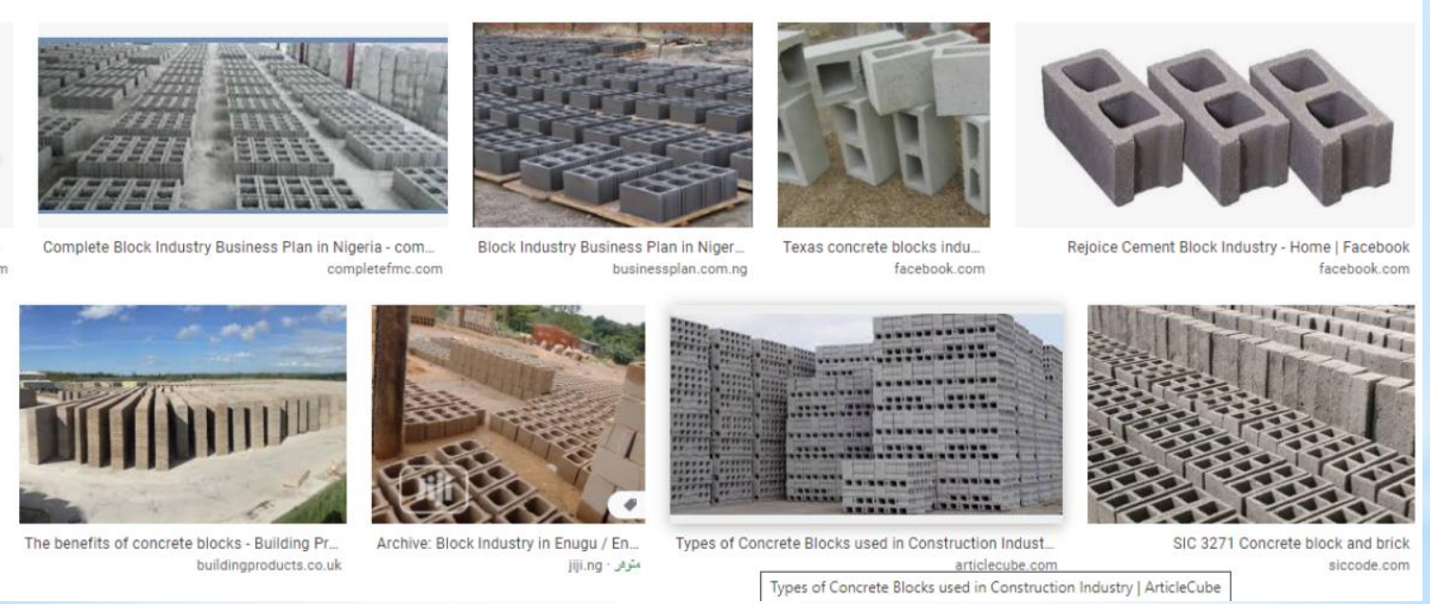

Slide 4
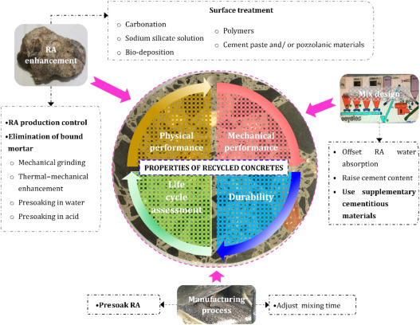
Raw Materials:
The concrete, commonly used to make concrete blocks is a mixture of powdered Portland cement, water, sand,and gravel. This produces a light gray block with a fine surface texture and a high compressive strength. A typical concrete block weighs (17.2-19.5 kg). In general, the concrete mixture used for blocks has a higher percentage of sand and a lower percentage of gravel and water than the concrete mixtures used for general construction purposes. This produces a very dry, stiff mixture that holds its shape when it is removed from the block mold.Light weight concrete blocks are made by replacing the sand and gravel with expanded clay, shale, or slate. Expanded clay, shale, and slate are produced by crushing the raw materials and heating them to about (1093°C). At this temperature, the material bloats, because of the rapid generation of gases caused by the combustion of small quantities of organic material trapped inside. A typical light-weight block weighs (10.0 12.7 kg), and is used to build non-load bearing walls and partitions. Also expanded blast furnace slag used to make lightweight blocks,
In addition to the basic components, the concrete mixture used to make blocks may also contain various chemicals, called admixtures, to alter curing time, increase compressive strength, or improve workability. The mixture may have pigments
added to give the blocks a uniform color throughout, or the surface of the blocks may be coated with a baked-onglaze to give a decorative effect or to provide protection against chemical attack.

Slide 5
Design of Blocks:
The shapes and sizes of the most common concrete blocks have been standardized to ensure uniform building construction. The most common block size in the United States is referred to as an 8-by-8-by-16 block, with the nominal ، measurements of 8 in (20.3 cm) high by 8 in (20.3 cm) deep by 16 in (40.6 cm) wide.
Many progressive block manufacturers offer variations on the basic block to achieve unique visual effects or to provide desirable structural features for specialized applications. For example, one manufacturer offers a block specifically designed to resist water leakage through exterior walls. The block incorporates a water repellent admixture to reduce the concrete's absorption and permeability, a beveled upper edge to shed water away from the horizontal mortar joint, and a series of internal grooves and channels to direct the flow of any crack-induced leakage away from the interior surface. Another block design, called a split-faced block, includes a rough, stone like texture on one face of the block instead of a smooth face. This gives the block the architectural appearance of a cut stone.
The Manufacturing Process:
The production of concrete blocks consists of four basic processes: mixing, molding, curing, and cubing. Some
manufacturing plants produce only concrete blocks, while others may produce a wide variety of precast concrete
products including blocks, flat paver stones, and decorative landscaping pieces such as lawn edging. Some plants are
capable of producing 2,000 or more blocks per hour.
The following steps are commonly used to manufacture concrete blocks:

Slide 6
1-Mixing process:
1- The sand and gravel are stored outside in piles and are transferred into storage bins in the plant by a conveyor belt as they are needed. The Portland cement is stored outside in large vertical silos to protect it from moisture.
2- As a production run starts, the required amounts of sand, gravel, and cement are transferred by gravity or by mechanical means to a weigh batcher which measures the proper amounts of each material.
3- The dry materials, then flow into a stationary mixer where they are blended together for several minutes. There are two types of mixers commonly used. One type, called a pan mixer, resembles a shallow pan with a lid. Mixing blades are attached to a vertical rotating shaft inside the mixer. The other type is called a horizontal drum mixer and has mixing blades attached to a horizontal rotating shaft inside the mixer.
4- After the dry materials are blended, a small amount of water is added to the mixer. If the plant is located in a climate subject to temperature extremes, the water may first pass through a heater or chiller to regulate its temperature. Admixture chemicals and coloring pigments may also be added at this time. The concrete is then mixed for six to eight minutes.

Slide 7
2-Molding process:
1- Once a load of concrete is thoroughly mixed, it is dumped into an inclined bucket conveyor and transported to
an elevated hopper. The mixing cycle begins again for the next load.
2- From the hopper, the concrete is conveyed to another hopper on top of the block machine at a measured flow
rate. In the block machine, the concrete is forced downward into molds. The molds consist of an outer mold box
containing several mold liners. The liners determine the outer shape of the block and the inner shape of the block
cavities. As many as 15 blocks may be molded at one time.
3- When the molds are full, the concrete is compacted by the weight of the upper mold head coming down on the
mold cavities. This compaction may be supplemented by air or hydraulic pressure cylinders acting on the mold
head. Most block machines also use a short burst of mechanical vibration to further aid compaction.
4-The compacted blocks are pushed down and out of the molds onto a flat steel pallet. The pallet and blocks are
pushed out of the machine and onto a chain conveyor. In some operations, the blocks then pass under a rotating
brush which removes loose material from the top of the blocks.

Slide 8
3-Curing process:
1- The pallets of blocks are conveyed to an automated stacker or loader which places them in a curing rack. Each rack holds several hundred blocks. When a rack is full, it is rolled onto a set of rails and moved into a curing kiln.
2- The kiln is an enclosed room with the capacity to hold several racks of blocks at a time. There are two basic types of curing kilns. The most common type is a low-pressure steam kiln. In this type, the blocks are held in the kiln for one to three hours at room temperature to allow them to harden slightly. Steam is then gradually introduced to raise the temperature at a controlled rate of not more than (16°C per hour). Standard weight blocks are usually cured at a temperature of (66-74°C), while lightweight blocks are cured at (77-85°C). When the curing temperature has been reached, the steam is shut off, and the blocks are allowed to soak in the hot, moist air for 12-18 hours. After soaking, the blocks are dried by exhausting the moist air and further raising the temperature in the kiln. The whole curing cycle takes about 24 hours.
•Another type of kiln is the high-pressure steam kiln, sometimes called an autoclave. In this type, the temperature is raised to (149-191°C), and the pressure is raised to 80-185 psi (5.5-12.8 bar). The blocks are allowed to soak for five to 10 hours. The pressure is then rapidly vented, which causes the blocks to quickly release their trapped moisture. The autoclave curing process requires more energy and a more expensive kiln, but it can produce blocks in less time.

Slide 9
4-Cubing process:
1- The racks of cured blocks are rolled out of the kiln, and the pallets of blocks are unstacked and placed on a chain conveyor. The blocks are pushed off the steel pallets, and the empty pallets are fed back into the block machine to receive a new set of molded blocks.
2- If the blocks are to be made into split-face blocks, they are first molded as two blocks joined together. Once these double blocks are cured, they pass through a splitter, which strikes them with a heavy blade along the section between the two halves. This causes the double block to fracture and form a rough, stone-like texture on one face of each piece.
3- The blocks pass through a cuber which aligns each block and then stacks them into a cube three blocks across by six blocks deep by three or four blocks high. These cubes are carried outside with a forklift and placed in storage.

Slide 10
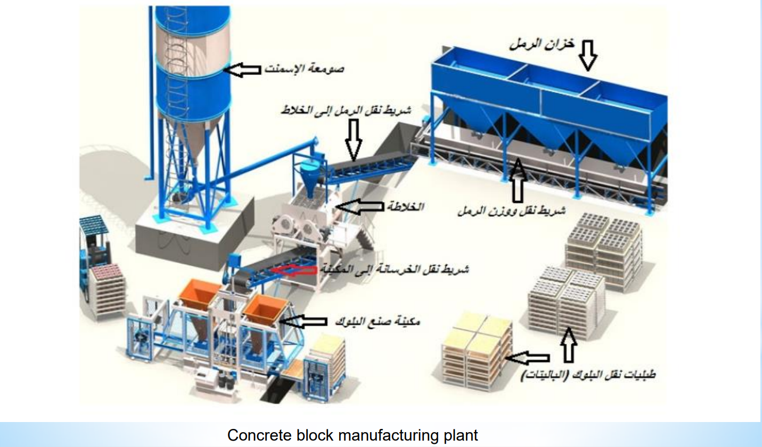

Slide 11
Quality Control
The manufacture of concrete blocks requires constant monitoring to produce blocks that have the required properties. The raw materials are weighed electronically before they are placed in the mixer. The amount of water to be added to the mix is automatically adjusted to compensate. In areas with harsh temperature extremes, the water may pass through a chiller orheater before it is used.As the blocks emerge from the block machine, their height may be checked with laser beam sensors. In the curing kiln, the temperatures, pressures, and cycle times are all controlled and recorded automatically to ensure that the blocks are cured properly, in order to achieve their required strength.
The future of concrete blocks industry :
The simple concrete block will continue to evolve as architects and block manufacturers develop new shapes and sizes. These new blocks promise to make building construction faster and less expensive, as well as result in structures that are more durable and energy-efficient.

