Slide 1
Constructional Technology
AL-USTAQABAL UNVERSTY COLLEGE
Asst.lec.Fatin Hashim
Production & industry operations for
several types of clay bricks / PART 2
Stage 2: Preparation and Tempering of MUD
A series of steps are taken before the soil is ready to form bricks. First, the specific area of the brick soil is cleaned, especially its surface layer. Most of the unwanted topsoil that is always rich in gravel and organic matter must be removed. Then, from this cleaned area, the brick soil is obtained through:
(I) Surface drilling: By using hand tools, it is the most popular method used in most countries.
(2) Mechanical drilling: Using heavy machinery called excavators. This method is used in the manufacture of mechanical bricks on a large scale, especially when the soil layers are hard and compact.

Slide 2
After removing the unwanted material from the soil, the clay is spread and distributed in stacks and layers above the
ground and exposed to the air. During this period, it is also cleaned of any pebbles, stones and lime nodules.
Moreover, any lump or clay stones are crushed into a fine powder (the clay is crushed and milled using large grinding wheels, each weighing from 4 to 8 tons, rotated in circular rings, grinding and mixing the raw materials. Then the plant parts are removed from the clay. By passing it through inclined vibrating sieves, to control particle sizes), so that soil of uniform size is prepared.
At this stage, any additional component (sand / clay) is mixed with the soil prepared for brick making to change its composition to the required proportions.

Slide 3
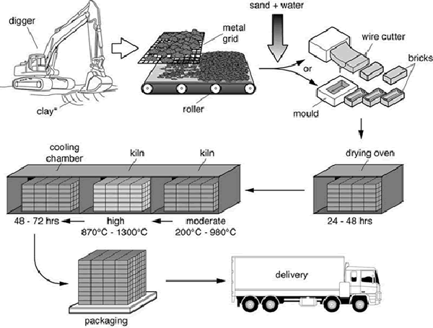
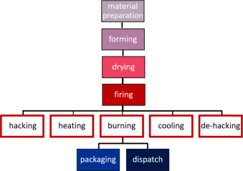

Slide 4
Additives in the manufacture of bricks:
Additives in brick making, such as fly ash, sandy loam, rice husk ash, basalt stone dust, etc.. are often required to modify the processes of forming, drying, and firing of the clay mass.
The soil or clay is said to be ready to be turned into clay intended for making bricks by mixing it with appropriate quantities of clean water.
""The processes of selecting, cleaning, digging the soil and spreading the mud are called winning of clays".
Tempering:
Tempering (softening) the clay "means converting the prepared clay, soil into a homogeneous mixture of the desired plasticity by mixing it well with appropriate amounts of water".
This is done either by manual labor or with the help of a specially designed mechanical device called a slurry mill (mixer) (it is a mixing chamber containing one or more rotor shafts with blades)
In manual tempering, the clay is kneaded well under the legs (both for men and animals) with gradual additions of water until the desired consistency and plasticity are obtained.

Slide 5
Stage 3: Molding of Bricks (Forming)
Brick molding is the process of making correct shaped brick units from clay that has been completely softened. There are two main molding methods:
Manually forming bricks: when the work is done by skilled people.
Mechanically forming bricks: when using specially designed machines. In most developing countries, even today, the most common method of forming bricks is by hand forming. In developed countries, automatic brick making is the main process of large-scale industrialization.
(1) Hand Molding of Bricks.
In hand molding, the quality of the tempered clay is invariably soft, so that it can be molded into the required shapes conveniently.
The mud contains more water (18-25 percent by weight) than what is used when machine molding is to be done. It is for this reason that this method is sometimes referred as SOFT MUD PROCESS.
are shaped from such a soft mud by hand either on a specially prepared ground (called ground molding) or on special tables (called table molding).

Slide 6
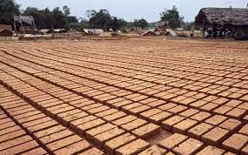
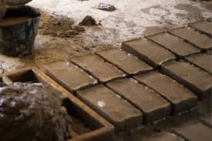
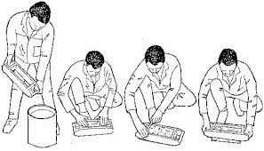
Tools: The essential tools used in the hand molding process are: a brick mold, cutting wire or strike, wooden plates called pallets, and a stock board. The mold is made either of wood or steel.
Its inside dimensions are slightly bigger (about 1/10th) than the desired dimensions of dry bricks (because bricks will
shrink on drying due to loss of moisture). It may be a Single-unit mold or a multiple-unit mold.
The stock board also called molding block, is a small wooden block, slightly bigger in dimensions than the mold and with a raised central projection carrying the identification mark. The pallets are thin wooden plates for handling wet bricks. The strike made up of wood or metal has one edge quite thin to cut surplus mud; cutting wire is meant for the same use.

Slide 7
Tools: The essential tools used in the hand molding process are: a brick mold, cutting wire or strike, wooden plates called pallets, and a stock board. The mold is made either of wood or steel.
Its inside dimensions are slightly bigger (about 1/10th) than the desired dimensions of dry bricks (because bricks will
shrink on drying due to loss of moisture). It may be a Single-unit mold or a multiple-unit mold.
The stock board also called molding block, is a small wooden block, slightly bigger in dimensions than the mold and with a raised central projection carrying the identification mark. The pallets are thin wooden plates for handling wet bricks. The strike made up of wood or metal has one edge quite thin to cut surplus mud; cutting wire is meant for the same use.

Slide 8
Types of Hand Molding of Bricks.
There are two types of molding used in the manufacturing of bricks.
(A) Ground Molding:
At present, this is the most common method of molding bricks in most countries. In this process a piece of the ground is first cleaned, then thoroughly leveled, and often made smooth by plastering. Some sand is sprinkled uniformly over it to make it non-sticky.
There are two variations of ground molding.
(a) For making ordinary, rough-faced bricks without any identification marks on them. The mold is either first dipped in water or some sand is sprinkled on its inside surfaces (sand molding).

Slide 9
This step is necessary to avoid sticking the mud to the sides of the mold. Then, the mold is placed on the ground.
A lump of mud is dashed into the mold by hand. Care is taken to see that mud reaches the edges and corners of the mold.
Any surplus mud is then removed by using either the strike or the cutting wire. After this, the mold is lifted up with a lifting tool. The molded brick is left behind on the ground. The molder man then keeps the mold at the next place.
The molder repeats this process. The face of the brick, which rests on the ground will be naturally rough and without any identification mark.

Slide 10
(b) For making smooth-sided, frogged bricks, this requires a stock board and pallets. The stock board has a raised
projection (6 mm) carrying impressions or marks of the manufacturer carved out in it.
For the molding bricks using the stock board, some sand is sprinkled on the inner sides of the mold (sand molding).
This (mold) is then placed on the stock board with a projection in the center and a lump of prepared clay is dashed into it.
Any surplus mud is removed by using the strike or cutting wire. A pallet is then placed on the top of the mold and the stock
board is turned over.
Thereafter, the mold is lifted up, leaving the molded brick on the pallet below.
Another pallet is placed on the upper surface of the wet brick and it is taken to the drying field, where it is placed first on its edges to dry.
The pallets are thus available for use again and again. This process, where pallets and stock boards are used is called rightly pallet molding.

Slide 11
(B) Table Molding.
It is also a type of hand-molding method. The molder carries out all the operations of pallet-molding on a table of suitable dimensions and while in a standing position.
Such a table is large enough to accommodate all the materials required in the hand molding, namely: a stock board, molds, a cutting-edge bucket full of water or sand, and a supply of tempered mud. The process is similar to pallet- molding on the ground.
The molder places the stock board in front of him, sprinkles some sand on the inside of a mold or dips it into the water, places it on the stock board, dashes a lump of mud into it, presses it thoroughly, cuts any surplus mud with the strike, places a pallet over the mold and turns it over. The molder then removes the mold by lifting tool, leaving the brick on the pallet.
A helper places another pallet on the brick so molded and carries it away to the drying ground where he makes the brick stand on edge. The pallets are thus available for use again. Although the initial cost is a little higher in table molding, it is considered more efficient.

Slide 12
(2)Mechanical Molding.
In advanced countries, machine molding is an essential part of the Mechanized brick making plant. It is both cheaper in
the long run and gives bricks of uniformly good quality.
There are two types of processes used in machine molding: first, stiff mud process and second, dry pressing process.
Since we are fast progressing towards modernization in all sectors, it is appropriate to understand the basic principles of both processes.
STIFF MUD PROCESS: The clay is mixed with only a small quantity (12-15%) of water during tempering so that it is a
quite stiff in consistency.
After thorough mixing, the tempered clay goes through the de-airing chamber in which a vacuum (375 to 725 mm) of mercury is maintained. The de-airing removes air holes and bubbles, thus resulting in greater strength. Next, the clay is extruded through a die to produce a column of clay in which two dimensions of the final unit are determined. The column then passes through an automatic cutter to make the final dimension of the brick unit. Cutter wire distances and die sizes must be carefully calculated to compensate for normal shrinkage during wet stages through drying and firing. As the clay column leaves the die, surface textures may be modified.

Slide 13
DRY PRESSING PROCESS: It is yet another common method for molding bricks in mechanized brick manufacturing making plants. In this method, only a very small quantity of water is added to finely crushed and thoroughly cleaned clay (up to 10%).
So that the resulting clay mix is not a plastic or stiff mud, but just damp enough to take a shape under pressure. Such damp clay is fed through hoppers to special brick mold under pressures (3.4 to 10.3 MPa) using hydraulic or compressed air rams.
Stage 4: Drying of Bricks
After molding, the wet bricks have to be dried. This is necessary for three reasons.
Firstly, to make them strong enough for rough handling during subsequent stages as for example for stacking, etc.
Secondly, to allow a slow loss of moisture from the brick without disintegrating the unit. If a wet brick is put to direct burning in a kiln, the rate of loss of moisture will be so fast that the brick will crack during the burning process.
Thirdly, to save fuel during the burning stage, a brick containing 20 percent moisture will require more fuel to burn
compared to a brick containing only 2-4 percent moisture

Slide 14
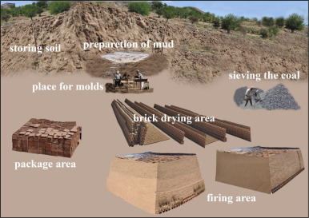
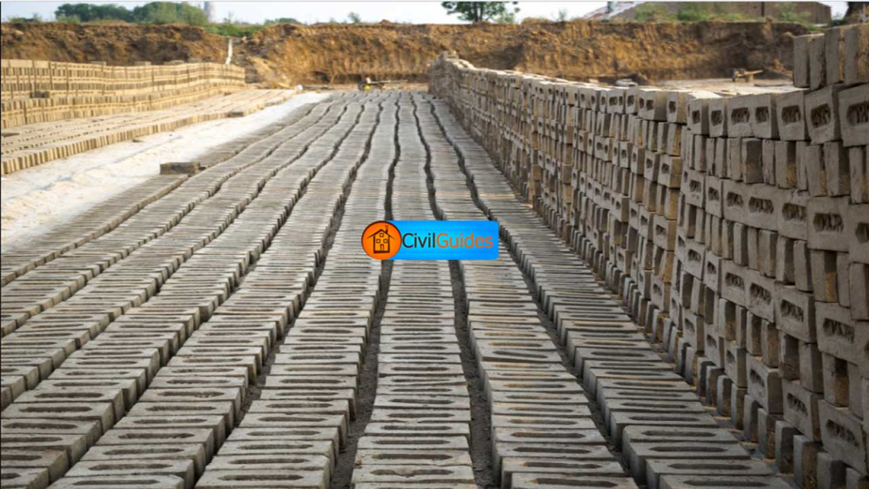
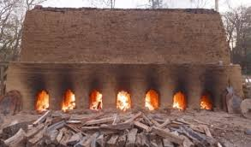
Drying of bricks is achieved either by natural methods or by artificial methods :
In the natural drying method, there are two distinct stages :
Pre-stacking stage, where the molded bricks are first laid edgewise, side-wise, and flat for 2-3 days so that they become hard-enough to handle without losing shape or breaking.
Stacking Stage, in which the hard bricks from the first stage are arranged in well-made layers, one layer above another.
Stacking in the manufacturing of bricks is done in specially prepared drying grounds. Each stack may be about 20 cm wide and as long as the ground allows.
The height of the stack is generally about ten brick layers. Enough space is left between the individual bricks in a stack and also between the different layers for easy circulation of air.

Slide 15
In the natural drying method: it is essential that the drying be carried out in groups properly protected from direct sunlight and rain. Air drying by stacking may take 4 to 12 days to reduce the moisture to 2-4 percent in the bricks. This depends on the time and place of drying.
The Artificial Drying: This method becomes essential in mechanized brick making plants. It is only by this method that the
drying of bricks can be ensured throughout the year independent of weather conditions.
Artificial drying may be done either in specially designed chambers or in tunnels.
*In the chamber drying, bricks are arranged in stacks with sufficient spaces in between them for free circulation of air.
Hot air under controlled conditions of temperature and humidity is made to circulate through these stacks for 2-3 days or
more. The dried bricks are then taken out and next batch loaded in the chamber.

Slide 16
*In the tunnel driers: the brick-stacks are made on vehicles that travel on rails within a drying tunnel. The tunnel is divided into compartments and the stack-loaded vehicles are made to enter from one end, stay in each compartment for a prefixed time and come out of the other end. This process may again take 1-3 days for a car-load of bricks to dry to the required moisture content
Stage 5: Burning and Cooling of Bricks
This stage of manufacturing of bricks is absolutely essential to develop in them the desired bricks properties such as sufficient strength, hardness, durability, and resistance to decay and disintegration.
At least three chemical changes are known to take place in the brick-earth during the burning process: dehydration, oxidation, and verification.
Dehydration(removing the water molecule from the manufactured bricks): It is completed within the temperature range of 425 – 750° C. Bricks heated to this temperature lose all the free water and most of the water of crystallization.

Slide 17
Oxidation: It also starts within the above range or temperature and is completed at about 900°C. All the organic matter in the brick-earth gets oxidized; carbon and sulphur are eliminated as oxides.
The fluxes ( lime, magnesia, and iron) also become reactive at this temperature. The brick acquires the red color due to oxidation of iron in the clays.
Vetrification: It is the reaction that takes place from 900°C to 1100°C or so. The constituents of brick clay, that is alumina and clay, start softening in the presence of fluxes and getting bound together firmly.
In fact, this is the change that makes a brick a strong and hard unit. But when the brick is heated to the extreme temperature of vetrification, the fluxes may actually cause considerable softening of the essential components of the brick earth. At that stage, the brick may lose even its original shape and get distorted at edges and corners. Hence ordinary, building bricks are not heated to very high vitrifying temperatures.
Cooling: At this stage of brick manufacturing, burnt bricks are placed in special storage places for the purpose of ventilation and cooling, in order to prepare them for final storage, and sell them to people.

