Slide 1
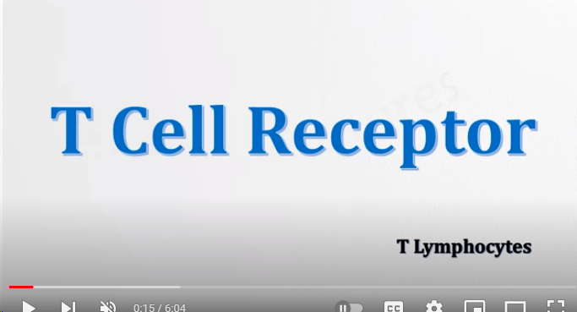
TCR
TCR

Slide 2
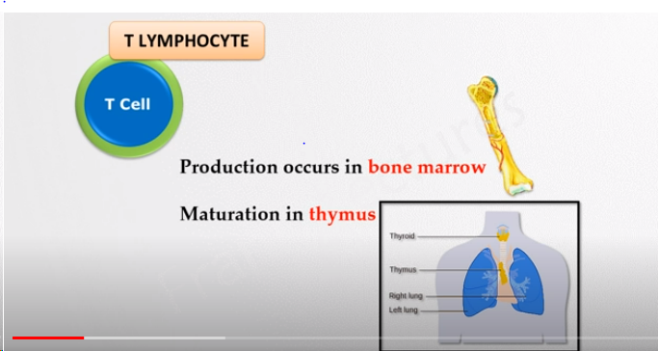

Slide 3
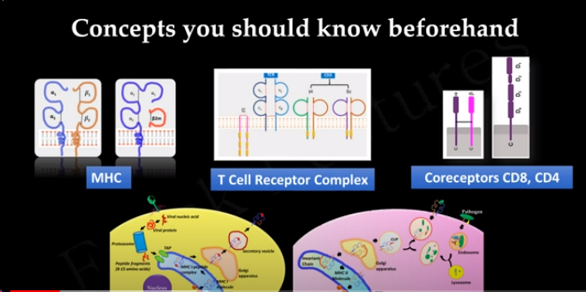

Slide 4
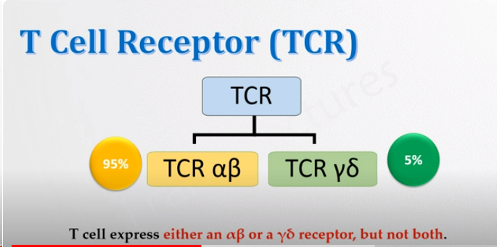
TCR

Slide 5
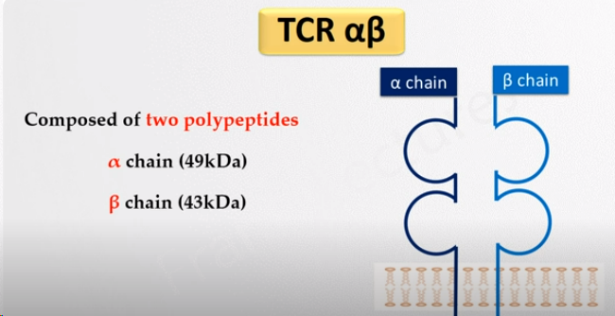
TCR
TCR

Slide 6
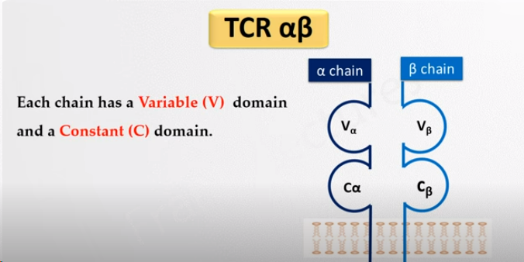
TCR
TCR

Slide 7
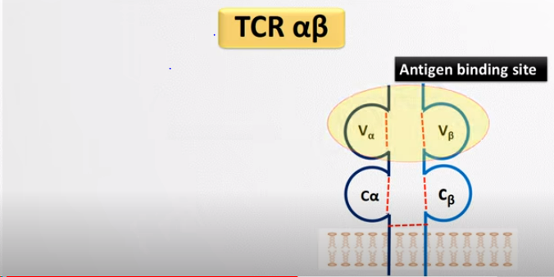
TCR
TCR

Slide 8
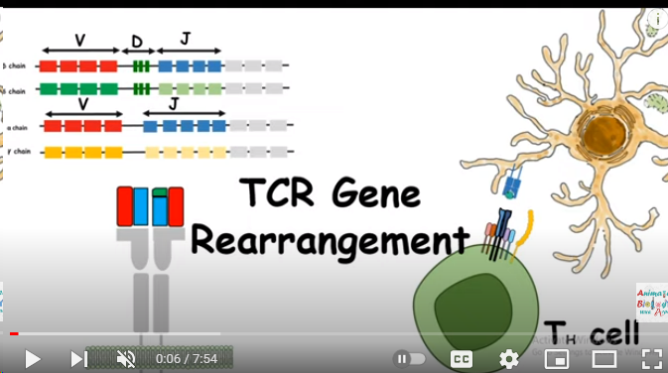
TCR
Control genes

Slide 9
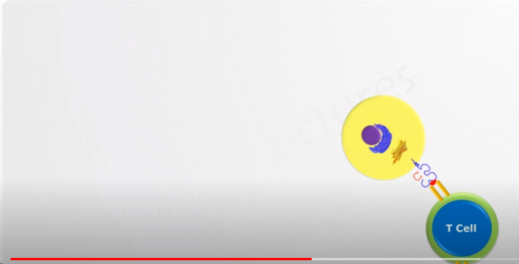
TCR

Slide 10
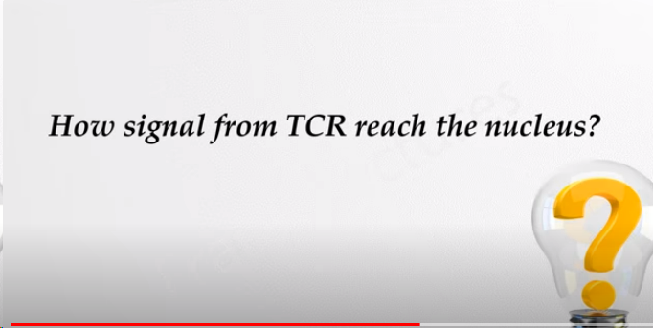
TCR
TCR

Slide 11
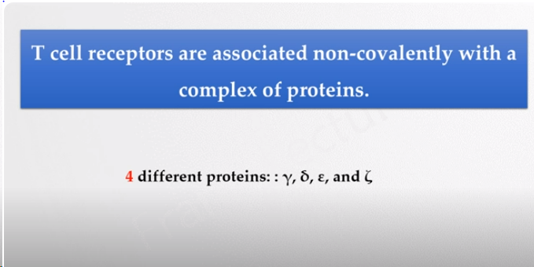
TCR
TCR

Slide 12
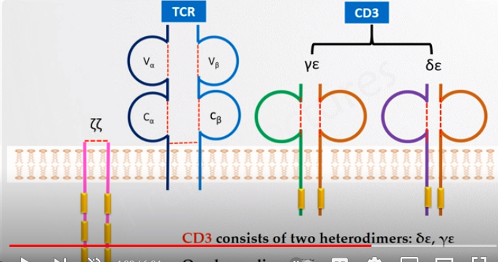
TCR
TCR

Slide 13
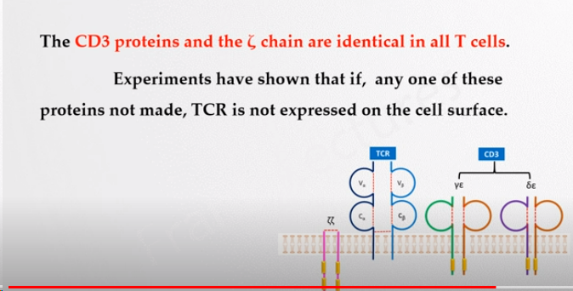
TCR
TCR

Slide 14
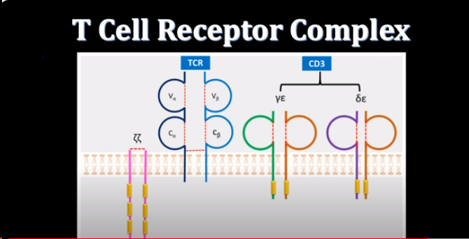

Slide 15
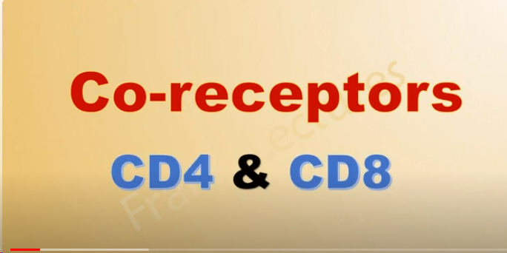
TCR-coreceptors

Slide 16
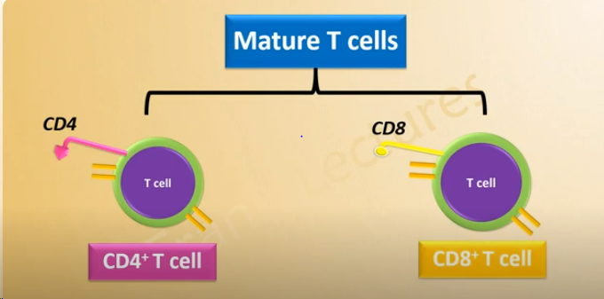
TCR-coreceptor

Slide 17
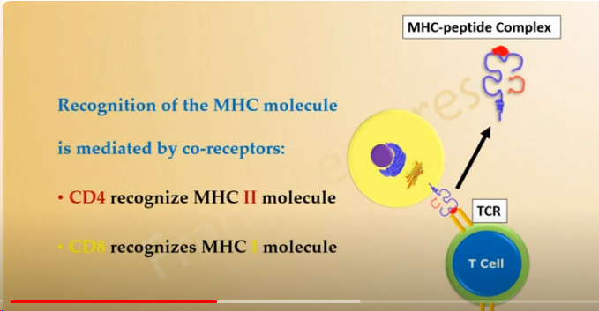
TCR-Coreceptors

Slide 18
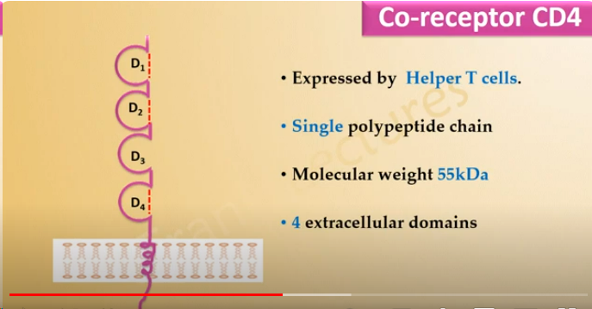
T-Cell coreceptor
CD4 molecule

Slide 19
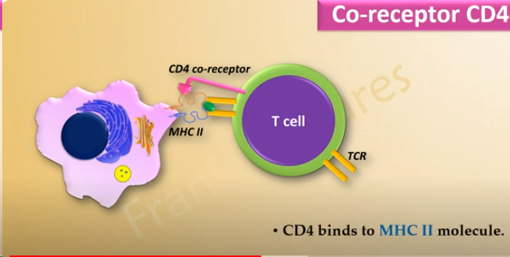
CD4 coreceptor

Slide 20
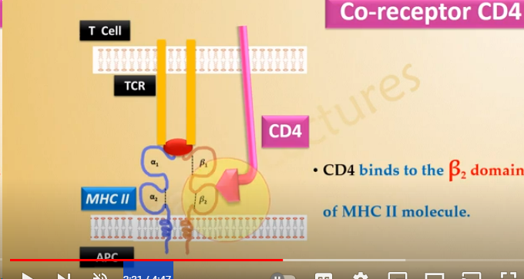
CD4-coreceptor

Slide 21
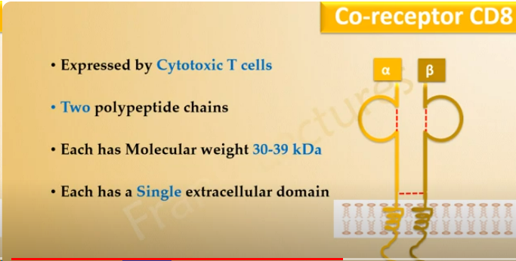
CD8-coreceptor
CD8

Slide 22
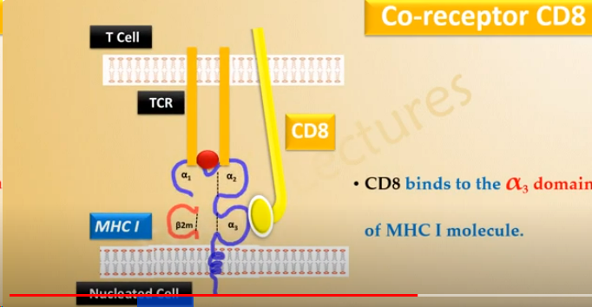
TCR-coreceptor
CD8 molecule

Slide 23
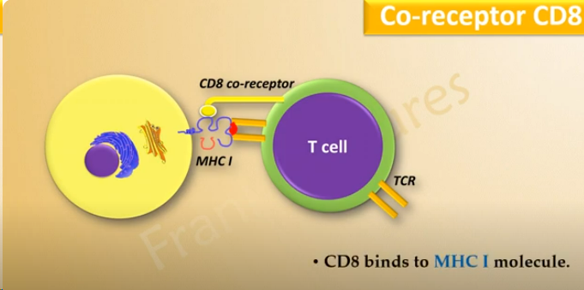
TCR-coreceptor
CD8

Slide 24
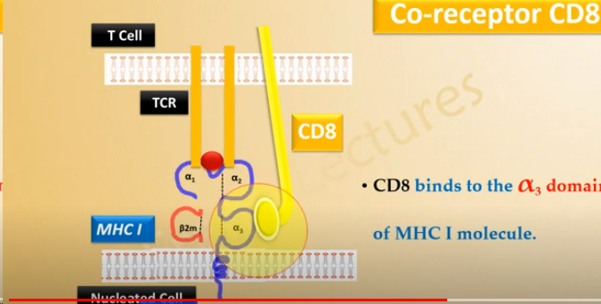
CD8-coreceptor

Slide 25
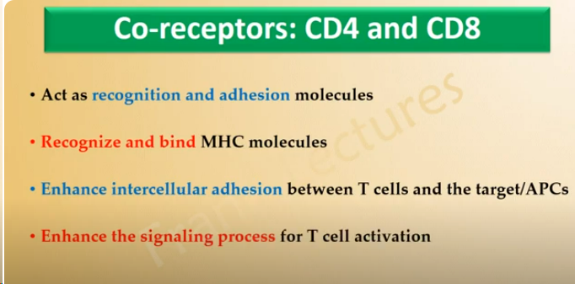
TCR-coreceptor
Functions

Slide 26
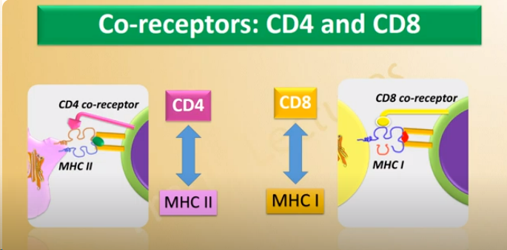
TCR-coreceptors
Summary

Slide 27
Summary
Summary

