Slide 1
Pharmaceutical Chemistry
Antipsychotic Drugs
By
Assist. Prof. Karima Fadhil Ali
Al mustansiriya university
College of pharmacy

Slide 2
Antipsychotics Drugs
Psychotic illness is a complication of multiple disorders, including schizophrenia, the manic phase of bipolar syndrome, acute idiopathic psychosis, and other conditions marked by severe agitation , yet the term “psychosis” is most often associated with schizophrenia.
Although the etiology of schizophrenia is unknown, the principal neurochemical theories focus on DA and, more recently, on glutamate and serotonin.

Slide 3
Schizophrenia
A mental disorder where person shows behavioral and cognitive dysfunction
Positive symptoms: abnormality of normal function leading to presence of inappropriate behaviors – Delusions (false belief)and hallucination (false perception), speech disturbances
Negative symptoms: loss of normal function leading to absence of appropriate behaviors – lack of motivation, social withdrawal, lack of interest in fun activity, doesn’t respond to questions
The basis of the DA hypothesis of schizophrenia (DHS) lies in the capacity of antipsychotic drugs to block DA receptors (D2 receptor subtype) positively correlated to their clinical potency in alleviating the symptoms of schizophrenia.
We don’t know the exact cause but it is believed that excess of dopamine activity is the reason for the disease.
Individuals with schizophrenia may have decreased densities of D1 receptors in the prefrontal cortex.

Slide 5
Typical antipsychotics
(also known as first-generation or conventional antipsychotics, classical neuroleptics, or major tranquilizers) are a class of antipsychotic drugs first developed in the 1950s and used to treat psychosis (in particular, schizophrenia).
Typical antipsychotics include phenothiazines, thioxanthenes, butyrophenones, diphenylbutylpiperidines, and the dihydroindolones.
first-generation antipsychotics are D2 antagonists. As a result, they reduce dopaminergic neurotransmission in the four dopamine pathways.

Slide 7
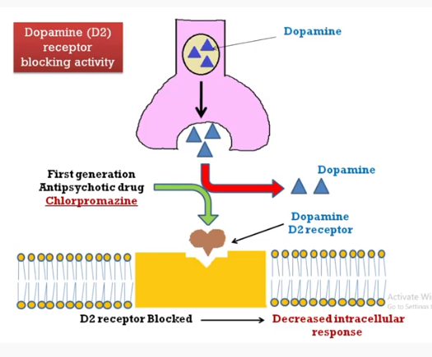

Slide 9
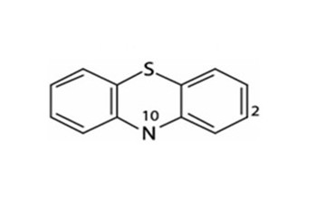
Typical Antipsychotic Agents
(First generation):1.Phenothiazines.
Phenothiazines have a tricyclic structure (6-6-6 system) in which two benzene rings are linked by a sulfur and a nitrogen atom.
Structure activity relationships
Un substituted phenothiazines has no activity but has enough lipophilicity for good brain penetration.
Substititution at C2 and N10 is required for activity.
Activity increases (with some exceptions) as with electron-withdrawing ability of the 2-substituent increases (e.g., chlorpromazine vs. promazine).

Slide 10
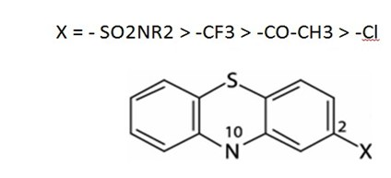
Structure activity relationships
4.Another possibly important structural feature in the more potent compounds is the presence of an unshared electron pair on an atom or atoms of the 2-substituent.
5.Substitution at the 3-position can improve activity over non substituted compounds but not as significantly as substitution at the 2-position.
6.Substitution at position 1 has a deleterious effect on antipsychotic activity, as does (to a lesser extent) substitution at the 4-position.

Slide 19
The SAR of phenothiazines is relatively simple because only position 2 (ring A) and the side chain afford active antipsychotic molecules
The significance of these substituent effects could be that the hydrogen atom of the protonated amino group of the side chain H-bonds with an electron pair of an atom of the 2-substituent to develop a DA-like arrangement.
Conformational studies on chlorpromazine reveal that tilting of the side chain toward ring A allows favorable van der Waals interactions of the side chain with the chlorine substituent.
The resulting conformation permits the superimposition of DA.
Substitution at the 1-position sterically hinders the ability of the side chain to approach ring A.

Slide 22
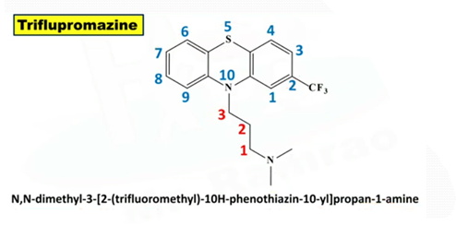
On the other hand, a substituent at the 3- position will be too far from the side chain to provide van der Waals attraction.
A trifluoromethyl group will give more van der Waals contacts with the side chain than a chloro substituent and, in fact, triflupromazine is more potent than chlorpromazine .

Slide 27
2.Thioxanthenes:
The structural difference between thioxanthene and phenothiazines is the bio isosteric replacement of the N at the 10-position by a carbon atom in the thioxanthenes.
The side chain (R10) in the thioxanthenes is attached by a double bond to the tricyclic system.
This portion of the molecule is not involved in the interaction with the receptor, but it serves to position correctly the other elements of the molecule. Thioxanthenes that have a double bond in the side chain can be either cis- or trans-isomers

Slide 28
The Cis and Trans conformation

Slide 29
The active form is the cis-isomer, which can be perfectly superimposed with the phenothiazine and the DA molecules, meaning that the Z-configuration is the preferred one for optimal receptor affinity.
In general, thioxanthenes are more potent than the structurally related phenothiazines.
In the thioxanthenes, the substituent at the 2-position does not govern the side chain in the same way as with the phenothiazines to assume a DA-like conformation. The cis or trans conformation of un substituted thioxanthenes does not show any differential potency.
For thioxanthenes, the 2-substituent of the cis form provides a closer approximation of the side chain toward ring A, enabling the substituent to enter into the van der Waals attractive forces with the side chain.

Slide 31
3. Butyrophenones And Related Structures

Slide 37
General structure and SAR of fluorobutyrophenones.

Slide 40
Atypical Antipsychotic Agents
(second-generations)
Ring Analogs of Phenothiazines: Benzazepines, Dibenzoxazepines, and Dibenzodiazepines:
Additional tricyclic antipsychotic agents are the benzazepines, containing a seven-membered central ring (6-7-6 system).
These newer atypical antipsychotics include:
Dibenzodiazepines (clozapine with 2-Cl)
Dibenzoxazepines (loxapine with 2-Cl),
Thienobenzodiazepines (olanzapine without 2-substituent)
Dibenzodiazepines (quetiapine without 2-substituent).
These ring analogs of phenothiazines are structural relatives of the phenothiazine antipsychotics; therefore, most of them share many clinical properties with the phenothiazines.
They have some important differences, notably low production of EPS and reduction of negative symptoms.

Slide 41
Atypical antipsychotics have generally shown to provide a greater reduction in both the positive and negative symptoms of schizophrenia, as well as an improvement in cognitive function.
These benzazepines and other atypical antipsychotics including risperidone, ziprasidone, and aripiprazole block both D2 and 5-HT2A receptor, other DA and serotonin receptor subtypes, adrenergic, histamine, and muscarinic receptors.
The low D2 receptor affinity and the high 5-HT2A receptor affinity of atypical antipsychotics including clozapine and olanzapine led to the proposal that 5-HT2A antagonism accounts for their lower EPS.
Thus, atypical antipsychotics are currently considered to be the first line of treatment for individuals with schizophrenia.

Slide 42
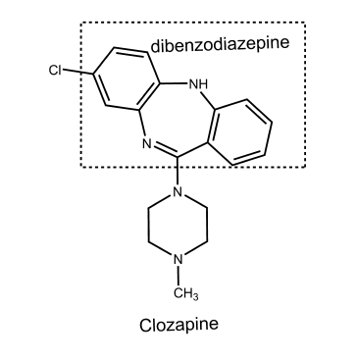
Clozapine analogs, olanzapine (Zyprexa) and quetiapine (Seroquel) possess tricyclic systems with greater electron density than chlorpromazine. Olanzapine is a more potent antagonist at D2 and 5-HT2A receptors than clozapine and is well absorbed, but about 40% of an oral dose is metabolized before reaching the systemic circulation.

Slide 44
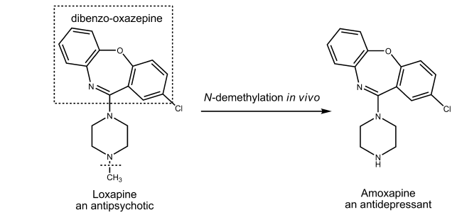
Affinity for 5-HT2A receptors is a feature of several of the recently developed atypical antipsychotics.
Many researchers believe that D2 receptor antagonism, coupled with 5-HT2A receptor antagonism, is responsible for the differentiation of effects observed with atypical anti psychotics.

Slide 46
An inverse agonist is a drug that binds to the same receptor as an agonist but induces a pharmacological response opposite to that of the agonist.

Slide 48
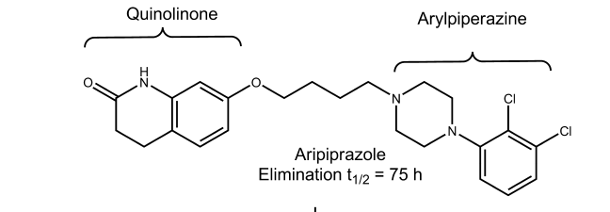
Aripiprazole

