Slide 1
Central Nervous System Stimulants
Pharmaceutical chemistry

Slide 2
Central Nervous system
Broad range of agents that stimulate the central nervous system (CNS).
The Analeptics classically are a group of agents with a limited range of use because of the general nature of their effects.
The Methylxanthines have potent stimulatory properties, mainly cortical at low doses but with more general effects as the dose is increased.
The central sympathomimetic agents Amphetamine and close relatives have alerting and antidepressant properties but are medically used more often as anorexiants.
The antidepressant drugs are used most frequently in depressive disorders and can be broadly grouped to: A. the monoamine oxidase inhibitors (MAOIs),

Slide 3
B. The monoamine reuptake inhibitors,
C. agents acting on auto receptors.
1. Analeptics
The traditional analeptics are a group of potent and relatively nonselective CNS stimulants. They can be illustrated by picrotoxinin and pentylenetetrazole. Both are obsolete as drugs but remain valuable research tools in determining how drugs act.
Newer agents, modafinil and doxapram, are more selective and have use in narcolepsy and as respiratory stimulants.

Slide 4
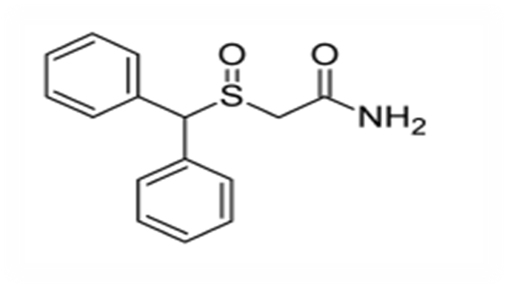
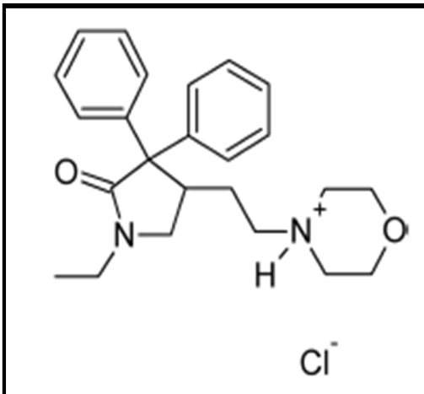
Modafinil ( Provigil)
It is considered an atypical α1-norepinephrine (NE) receptor stimulant and is used to treat daytime sleepiness in narcolepsy patients.
Doxapram Hydrochloride (Dopram)
Has an obscure molecular mechanism of action.
It stimulates respiration by action on peripheral
carotid chemoreceptors.
It has use as a respiratory stimulant post anesthetically, after CNS depressant drug overdose, in chronic obstructive pulmonary diseases, and in the apneas.

Slide 5
2. Methylxanthines
The naturally occurring Methylxanthines are caffeine, theophylline, and theobromine.
Caffeine is a widely used CNS stimulant.
Theophylline has some medical use as a CNS stimulant, but its CNS stimulant properties are encountered more often as sometimes severe, and potentially life-threatening, side effects of its use in bronchial asthma therapy.
Theobromine has very little CNS activity (probably because of poor physicochemical properties for distribution to the CNS).

Slide 6
The CNS-stimulating effects of the Methylxanthines were once attributed to their
competitive nonselective phosphodiesterase-inhibiting ability which is responsible for the breakdown of cyclic AMP. . This action is probably irrelevant at therapeutic doses.
nonselective antagonize adenosine at A1 and A2A receptors. which inhibit sleepiness inducing adenosine.
Problems with the present compounds, such as caffeine and theophylline, are lack of receptor selectivity .

Slide 7
Chemical Structures of the Xanthine Alkaloids

Slide 8
3. Central sympathomimetic agents
(Psychomotor stimulants)
The central sympathomimetic agents amphetamine and close relatives have alerting and antidepressant properties but are medically used more often as anorexiants.
Sympathomimetic agents, whose effects are manifested mainly in the periphery, A few simple structural changes in these peripheral agents produce compounds that are more resistant to metabolism, more non polar, and better able to cross the blood-brain barrier. These effects increase the ratio of central to peripheral activity, and the agents are designated, as central Sympathomimetic agents.

Slide 9
In addition to CNS-stimulating effects, manifested as excitation and increased wakefulness, many central sympathomimetics exert an anorexiant effect.
Other central effects, notably dopaminergic and serotoninergic effects, can be operative.
Structure activity relationship
Structural features for many of the agents can be visualized easily by considering that within their structure, they contain a β-phenethylamine moiety, and this grouping can give some selectivity for presynaptic or postsynaptic noradrenergic systems.
*β-Phenethylamine, given peripherally, lacks central activity..

Slide 10
1. Branching with lower alkyl groups on the carbon atom adjacent (α) to the amino nitrogen increases CNS rather than peripheral activity (e.g., amphetamine, presumably by retarding metabolism). The branching generates a chiral center. 2. The dextro (S)-isomer of amphetamine is up to 10 times as potent as the levo (R)-isomer for alerting activity and about twice as active as a psychotomimetic agent.

Slide 11
3. Hydroxylation of the ring or hydroxylation on the β-carbon (to the nitrogen) decreases activity, largely by decreasing the ability to cross the blood brain barrier.
For example, phenylpropanolamine, with a -hydroxyl (OH), has about 1/100th the ability to cross the blood-brain barrier of its deoxy congener, amphetamine.
4. Halogenation (F, Cl, Br) of the aromatic ring decreases sympathomimetic activity. Other activities may increase.

Slide 12
p-Chloro amphetamine has strong central serotoninergic activity.
5. Methoxyl or methylenedioxy substitution on the ring tends to produce psychotomimetic agents, suggesting tropism for dopaminergic (D2) receptors.
6. N-methylation increases activity (e.g., compare methamphetamine with dextroamphetamine).
7. Di-N-methylation decreases activity .
8. Mono-N substituents larger than methyl decrease excitatory properties, but many compounds retain anorexiant properties.
Consequently, some of these agents are used as anorexiants, reportedly with less abuse potential than amphetamine.

Slide 13
Amphetamine Sulfate
(±)-1-phenyl-2-aminopropane (Benzedrine), as the racemic mixture has a higher proportion of cardiovascular effects than the dextro isomer.
For most medical uses, the dextrorotatory isomer is preferred.

Slide 14
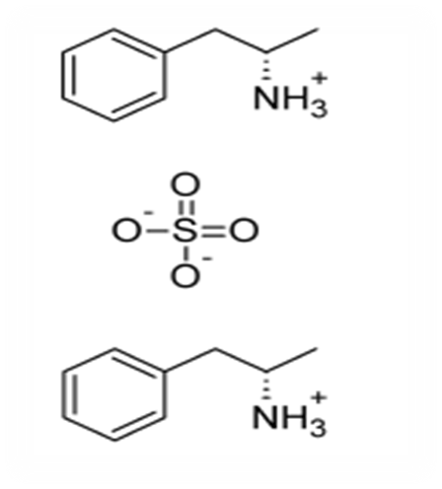
Dextroamphetamine
(+)-(S)methylphenethylamine, forms salts with sulfuric acid (Dexedrine) and with phosphoric acids.
The phosphate is the more water-soluble salt and is preferred if parenteral administration is required. The dextrorotatory isomer has the (S) configuration and fewer cardiovascular effect than the levorotatory (R)-isomer. Additionally, it may be up to 10 times as potent as the (R)-isomer as an alerting agent and about twice as potent a psychotomimetic agent.
Although it is a more potent psychotomimetic agent than the (R)-isomer, it has a better ratio of alerting to psychotomimetic effects.

Slide 15
The major mode of action of dextroamphetamine
release of NE from the mobile pool of the nerve terminal.
inhibition of uptake, may make a small contribution to the overall effects. The alerting actions relate to increased NE available to interact with postsynaptic receptors (α1 ).
Central β1-receptor activation has classically been considered the basis for most of the anorexiant effect.
The psychotomimetic effects are linked to release of DA and activation of postsynaptic receptors.

Slide 16
D2 and mesolimbic D3 receptors would be involved.
Effects on 5-HT systems also have been linked to some behavioral effects of dextroamphetamine.
Dextroamphetamine is a strongly basic amine.
The α-methyl group retards, but does not terminate, metabolism by MAO. Under most conditions, the bulk of a dose of dextroamphetamine is metabolized by N-de alkylation to phenyl acetone and ammonia. Phenyl acetone is degraded further to benzoic acid.

Slide 17
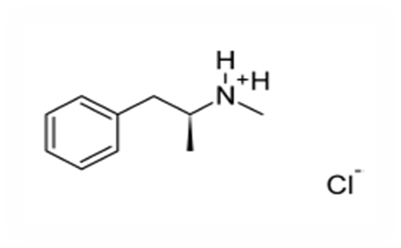
Methamphetamine
(+)-1-phenyl-2-methylaminopropane hydrochloride, desoxyephedrine hydrochloride (Desoxyn), is the N-methyl analog of dextroamphetamine. It has more marked central and less peripheral action than dextroamphetamine.

Slide 18
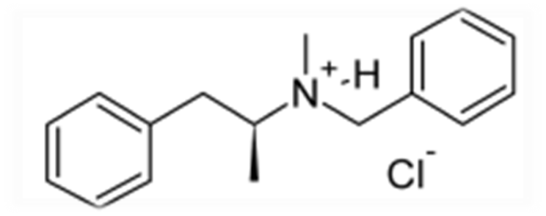
Benzphetamine hydrochloride
(+)-N-benzyl-N,-dimethylphenethylamine hydrochloride,(+)-1-phenyl-2-(N-methyl-N-benzylamine) propane hydrochloride (Didrex), is N-benzyl–substituted methamphetamine.
The large (benzyl) N-substituent decreases excitatory properties, in keeping with the general structure–activity relationship (SAR) for the group. Anorexiant properties are retained.
Classically, amphetamine-like drugs with larger than N-methyl substituents are cited as anorexiant through central β- agonism.

Slide 19
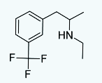
Fenfluramine hydrochloride
(+)N-ethyl-α-methyl-m-(trifluoromethyl) phenethylamine hydrochloride (Pondimin), is unique in this group of drugs, in that it tends to produce sedation rather than excitation. Effects are said to be mediated principally by central serotoninergic, rather than central noradrenergic, mechanisms. It, too, was withdrawn because of toxicity.

Slide 20
4. Antidepressants
Monoamine Oxidase Inhibitors
Antidepressant therapy usually implies therapy directed against major depressive disorders of the unipolar type and is centered on three groups of chemical agents:
A. The MAOIs
B. The monoamine reuptake inhibitors
C. Auto receptor desensitizers and antagonists.

Slide 21
A. Monoamine Oxidase Inhibitors
MAOIs act by inhibiting the activity of monoamine oxidase, thus preventing the breakdown of monoamine neurotransmitters and thereby increasing their availability.
A severe problem associated with the MAOIs Several severe hypertensive responses, some fatal, have followed ingestion of foods high in pressor amines.
The clinically useful MAOIS antidepressants are nonselective between inhibiting metabolism of NE and 5-HT.

Slide 22
Phenelzine Sulfate
Phenelzine sulfate, 2-(phenyl ethyl)hydrazine sulfate (Nardil), is an effective antidepressant agent. It irreversibly inactivates the enzyme or its cofactor, presumably after oxidation to the diazine, which can then break up into molecular nitrogen, a hydrogen atom, and a phenethyl free radical. The latter would be the active species in irreversible inhibition. Phenelzine is one of the few non-selective MAOIs still in widespread clinical use.

Slide 23
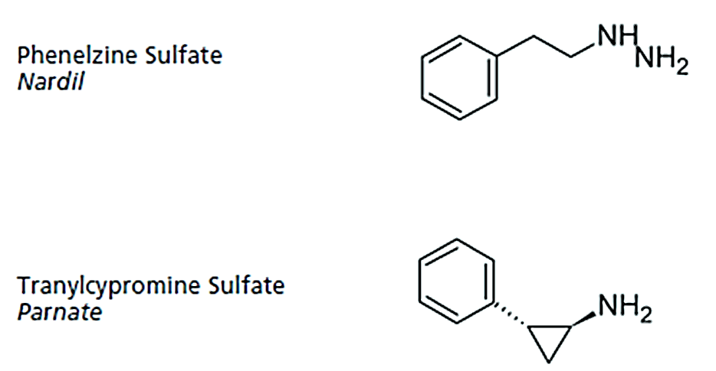
Tranylcypromine Sulfate
It was synthesized to be an amphetamine analog (visualize the α-methyl of amphetamine condensed onto the β-carbon atom). It does have some amphetamine-like properties, which may be why it has more immediate CNS-stimulant effects than agents that act by MAO inhibition alone.

Slide 24
B. Monoamine Reuptake Inhibitors
The monoamine reuptake inhibitors were a group of closely related agents, the tricyclic antidepressants (TCAs),. Almost all of the agents block neuronal reuptake of NE or 5-HT or both.
Reuptake inhibition by these agents is at the level of the respective monoamine transporter via competitive inhibition of binding of the monoamine to the substrate-binding compartment.
The net effect of the drug is to increase the level of the monoamine in the synapse. Sustained high synaptic levels of 5-HT, NE, or both appear to be the basis for the antidepressant effect of these agents.

Slide 25
There are two major groups of TCAs in terms of chemical structure, which most, but not all, TCAs fall into.
The groupings are based on the tricyclic ring system.
They are the dibenzazepines (imipramine, desipramine, clomipramine, trimipramine, lofepramine) and the dibenzocycloheptadienes (amitriptyline, nortriptyline, protriptyline, butriptyline).
Minor TCA groups based on ring system include the dibenzoxepins (doxepin), the dibenzothiepines (dosulepin), and the dibenzoxazepines (amoxapine).
In addition to classification based on the ring system, TCAs can also be usefully grouped based on the number of substitutions of the side chain amine.

Slide 26
These groups include:
The tertiary amines (imipramine, clomipramine, trimipramine, amitriptyline, butriptyline, doxepin, dosulepin).
The secondary amines (desipramine, nortriptyline, protriptyline).
Lofepramine is technically a tertiary amine, but acts largely as a prodrug of desipramine, a secondary amine, and hence is more similar in profile to the secondary amines than to the tertiary amines.
Amoxapine does not have the TCA side chain and hence is neither a tertiary nor secondary amine, although it is often grouped with the secondary amines due to sharing more in common with them

Slide 27
Tricyclic Antidepressants
The SARs for the TCAs:
There is a large, bulky group encompassing two aromatic rings, preferably held in a skewed arrangement by a third central ring, and three- or, sometimes, two-atom chain to an aliphatic amino group that is monomethyl or dimethyl substituted.
The overall arrangement has features that approximate a fully extended trans conformation of the -aryl amines.
*An extra aryl bulky group that enhances affinity for the substrate-binding compartment of the transporter.
* The dimethyl amino compounds tend to be sedative, whereas the monomethyl relatives tend to be stimulatory.
The dimethyl compounds tend toward higher 5-HT to NE reuptake block ratios.

Slide 28
*In the monomethyl compounds, the proportion of NE uptake block tends to be higher and, in some cases, is considered selective NE reuptake.
* The compounds have anti cholinergic properties, usually higher in the dimethyl amino compounds.
The TCAs are extremely lipophilic and, accordingly, very highly tissue bound outside the CNS. Because they have anti cholinergic and noradrenergic effects, both central and peripheral side effects are often unpleasant and sometimes
dangerous.

Slide 29
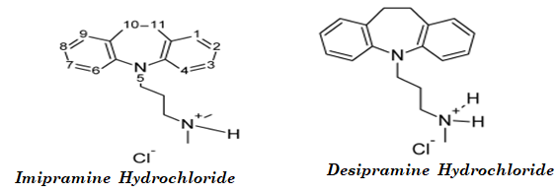
Imipramine Hydrochloride (Tofranil),
Imipramine hydrochloride, 5-[3 (dimethyl amino) propyl]- 10,11-dihydro-5H-dibenzazepine mono hydrochloride
Tofranil, is the lead compound of the TCAs mainly affects amines (5-HT, NE, and DA) via the transporters. As is typical of dimethyl amino compounds, anti cholinergic and sedative (central H1 block) effects tend to be marked.
The compound per se has a tendency toward a high 5-HT-to-NE uptake block ratio and probably can be called a serotonin transport inhibitor (SERTI).

Slide 30
Metabolic N-demethylation occurs, with a buildup of nor imipramine (or desimipramine).
The demethylated metabolite is less anti cholinergic, less sedative, and more stimulatory and is a selective norepinephrine reuptake inhibitor (SNERI)
Clomipramine Hydrochloride
Clomipramine (Anafranil) is up to 50 times as potent as imipramine in some bioassays. The chloro replacing the H-substituent could increase potency by increasing distribution to the CNS.
Clomipramine Hydrochloride

Slide 31
An H-bond between the protonated amino group (as in vivo) and the unshared electrons of the chloro substituent might stabilize a - β aryl amine–like shape and give more efficient competition for the transporter. The drug is an antidepressant. It is used in obsessive–compulsive disorder, an anxiety disorder that may have an element of depression.

Slide 32
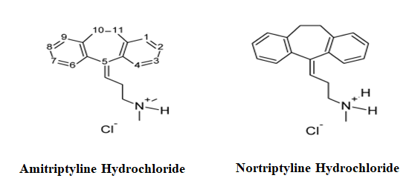
Amitriptyline Hydrochloride(Elavil)
Is one of the most anti cholinergic and sedative of the TCAs. Because it lacks the ring-electron–enriching nitrogen atom of imipramine, metabolic inactivation mainly proceeds not at the analogous 2-position but at the benzylic 10-position. Because of the 5- exocyclic double bond, E- and Z-hydroxy isomers are produced by oxidation metabolism. Metabolic N-demethylation occurs, and nortriptyline is produced, which has a less anti cholinergic, less sedative, and more stimulant action than amitriptyline. Nortriptyline is
a( SNERI).

Slide 33
Doxepin Hydrochloride (Sinequan, Adapin)
Is an oxa congener of amitriptyline, as can be seen from its structure.
The oxygen is interestingly placed and should influence oxidative metabolism as well as postsynaptic and presynaptic binding affinities.
Doxepin Hydrochloride

Slide 34
The (Z)-isomer is the more active, although the drug is marketed as the mixture of isomers. The drug overall is a NE and 5-HT reuptake blocker with significant anti cholinergic and sedative properties.
Another derivatives
Amoxapine
Maprotiline Hydrochloride

Slide 35
Selective Serotonin Reuptake Inhibitors
β- arylamine–like grouping is present, as in the tricyclics, and the compounds can compete for the substrate binding site of the serotonin transporter protein (SERT). As in the tricyclics, the extra aryl group can add extra affinity and give favorable competition with the substrate, serotonin.
Many of the dimethyl amino tricyclics are, in fact, SSRIs. Because they are extensively N-demethylated in vivo to nor compounds, which are usually SNERIs, however, the overall effect is not selective.
Breaking up the tricyclic system breaks up an anti cholinergic pharmacophoric group and gives compounds with diminished anti cholinergic effects.
Overall, this diminishes unpleasant CNS effects and increases cardiovascular safety. Instead, side effects related to serotonin predominate.

Slide 36
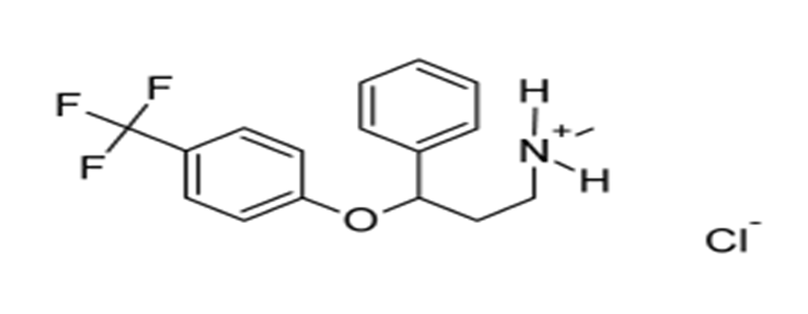
Fluoxetine
In fluoxetine (Prozac), protonated in vivo, the protonated amino group can H-bond to the ether oxygen electrons, which can generate the aryl amino–like group, with the other aryl serving as the characteristic “extra” aryl. the extra aryl group can add extra affinity and give favorable competition with the substrate, serotonin.
The S-isomer is much more selective for SERT than for NET. The major metabolite is the N-demethyl compound, which is as potent as the parent and more selective (SERT versus NET). (serotonin transporter protein, NE transporter) Therapy for 2 or more weeks is required for the antidepressant effect.

Slide 37
Paroxetine
is an antidepressant of the selective serotonin reuptake inhibitor (SSRI) class. In the structure of Paroxetine (Paxil), an amino group, protonated in vivo could H-bond with the –CH2–O– unshared electrons. A β-aryl amine–like structure with an extra aryl group results. The compound is a very highly selective SERT. As expected, it is an effective antidepressant and anxiolytic.
Paroxetine

Slide 38
Sertraline
Inspection of Sertraline (Zoloft) (1S,4S) reveals the pharmacophore for SERT inhibition. The Cl substituents also predict tropism for a 5-HT system. The depicted stereochemistry is important for activity.

Slide 39
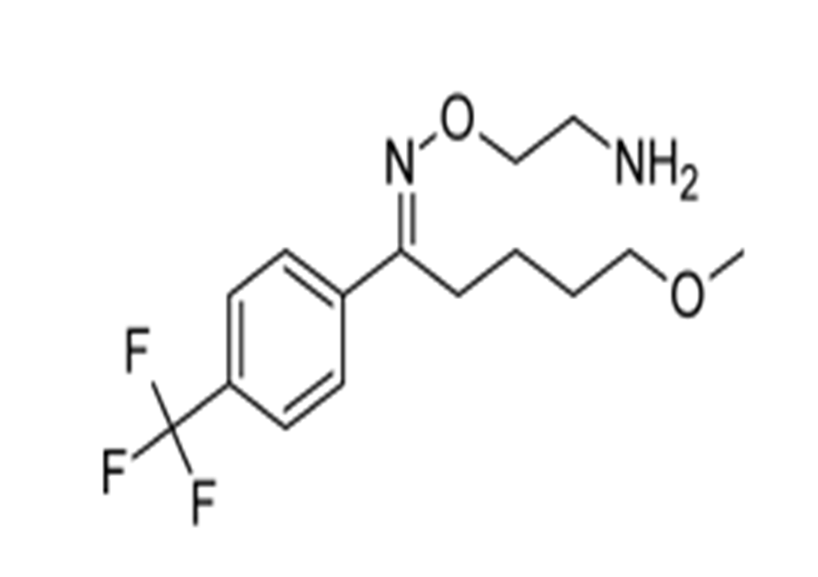
Fluvoxamine
is a medication which functions as a selective serotonin reuptake inhibitor (SSRI) and σ₁ receptor agonist. Fluvoxamine is used primarily for the treatment of obsessive–compulsive disorder (OCD), and is also used to treat major depressive disorder and anxiety disorders The E-isomer of fluvoxamine (Luvox) (shown) can fold after protonation to the -aryl amine–like grouping. Here, the “extra” hydrophobic group is aliphatic.

Slide 40
Citalopram
Citalopram (Celexa) is an antidepressant drug of the selective serotonin reuptake inhibitor(SSRI) class.
It is a racemic mixture and is very SERT selective.
The N-mono demethylated compound is slightly less potent but is as selective.
The aryl substituents are important for activity.
The ether function is important and probably interacts with the protonated amino group to give a suitable shape for SERT binding.

Slide 41
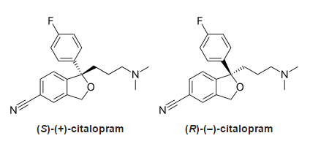
Citalopram has one stereo center, to which a 4-fluoro phenyl group and an N,N-dimethyl-3-aminopropyl group bind.
As a result of this chirality, the molecule exists in (two) enantiomeric forms (mirror images).
They are termed S-(+)-citalopram and R-(–)-citalopram.
Only the (S)-(+) enantiomer has the desired antidepressant effect

Slide 42
4. Selective Norepinephrine Reuptake Inhibitors movement of a para substituent of fluoxetine (and relatives) to an ortho position produces a SNERI.
Nisoxetine
Nisoxetine is a SNERI and is an antidepressant. Most activity resides in the –isomer.
Nisoxetine

