Slide 1

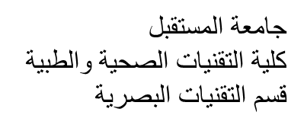
Al-Mustaqbal University
Department/ Optical techniques
Medical glasses
3rd stage
By
Dr. Marrwan Hisham Mohammed
2024/03/04

Slide 2
Boxing System
In 1962 the Optical Manufacturers Association adopted the boxing system to provide a standard for frame and lens measurement that greatly improved upon the accuracy of previous systems.
The boxing system is based upon the idea of drawing an imaginary box around a lens shape with the box's sides tangent to the outermost edges of the shape.

Slide 3
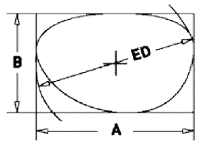
Boxing System
“A" Measurement
The horizontal distance between the furthest temporal and nasal edges of the lens shape
The A measurement is also commonly known as the eye size.

Slide 4
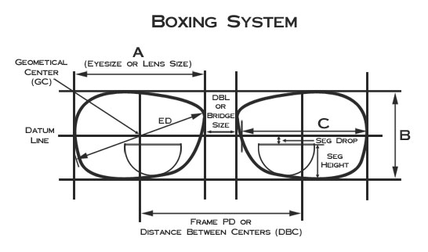

Slide 5
Boxing System
B" Measurement
The vertical distance between the furthest top and bottom edges of the lens shape or the distance between the horizontal sides of the box.

Slide 6
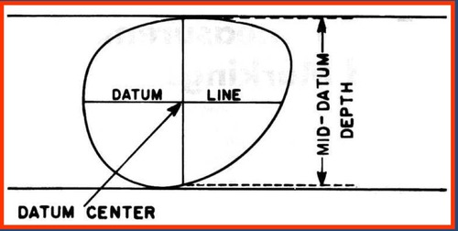
Boxing System
Datum Line - The horizontal line that runs through the vertical center of the frame.
Geometric Center (GC) - The intersection of the Datum Line and horizontal centers of each lens shape.

Slide 7
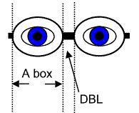
Boxing System
Distance Between Lenses (DBL) - The shortest distance between the nasal edges of each lens
or the distance between boxes.
DBL is also commonly referred to as bridge size.

Slide 8
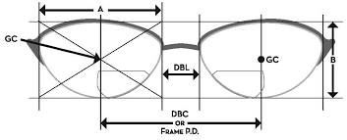
Boxing System
Distance Between Centers (DBC)
The horizontal distance between the geometric centers of the lenses.
DBC is also know as the Geometric Center Distance (GCD), but more commonly referred to as the frame PD.

Slide 9
Boxing System
Note: Frames are typically marked for size, for example:
54-18, where 54 is the "A" Measurement
and 18 is the DBL.

Slide 10
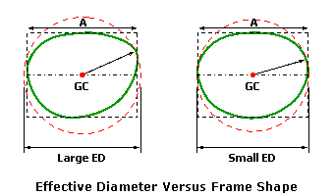
Boxing System
Effective Diameter (ED)
Twice the distance from the geometric center of the lens furthest edge of the lens shape.

Slide 11
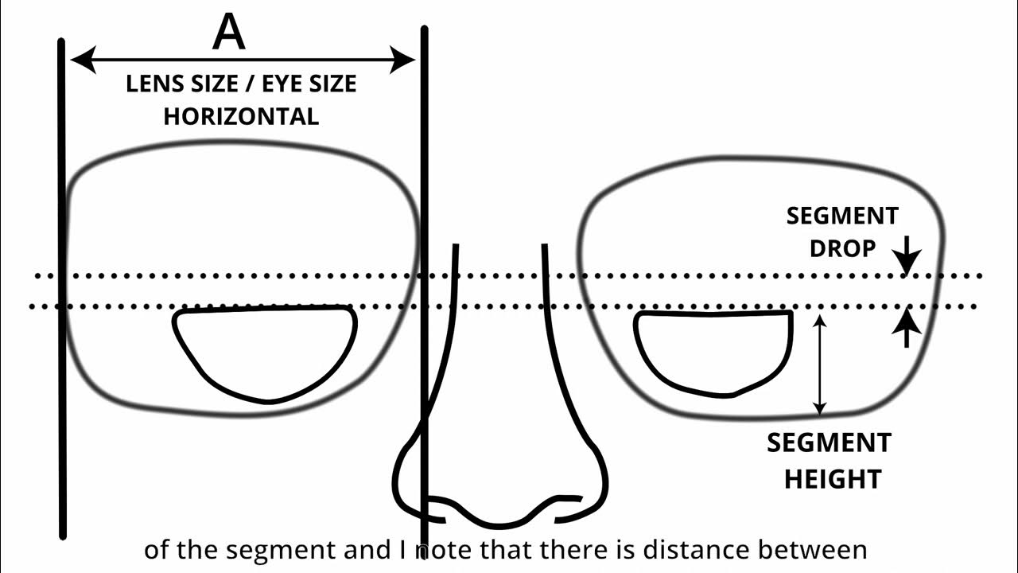
Boxing System
Seg Height
The vertical distance between the bottom edge of the box and the top of the bifocal or trifocal segment
Seg Drop
The vertical distance between the Datum line and the top of the bifocal or trifocal segment Overall

Slide 12
Boxing System
Thank you

