Slide 1


Al-Mustaqbal University
Department/ Optical techniques
Medical glasses
3rd stage
By
Dr. Marrwan Hisham Mohammed
2024/03/23

Slide 2
Decentration
To understand decentration in basic terms, it means how far the optical center of the lens needs to be moved to be directly in front of the patient’s eye when fitted into the frame.

Slide 3
Decentration
The formula for decentration on a single-vision lens is as follows:
• Frame pupillary distance (PD) – Patient (Px) PD / 2
• For example,
frame size 50, 17 = frame PD 67
• Px PD 62
• Using the formula: 67 – 62/2 = 2.5mm

Slide 4
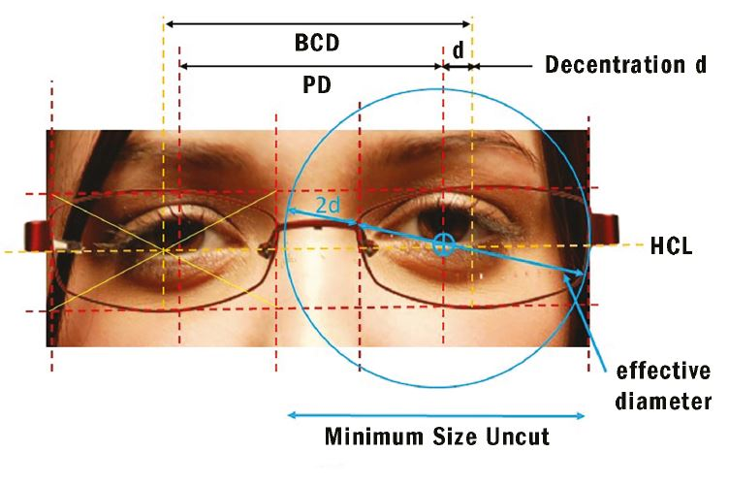
Decentration
This indicates that the optical center needs to move 2.5mm towards the nasal on each lens for the desired PD.

Slide 5
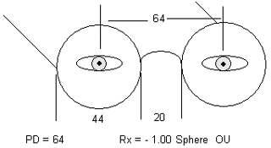
Decentration
If the wearer’s binocular Pupillary Distance (PD) and the Frame Centre Distance (FCD) are equal, no Decentration is required, although this rarely happens.

Slide 6
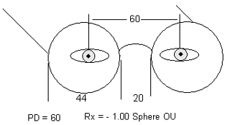
Decentration
When the wearer’s PD is smaller than the FCD, which is common, the lens must be decentered in, towards the bridge.

Slide 7
Decentration
In the uncommon situation where the PD is wider than the FCD, the lens is decentered out, towards the temple.
66
66
66

Slide 8
Decentration
Another key factor is understanding minimum blank size (MBS). It’s easy enough to decenter a lens but it’s important to ensure you have enough room to do so.
The formula for calculating minimum blank size is:
• MBS = Frame PD – Px PD + ED
• For example, frame size 50, 17 Px PD 62 and ED 53.
• MBS = 67 – 62 + 53 = 58 mm MBS.

Slide 9
Decentration
As can be seen, the minimum size blank required for this patient is 58mm which allows plenty of room to decenter the size comfortably.
Be aware, however, the narrower the PD and the larger the frame, the less room there is to work with.

Slide 10
Vertical Decentration
For vertical decentration you would take HALF of the B measurement and subtract either the OC or the SEG height.
These measurements tell us how far away the OC of the lens is from the center of the frames.
It is important to know this because the thickness of a lens is greatly affected by the amount of decentration
Vertical Decentration = seg height - (B measurement / 2)

Slide 11
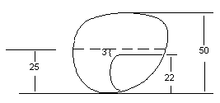
Vertical Decentration
In the example below, since the B measurement = 50 mm the datum line is 25 mm from the bottommost portion of the lens.
The seg height is 22 mm.
Subtracting half the B measurement from the seg height results in :
22 – 25 = –3.

Slide 12
Vertical Decentration
Therefore the segment line is decentered 3 mm below the datum line, or would be commonly referred to as seg = -3 below. If the seg height were say, at 28 mm, the result would be + 3 mm positioning the seg line 3 mm above the datum line or +3 above.

Slide 13
Determine the amount of horizontal decentration required for the following:
"A" measurement = 54
DBL = 16
PD = 62
"A" measurement = 42
DBL = 14
PD = 50
"A" measurement = 50
DBL = 16
PD = 66
"A" measurement = 58
DBL = 22
PD = 64

Slide 14
Determine the "theoretical" minimum blank size for each of the following:
"A" measurement = 58
DBL = 18
PD = 68
ED = 60
"A" measurement = 52
DBL = 20
PD = 60
ED = 54
"A" measurement = 56
DBL = 16
PD = 64
ED = 59
"A" measurement = 48
DBL = 14
PD = 50
ED = 50

Slide 15
Calculate vertical decentration of the bifocal segment for the following:
"B" Measurement = 52
Seg height = 23
"B" Measurement = 48
Seg height = 24
"B" Measurement = 50
Seg height = 28
"B" Measurement = 46
Seg height = 19

Slide 16
Thank you

