Slide 1
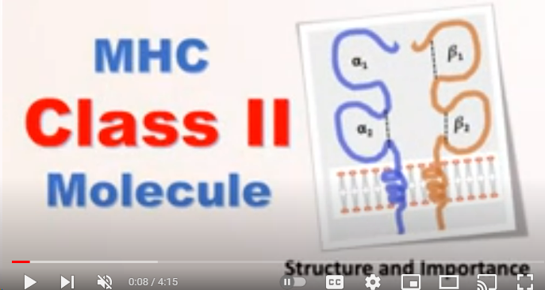
Class II MHC

Slide 2
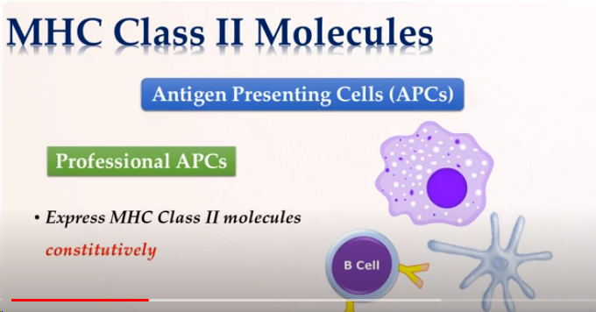
MHC-Class II
Class II

Slide 3
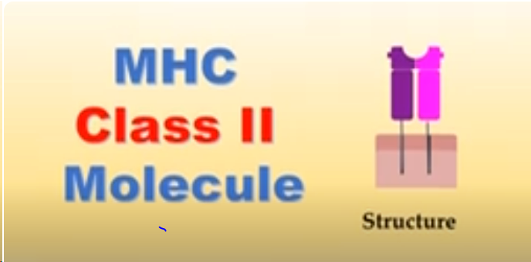
MHC-class II
Class II MHC

Slide 4
MHC-Class II
Class II

Slide 5
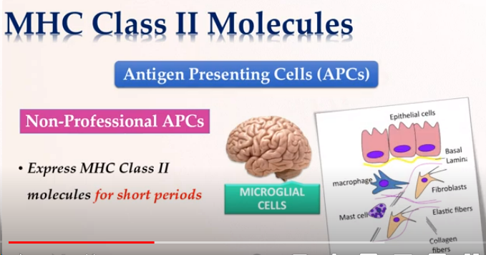
MHC-Class II
Class II

Slide 6
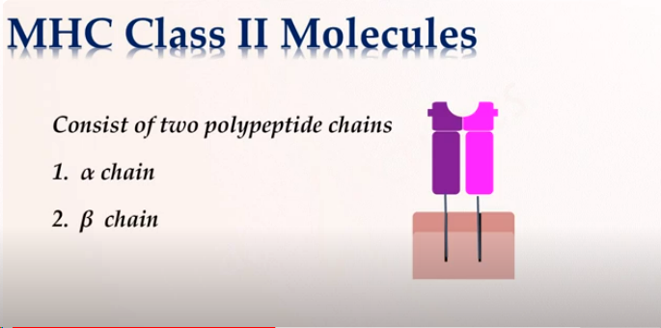
MHC-Class II
Class II MHC

Slide 7
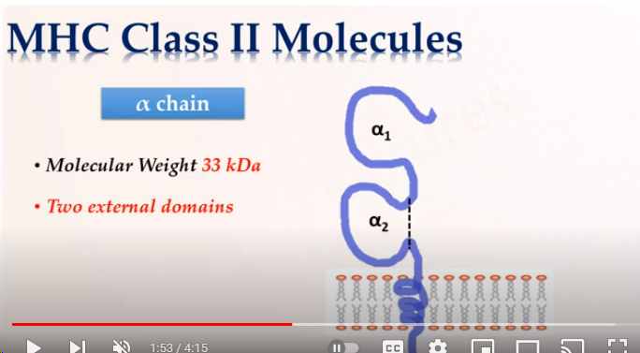
MHC-Class II

Slide 8
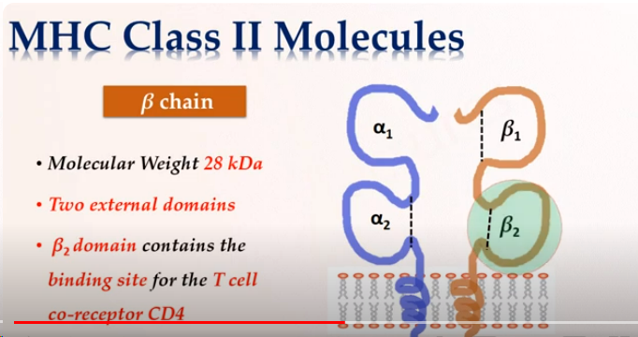
MHC-Class II
Class II MHC

Slide 9
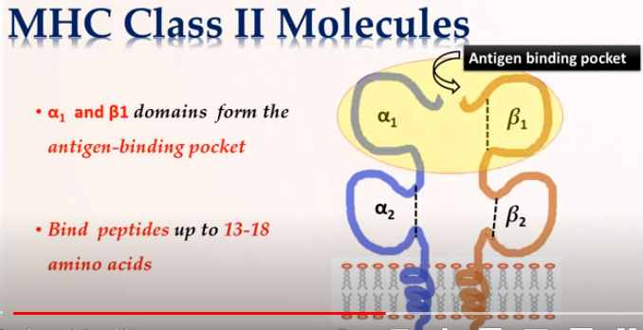
MHC-Class II

Slide 10
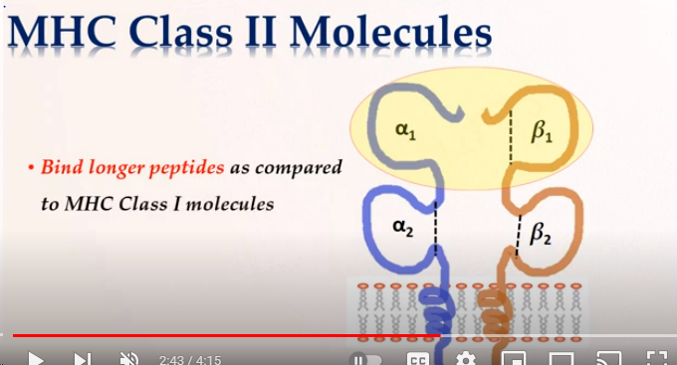
MHC-Class II
Class II

Slide 11
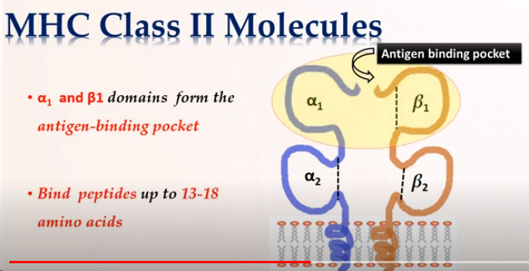
MHC-class II
Class II

Slide 12
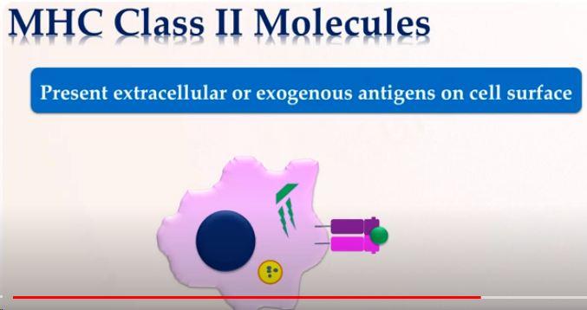
MHC-Class II
Class II

Slide 13
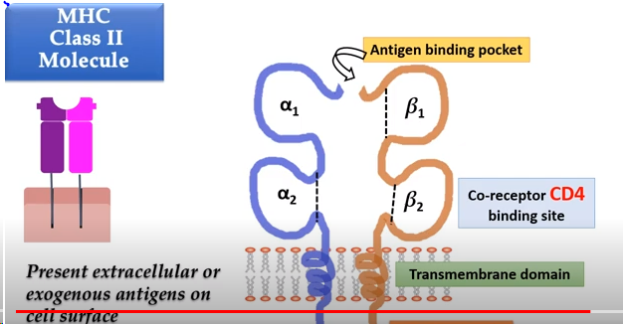
MHC Class II
Class II MHC

