Slide 1



Al-Mustaqbal University.
College of Engineering and Technologies.
Biomedical Engineering Department.
Subject: Biomedical Instrumentation Design_II.
Class (code): 5th (MU0115202).
Lecture: 8.
BMID_II

Slide 2
Methods of Data Acquisition.
The Localizer scans
Most CT studies begin with one or more localizer images.
Localizer scans in CT studies are not cross-sectional but resemble conventional radiographic images.
These digital image acquisitions are created with a stationary tube and a moving table within the scan field.
CT localizer images, while slightly lower in quality compared to conventional radiographs, expose patients to a similar radiation dose.
The tube's position determines the orientation of the image; above the patient results in an anterior–posterior (AP) view, while positioning it to the side creates a lateral view.
BMID_II

Slide 3
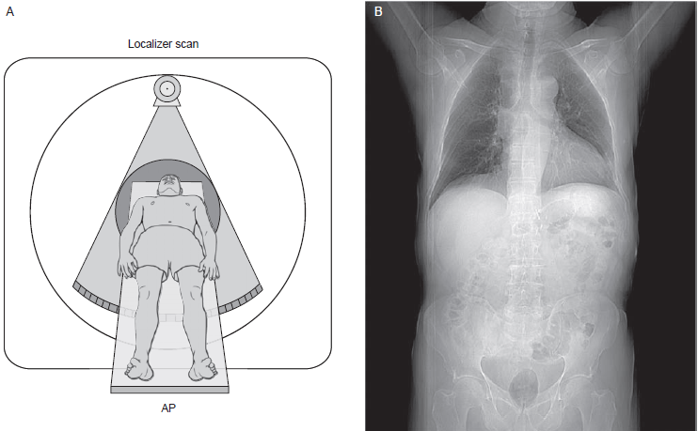
Methods of Data Acquisition.
With the tube positioned above the patient (Fig. A), the resulting localizer image will be an anterior–posterior projection, such as the localizer image of the chest and abdomen in (Fig. B).
BMID_II

Slide 4
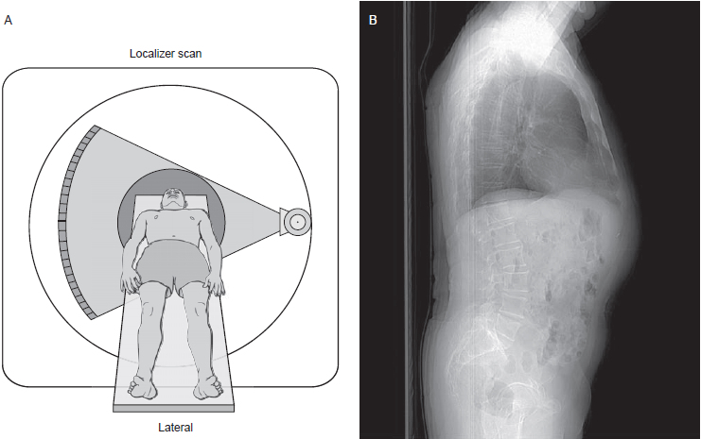
Methods of Data Acquisition.
With the tube positioned at the patient side (Fig. A), the resulting localizer image will be a lateral projection, such as the localizer image of the chest and abdomen in (Fig. B).
BMID_II

Slide 5
Methods of Data Acquisition.
Localization images are known as: scout, surview, topogram, scanogram, preview, and pilot.
At least one localizer scan is typically acquired in routine studies.
An optimal scout should encompass all areas to be scanned to ensure proper placement of the anatomy within the system's range.
Correct patient positioning in the head–foot (z axis) direction and centering in the x and y directions within the gantry are crucial.
Miscentering in x or y directions can lead to out-of-field artifacts; x miscentering occurs when the patient is off-center laterally, while y miscentering happens when the table height is incorrect.
Proper centering is essential for accurate imaging, especially when using automatic exposure control techniques.
Miscentered localizer scans may result in incorrect tube current calculations, impacting image quality and patient radiation dose.
BMID_II

Slide 6
Methods of Data Acquisition.
Localizer images allow technologists to determine the location of cross-sectional slices, typically extending just beyond the area to be imaged.
Examples of localizer images include a CT of the chest, which starts at the lower neck and ends mid-abdomen.
When readily identifiable landmarks are unavailable, the operator must make an educated guess and, if possible, verify the accuracy with a cross-sectional slice.
For critical situations like intravenous contrast material timing, the technologist must ensure the area of interest is entirely included by obtaining additional slices.
Q: How do localized scans help determine the optimal Display Field of View (DVOF) for a CT scan?
BMID_II

Slide 7
Methods of Data Acquisition.
Localizer images help select the optimal display field of view (DFOV) and image center, improving department efficiency if set correctly from the onset.
DFOV and image center are selected by placing and sizing lines over the localizer image, with the length of the lines demonstrating the DFOV and the center of the line indicating the image center.
Including a second localizer scan at 90° from the first can improve DFOV and image center selection.
After the study is complete, localizer scans are used to include a cross-referenced image with lines representing the location of each cross-sectional image.
BMID_II

Slide 8
Methods of Data Acquisition.
The Single-Detector Row Systems
In the past, commercial CT scanners utilized single-detector row systems with many detector elements aligned in a single row.
Third-generation systems had around 700 detector elements in an arc, while fourth-generation systems had up to 4,800 detectors in a single row forming a complete ring.
Each detector element in single-detector row systems had a considerable width in the z direction (approximately 15 mm), and adjusting the collimator controlled the slice thickness by managing the exposed portion of the detector's width to incoming x-rays.
The width of the detectors set an upper limit on slice thickness, typically around 10 mm, to prevent excessive patient dose and scattered radiation.
The emitted radiation from the collimated x-ray source in these systems was commonly known as a fan beam.
BMID_II

Slide 9
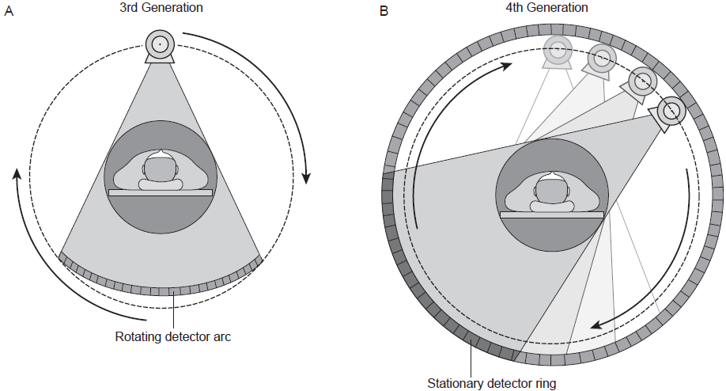
Methods of Data Acquisition.
Single-detector row scanners have many detectors situated in an arc (third-generation) or a ring (fourth-generation).
BMID_II

Slide 10
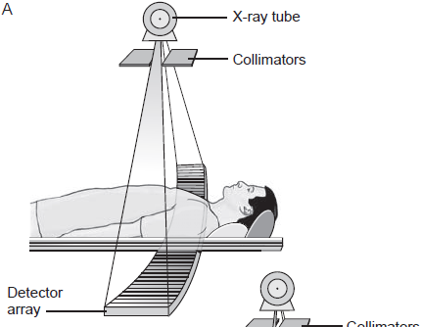

Methods of Data Acquisition.
In single-detector row systems, each gantry rotation produces data for a single slice.
To calculate the area of patient anatomy to be covered, multiply the slice increment by the number of slices acquired.
If slices are contiguous, the slice increment will be equal to the slice thickness.
For example, in an abdomen examination with contiguous 5-mm slices from the diaphragms to the iliac crest, 40 images would be required if the total z distance to be scanned is 200 mm (40 images × 5 mm).
BMID_II

Slide 11
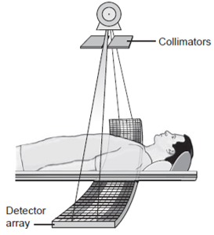
Methods of Data Acquisition.
The Multidetector Row Systems
In multidetector row (MDCT) scanners, use multiple detector elements in parallel rows (4 to 64, or higher).
MDCT systems can produce multiple slices in a single rotation, providing longer and faster z-axis coverage.
Increased gantry rotation speed in MDCT systems further enhances volume coverage per unit time.
Slice thickness is determined by the x-ray beam width and the detector configuration.
BMID_II

Slide 12
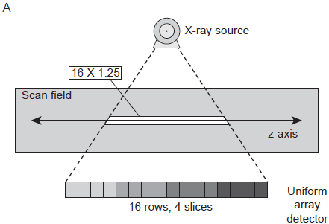
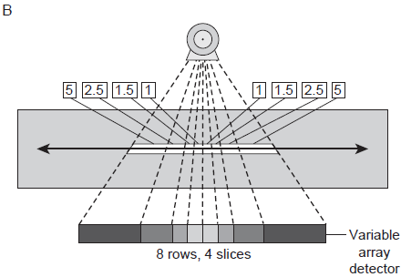
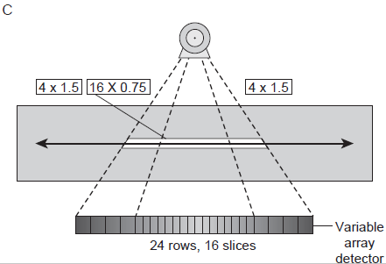
Methods of Data Acquisition.
MDCT systems emit a cone beam radiation from the collimated x-ray source.
Multiple detector channels can be used for axial or helical data acquisitions.
Depending on the scanner manufacturer and the number of detector rows, the parallel rows may be of equal size (uniform array) or variable, with thinner rows centrally and wider rows peripherally (adaptive arrays or hybrid arrays).
In some MDCT systems,
the width of the detector rows is uniform (A).
In others, the width of the detector row is variable,
with the rows thinner in the center and wider
at the periphery (B, C).
BMID_II

Slide 13
Methods of Data Acquisition.
The MDCT systems capable of acquiring four simultaneous slices feature multiple parallel rows of detector elements (as thin as 1 mm) that can be combined to yield four contiguous slices per gantry rotation.
The parallel rows can be thought of as dividing the detector into segments in the z axis, with the size and number of segments determining slice thickness and the number of slices acquired simultaneously.
For a given slice thickness, this configuration results in a fourfold increase in the volume of data acquired in a single rotation compared to SDCT.
Scanners with four data acquisition channels have more than four parallel rows of detectors, allowing for scanning with various slice thicknesses.
For example, the General Electric Lightspeed QX/I scanner system uses 16 detector rows, each 1.25 mm wide, arranged side-by-side, and aligned along the z-axis.
BMID_II

Slide 14
Methods of Data Acquisition.
These rows can be combined in various configurations to produce four slices with different thicknesses.
Using one detector row per slice results in 1.25 mm thick slices.
Grouping two detector rows together yields 2.5 mm thick slices, while three rows create 3.75 mm thick slices.
Utilizing all 16 detectors in groups of four generates 5 mm thick slices.
The slice thickness in MDCT is influenced not only by x-ray beam collimation but also by the width of the detectors in the z-axis dimension.
Altering the slice width involves combining different numbers of detector elements, with electronic signals from adjacent detectors being summed when combined.
BMID_II

Slide 15
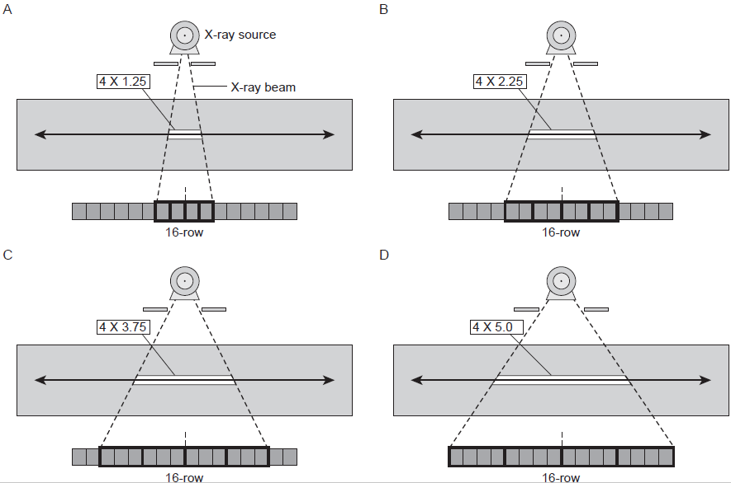
Methods of Data Acquisition.
BMID_II

Slide 16
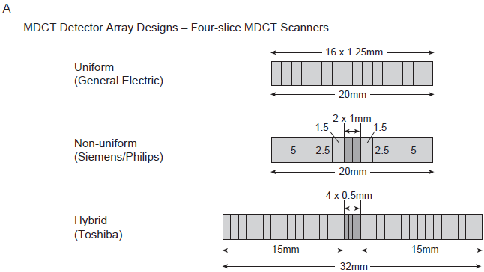
Methods of Data Acquisition.
BMID_II

Slide 17
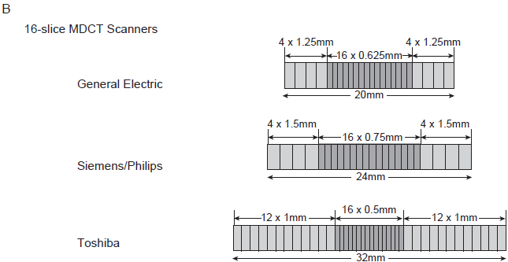
Methods of Data Acquisition.
BMID_II

Slide 18
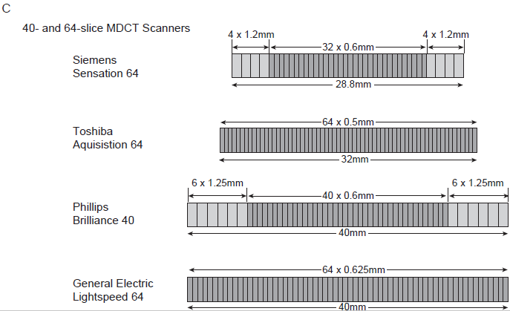
Methods of Data Acquisition.
BMID_II

Slide 19
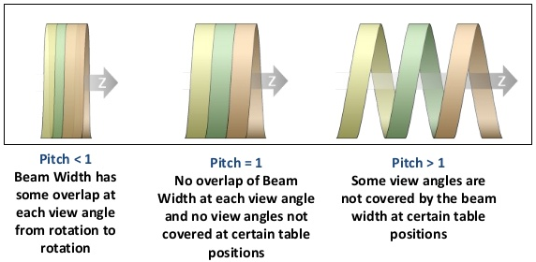
Methods of Data Acquisition.
The Pitch
Pitch is a parameter that is commonly used to describe the CT table movement during a helical scan.
It is most commonly defined as the travel distance of the CT scan table per 360° rotation of the x-ray tube, divided by the x-ray beam collimation width.
When the table feed and beam collimations are identical, pitch is 1. When the table feed is less than the beam collimation, pitch is less than 1 and scan overlap occurs.
BMID_II

Slide 20
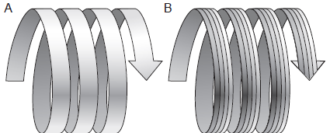
Methods of Data Acquisition.
The Pitch in MDCT Systems
In MDCT, the pitch is commonly defined as beam pitch.
Beam pitch can be defined as table movement per rotation divided by beam width. The beam width can be determined by multiplying the number of slices by slice thickness.
For example, with a 4-slice MDCT at 4 × 1.25-mm slice thickness and a table feed of 6 mm per rotation, the pitch is 1.2.
6/(4 X 1.25) = 6/5 = 1.2
With a 64-slice MDCT at 64 × 0.5-mm slice thickness and a table-feed of 48 mm per rotation, the pitch again is 1.5.
48/(64 X 0.5) = 48/32 = 1.5
BMID_II

Slide 21
Methods of Data Acquisition.
The Distance Covered in an MDCT Helical Scan Sequence
(Pitch X total acquisition time) X (1/rotation time) X (slice thickness X slices per rotation) = amount of anatomy covered
Example:
A helical scan with a 20-second total acquisition time, a 0.5-second rotation time, a 2.5-mm slice thickness, 4 slices per rotation, with a pitch of 1.2.
(1.2 X 20s) X (1/0.5s) X (2.5mm X 4) = 480 mm of anatomy covered.
BMID_II

Slide 22

BMID_II

