Slide 1



Al-Mustaqbal University
College of Engineering and Technical Technologies
Biomedical Engineering Department
Subject: Biomedical Instrumentation Design_II.
Class (code): 5th (MU0115202)
Lecture: 1
BMID_II

Slide 2
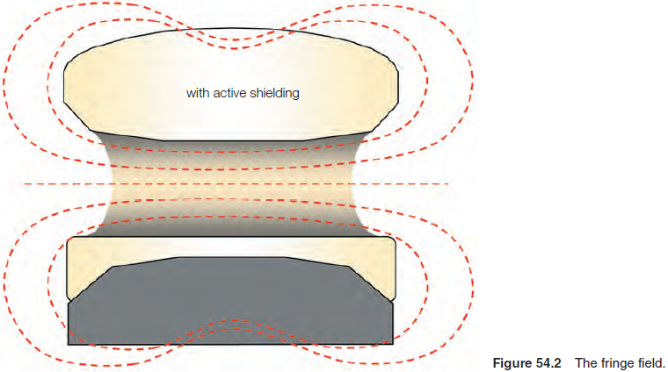
MRI Design: MR safety – bio-effects
Static magnetic field bio-effects
Current guidelines recommend a maximum limit of 8T for clinical imaging, rising to 12T for research purposes and spectroscopy. Most clinical units operate below 3T.
The static field is always present (24 hours a day, 365 days a year, to infinity). It is switched on even when the system is out of use.
The fringe field may extend several metres beyond the examination room and therefore any harmful effects or risks may come into play at some distance from the scanner.

Slide 3
MRI Design: MR safety – bio-effects
Static magnetic field bio-effects
There is no conclusive evidence for irreversible or harmful bio-effects in humans below 2.5T.
Reversible abnormalities may include:
an increase in the amplitude of the T-wave that can be noted on an ECG due to the magnetic hydrodynamic effect (also known as the magnetic haemodynamic effect);
heating of patients; fatigue; headaches; hypotension; irritability.

Slide 4
MRI Design: MR safety – bio-effects
Time-varying field bio-effects
Gradients create a time-varying magnetic field. This changing field occurs during the scanning sequence.
The health consequences are related to the changes in the magnetic field that cause induced currents. Nerves, blood vessels and muscles, which act as conductors in the body, may be affected.
The induced current is greater in peripheral tissues, since the amplitude of the gradient is higher away from magnetic isocentre.
Time-varying bio-effects from gradient coils include:
• light flashes in the eyes; • alterations in the biochemistry of cells and fracture union;
• mild cutaneous sensations; • involuntary muscle contractions; • cardiac arrhythmias.

Slide 5
MRI Design: MR safety – bio-effects
Time-varying field bio-effects
RF transmit coils also produce time-varying fields.
The predominant bio-effect of RF irradiation absorption is the potential heating of tissue.
As an excitation pulse is applied, some nuclei absorb the RF energy and enter the high-energy state.
As they relax, nuclei give off this absorbed energy to the surrounding lattice.
Energy dissipation described by the specific absorption rate or SAR. SAR is expressed in watts per kilogram (W/kg), a quantity that depends on:
• induced electrical field; pulse duty cycle; tissue density; conductivity; the size of the patient.

Slide 6
MRI Design: MR safety – bio-effects
Time-varying field bio-effects
SAR is used to calculate an expected increase in body temperature during an average examination.
In the UK, it is recommended that this should not exceed 1°C during the examination.
As body temperature increases, blood pressure and heart rate also increase slightly.
Even though these effects seem insignificant, patients with compromised thermoregulatory systems may not be candidates for MRI.
Equipment used in MRI, such as ECG leads and surface coils, should therefore be employed with extreme caution. When using a surface coil, the operator must be careful to prevent any electrically conductive material (e.g. cable of surface coil) from forming a ‘conductive loop’ with itself or with the patient.

Slide 7
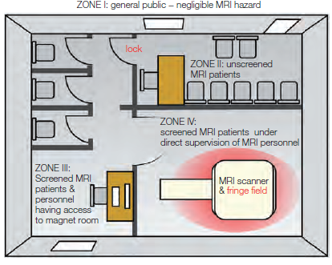
MRI Design: MR safety – bio-effects
Site planning
It is vital that access to the MRI system and the magnetic field is controlled.
The American College of Radiologists recommends that all centres define the following zones.
Zone I includes all areas that are accessible to the public. All personnel are allowed in Zone I.

Slide 8
MRI Design: MR safety – bio-effects
Site planning
Zone II is the interface between Zone I and the controlled Zone III. There must be a lock or warning signs between Zones I and II. All personnel are allowed in Zone II, but there should be a trained ‘gate-keeper’ to keep patients and non-MR personnel from inadvertently entering Zones III and IV.

Slide 9
MRI Design: MR safety – bio-effects
Site planning
Zone III is strictly restricted because free access by unscreened personnel and ferromagnetic objects may cause death or serious injury. This area must be strictly monitored and only MR-trained personnel and screened patients are permitted in this area.

Slide 10
MRI Design: MR safety – bio-effects
Site planning
Zone IV is only suitable for screened patients under direct and constant supervision from MR-trained personnel, as death and serious injury can occur. The patient may also experience heating, missile effects, RF antenna effects and anoxia in this zone.

Slide 11
MRI Design: MR safety – projectiles
The projectile effect of a metal object exposed to the field can seriously compromise the safety of anyone sited between the object and the magnet system.
Small objects (like paperclips and hairpins) have a terminal velocity of 40 mph when pulled into a 1.5T magnet. Larger objects (like scissors) travel at much higher velocities and may be fatal to any person in their path.
Many types of clinical equipment are ferromagnetic and should never be brought into the scan room. These include surgical tools, scissors, clamps and oxygen tanks.

Slide 12
MRI Design: MR safety – projectiles
If an accident occurs where a patient or other person in the scan room is pinned to the magnet by a projectile that cannot be removed by hand, the magnetic field must be immediately quenched.
Quenching is the process whereby there is a sudden loss of absolute zero of temperature in the magnet coils, so that they cease to be superconducting and become resistive.
Quenching can be initiated by pressing a quench button in the control room.
Quenching causes helium to escape from the cryogen bath extremely rapidly.
Quenching may cause severe and irreparable damage to the superconducting coils, and so all systems should have helium-venting equipment, which removes the helium to the outside environment in the event of a quench.
All scan rooms should contain an oxygen monitor that sounds an alarm if the oxygen falls below a certain level.

Slide 13
MRI Design: MR safety – projectiles
Metallic implants and prostheses
It is vital to check the type of device or implant and whether it is safe before booking the appointment.
Metallic implants and prostheses produce serious effects, which include torque or twisting in the field, heating effects and artefacts on MR images.
While non-ferrous metallic implants may show little or no deflection to the field, they could cause significant heating due to their inability to dissipate the heat caused by radiofrequency absorption.
Devices that might need to be taken into the scan room must be tested beforehand. There are standard labels depending on whether the device is safe, unsafe or conditional on the field strength

Slide 14
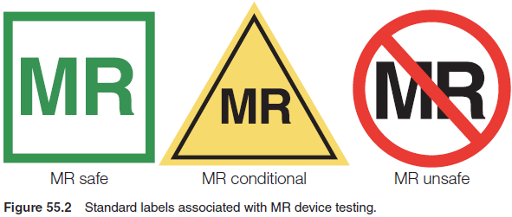
MRI Design: MR safety – projectiles

Slide 15
MRI Design: MR safety
What is not safe to scan?
Cochlear implants are attracted to the magnetic field and are magnetically or electronically activated.
Patients who have worked with sheet metal to have metal fragments or slivers located in and around the eye
Aneurysm clip motion may damage the vessel, resulting in haemorrhage, ischaemia or death
Intracranial clips also cause severe magnetic susceptibility artefact, especially in gradient echo sequences

Slide 16
MRI Design: MR safety
What is probably safe to scan?

Slide 17
The MRI Design has just started but after graduation!!!

