Slide 1



Al-Mustaqbal University.
College of Engineering and Technologies.
Biomedical Engineering Department.
Subject: Biomedical Instrumentation Design_II.
Class (code): 5th (MU0115202).
Lecture: 2 and 3..
BMID_II

Slide 2
Computed Tomography
Conventional radiographs depict a three-dimensional object as a two-dimensional image. Another limitation of the conventional radiograph is its inability to distinguish between two tissues with similar densities.
This results in overlying tissues being superimposed on the image, a major limitation of conventional radiography.
Computed tomography (CT) overcomes this problem by scanning thin sections of the body with a narrow x-ray beam that rotates around the body, producing images of each cross section. The unique physics of CT allow for the differentiation between tissues of similar densities.
The main advantages of CT over conventional radiography are in the elimination of superimposed structures, the ability to differentiate small differences in density of anatomic structures and abnormalities, and the superior quality of the images.

Slide 3
Computed Tomography
CT image quality is typically evaluated using a number of criteria:
Spatial resolution describes the ability of a system to define small objects distinctly.
Low-contrast resolution refers to the ability of a system to differentiate, on the image, objects with similar densities.
Temporal resolution refers to the speed that the data can be acquired. This speed is particularly important to reduce or eliminate artifacts that result from object motion, such as those commonly seen when imaging the heart.

Slide 4
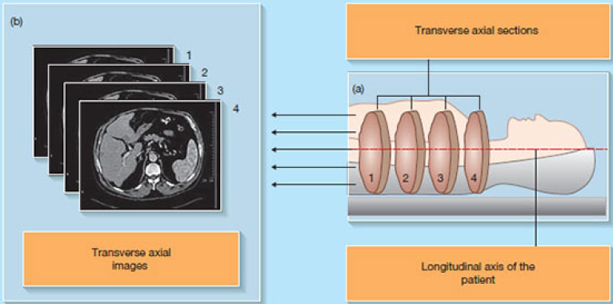
Computed Tomography
Computed tomography uses a computer to process information collected from the passage of x-ray beams through an area of anatomy.
The images created are cross-sectional.

Slide 5
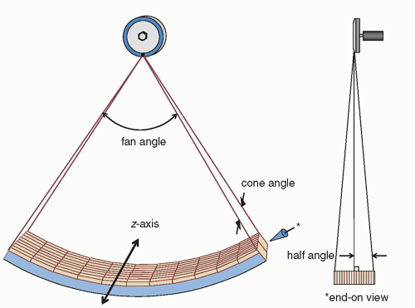
Computed Tomography
Each CT slice represents a specific plane in the patient’s body. The thickness of the plane is referred to as the Z axis, which determines the thickness of the slices.
The operator selects the thickness of the slice from the choices available on the specific scanner.
Selecting a slice thickness limits the x-ray beam so that it passes only through this volume; hence, scatter radiation and superimposition of other structures are greatly diminished.
Limiting the x-ray beam in this manner is accomplished by mechanical hardware that resembles small shutters, called collimators, which adjust the opening based on the operator’s selection

Slide 6
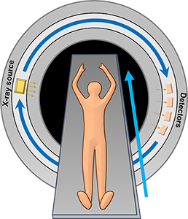
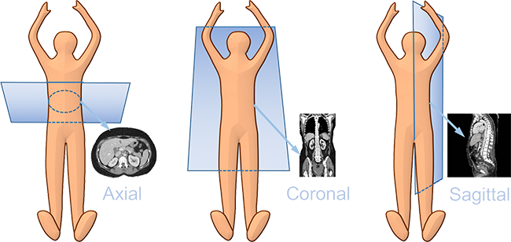
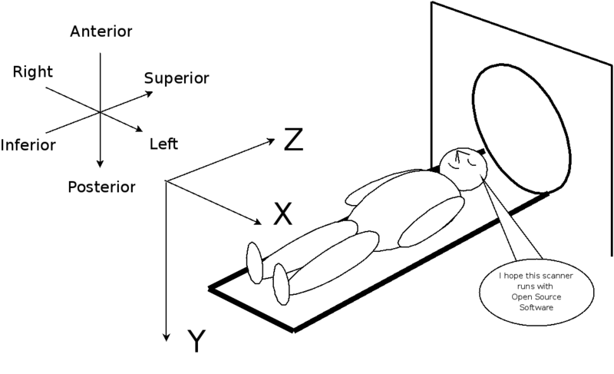
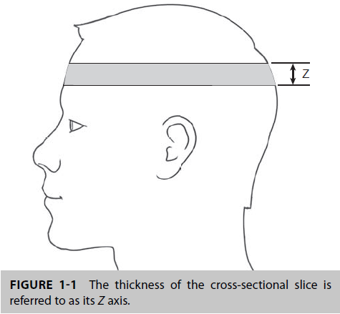
Computed Tomography

Slide 7
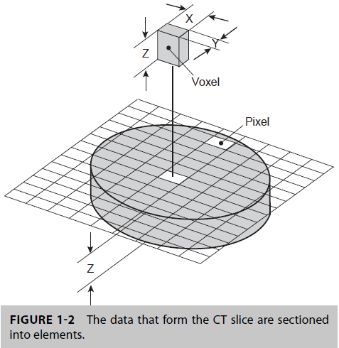
Computed Tomography
The data are further sectioned into elements: width is indicated by X, while height is indicated by Y. Each one of these two-dimensional squares is a pixel (picture element).
A composite of thousands of pixels creates the CT image that displays on the CT monitor.
If the Z axis is taken into account, the result is a cube, rather than a square. This cube is referred to as a voxel (volume element).

Slide 8
Computed Tomography
Beam attenuation
The structures in a CT image are represented by varying shades of gray.
The creation of these shades of gray is based on basic radiation principles.
An x-ray beam consists of bundles of energy known as photons. These photons may pass through or be redirected (i.e., scattered) by a structure, or my be may be absorbed by a given structure in varying amounts, depending on the strength (average photon energy) of the x-ray beam and the characteristics of the structure in its path.
The degree to which a beam is reduced is a phenomenon referred to as attenuation.

Slide 9
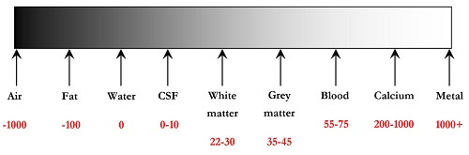
Computed Tomography
In CT, the x-ray beam passes through the patient’s body and is recorded by the detectors. The computer then processes this information to create the CT image.
The quantities of x-ray photons that pass through the body determine the shades of gray on the image.
X-ray photons that pass through objects unimpeded are represented by a black area on the image (the areas having low attenuation). While an X-ray beam that is completely absorbed by an object cannot be detected, the place on the image is white (the areas having high attenuation).
Areas of intermediate attenuations are represented by various shades of gray.
The number of the photons that interact depends on the thickness, density, and atomic number of the object.

Slide 10
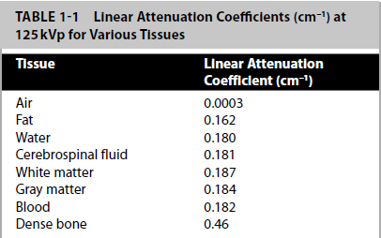
Computed Tomography
The amount of the x-ray beam that is scattered or absorbed per unit thickness of the absorber is expressed by the linear attenuation coefficient, represented by the Greek letter µ.
For example, if a 125-kVp x-ray beam is used, the linear attenuation coefficient for water is approximately 0.18 cm⁻¹. This means that about 18% of the photons are either absorbed or scattered when the X-ray beam passes through 1 cm of water.

Slide 11
Computed Tomography
In general, the attenuation coefficient decreases with increasing photon energy and increases with increasing atomic number and density.
If the kVp is kept constant, the linear attenuation coefficient will be higher for bone than it would be for lung tissue.
That is, bone attenuates more of the x-ray beam than does lung, allowing fewer photons to reach the CT detectors.
Ultimately, this results in an image in which bone is represented by a lighter shade of gray than that representing lung.
The CT image is a direct reflection of the distribution of linear attenuation coefficients. For soft tissues, the linear attenuation coefficient is roughly proportional to physical density.
For this reason, the values in a CT image are sometimes referred to as density.

Slide 12
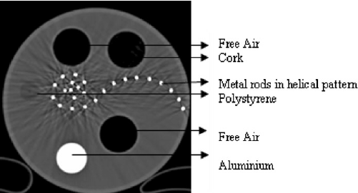
Computed Tomography
Metals are generally quite dense and have the greatest capacity for beam attenuation.
Consequently, surgical clips and other metallic objects are represented on the CT image as white areas.
Air (gas) has very low density, so it has little attenuation capacity.
Air-filled structures (such as lungs) are represented on the CT image as black areas.

Slide 13
Computed Tomography
HOUNSFIELD UNITS
In CT, the beam attenuation capability of a given object can be quantified. Measurements are expressed in Hounsfield units (HU). These units are also referred to as CT numbers, or density values.
Hounsfield arbitrarily assigned distilled water the number 0.
He assigned the number 1000 to dense bone and −1000 to air.
Objects with a beam attenuation less than that of water have an associated negative number. Conversely, substances with an attenuation greater than that of water have a proportionally positive Hounsfield value.

Slide 14
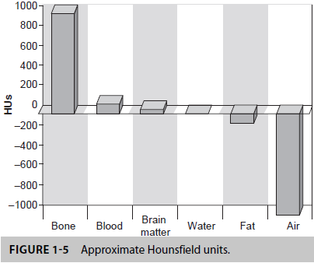
Computed Tomography
The Hounsfield unit of naturally occurring anatomic structures fall within this range of 1000 to −1000.
The Hounsfield unit value is directly related to the linear attenuation coefficient: 1 HU equals a 0.1% difference between the linear attenuation coefficient of the tissue as compared with the linear attenuation coefficient of water.

Slide 15
Computed Tomography
Example of Hounsfield Units and Linear Attenuation Coefficient:
For a CT scan image of a head, when comparing the density of the brain tissue to the skull bone. Here's how the Hounsfield unit (HU) and linear attenuation coefficient (µ) come into play:
Linear Attenuation Coefficient:
  The skull bone has a higher µ than brain tissue because it's denser and absorbs more X-rays. Let's say the µ of skull bone is 0.20 cm⁻¹.
  Brain tissue is less dense and absorbs fewer X-rays, so its µ might be 0.18 cm⁻¹.
Hounsfield Unit Conversion:
  Each 1 HU represents a 0.1% difference in µ compared to water (µ_water ≈ 0.00096 cm⁻¹).
  For the skull bone:
  Difference in µ compared to water: 0.20 cm⁻¹ - 0.00096 cm⁻¹ ≈ 0.19904 cm⁻¹
  Percentage difference: (0.19904 cm⁻¹ / 0.00096 cm⁻¹) * 100% ≈ 20712.5%
  Hounsfield units: 20712.5% / 0.1% = 207125 HU (rounded)
  For the brain tissue:
  Difference in µ compared to water: 0.18 cm⁻¹ - 0.00096 cm⁻¹ ≈ 0.17904 cm⁻¹
  Percentage difference: (0.17904 cm⁻¹ / 0.00096 cm⁻¹) * 100% ≈ 18629.17%
  Hounsfield units: 18629.17% / 0.1% ≈ 186292 HU (rounded)

Slide 16
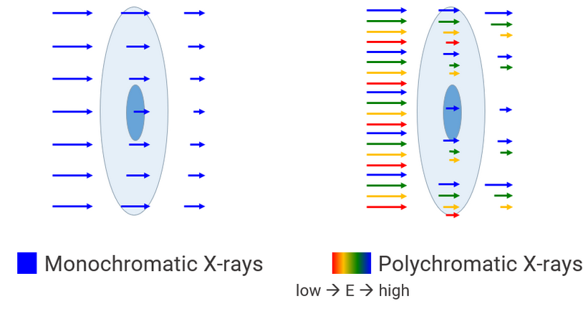
Polychromatic X-Ray Beam
Polychromatic X-Ray energy: the x-ray beam comprises photons with varying energies ranging from weak x-ray photons to others that are relatively strong.
Low-energy X-ray photons are more readily attenuated by the patient, producing artifacts on the image, which degrade the image quality.
Artifacts that result from preferential absorption of the low energy photons, which leaves higher-intensity photons to strike the detector array, are called beam-hardening (cupping) artifacts.

Slide 17
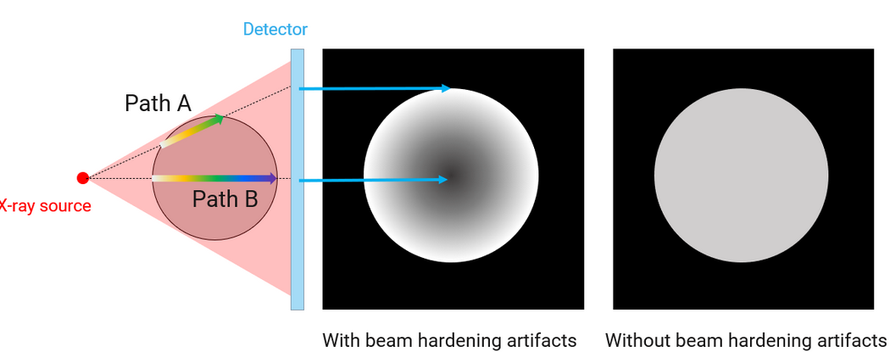
Polychromatic X-Ray Beam
Filtering the x-ray beam with Teflon or aluminum, helps to reduce the range of x-ray energies that reach the patient by eliminating the photons with weaker energies and makes the beam more homogeneous.
Creating a beam intensity that is more uniform improves the CT image by reducing artifacts.
Additionally, filtering the soft (low-energy) photons reduces the radiation dose to the patient.

Slide 18
Volume Averaging
All CT examinations are performed by obtaining data for a series of slices through a designated area of interest (the anatomy and the pathology).
Scanners allow the technologist to select slice thickness,
Generally, the smaller the object being scanned, the thinner the CT slice required. Thicker CT slices increase the likelihood of missing very small objects.
For example, if 10-mm slices are created, the area of pathologic tissue measures just 2mm, normal tissue represents 8mm and is averaged in with the pathologic tissue, potentially making the pathologic tissue less apparent on the image.
This process is referred to as volume averaging, or partial volume effect.
The volume averaging refers to the phenomenon where the reconstructed CT image represents an average value for a particular volume element (voxel) rather than the exact density of a specific material within that voxel. This happens because the X-ray beam used in CT scanning interacts with all materials within the voxel, not just a single point.

Slide 19
Volume Averaging
How volume averaging works:
During a CT scan, the X-ray beam penetrates the patient and is attenuated (weakened) by the tissues it encounters.
The CT scanner measures the attenuation and reconstructs an image based on these measurements.
However, the X-ray beam doesn't interact with a single point but rather with a small volume of tissue at each location.
This volume, known as the voxel, is the basic unit of information in a CT image.
If the voxel contains multiple tissue types with different densities (e.g., bone and muscle), the measured attenuation will reflect an average of their properties.

Slide 20
Volume Averaging
The impact of volume averaging :
It can blur the boundaries between tissues with different densities, making it difficult to distinguish fine details in the image.
It can lead to inaccuracies in measured densities, especially for small structures or those with a mix of different materials within the voxel.
Factors affecting volume averaging:
Voxel size: Smaller voxels minimize volume averaging but require higher radiation doses and longer scan times.
Tissue composition: Mixing of materials with different densities within a voxel leads to greater averaging.
X-ray beam energy: Lower energy X-rays experience more interaction with tissue, hence more averaging.

Slide 21
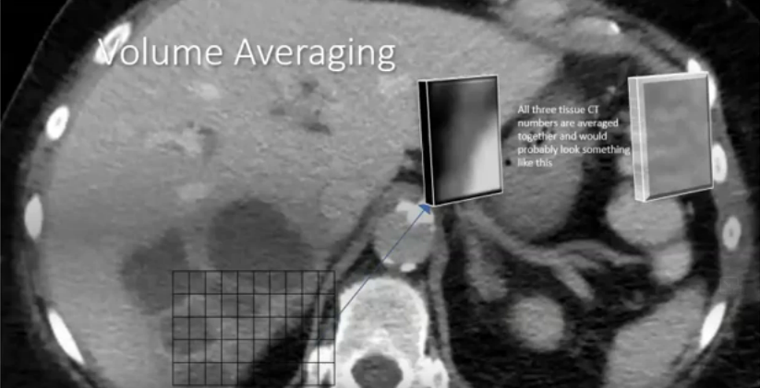
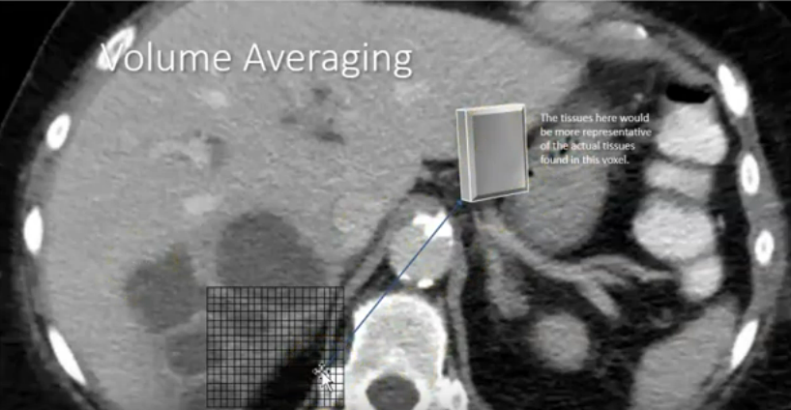
Volume Averaging

Slide 22
Volume Averaging
Thinner slices result in a higher radiation dose to the patient.
If the scanned area is too large, a huge number of slices are produced.
Scanning procedures are designed to provide the image quality necessary for diagnosis at an acceptable radiation dose.
Generally, if the structures being investigated are very small (coronary arteries, for example) and the region to be scanned is not extensive (the heart versus the entire abdomen), then slice thickness can be quite thin.
if the structures being investigated are in along anatomical region (e.g. abdomen), then slice thickness can be 5 to 7 mm.

Slide 23
Volume Averaging: X and Y
The larger the X and Y dimensions (i.e., the larger the pixel), the more chance that the pixel will contain tissues of different densities.
Because the Hounsfield unit of a single pixel is the average of all data measurements within that pixel, this type of averaging can lead to inaccuracies in the image.
For example, imagine a pixel that contains equal parts calcium (measuring 600 HU) and lung tissue (measuring −600 HU).
The resulting density of the specific pixel is the average of the two tissues, or 0 HU.

Slide 24
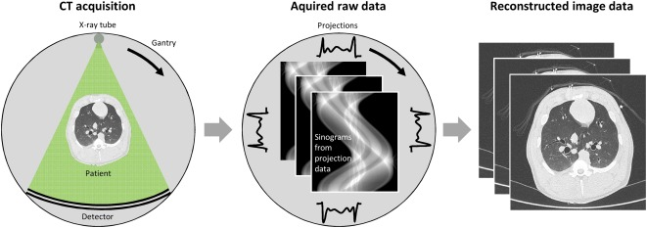
Raw Data and Image Data
Raw data: All of the thousands of bits of data acquired by the system with each scan.
Image reconstruction: creating an image by assigning a Hounsfield unit value for each pixel of the raw data to create an image.
Image data: the data included in the image are referred to as image data.
Prospective reconstruction: the reconstruction that is automatically produced during scanning.
Retrospective reconstruction: the same raw data may be used later to generate new images.

Slide 25
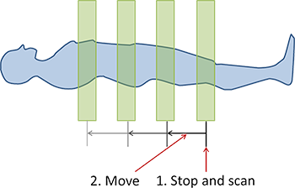
Scanning modes: step and shot
In this modes:
1) the x-ray tube rotated 360° around the patient to acquire data for a single slice.
2) the motion of the x-ray tube was halted while the patient was advanced on the CT table to the location appropriate to collect data for the next slice.
3) steps one and two were repeated until the desired area was covered.
The gantry motion had to be stopped before the next slice could be taken.

Slide 26
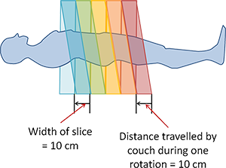
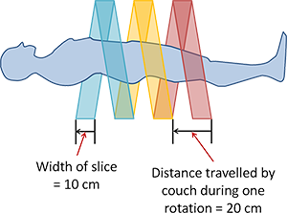
Scanning modes: Helical (Spiral)
In 1990 the development of a continuous acquisition scanning mode is allowed and most often called spiral or helical scanning.
Key among the advances was the development of a system that eliminated the cables and thereby enabled continuous rotation of the gantry.
This, in combination with other improvements, allowed for uninterrupted data acquisition that traces a helical path around the patient.

Slide 27
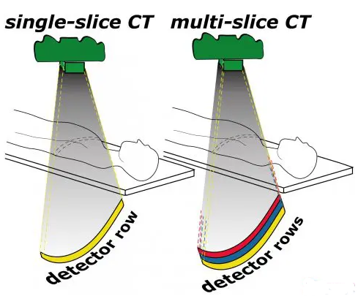
Multidetector Scanner
The first helical scanners emitted x-rays that were detected by a single row of detectors, yielding one slice per gantry rotation.
Further improvements equipped scanners with multiple rows of detectors, allowing data for many slices to be acquired with each gantry rotation.

Slide 28
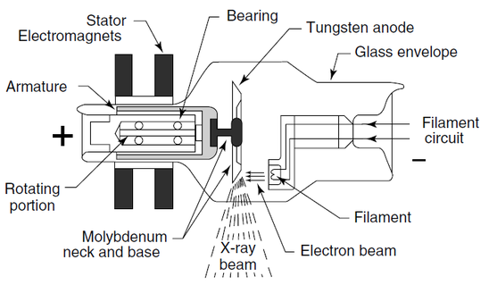
Overview of CT System

Slide 29
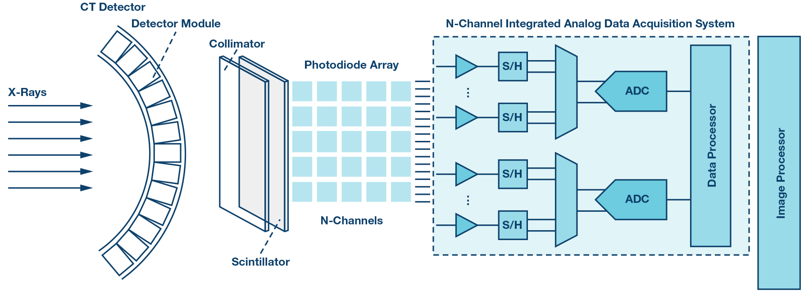
Overview of CT System

