Slide 1



Al-Mustaqbal University.
College of Engineering and Technologies.
Biomedical Engineering Department.
Subject: Biomedical Instrumentation Design_II.
Class (code): 5th (MU0115202).
Lecture: 9.
BMID_II

Slide 2
CT Informatics
Informatics: the collection, classification, storage, retrieval, and dissemination of recorded information.
Imaging informatics is a subspecialty that is vital to radiology and is devoted to how information about medical images is exchanged within the radiology departments and throughout the medical enterprise.
Hospital information systems (HIS) focus on administrative issues, such as patient demographic data, financial data, and patient locations within the hospital.
Clinical information systems (CIS) may be integrated into the HIS, but are often separate systems that keep track of clinical data.
Individual facilities may also have a computerized physician (or provider) order entry (CPOE) system that electronically transmits clinician orders to radiology and other departments.

Slide 3
CT Informatics
A generic term for a digital patient record is electronic health record or EHR. These are often composed of electronic medical records (EMR) from a variety of sources, including radiology. However, in general usage, EHR and EMR are used synonymously.
Within the radiology department two key elements form the information infrastructure. First is the radiology information system (RIS).
The RIS is most often designed for scheduling patients, storing reports, patient tracking, protocoling examinations, and billing.
The RIS should have two-way communication with both the HIS and the CIS.
Ideally, the RIS ties together all the computer systems within the radiology department.
The second key element is the imaging network, most often called the picture archive and communication system (PACS).

Slide 4
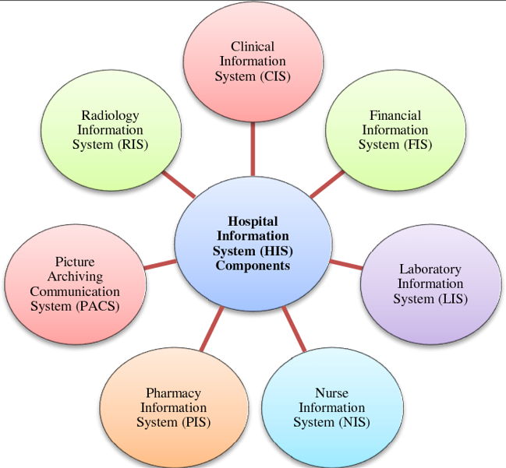
CT Informatics
PACS encompasses a broad range of technologies necessary for the storage, retrieval, distribution, and display of images.
MDCT data sets result in higher-resolution images that aid in more accurate diagnosis, but present significant challenges in how the images are handled after they are acquired.
For example, it is not uncommon
For a coronary study to produce
well over two thousand images.

Slide 5
PACS Fundamentals
PACS is used to refer to a broad range of technologies that enable digital radiology.
Using a computer network, the PACS technology allows the integration of image acquisition devices, display workstations, and storage systems.
Physicians can allow easy remote access to the images of their patients, improving turnaround times and patient care.
PACS can also provide an excellent resource for education, statistical analysis, and research.
To be included in a PACS, images must be in a digital form. CT, like magnetic resonance imaging (MRI) and positron emission tomography (PET), is intrinsically digital.
All other modalities (i.e., nuclear medicine, ultrasound, conventional radiography, angiography, and mammography) have been modified to allow direct digital image capture.

Slide 6
PACS Fundamentals
The necessary component of any PACS is a skilled team of information technology (IT) personnel to keep the PACS running smoothly.
These individuals must possess a thorough understanding of the technology so that they can be relied on to troubleshoot most problems.
Technologists should become familiar with the basic elements of the PACS: networking, digital image format standards, image acquisition, workstations, data storage, and image distribution.
Computer networks are fundamental to the success of a PACS because they regulate the movement of data and directly affect all users.
Network problems can mean that technologists are unable to send images, radiologists are unable to interpret studies, and referring clinicians are unable to access images or reports.

Slide 7
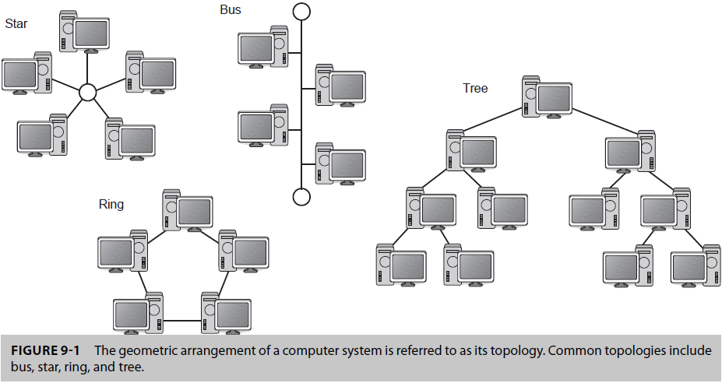
Networks
There are many different types and configurations of computer networks,. Linked computers that are geographically close together (i.e., in the same building) are often called local area networks, or LANs. Computers that are farther apart and must be connected by telephone lines, cables, or radio waves are called wide area networks, or WANs.
The geometric arrangement of a computer system is referred to as its topology. Common topologies include bus, star, ring, and tree. A LAN can be a combination of these types of topologies.

Slide 8
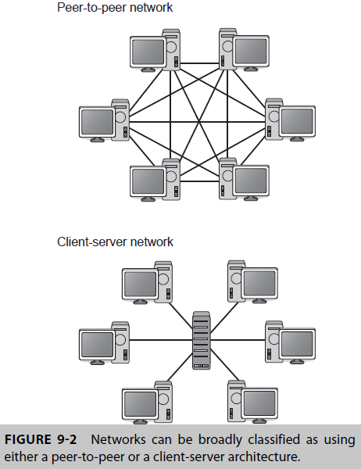
Networks
Networks can be broadly classified into:
In Peer-to-peer (or P2P) networks, each party has the same capabilities, and any party can initiate communication. P2P networks exploit the diverse connectivity and the cumulative data capacity of network participants rather than using a centralized resource.
Client-server architecture: computers in this models are classified as servers or clients.

Slide 9
Networks
A server is a computer that facilitates communication between and delivers information to other computers.
The server acts on requests from other networked computers rather than from a person inputting directly into it. Servers are passive; that is, they wait for requests from clients.
A server typically accepts connections from a large number of clients.
End-users interact directly with client computers to send data requests to one or more connected servers.
The servers then accept the requests, process them, and supply the requested information to the client. Clients usually connect to a small number of servers at one time.
Each client or server in the network may also be referred to as a node.
The server computers that are integral to the functioning of the PACS are referred to as core servers.

Slide 10
Networks
The routing mechanisms (Bridging, switching, routers, and hubs) have a significant impact on eliminating bottlenecks and allowing data to flow smoothly and rapidly to all users in the network.
Network bandwidth: The amount of data that can be transmitted between two points in the network in a set period of time, commonly expressed in bits per second; one million bits is known as a megabit and denoted as 1 Mb.
Bandwidth represents the capacity of the network connection and is primarily dependent on the transmission medium (e.g., copper wires, fiberoptics, wireless).
The greater the capacity, the more likely that greater performance will follow.
Overall network performance also depends on other factors, such as the number of computers sharing the same bandwidth. The time required for an image to be sent from a PACS server to a workstation depends greatly on the bandwidth of the network infrastructure and the number of simultaneous requests from users on the network.

Slide 11
Networks
Image data can be compressed to make transmission more efficient, requiring less bandwidth.
The goal of image compression is to minimize the size (in bytes) of an image file without degrading the quality of the image to an unacceptable level.
Image compression schemes can be lossless or lossy.
When a lossless scheme is used for compression, the image that is then decompressed is an exact replica of the original.
Lossy compression methods introduce compression artifacts because not all data are restored.
Lossy compression can be applied to an image without decreasing diagnostic accuracy. Therefore, many PACS use only lossless compression methods.
Lossy compression can be used to transmit images that do not need to be of diagnostic quality, referred to as “conversational” quality.

Slide 12

BMID_II

