Slide 1


Al-Mustaqbal University.
College of Engineering and Engineering Technologies
Biomedical Engineering Department
Subject: Biomedical Clinical issues of Biomedical
Engineering.
Class : 4th
Lecture: 1
BY: M.SC. Zainab Sattar Jabbar
BME

Slide 2
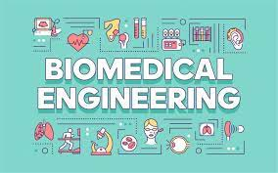
Clinical issues of Biomedical
Engineering
Biomedical Engineering
Biomedical engineers, apply electrical, mechanical, chemical, optical, and other engineering principles to understand, modify, or control biologic systems, as well as design and manufacture products that can monitor physiologic functions and assist in the diagnosis and treatment of patients. When biomedical engineers work within a hospital or clinic, they are more properly called clinical engineers.
BME

Slide 3
Activities of Biomedical Engineers
Application of engineering system analysis (physiologic modeling, simulation, and control) to biologic problems.
Detection, measurement, and monitoring of physiologic signals (i.e., biosensors and biomedical instrumentation).
Diagnostic interpretation via signal-processing techniques of bioelectric data.
Therapeutic and rehabilitation procedures and devices (rehabilitation engineering).
Devices for replacement or augmentation of bodily functions (artificial organs).
BME

Slide 4
Activities of Biomedical Engineers
Computer analysis of patient-related data and clinical decision making (i.e., medical informatics and artificial intelligence).
Medical imaging, that is, the graphic display of anatomic detail or physiologic function.
The creation of new biologic products (i.e., biotechnology and tissue engineering).
The development of new materials to be used within the body (biomaterials).
BME

Slide 5
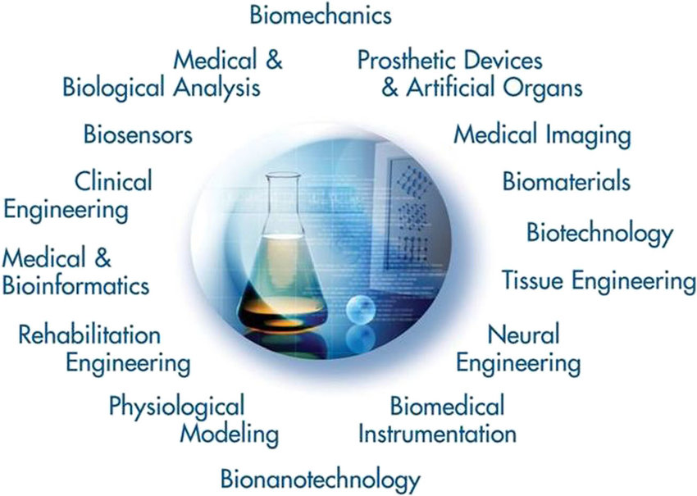
Biomedical Engineering
BME

Slide 6
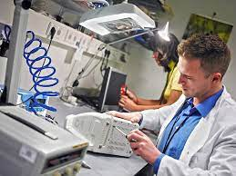
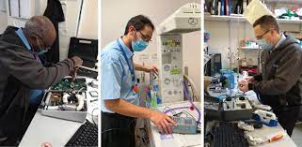
Who Is a Clinical Engineer?
A clinical engineer is a specialty within biomedical engineering responsible for using medical technology to optimize healthcare delivery. Clinical engineers are required to understand all modern medical technologies, as well as train, troubleshoot, and design entire clinical settings.
BME

Slide 7
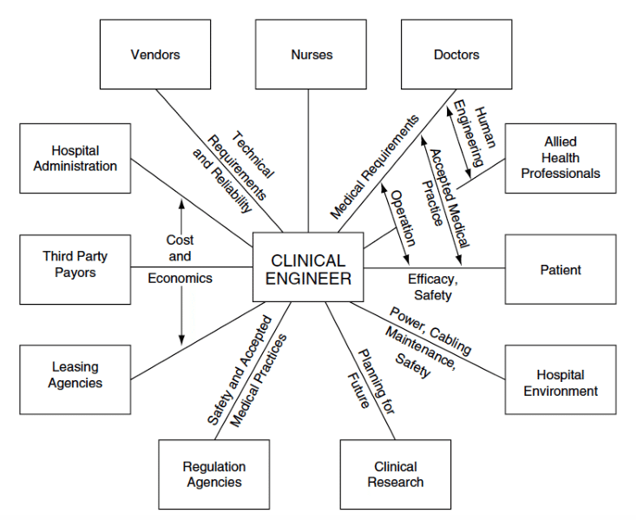
Clinical Engineer
BME

Slide 8
Typical pursuits of clinical engineers
Clinical engineers are responsible for ensuring that medical equipment is safe and effective.
They often work with doctors, nurses, and other healthcare professionals to design, develop, test, and implement new technologies or procedures.
Clinical engineers may also be tasked with maintaining existing equipment.
Pre-purchase evaluation and planning for new medical technology.
BME

Slide 9
Typical pursuits of clinical engineers
Design, modification, or repair of sophisticated medical instruments or systems.
Cost-effective management of a medical equipment calibration and repair service.
Inspection of all incoming equipment (i.e., both new and returning repairs).
Establishment of performance benchmarks for all equipment.
Medical equipment inventory control.
Coordination of outside engineering and technical services performed by vendors.
BME

Slide 10
Typical pursuits of clinical engineers
Clinical engineers thus provide extensive engineering services for the clinical staff and, in recent years, have been increasingly accepted as valuable team members by physicians, nurses, and other clinical professionals. Furthermore, the acceptance of clinical engineers in the hospital setting has led to different types of engineering–medicine interactions, which in turn have improved health care delivery.
BME

Slide 11
THANK YOU

