Slide 1
A practical lecture of
Capnography

Slide 2
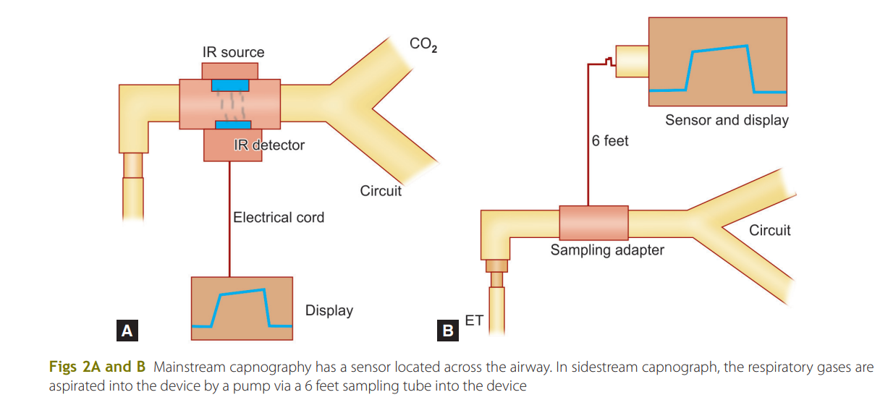

Slide 3
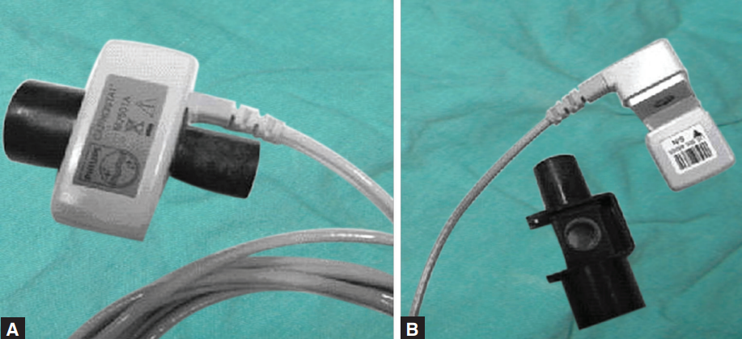

Slide 4
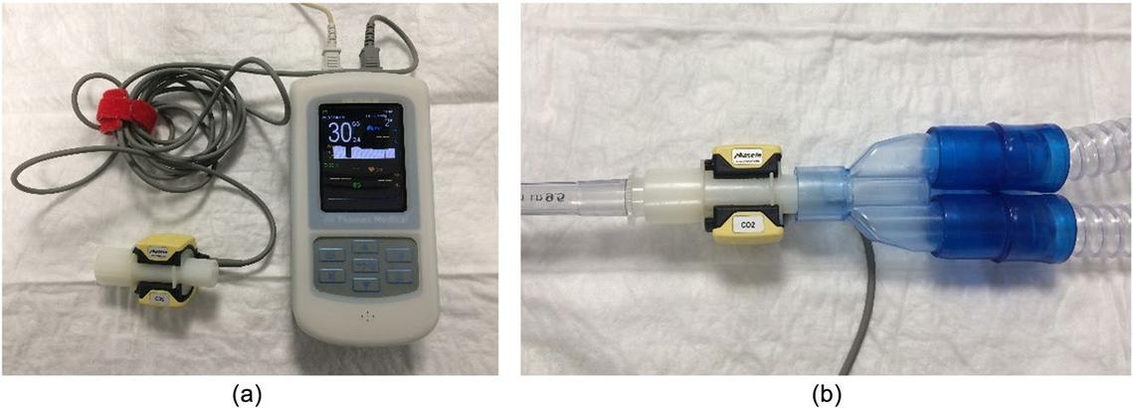

Slide 5
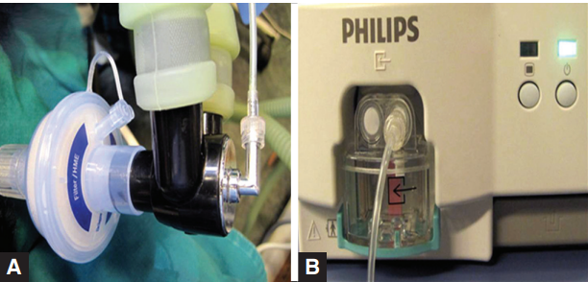

Slide 6
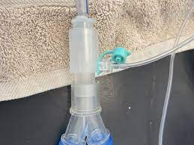


Slide 7
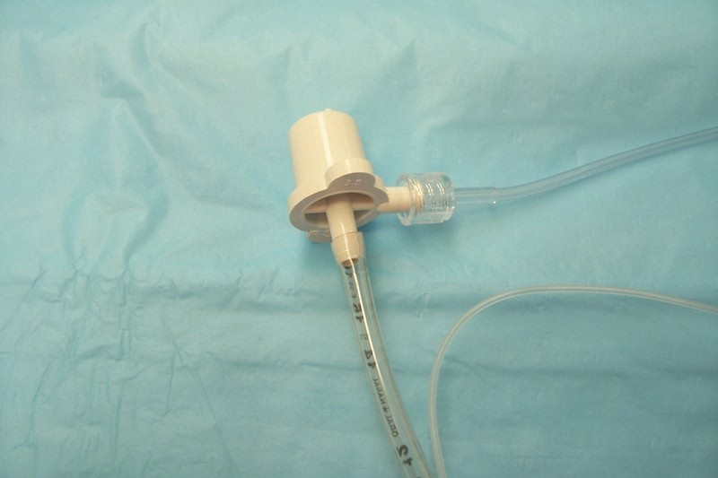
0

Slide 8
Mainstream | Sidestream
CO2 sensor is housed external to the breathing circuit | CO2 sensor is inserted between the breathing circuit and endotracheal tube
No gas removed from circuit | Gas is constantly aspirated from circuit via a 6 feet sampling tube into the unit containing CO2 sensor
ncrease in mechanical dead space | Minimal dead space
Waveform in real time | Waveform is delayed (1–4 seconds) due to transportation of gases from the patient’s airway to the unit containing the sensor

Slide 9
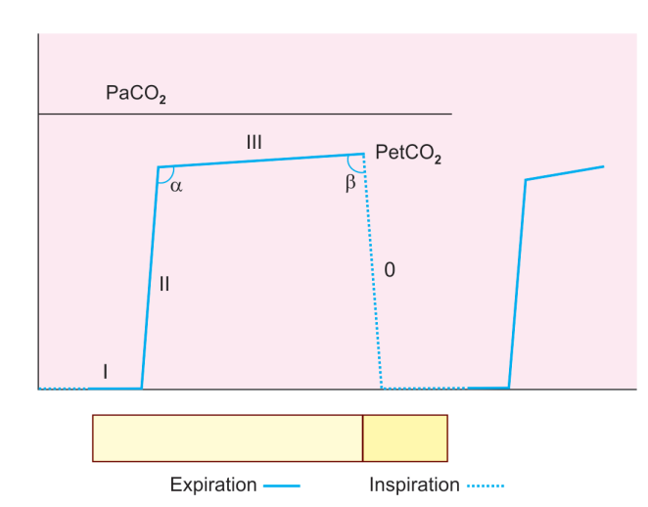

Slide 10
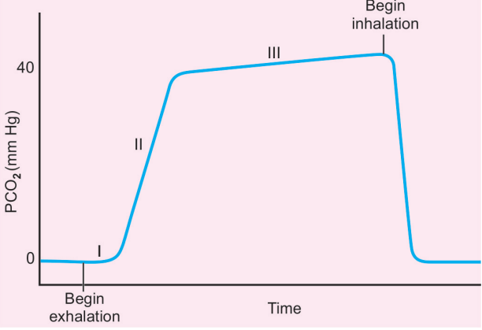

Slide 11
Time capnogram and its components.
Time capnogram showing segments, phases and angles.
The inspiratory segment is phase 0
The expiratory segment is divided into three phases: I, II, and III.
The maximum value of CO2 at the end of the breath is designated as end-tidal PCO2 (PetCO2). It is lower than arterial CO2 by about 5 mm Hg

Slide 12
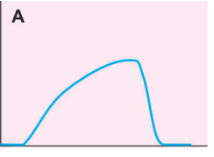
Prolonged phase II and steeper phase III suggestive of bronchospasm, or airway obstruction

Slide 13
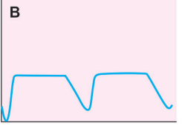
B. Expiratory valve malfunction resulting in elevation of the baseline This is due to rebreathing of expiratory gases from the expiratory limb during inspiration

Slide 14
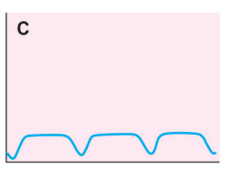
Inspiratory valve malfunction resulting in rebreathing of expired gases from inspiratory limb during inspiration

Slide 15
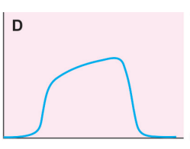
Capnogram with normal phase II but with an increased slope of phase III. Observed in pregnant subjects under general anesthesia.

Slide 16
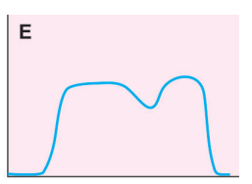
Patient is attempting to breathe during partial muscle paralysis. Surgical movements on the chest and abdomen can also result

Slide 17
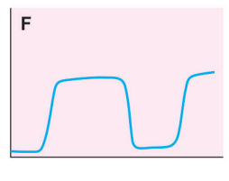
The baseline is elevated as a result of CO2 rebreathing

Slide 18
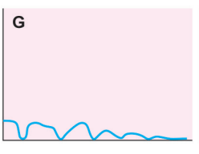
Esophageal intubation resulting in the gastric washout of residual CO2 and subsequent CO2 will be zero;

Slide 19
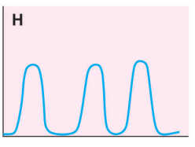
Spontaneously breathing capnograms where phase III is not well delineated

Slide 20
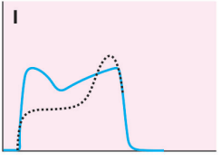
Dual capnogram in one lung transplantation patient. The first of peak of phase III is from the transplanted normal lung, whereas the second peak is from the native disease lung. A leak around the sidestream sensor port at the monitor can also result in a dual peaked capnogram. This is because of the dilution of expired PCO2 with atmospheric

Slide 21
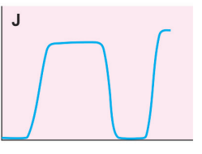
Malignant hyperpyrexia where CO2 is raising gradually with zero baseline suggesting increased CO2 production with CO2 absorption by the soda lime

Slide 22
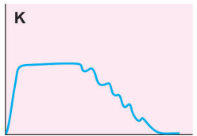
cardiogenic oscillations

Slide 23
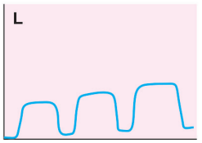
Sudden raise of baseline and the partial pressure of end-tidal carbon dioxide (PetCO2) due to contamination of the sensor with secretions or water vapor

Slide 24
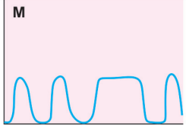
Intermittent mechanical ventilation (IMV) breaths in the midst of spontaneously breathing patient

Slide 25
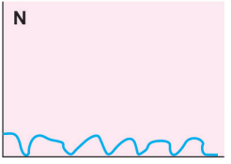
Cardiopulmonary resuscitation: Capnogram showing positive waveforms during each compression suggesting effective cardiac compression generating pulmonary blood

Slide 26
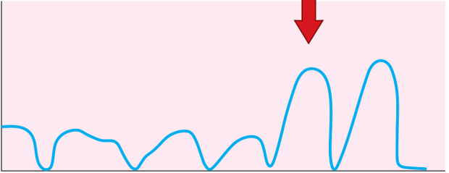
increase in partial pressure of end-tidal carbon dioxide (PetCO2) values suggest spontaneous return of circulation during cardiopulmonary resuscitation

Slide 27
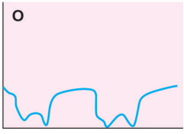
Capnogram showing rebreathing during inspiration.
This is normal in rebreathing circuits such as Mapelson D or Bain circuit

Slide 28
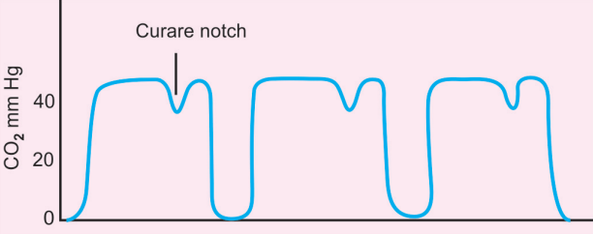
Home work

Slide 29
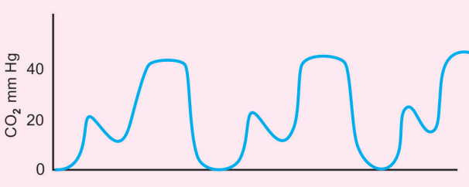
Home work

Slide 30
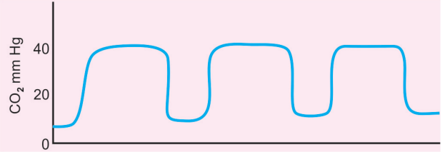
Home work

Slide 31
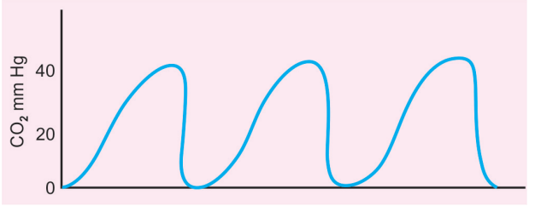
Home work

Slide 32
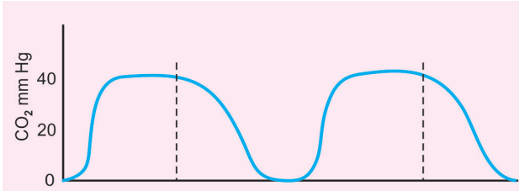
Home work

Slide 33
Thank you

