Slide 1



Subject Name: Biology
1st Class, First Semester
Academic Year: 2024-2025
Lecturer: Assist lect. Zainab Sattar Jabbar
Email: zainab.sattar.jabbar@uomus.edu.iq
Lecture No.:- 3
Lecture Title: [The Cytoplasm and Cellular Organelles]

Slide 2
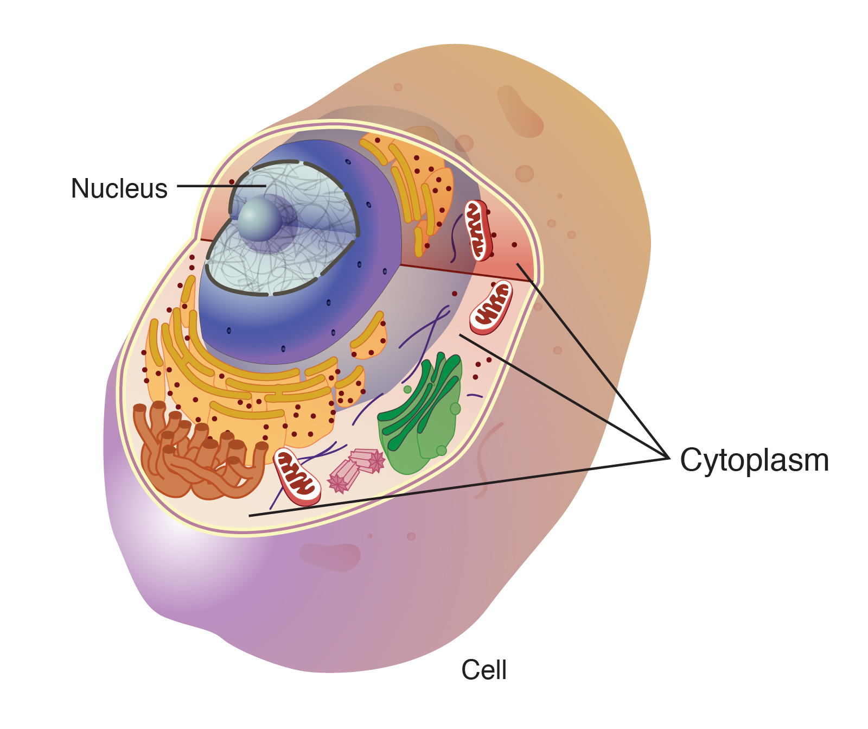
Introduction
The cell is the fundamental unit of life, and its structure is highly organized, with each part performing specific functions necessary for the cell's survival and activity.
The cytoplasm and cellular organelles are essential components that play a crucial role in maintaining the cell's functions.
In this lecture, we will explore the structure and functions of the cytoplasm and the various organelles within the cell.

Slide 3
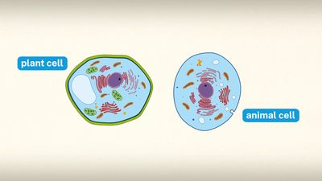
Cytoplasm
Definition: The cytoplasm is the jelly-like substance that fills the cell and surrounds the organelles. It is located between the cell membrane and the nucleus in eukaryotic cells. In prokaryotic cells, it encompasses the region within the cell membrane.
Cytoplasm refers to all material within a cell, enclosed by the cell membrane, except for the cell nucleus.

Slide 4
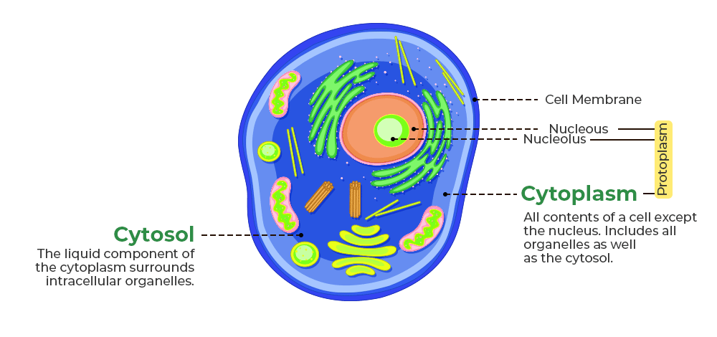
Components of Cytoplasm
Cytosol :The gel-like fluid component of the cytoplasm. It is primarily made up of water, salts, proteins, and various molecules.
Organelles :Structures within the cytoplasm that carry out specific functions.
Cytoskeleton: A network of protein filaments and tubules that provide structural support and shape to the cell. It also helps in intracellular transport and cell division.

Slide 5
Functions of Cytoplasm
Supports Organelles: The cytoplasm provides a medium for the organelles to remain suspended and allows them to perform their functions.
Chemical Reactions: Many biochemical reactions, such as glycolysis, occur in the cytoplasm.
Transport: The cytoplasm helps in the transport of materials within the cell through diffusion and the movement of organelles along the cytoskeleton.
Storage: The cytoplasm stores nutrients, ions, and other essential molecules required for cellular processes.

Slide 6
Cellular Organelles: Structure and Function
Cellular organelles are specialized structures within the cell that perform specific functions necessary for the cell’s survival and activity.
Organelles can be broadly divided into:
Membrane-bound organelles: Nucleus, Mitochondria, Endoplasmic Reticulum (ER), Golgi Apparatus, Lysosomes, Peroxisomes, Chloroplasts (in plant cells)
Non-membrane-bound organelles: Ribosomes, Cytoskeleton, Centrioles (in animal cells).
They are similar in all cells, but with some variations depending on the cell specialization. Each organelle is a separate compartment, containing different chemically setting for fulfilling a partial or cellular function. These organelles occupy about half of the total cell volume.

Slide 7
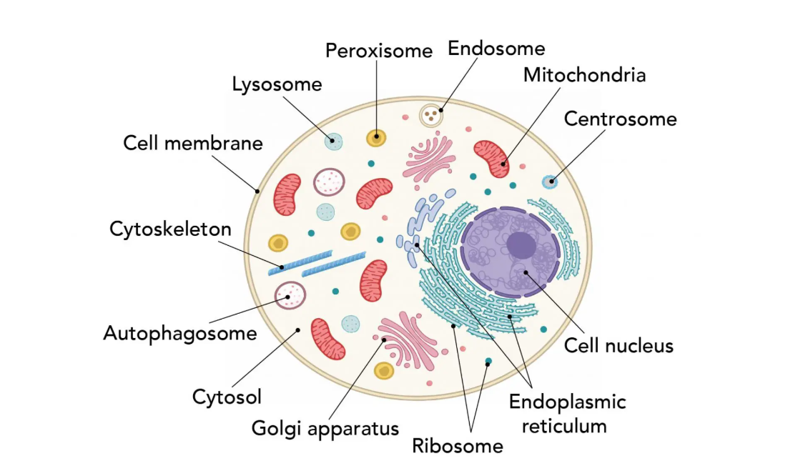
Cellular Organelles

Slide 8
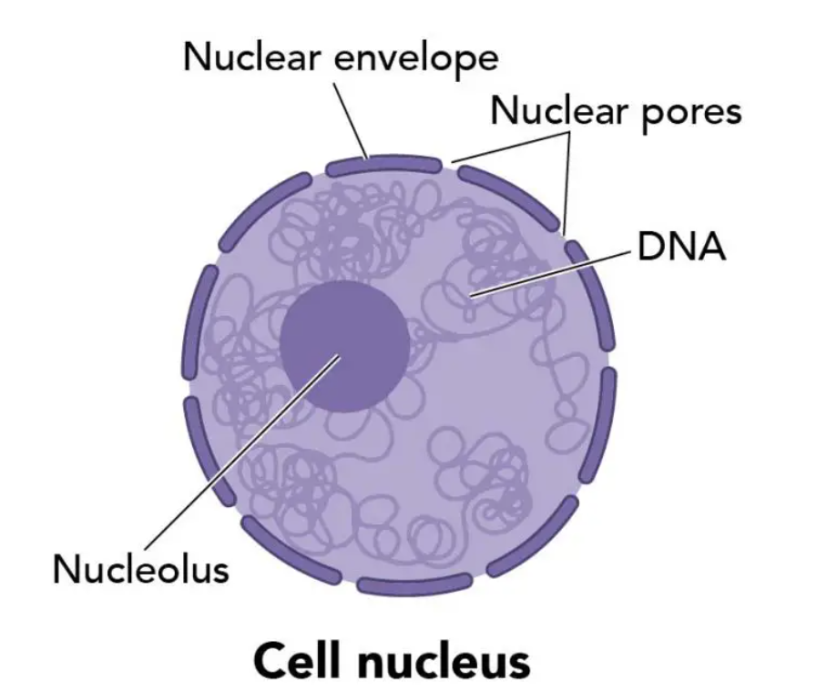
Nucleus
Structure: The nucleus is the largest organelle, often spherical, and is surrounded by a double membrane called the nuclear envelope. The nuclear envelope has pores that regulate the movement of molecules in and out of the nucleus.
Function: The nucleus is the control center of the cell. It stores genetic material in the form of DNA and coordinates cell activities such as growth, metabolism, protein synthesis, and cell division.
The key feature that separates eukaryotic cells (animals, plants, and fungi) from prokaryotic cells (bacteria and archaea) is the presence of a nucleus.

Slide 9
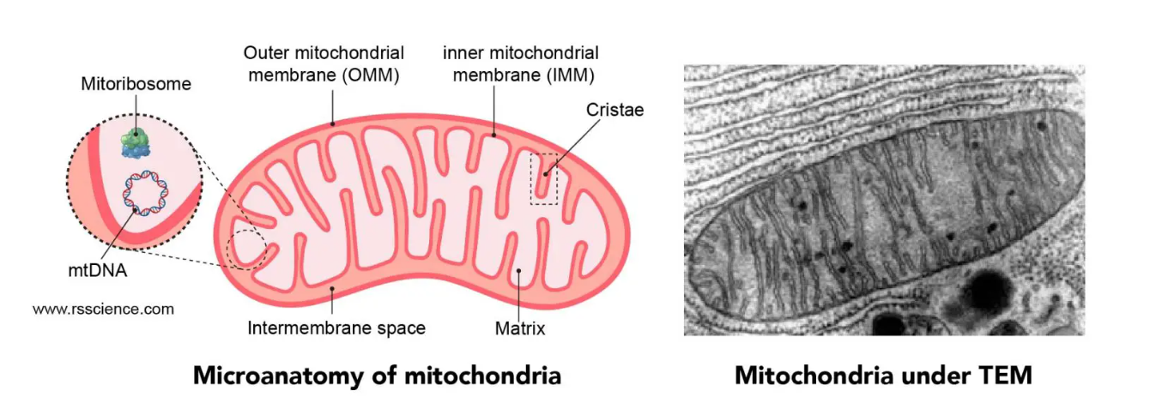
Mitochondria
Structure: Mitochondrion is a rod-shaped organelle that is considered the power generators of the cell. Mitochondria are double-membraned organelles with an inner membrane that folds into structures called cristae. Mitochondrion has double layers of the membrane: outer mitochondrial membrane (OMM) and inner mitochondrial membrane (IMM). Between the OMM and IMM is the intermembrane space. The region inside the inner membrane is called the matrix. Inside is the matrix, where several metabolic reactions take place.
Function: Known as the "powerhouses" of the cell, mitochondria generate energy in the form of adenosine triphosphate (ATP) through cellular respiration. They are involved in energy metabolism, cell death regulation, and calcium storage.

Slide 10
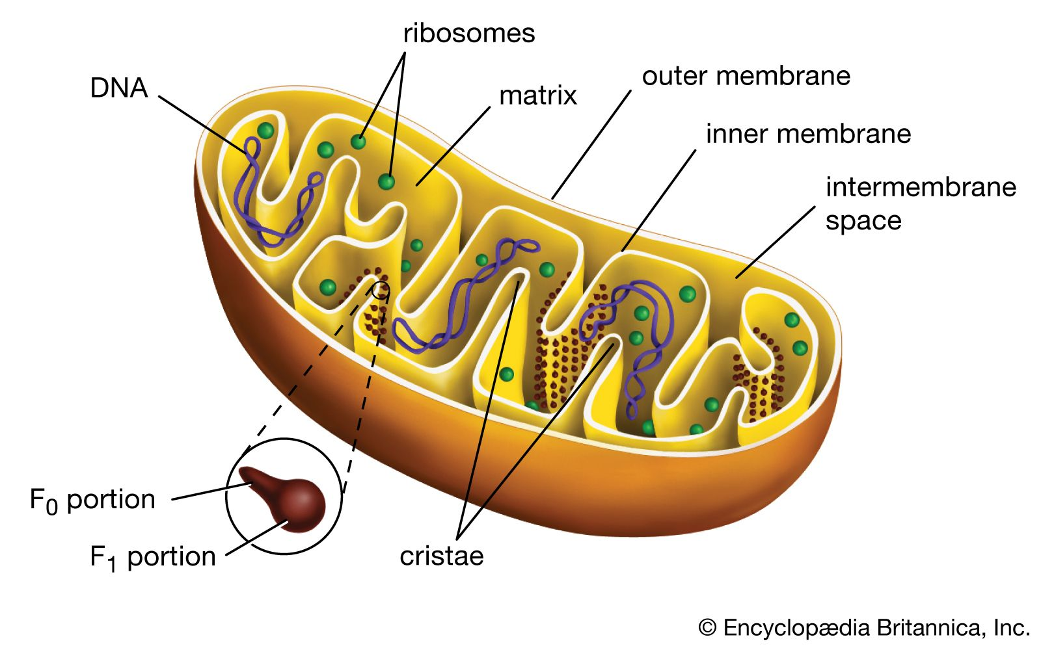
Mitochondria
The cristae contain proteins that convert much of the energy in food into a usable form (the electron transport protein). The enfolding increase the surface area available for keeping these important proteins.
The matrix contains a mixture of hundreds of different dissolved enzymes (Citric acid cycle enzymes) that are important in preparing nutrient molecules for the final extraction of usable energy by the cristae proteins.
Mitochondria are unusual organelles in two ways:
In the matrix they have their own unique DNA called mitochondrial DNA.
Mitochondria have the ability to replicate themselves even when the cell to which they belong is not undergoing cell division.

Slide 11
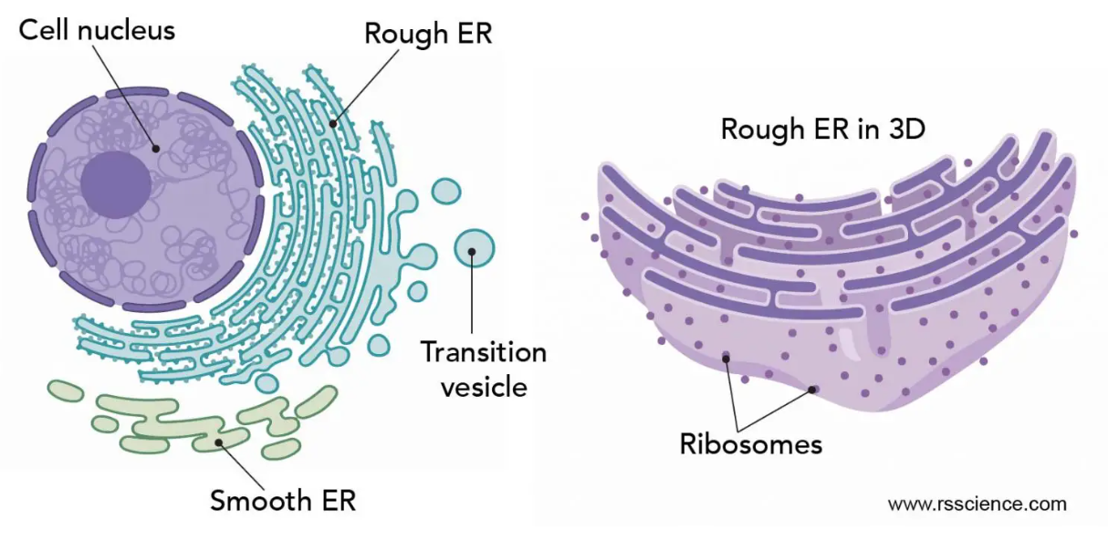
Endoplasmic Reticulum (ER)
Structure: Endoplasmic reticulum (ER) is an internal membrane that forms branching networks of many interconnected sacs and tubes.
There are two types:
Rough ER: Studded with ribosomes on its cytoplasmic surface.
Smooth ER: Lacks ribosomes.
Function:
Rough ER: Rough ER stays closer to the nucleus and coordinates protein synthesis.
Smooth ER: It specializes in lipid synthesis, steroid hormone production, and detoxification.

Slide 12
Golgi Apparatus
Structure: The Golgi apparatus consists of sets of flattened, curved, membrane- enclosed sacs, or cisternae, stacked in layers.
Function: It modifies, packages, sorts and targeting of vesicle of proteins and lipids for transport to their destination, either within the cell or for secretion outside the cell. It also synthesizes carbohydrates.
The transportation of proteins is done within small bubbles, called vesicles. The vesicles are generated by budding from the membrane of the ER and Golgi. Once the vesicles reach their destinations, the fusion of membrane releases their protein cargos.
There are three major destinations of proteins:
Sent to other organelles (lysosomes).
Released into the cytosol (membrane protein).
Secreted outside the cells (secretory protein).
Secreting vesicles can also store the proteins until they receive a signal to release at a specific event.

Slide 13
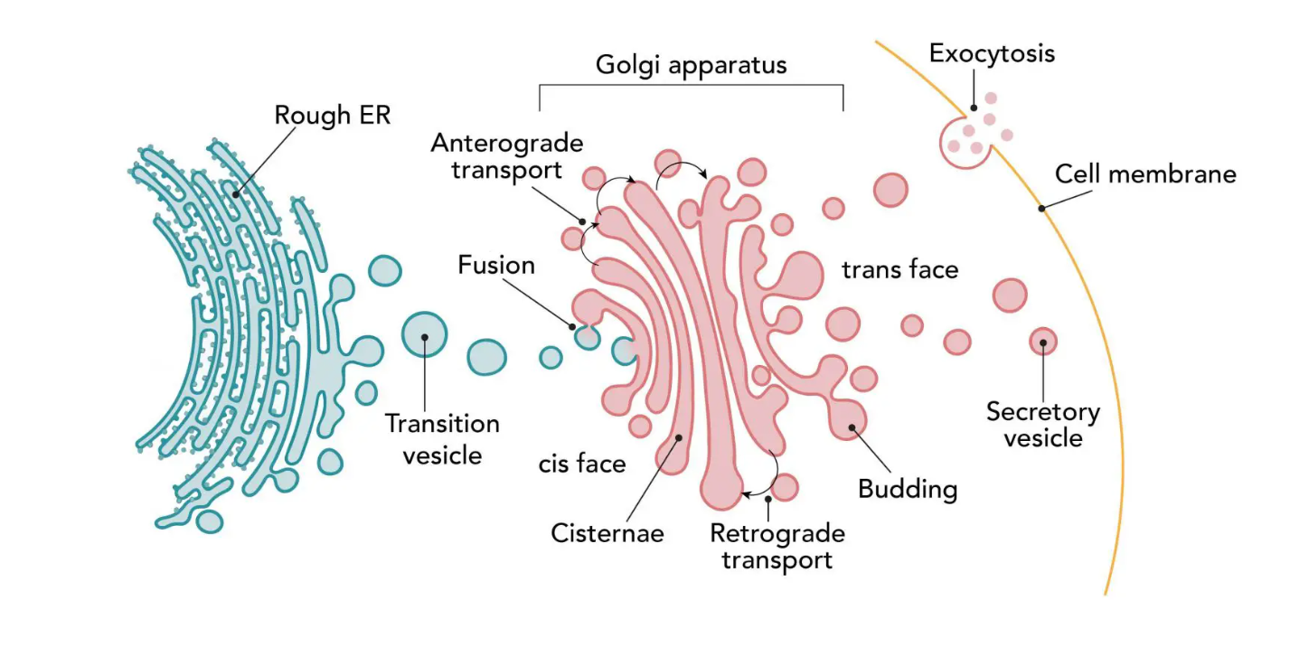
Golgi Apparatus

Slide 14
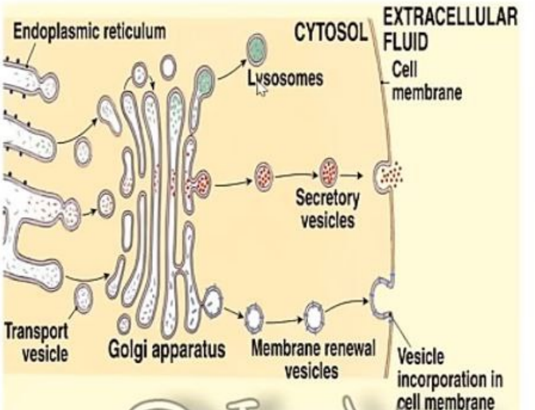
Golgi Apparatus

Slide 15
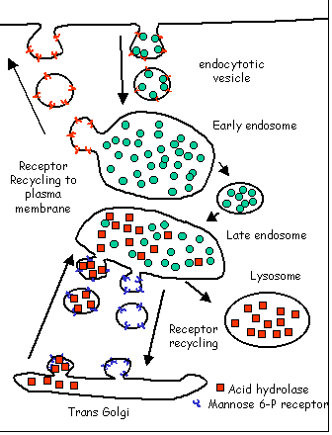
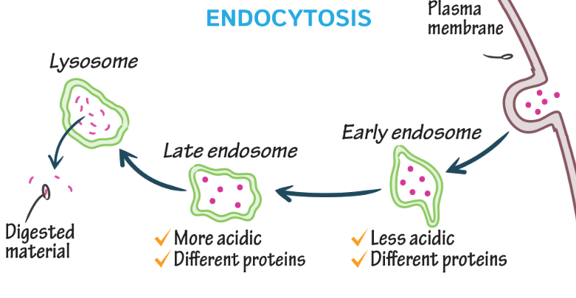
Endosome
Endosome is a membrane-bound temporary organelle for engulfing the stuff outside of the cell. Endosomes are formed by the invagination of the cell membrane, a process called “endocytosis”. After endocytosis, the endosome can carry its cargo to different places in the cell.

Slide 16
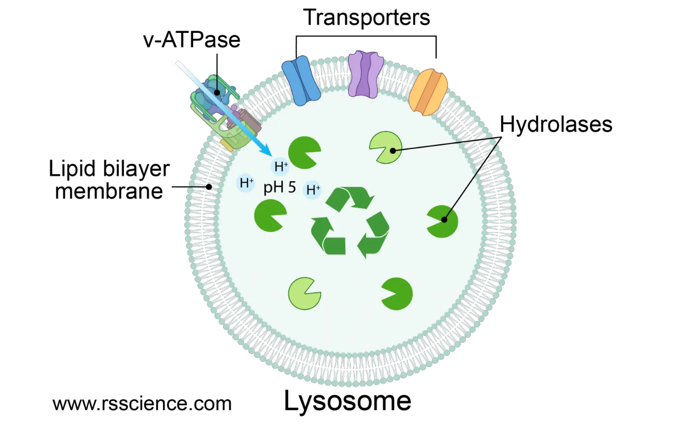
Lysosomes
Structure: Lysosome is a membrane-bounded sphere full of digestive enzymes and works like a recycling center in the cell.
Function: They are involved in breaking down waste materials and cellular debris. They can digest food particles, worn-out organelles, and foreign invaders like bacteria.
Lysosomes serve as the intracellular ''digestive system‘’. Inside the lysosome is an acidic environment (pH 5), which activates the digestive enzymes. These enzymes won’t be active in the cytosol (pH 7).

Slide 17
Lysosomes
Extrinsic material to be attacked by lysosomal enzymes is brought into the interior of the cell through the process of endocytosis, which include: Pinocytosis and Phagocytosis.
In pinocytosis, extracellular small particle is engulfed.
In phagocytosis, extracellular large particle is engulfed; this is achieved by only a few specialized cells. When this cells encounters large particle, such as bacteria or tissue debris, it extends projection (pseudopodia) that completely surround or engulf the particle, forming an internalized vesicle that traps the large particle within it. A lysosome fuses with the membrane of the internalized vesicle and releases its contents of hydrolytic enzymes into the vesicle. These enzymes safely attack the microbes or other trapped material within the enclosed confines of the vesicle without damaging the remainder of the cell.
The intracellular particles are removed by a process called autophagy, the enclosure of this organelle by membranes from smooth ER (autophagosome) fuses with a late endosome.

Slide 18
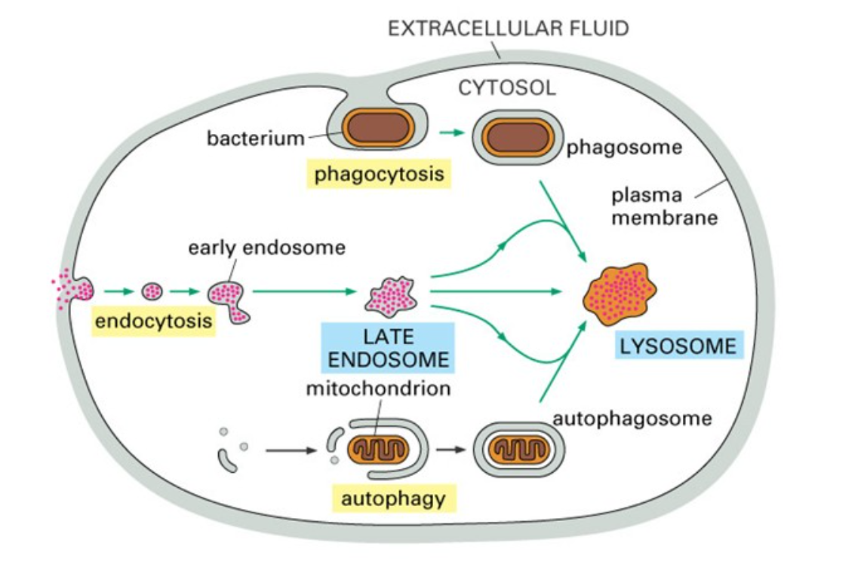
Lysosomes

Slide 19
Peroxisome
Structure: Peroxisomes are membrane-bound (spherical) organelles containing enzymes for oxidative reactions.
Function:
They break down fatty acids to produce energy and this energy is released as heat to maintain body temperature .
Generation of hydrogen peroxide , which detoxifies toxic agents.
Contain catalase enzyme that converts the excess hydrogen peroxide into water,thus protecting the cell.
Peroxisomes in the liver cells also handle the detoxification of many chemicals, including alcohol and drugs.

Slide 20
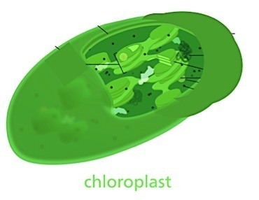
Chloroplasts
Structure: Chloroplasts are double-membraned organelles that contain the pigment chlorophyll.
Function: They carry out photosynthesis, converting light energy, carbon dioxide, and water into glucose and oxygen, providing energy for plant cells.
Chloroplasts are useful organelles among plastids as they highly participate in the process of photosynthesis which is a process by which plants synthesize their own food.
They are located in outer surface of the cell to receive enough light. Chloroplasts are green colored due to the chlorophyll pigments found in its internal parts. Some of important characteristics of plant is its ability to carry out photosynthesis as the way they use in making their own food and pass through converting light energy in chemical energy.

Slide 21
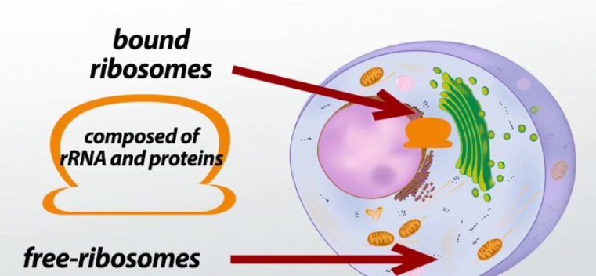
Ribosomes
Structure: Ribosomes are small, dense particles composed of RNA and proteins. They may be free in the cytoplasm or attached to the rough ER.
Function: Ribosomes are the sites of protein synthesis. They translate messenger RNA (mRNA) into amino acid sequences to form proteins.

Slide 22
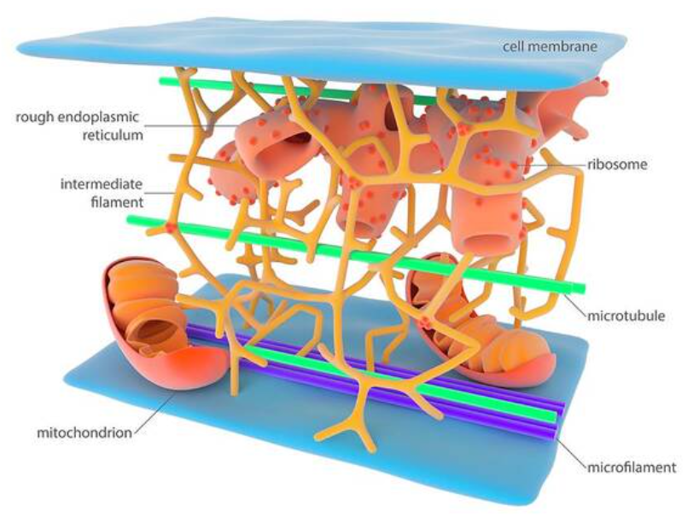
Cytoskeleton
Structure: The cytoskeleton is a network of protein fibers, including microfilaments, intermediate filaments, and microtubules.
Function: It provides structural support to the cell, facilitates intracellular transport, aids in cell division, and helps in cell movement.
The cytoskeleton is a complex protein network that act as the ''bone and muscle'' of the cell.

Slide 23
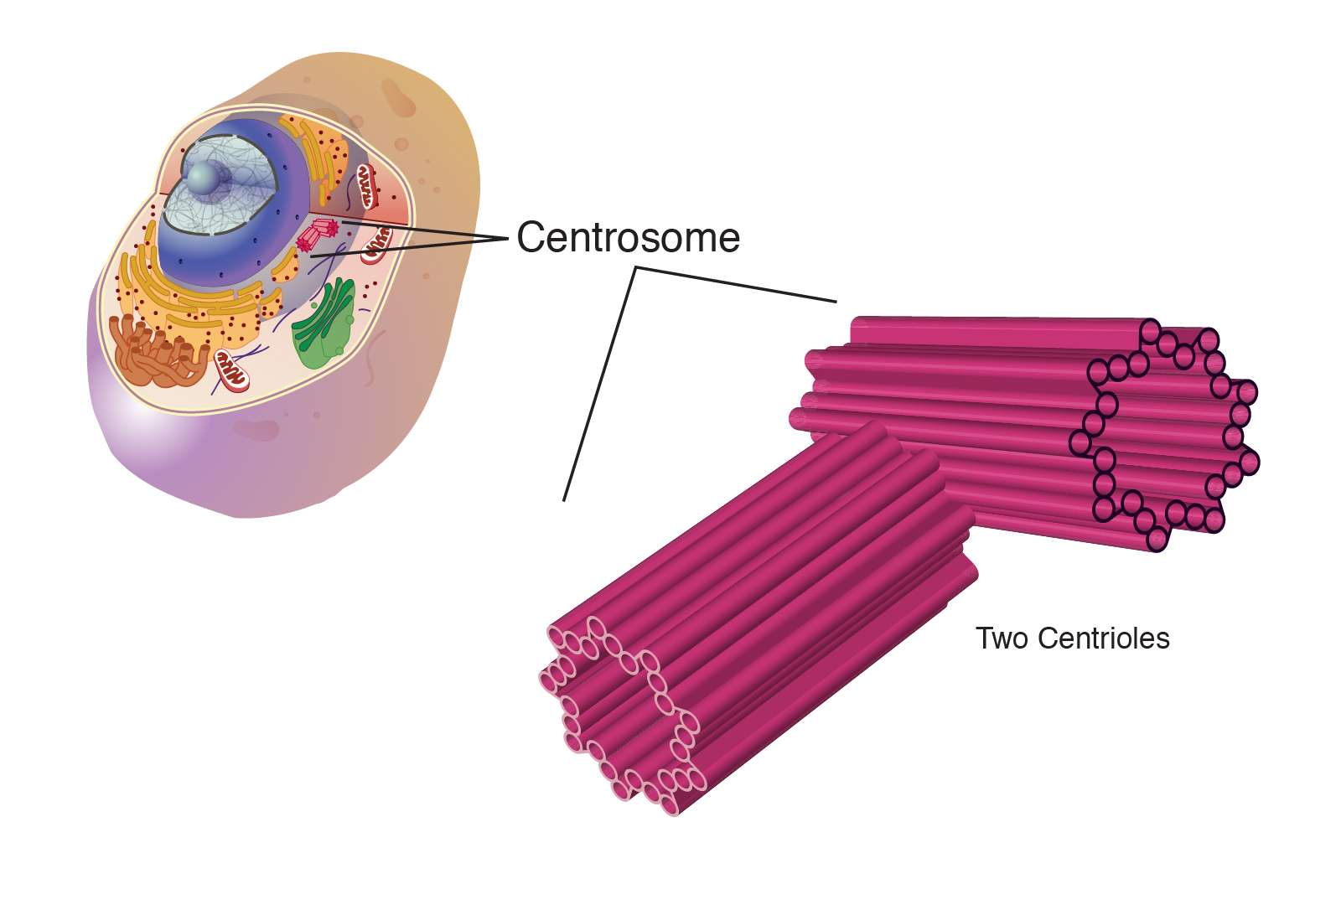
Centrioles
Structure: Centrioles are cylindrical structures composed of microtubules, usually found in pairs.
Function: Centrioles play a role in organizing microtubules that serve as the cell’s skeletal system. They help determine the locations of the nucleus and other organelles within the cell, which also have a vital role in cell mitotic division.

Slide 24
Interaction Between Cytoplasm and Organelles
The cytoplasm and organelles work in harmony to carry out cellular functions. For example:
The nucleus sends instructions for protein synthesis, which are executed by ribosomes in the cytoplasm or on the rough ER.
Mitochondria provide energy for processes like protein synthesis and transport within the cell.
The Golgi apparatus packages proteins and lipids for distribution to other organelles or outside the cell, facilitated by vesicles.
Additionally, the cytoskeleton helps move these organelles around and aids in communication between them.

Slide 25


