Slide 1
Management and leadership
Collage of Nursing
Al-Mustaqbal University
Review for leadership styles
By
Dr. Mahdi Hamzah AL-Taee

Slide 2
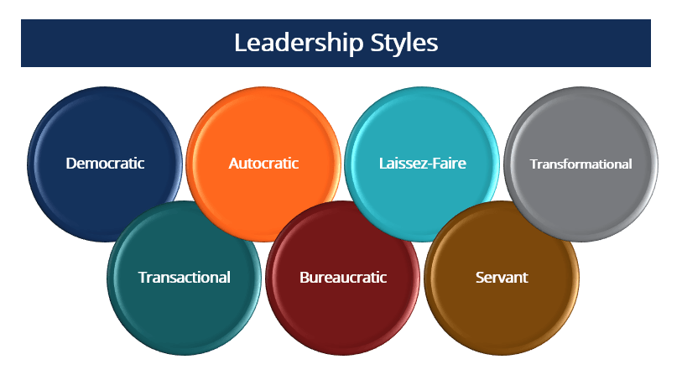

Slide 3
INTRODUCTION
What is leadership by authors?
Leadership is the process of influencing the activities of an organized group toward goal achievement. source (Rauch & Behling, 1984)
Leadership is a process of giving purpose (meaningful direction) to collective effort, and causing willing effort to be expended to achieve purpose. source (Jacobs & Jacques, 1990)

Slide 4
Cont..
What are Leadership Styles?
Leadership styles refer to the behavioral approach employed by leaders to influence, motivate, and direct their followers. A leadership style determines how leaders implement plans and strategies to accomplish given objectives while accounting for stakeholder expectations and the wellbeing and soundness of their team.

Slide 5
leadership style type
1. Democratic Leadership :
It is a collaborative and consultative leadership style where each team member has an opportunity to contribute to the direction of ongoing projects.
Democratic leadership is one of the most popular and effective leadership styles because of its ability to provide lower-level employees a voice making it equally important in the organization. It is a style that resembles how decisions are made in company boardrooms

Slide 6
Cont..
2. Autocratic Leadership:
Autocratic leadership is the opposite of democratic leadership. In this case, the leader makes all decisions on behalf of the team without taking any input or suggestions from them. The leader holds all authority and responsibility. They have absolute power and dictate all tasks to be undertaken. There is no consultation with employees before a decision is made. After the decision is made, everyone is expected to support the decision made by the leader. There is often some level of fear of the leader by the team.

Slide 7
Cont..
3. Laissez-Faire Leadership :
Laissez-faire leadership is accurately defined as a hands-off or passive approach to leadership. Instead, leaders provide their team members with the necessary tools, information, and resources to carry out their work tasks. leader steps back and lets team members work without supervision and free to plan, organize, make decisions, tackle problems, and complete the assigned projects.
The laissez-faire leadership approach is empowering to employees who are creative, skilled, and self-motivated.

Slide 8
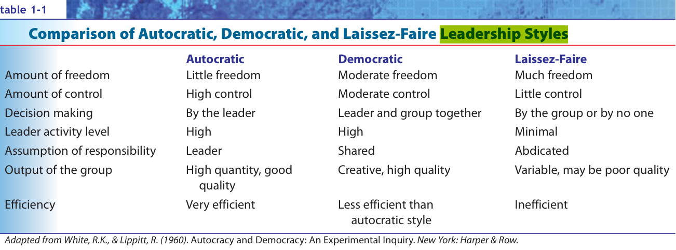
Cont..

Slide 9
Cont..
4. Transformational Leadership :
Transformational leadership is about cultivating change in organizations and people. The transformation is done by motivating team members to go beyond their comfort zone and achieve much more than their perceived capabilities, To be effective, transformational leaders should possess high levels of integrity, emotional intelligence, a shared vision of the future, empathy, and good communication skills.

Slide 10
Cont..
Such a style of leadership is often associated with high growth-oriented organizations that push boundaries in innovation and productivity. Practically, such leaders tend to give employees tasks that grow in difficulty and deadlines that keep getting tighter as time progresses.

Slide 11
Cont..
5. Transactional Leadership :
Transactional leadership is more short-term and can best be described as a “give and take” kind of transaction. Team members agree to follow their leader on job acceptance; therefore, it’s a transaction involving payment for services rendered. Employees are rewarded for exactly the work they would’ve performed. If you meet a certain target, you receive the bonus that you’ve been promised. It is especially so in sales and marketing jobs.

Slide 12
Cont..
Transactional leadership establishes roles and responsibilities for each team member and encourages the work to be completed as scheduled. There are instances where incentive programs can be employed over and above regular pay.

Slide 13
Cont..
6. Bureaucratic Leadership :
is a “go by the book” type of leadership. Processes and regulations are followed according to policy with no room for flexibility. Rules are set on how work should be done, and bureaucratic leaders ensure that team members follow these procedures meticulously. Input from employees is considered by the leader; however, it is rejected if it does not conform to organizational policy. New ideas flow in a trickle, and a lot of red tape is present. Another characteristic is a hierarchical authority structure implying that power flows from top to bottom and is assigned to formal titles.

Slide 14
Cont..
Bureaucratic leadership is often associated with large, “century-old” organizations where success has come through the employment of traditional practices. Hence, proposing a new strategy at these organizations is met with fierce resistance, especially if it is new and innovative. New ideas are viewed as wasteful and ineffective, or even downright risky.

Slide 15
Cont..
Now you have question: which type of leadership is the best ?
The answer non of them, because some time you need to collaborate with them to solve problem and some time you will decision the without discussion due to limited time so its depend on many factors.

Slide 16
References
https://corporatefinanceinstitute.com/resources/management/leadership-styles
Diane K., Sally A. and Rutb M. (2007).Essentials of Nursing Leadership and Management. 5th edition. F. A. Davis Company 1915 Arch Street Philadelphia, PA 19103.
Sullivan, J.(2012) Effective Leadership and Management in Nursing.8th Edition .

Slide 17


