Slide 1

Fundamental of Nursing
Collage of Nursing
Lec:6
Wounds Management
Instructor:
Dr. Mahdi Hamzah AL- Taee

Slide 2
Skin Integrity
Normal skin
Uninterrupted Skin layers by wound
What is a wounds?
It is a circumscribed injury which is caused by an external force and it can involve any tissue or organ. surgical, traumatic. It can be mild, severe, or even lethal.

Slide 3
Factors Affecting Skin Integrity
Genetics or heredity
Age
Chronic illnesses and their treatments
Medications
Poor nutrition

Slide 4
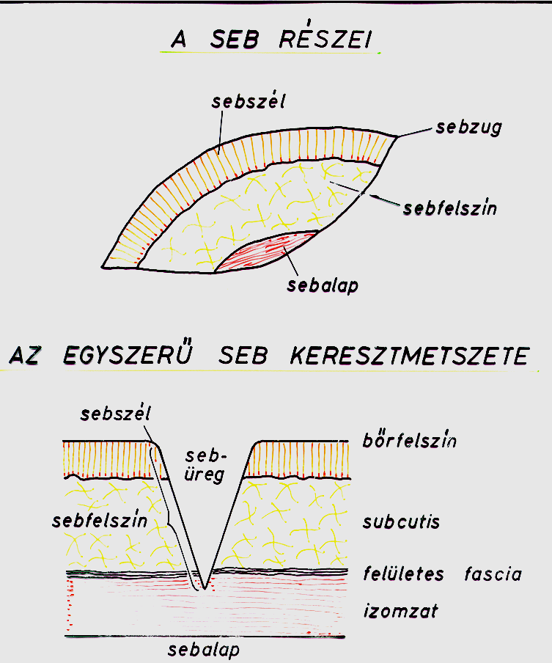
Parts of the wound
Wound edge
Wound
corner
Surface of
the wound
Base of the wound
Cross section of a simple wound
Wound edge
Wound
cavity
Skin surface
Surface of
the wound
Subcutaneus tissue
Superficial fascia
Muscle layer
Base of the wound

Slide 5
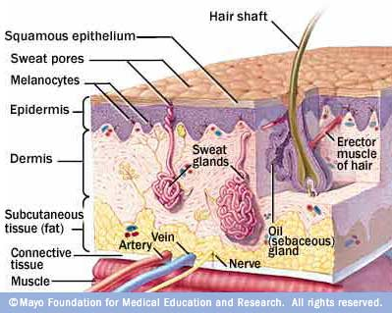
Classification of the wounds
1. Depending on the depth of injury
Superficial
Partial thickness
Full thickness
Deep wound
Superficial
Partial thickness
Full thickness
Deep wound
+ bone, opened cavities, organs…etc.

Slide 6
2.Types of wound according to contamination
1. Clean Wound
2. Clean-contaminated wound
Uninfected wound
Minimal inflammation
The respiratory, alimentary, genital, urinary tracts are not entered
Clean wounds primarily closed wounds
Examples: mastectomy, Cosmetic surgery, hernia, splenectomy.
Surgical wounds in which respiratory, alimentary, genital or urinary tracts has been entered.
No evidence of infection
Examples: gastric surgery, bronchi, colon surgery

Slide 7
Cont.,..
3. Contaminated wound
4. Dirty or Infected
Open, fresh, accidental wounds and surgical wounds.
Major break in sterile technique or large amount of spillages from gastrointestinal tract.
Evidence of inflammation
Examples: Rectal surgery, penetrating wounds.
Wounds containing dead tissue.
Wound with evidence of clinical infection
Purulent discharge
Examples: Abscess Incision and drainage, perforated bowel.

Slide 8
3.Types of wound according to tissue layer involved
1. Incision
2. Contusion
Caused by sharp instrument
Open wound
Deep or Superficial
Blow from blunt instrument
Closed wound skin appears echymotic (bruised)
Because of damaged blood vessels

Slide 9
Cont.,..
3. Abrasion
4. Puncture
Surface scrape, unintentionally or intentionally
Open wound
Penetrating of the skin and underlying tissues
Sharp instrument.

Slide 10
Cont.,..
5. Laceration
Tissue torn
From accident
Open wounds
Edges are uneven

Slide 11
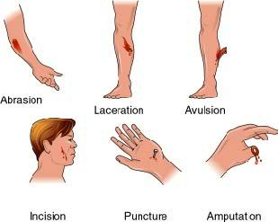
Types of wound

Slide 12
Types of Wound Healing
Primary intention : clean, straight line, edges well approximated with sutures, rapid healing.
Secondary intention : large wounds with tissue loss, edges not approximated, heals from the inside out, granulation tissue fills in the wound, longer healing time, large scars.
Tertiary intention : delay 3-5 days before injury is sutured, greater access for pathogens to invade inflammation, more granulation, larger scars.

Slide 13
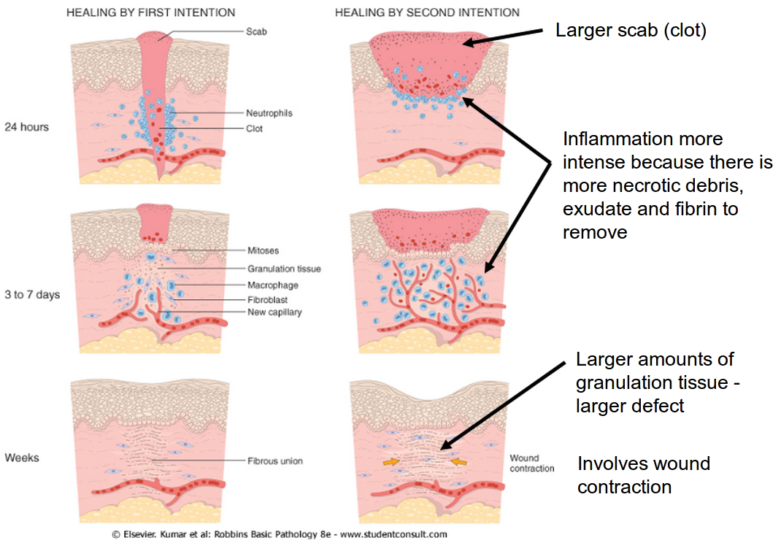
Cont.,..

Slide 14
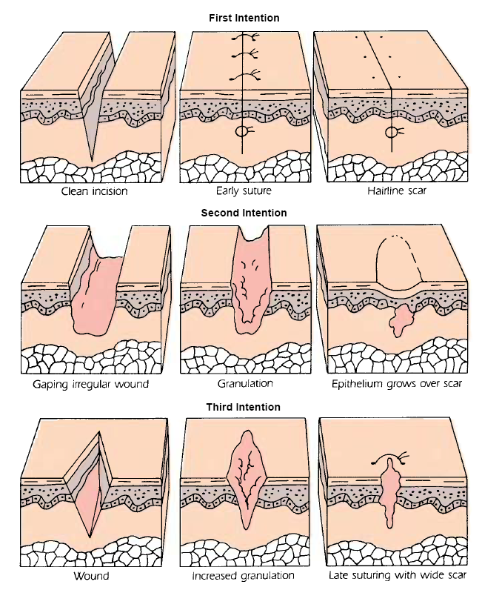
Cont.,..

Slide 15
Phases of wound healing
Inflammatory phase
Proliferative phase
Maturation phase
Immediately after wound -3-6 days
Hemostasis
Vascular and cellular response
Increase blood supply
WBC move to site
Macrophage
Microcirculatory network
3-4 to 21 days after injury
Fibroblast
Collagen provide strength to the wound
Capillaries grow
Fibrin
Granulation tissue
21 days post injury -1-2 years
Begin when scar is formed
Collagen replaced with new tissue
Wound remodeled and contracted
Strong scar

Slide 16
Wound drainage
Exudates:
Types of exudate
Material such as fluid and cells escaped from blood vessels during inflammatory process and deposits in tissue
  1.Serous (clear, watery exudates)
  2.Purulent (green, brown, dark yellow, pus foul smelling)
  3.Sanguineous (bloody)

Slide 17
Complications of Wound Healing
Hemorrhage – internal or external Infection
Dehiscence – separation of healing wound
Evisceration – organs protrude through wound
Fistula – unnatural opening between organs
Delayed Wound Closure

Slide 18
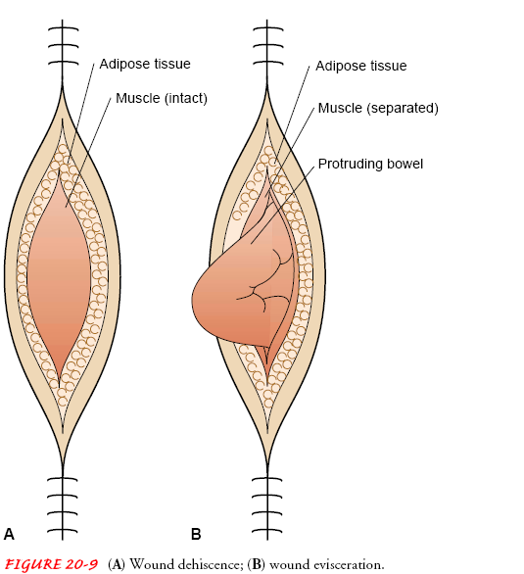
Wound dehiscence and Evisceration

Slide 19
Factors affecting wound Healing
Developmental consideration
Nutrition
Lifestyle
Medication
Factors Impairing Healing
  Age – elderly at greater risk
  Malnutrition
  Obesity
  Impaired oxygenation
  Smoking
  Drugs
  Diabetes
  Wound stress

Slide 20
Nursing management of wounds
The goals focusing on promoting wound healing, preventing infections, and
educating the client.
1) Initiate Emergency Measures:
➢ Standard precautions are always implemented.
➢ If hemorrhage is detected, sterile dressings and pressure should be applied
to stop the bleeding and elevated the effected extremity.
➢ When dehiscence or evisceration occurs, instruct the client to remain quiet,
and instruct the client to avoid coughing or straining. Sterile dressings,
soaked with sterile normal saline, should be used to cover the wound and
abdominal contents. This will reduce the risk of bacterial contamination and
drying of the viscera. Notify the surgeon immediately and prepared the
client for surgical repair.
➢ Vital signs should be monitored frequently.

Slide 21
Cont….
2) Cleanse the Wound: The goal of cleansing the wound is to remove debris and
bacteria from the wound bed. It is recommended that isotonic solutions such as
normal saline or lactated Ringers be used to preserve healthy tissue. Commonly
used antiseptic agents such as povidone-iodine 10%, hydrogen peroxide 3%,
sodium hypochlorite, and acetic acid are effective in destroying bacteria but at
the same time destroy fibroblasts and healthy granulation tissue.
3) Provide Suture Care.

Slide 22
Cont…
4) Dressing the Wound. The purposes of a wound dressing are:
▪ Provide moist environment and therefore enhance epithelialization.
▪ Supporting healing by absorbing drainage.
▪ Protect the wound from microbial invasion.
▪ Promote homeostasis.
▪ Provide thermal insulation of the wound.
▪ Protect the wound from physical trauma and supporting the wound site.
5) Monitor Drainage of Wounds.

Slide 23
Cont…
6) Control swelling and pain: by applying ice over wound and surrounding
tissues.
7) Checking Bandages, Binders, and Slings.

Slide 24
Thank You

