Slide 1


Protein
Lecture.5
Prof. Dr. Fakhria Jaber

Slide 2
Proteins: are composed of carbon, hydrogen, oxygen, and nitrogen; they provide
the foundation for every cell in the body. Proteins are broken down to amino acids by
the body.
All proteins in our body and food are built from basic units or compounds known as
amino acids.

Slide 3
Amino acids are classified as:
Essential (indispensable (IDAA))—that which cannot be produced by the body and must be obtained from food. Lack of these amino acids in diet, leads to growth failure.
Nonessential (dispensable (DAA))—that which can be produced by the body .

Slide 4
Classification of Protein
I- More complex proteins have a tertiary structure in whcih the polypeptide chain is wound into a globular form.
II- Simple proteins yield only amino acids on hydrolysis. Albumins, globulins, glutelins, prolamins and albuminoids are simple proteins.
III-Conjugated proteins are combinations of simple proteins with non-protein substances.
The combinations result in formations, which are functionally very important to the body.

Slide 5
Functions of protein
Provide the body with the amino acids
necessary for growth and maintenance of body tissues.
Cells, enzymes, hormones, antibodies, muscles, blood, and all tissues and fluid require protein except bile and urine .

Slide 6
Storage
Proteins in the form of amino acids are the building blocks of the body. Protein
as such is not stored; therefore, a daily intake is required.

Slide 7
Sources of protein:
Animal sources include milk and milk products, meat, fish, poultry, and eggs.
Plant sources include breads and cereal products, legumes, nuts and seeds, and textured vegetable protein. Cereal grains are the primary source of protein

Slide 8
DIGESTION AND ABSORPTION OF PROTEINS
DIGESTION
Dietary proteins are of plant and animal origin, and average intake is
50 - 100 g/day.
Stages of Protein Digestion
1. Digestion by gastric juice
2. Digestion by pancreatic juice
3. Digestion by intestinal juice

Slide 9
Absorption of protein
To be absorbed, proteins must be broken down to amino acids or small peptides. Absorption of Amino Acids It occurs mainly in the distal jejunum and ileum of small intestine.
Proteins provide 4 kcal per g, the same as carbohydrates.

Slide 10
Recommended protein intake:
1- An average of 15-20 % of total energy intake for adult male &female in form of essential
a.a. (0.8 gm/kg IBW).
2-For children require 35% of total energy requirement in form of essential a.a. (2.2 gm/kg) for <0.5months age.
3-For infants 0.5months-1years = 1.6gm/kg.
4-It decrease with increasing of age 1.2-1g/kg (till the age of 14years).
5- For 15-18years 0.9gm/kg.
Note/ IBW= Ideal Body Weight

Slide 11
Calculating your daily requirement of protein:
Multiply IB wt. ( kg) x 0.8gm/kg = gm of protein (RDA)
e.g. 63.5 kg x 0.8gm/kg = 50.8 gm prot. RDA

Slide 12
Vegetarianism
many reasons why individuals eliminate animal foods from their diets. The most common reasons are
1. economic concerns,
2. religious guidelines,
3. health considerations, and
4. concern for animal life.

Slide 13
When a vegetarian consumes no meat, fowl, or fish as food, the further restrictions
on the remaining part of the diet can be classified as follows:
1. Fruitarians: individuals who eat only fruit.
2. Vegans: individuals who eat no animal flesh nor any food of animal origin.
3. Lacto-vegetarians: individuals who eat plant proteins, and also use milk.
4. Ovo-vegetarians: individuals who eat plant proteins, as well as eggs.
5. Lacto-ovo-vegetarians: individuals who eat both milk and eggs along with plant proteins.

Slide 14
Health effects of High protein diet:
It increase deamination by the liver which increase keto acids& ketosis.
• The increased urea is excreted by the kidneys.
• It should be not more than twice the RDA.
• If more it produce rapid wt.
• high-protein diets discourage eating carbohydrate (starchy) foods.
High protein diets may INCREASE the risk of cancer of the digestive tract.

Slide 15
Protein in pregnancy
• During pregnancy, the body needs more protein for tissue development and growth.
• consume 0.55–0.69 grams per pound (1.2–1.52 grams per kg) of protein daily during pregnancy.
• The recommended daily allowance for protein during breastfeeding is 0.59 grams per pound
(1.3 grams per kg) per day, plus 25 additional grams.

Slide 16
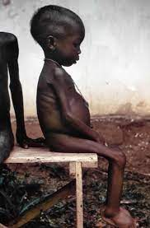
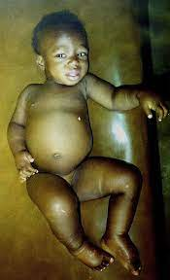
Disease associated with protein energy malnutrition
Kwashiorkor is a type of malnutrition characterized by severe protein deficiency. It causes fluid retention and a swollen, distended abdomen.

Slide 17
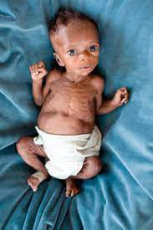
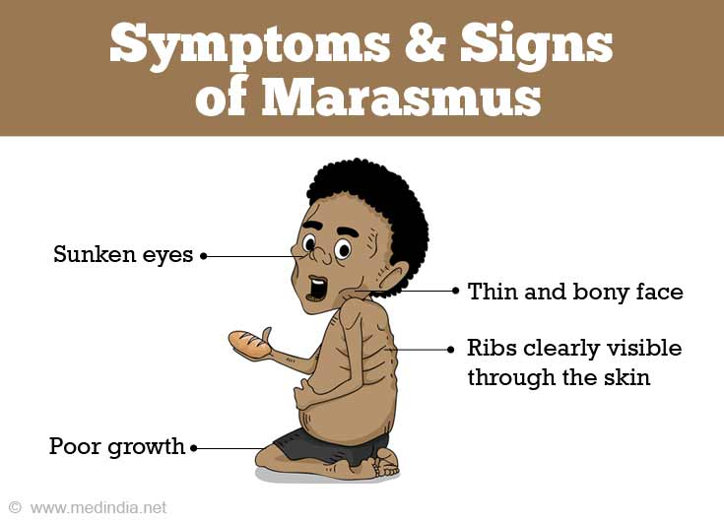
2- Marasmus: a condition occurs in children when both protein and energy are insufficient,
over prolonged periods.

Slide 18
Thank you

