Slide 1
Medication Administration
Clinical Part II
Prepared by:
Dr. Alaa Hamza
M.Sc.N: Ali Jassim

Slide 2
Intramuscular Injections
Intramuscular (IM) injections, are absorbed more quickly than subcutaneous injections because of the greater blood supply to the body muscle.
An adult with well-developed muscles can usually safely tolerate up to 3 mL of medication in the gluteus Medius and gluteus maximus muscle.
A volume of 1 to 2 mL is usually recommended for adults with less developed muscles. In the deltoid muscle, volumes of 0.5 to 1 mL are recommended.
The size of syringe used depends on the amount of medication being administered. The standard prepackaged intramuscular needle is 1 1/2 inches and #21 or #22 gauge.
Several factors indicate the size and length of the needle to be used:
• The muscle
• The type of solution
• The amount of adipose tissue covering the muscle
• The age of the client.

Slide 3
Intramuscular Injections
A major consideration in the administration of IM injections is the selection of a safe site located away from large blood vessels, nerves, and bone. Several body sites can be used for IM injections. These sites are discussed in detail next. Contraindications for using a specific site include tissue injury and the presence of nodules, lumps, abscesses, tenderness, or other pathology.
-1Ventrogluteal Site
The ventrogluteal site is in the gluteus medius muscle, which lies over the gluteus minimus .
The ventrogluteal site is the preferred site for intramuscular injections because the area:
• Contains no large nerves or blood vessels.
• Provides the greatest thickness of gluteal muscle consisting of both the gluteus medius and gluteus minimus.
• Is sealed off by bone.
• Contains consistently less fat than the buttock area, thus eliminating the need to determine the depth of subcutaneous fat.

Slide 4
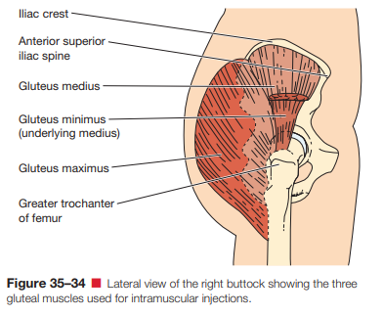

Slide 5
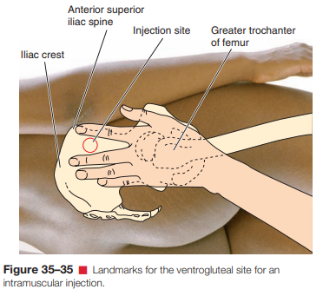

Slide 6
Intramuscular Injections
2- The Dorsogluteal Site was historically used for intramuscular injections, but it carries risks due to its proximity to the sciatic and superior gluteal nerves, as well as the artery. Injecting near these nerves can lead to complications like numbness, pain, or paralysis. Additionally, the site has more subcutaneous tissue, increasing the chance that medication may be injected into this tissue rather than the muscle, which can reduce its effectiveness. Due to these safety concerns, the ventrogluteal site is now preferred for intramuscular injections. Despite these risks, some older nurses still use the dorsogluteal site due to familiarity, ease of identification, and lack of training on the ventrogluteal site.

Slide 7
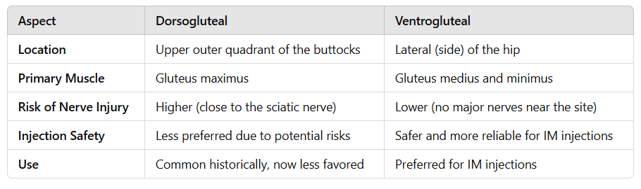
The differences between dorsogluteal and ventrogluteal Sites

Slide 8
Intramuscular Injections
3-The Vastus Lateralis Muscle, located on the anterior lateral aspect of the thigh, is commonly used for intramuscular injections, especially in infants and young children, due to its large muscle mass and lack of major blood vessels or nerves. This makes it a safer option, particularly when gluteal muscles are underdeveloped.
The recommended injection site is the middle third of the muscle. In adults, the site is determined by dividing the area between the greater trochanter and the lateral femoral condyle into thirds and selecting the middle third. The client can be either lying on their back or sitting for the injection.

Slide 9
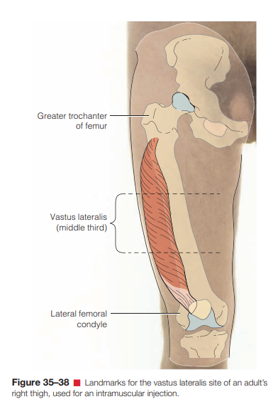
Intramuscular Injections

Slide 10
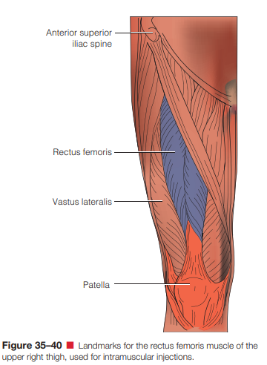
Intramuscular Injections
4- The rectus femoris muscle, located on the front of the thigh, is occasionally used for intramuscular injections. Its main advantage is that it is easily accessible for clients who administer their own injections. However, a significant disadvantage is that injections in this area can cause considerable discomfort for some individuals.

Slide 11
Intramuscular Injections
5- The deltoid muscle, located on the outer upper arm, is not frequently used for intramuscular injections due to its small size and proximity to the radial nerve and artery. While it allows for rapid absorption, only up to 1 mL of solution can be injected. It is commonly used for administering the hepatitis B vaccine in adults. To locate the deltoid site, the nurse places four fingers across the muscle with the first finger on the acromion process, using the top of the axilla as the lower border. The injection site is within a triangle formed by these boundaries, about 5 cm (2 inches) below the acromion process.

Slide 12
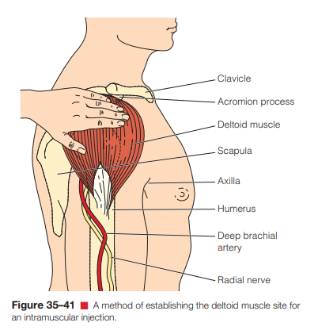
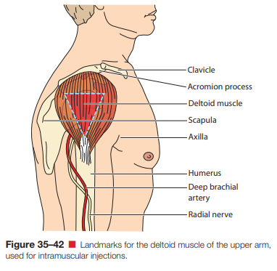

Slide 13
Techniques for Intramuscular Injections
The Z-track technique is a method used for administering intramuscular (IM) injections that helps minimize discomfort and prevent medication from leaking into the subcutaneous tissue. It involves pulling the skin and tissue to one side before inserting the needle, and then releasing the tissue after the injection, which creates a "Z" shape. This technique is particularly useful for injecting irritating or staining medications, as it seals the medication within the muscle and reduces the risk of leakage. It is considered a less painful approach and is recommended for all IM injections, although it may not be used in every clinical situation.

Slide 14
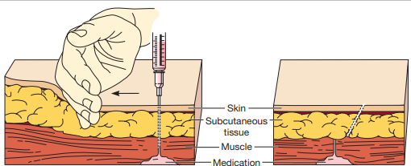

Slide 15
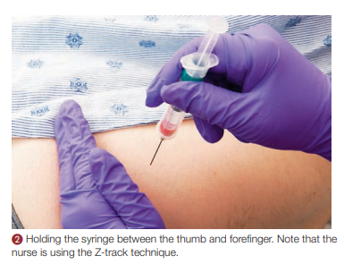

Slide 16
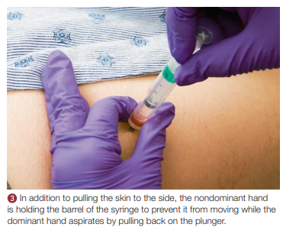
Techniques for Intramuscular Injections
Aspiration in an intramuscular injection involves pulling back the syringe plunger after inserting the needle to check for blood. If blood appears, it means the needle may have hit a blood vessel, and the injection site should be changed. Many current guidelines, however, no longer recommend aspiration for most IM injections, especially vaccines.

Slide 17
Drugs Calculations
Grams (g) and Milligrams (mg):
1 gram (g) = 1,000 milligrams (mg)
So, when you need to convert from grams to milligrams, multiply by 1,000.
When you need to convert from milligrams to grams, divide by 1,000.
Example:
5 g = 5 × 1,000 = 5,000 mg
2,500 mg = 2,500 ÷ 1,000 = 2.5 g
2. Milliliters (mL) and Liters (L):
1 liter (L) = 1,000 milliliters (mL)
To convert from liters to milliliters, multiply by 1,000.
To convert from milliliters to liters, divide by 1,000.
Example:
3 L = 3 × 1,000 = 3,000 mL
500 mL = 500 ÷ 1,000 = 0.5 L

Slide 18
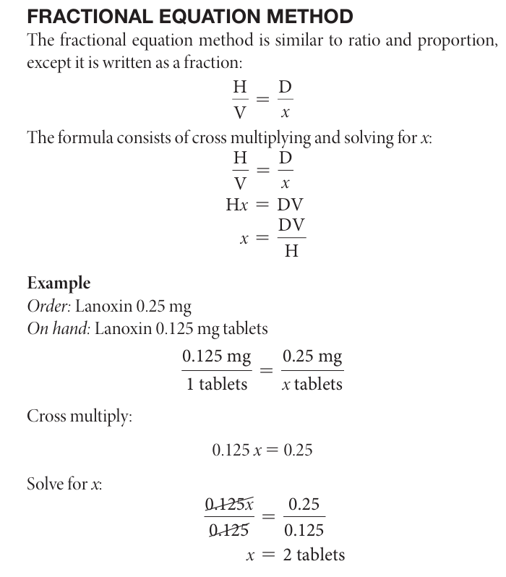
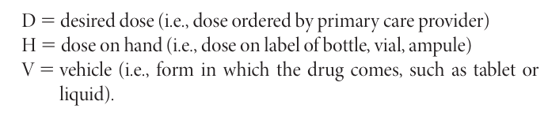
Drugs Calculations

Slide 19


