Slide 1
Vital Signs
Clinical Part I
Prepared by:
Dr. Alaa Hamza
M.Sc.N: Ali Jassim

Slide 2
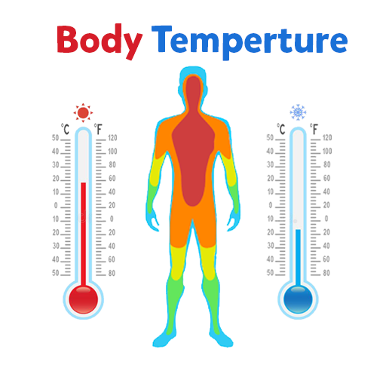

Slide 4
Types of Body Temperature
1- Core Temperature: is the temperature of the deep tissues of the body, such as the abdominal cavity and pelvic cavity. It remains relatively constant.
EX. Rectal temperature, Tympanic
2-Surface Temperature: is the temperature of the skin, the subcutaneous tissues ,fat. It, by contrast, rises and falls in response to the environment.
EX. Oral, Axillary, and Temporal

Slide 5
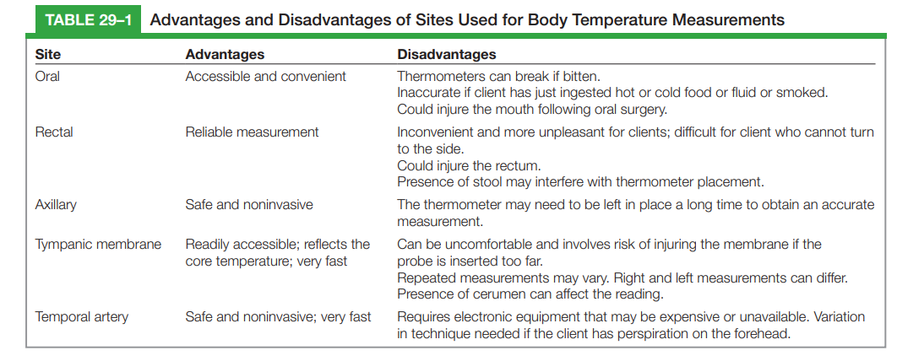
Sites of Body Temperature Measuring

Slide 6
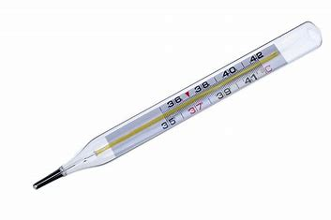
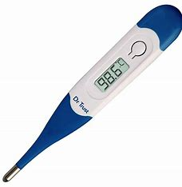
Types of Thermometers
1- Mercury Thermometer: A traditional thermometer that uses mercury to indicate temperature. It's rarely used now due to safety concerns with mercury.
2- Digital Thermometer: Uses electronic sensors to measure body temperature and display it digitally. It’s fast, accurate, and commonly used for oral, rectal, and axillary measurements.
1
2

Slide 7
Notes about the Mercury Thermometer
When using a mercury thermometer, the recommended times for placement in different locations are:
Oral: Leave the thermometer in place for 3-5 minutes to get an accurate reading.
Axillary (Underarm): Leave the thermometer in place for 5-10 minutes for
a reliable result.
Rectal: Leave the thermometer in place for 2-3 minutes for the most accurate measurement.
Clean the thermometer before use, from the bulb to the stem, after use, from the stem to the bulb.

Slide 8
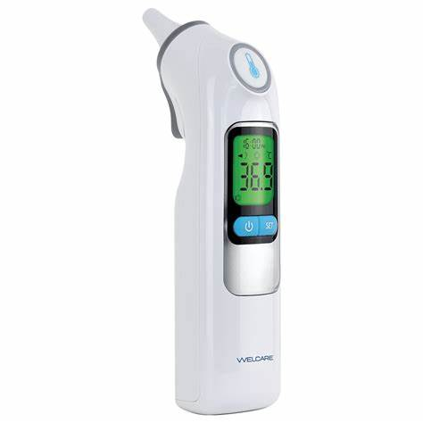
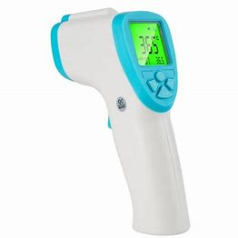
Types of Thermometers
3- Tympanic Thermometer (Ear): Uses infrared technology to measure the temperature of the eardrum. It's quick and non-invasive but may be inaccurate if the ear canal is not properly aligned.
4- Temporal Artery Thermometer: Also uses infrared technology to measure the temperature of the temporal artery on the forehead. It's quick, non-invasive, and often used for children.
3
4

Slide 9
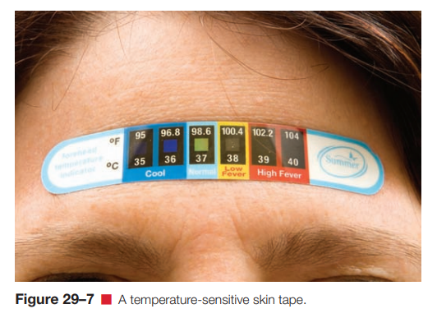
Types of Thermometers
5- Chemical Thermometer: Contains a heat-sensitive chemical that changes color to indicate temperature. These are usually single-use and less accurate than digital or infrared models.

Slide 10
Steps for Assessing Body Temperature
1. Prepare Equipment: Use a clean thermometer (Mercury , digital, tympanic, temporal or chemical).
2. Explain the Procedure: Inform the patient why you're taking their temperature.
3. Choose the Site: Common sites include oral, axillary (+ 0.5 c), rectal (most accurate – 0.5 c), tympanic (ear), or temporal (forehead).
4. Take the Measurement: Place the thermometer properly, wait for the required time.
5. Read the Temperature: Record the temperature (normal is 36.1°C to 37.2°C, with slight variation).
6. Record the Results: Note the temperature and site used.
7. Interpret Results: Abnormal readings indicate fever (<38°C) or hypothermia (<35°C).
8. Clean Equipment: Disinfect reusable thermometers.

Slide 11


Slide 12
Pulse Sites
1- Temporal, where the temporal artery passes over the temporal bone of the head. The site is superior (above) and lateral to (away from the midline of) the eye.
2- Carotid, at the side of the neck where the carotid artery runs between the trachea and the sternocleidomastoid muscle
3- The apical pulse is measured at the apex of the heart, located on the left side of the chest. In adults, it's about 8 cm (3 inches) to the left of the sternum, at the fifth intercostal space. In older adults, the apex may shift further left due to heart enlargement.
4- Brachial, at the inner aspect of the biceps muscle of the arm or medially in the antecubital space.
5. Radial, where the radial artery runs along the radial bone, on the thumb side of the inner aspect of the wrist.

Slide 13
Pulse Sites
6- Femoral, where the femoral artery passes alongside the inguinal ligament.
7-Popliteal, where the popliteal artery passes behind the knee.
8- Posterior tibial, on the medial surface of the ankle where the posterior tibial artery passes behind the medial malleolus.
9- Dorsalis pedis, where the dorsalis pedis artery passes over the bones of the foot, on an imaginary line drawn from the middle of the ankle to the space between the big and second toes

Slide 14
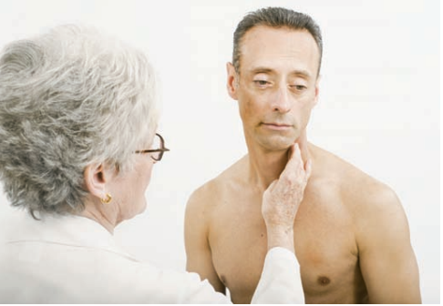
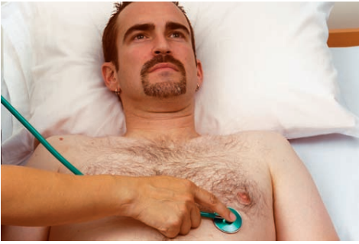
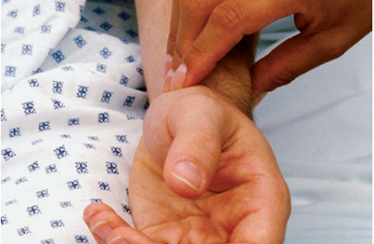
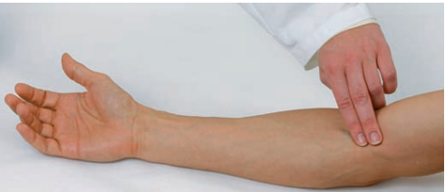

Slide 15
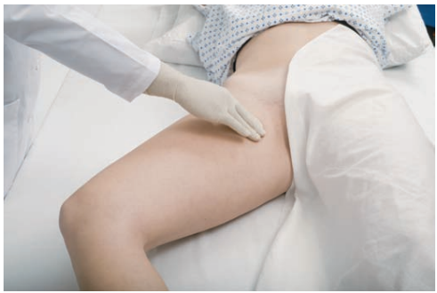
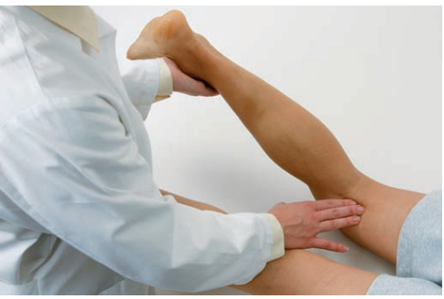
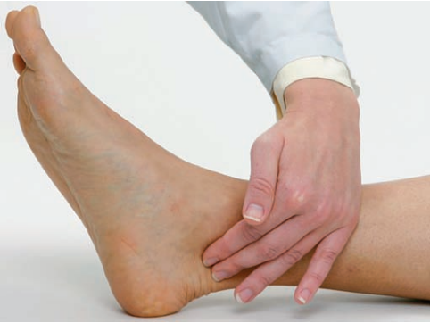
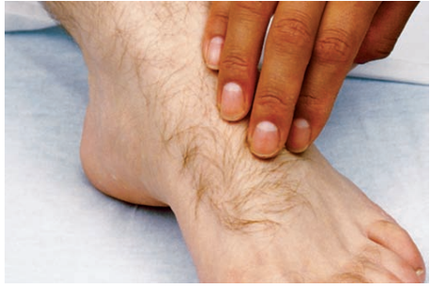
Pulse Sites

Slide 16
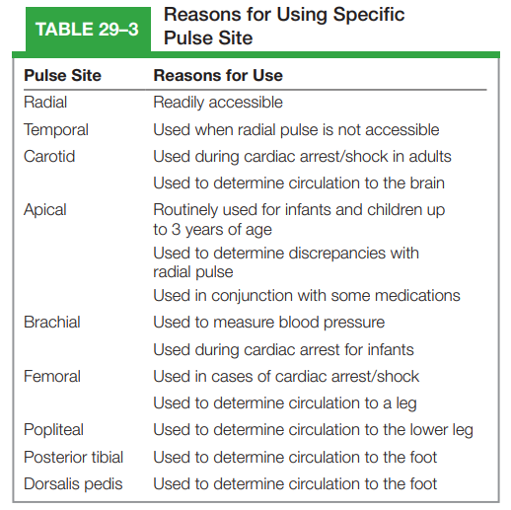
Reasons for Using Specific
Pulse Site

Slide 17
To Assess A Peripheral Pulse
Prepare the patient: Ensure they are relaxed and in a quiet environment.
Choose a site: Common sites include radial (wrist), brachial (elbow), femoral (groin), popliteal (behind the knee), dorsalis pedis (foot), or posterior tibial (ankle).
Locate the pulse: Use your index and middle fingers (not your thumb) to gently palpate the artery.
Evaluate characteristics:
Rate: Count beats per minute (normal: 60-100 bpm).
Rhythm: Check if the pulse is regular or irregular.
Quality: Assess strength (weak, normal, bounding).
Equality: Compare both sides for symmetry.
5. Document findings: Record rate, rhythm, amplitude, and symmetry.

Slide 18


