Slide 1
Medication Administration
Clinical Part I
Prepared by:
Dr. Alaa Hamza
M.Sc.N: Ali Jassim

Slide 2
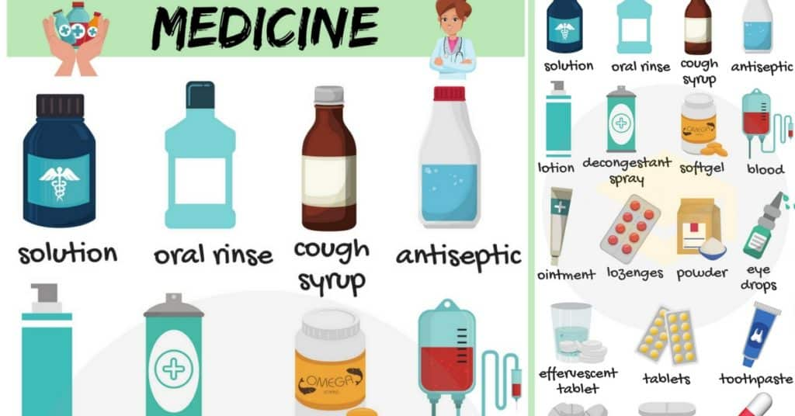

Slide 3
The parenteral route
The parenteral route is defined as other than through the alimentary or respiratory tract; that is, by needle. The following are some of
the more common routes for parenteral administration:
• Subcutaneous (hypodermic)—into the subcutaneous tissue, just below the skin
• Intramuscular (IM)—into a muscle
• Intradermal (ID)—under the epidermis (into the dermis)
• Intravenous (IV)—into a vein.
Some of the less commonly used routes for parenteral administration are intra-arterial (into an artery), intracardiac (into the heart muscle), intraosseous (into a bone), intrathecal or intraspinal (into the spinal canal), intrapleural (into the pleural space), epidural (into the epidural space), and intra-articular (into a joint).
Sterile equipment and sterile drug solution are essential for all parenteral therapy.
The main advantage is fast absorption.

Slide 4
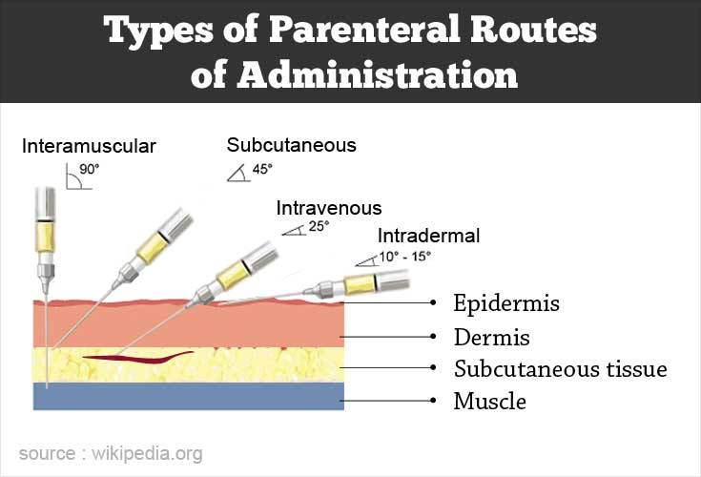

Slide 5
Syringes Overview
Parts:
  Tip: Connects with the needle.
  Barrel: Outer part with scales for measurement.
  Plunger: Inside the barrel for drawing or injecting fluid.
Handling: Avoid contamination by not touching the tip, inside barrel, plunger shaft, or needle.
Types & Sizes:
  Syringes range from 1 mL to 60 mL.
  Common sizes for injections: 1–5 mL for subcutaneous or intramuscular.
  Larger syringes (10–50 mL) used for IV solutions or wound irrigation.
  Insulin syringes have a 100-unit scale and should only be used for insulin.

Slide 6
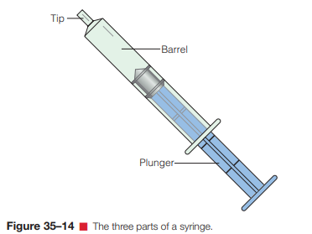

Slide 7
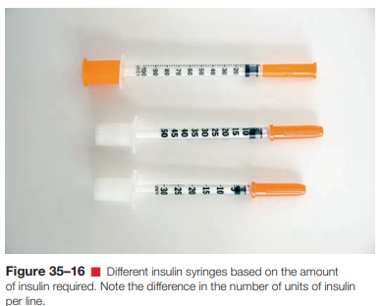
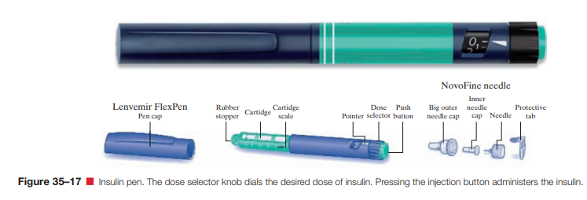
Insulin Syringes and Pens
Insulin Syringes:
  Calibrated for U-100 insulin and available in different doses (e.g., 30 or 50 units).
  Typically have a nonremovable needle.
Insulin Pens:
  Devices that hold a prefilled insulin cartridge, offering easy self-administration.
  Available as disposable (single-use) or reusable (cartridge refillable).
  Some pens allow for half-unit doses.

Slide 8
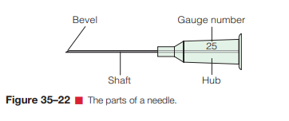
Needles Overview
Parts of a Needle:
  Hub: Attaches to the syringe.
  Shaft: The needle’s length.
  Bevel: Slanted tip for smooth insertion.
Characteristics:
  Bevel: Longer bevels cause less discomfort, used for subcutaneous/intramuscular. Short bevels are for intradermal/IV injections.
  Length: Commonly ranges from 1/2 to 2 inches, selected based on muscle, weight, and injection type.
  Gauge: Varies from #18 to #30, where larger gauge numbers mean smaller needle diameters. Larger gauges are needed for thicker medications.

Slide 9
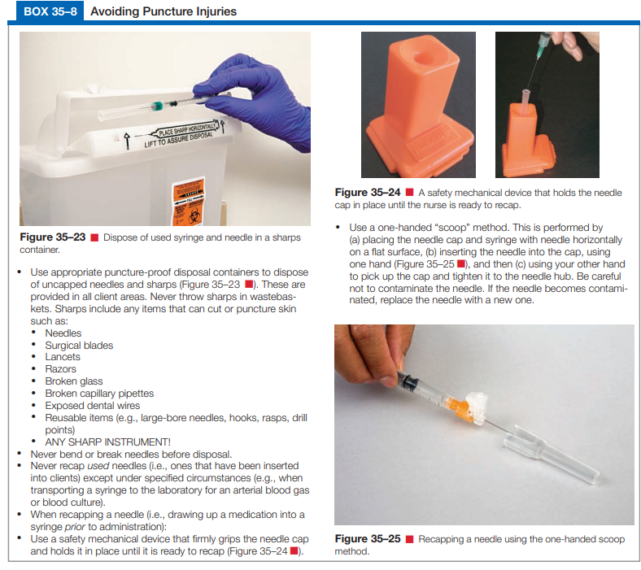

Slide 10
Preventing Needlestick Injuries
Risk:
  Needlestick injuries pose a significant risk for infections, including hepatitis B, HIV, and other pathogens.
OSHA Standards:
  The Occupational Safety and Health Administration (OSHA) has established guidelines to prevent needlestick injuries.
  Specific steps must be followed if an accidental needlestick occurs, as outlined by OSHA.
Safety Syringes:
  Designed to protect healthcare workers from needlestick injuries.
  Types of Safety Devices:
    Passive Safety Device: No action required by the nurse; e.g., needle retracts automatically after injection.
    Active Safety Device: Requires manual activation by the nurse, such as retracting the needle or covering it with a plastic sheath after use.

Slide 11
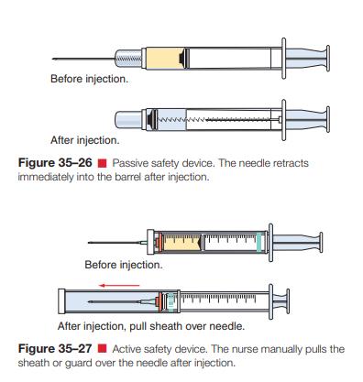

Slide 12
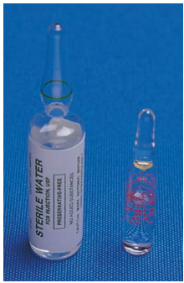
Ampules and Vials Overview
Ampules:
Glass containers, typically holding a single dose of medication.
Size ranges from 1 to 10 mL.
Constricted neck for easy opening, often with colored marks.
Must be broken at the neck to access the medication.
Use of plastic ampule openers is recommended to prevent injury.
A filter needle or straw is used to aspirate the medication to prevent glass particles.

Slide 13
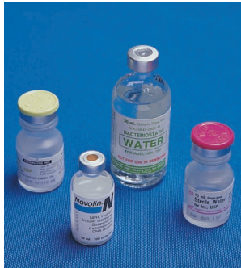
Ampules and Vials Overview
Vials:
Small glass bottles with a rubber cap, available in
single-use or multiple-dose forms.
Needles must pierce the rubber cap to access medication.
Air must be injected into the vial before withdrawing
the medication to avoid a vacuum.
Single-use vials are for one dose, while multidose vials contain multiple doses (e.g., insulin).
Single-dose vials are preferred to reduce infection risks, especially when multiple patients are involved.
Proper sterilization is required when using multidose vials to avoid contamination.

Slide 14
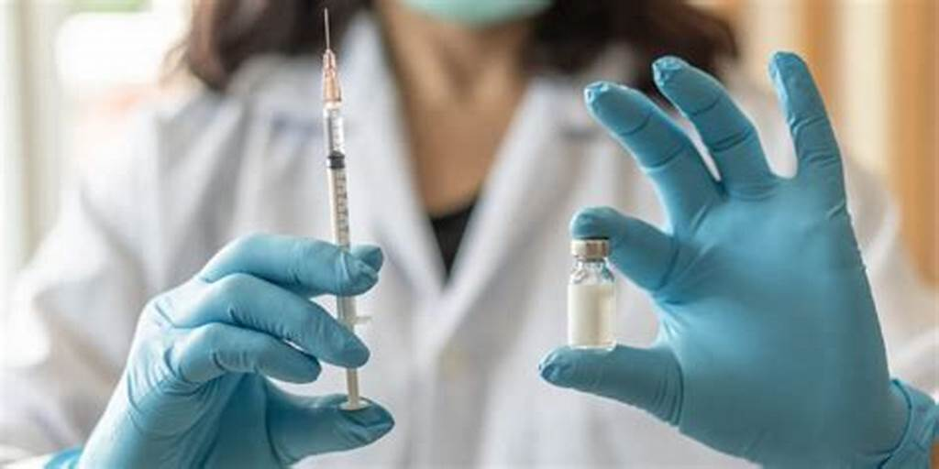
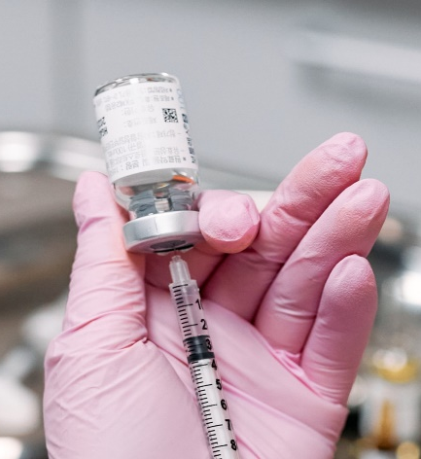
Reconstitution Procedure
Reconstitution of Powdered Drugs:
Some drugs come in powdered form and require a diluent (e.g., sterile water or saline) for injection.
The process is called reconstitution and should follow manufacturer’s instructions for solvent amounts.
Example: Adding 1.5 mL of sterile water to powdered drug to make 2 mL of solution.
Expiration dates should be noted on reconstituted vials, as some have a limited use period.

Slide 15


