Slide 1
Vital Signs
Clinical Part II
Prepared by:
Dr. Alaa Hamza
M.Sc.N: Ali Jassim

Slide 2
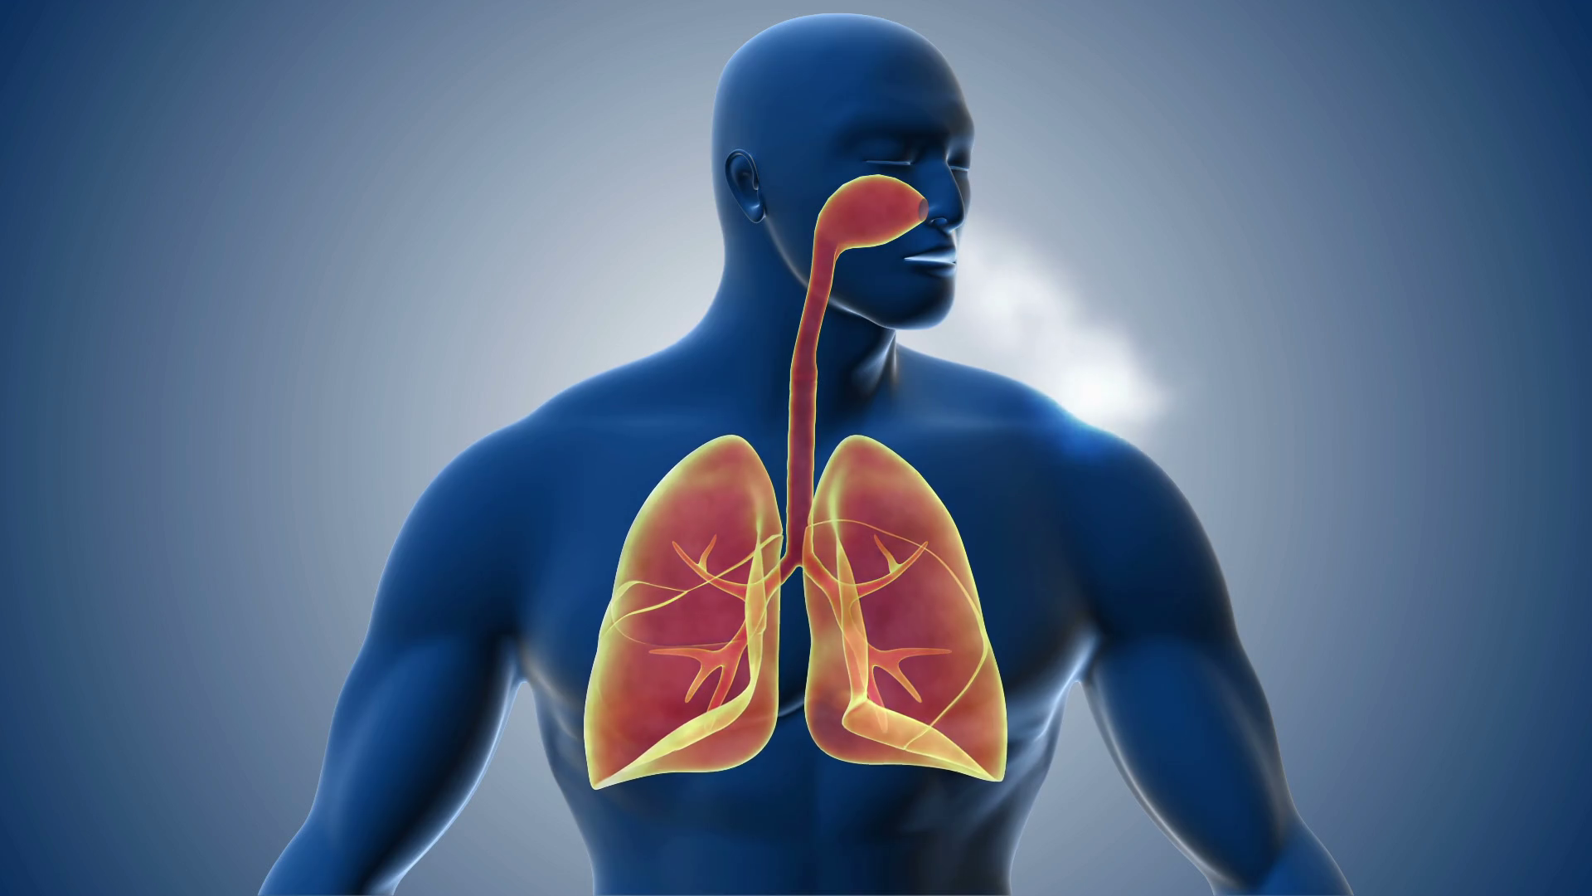
Respirations

Slide 3
General Assessment before Assessing Respiration
Assess :-
Skin and mucous membrane color (e.g., cyanosis or pallor)
• Signs of lack of oxygen to the brain (e.g., irritability, restlessness, drowsiness, or loss of consciousness)
• Chest movements
• Activity tolerance
• Chest pain
• Dyspnea
• Medications affecting respiratory rate

Slide 4
Steps for Assessing Respirations
1- Introduce Yourself and explain the procedure.
2- Perform Hand Hygiene: Ensure proper infection prevention practices are followed.
3- Provide Client Privacy: Maintain the client’s privacy throughout the procedure.
4- Count Respiratory Rate: Observe or palpate to count the client’s respirations. If the client may alter their breathing due to awareness, place a hand on the chest to feel the movements. Count for 30 seconds if respirations are regular, or 60 seconds if irregular. Each inhalation and exhalation is one respiration.

Slide 5
Steps for Assessing Respirations
5- Observe Respiratory Characteristics: Assess the depth, rhythm, and character of the respirations. Depth is noted by chest movement, rhythm by regularity, and character by sound and effort (normal respirations should be silent and effortless).
6- Document Findings: Record the respiratory rate, depth, rhythm, and character in the client's medical record.

Slide 6
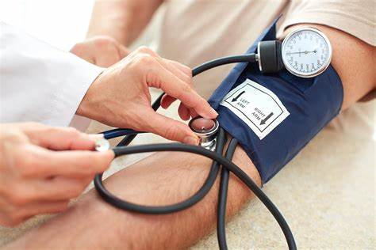
Blood Pressure

Slide 7
Blood Pressure Assessment Sites
Standard Site
Blood pressure is usually measured on the upper arm using the brachial artery with a stethoscope.
Alternative Site: Blood pressure may be assessed on the thigh if:
The arm cannot be used (e.g., due to burns or trauma).
Comparing blood pressure between the thighs is needed.
Avoid Measuring on These Limbs:
If the limb is injured or diseased (shoulder, arm, hand, hip, knee, ankle).
If there's a cast or bulky bandage.
If the client has had surgical removal of lymph nodes on that side.
If the limb has an intravenous infusion or blood transfusion.
If there's an arteriovenous fistula in the limb (e.g., for dialysis).

Slide 8
Types of Sphygmomanometer
1- Aneroid Sphygmomanometer:
Manual device with a dial and needle to indicate pressure.
Requires a stethoscope to listen for Korotkoff sounds during measurement.
2- Digital (Electronic) Sphygmomanometer:
Automatic device that electronically measures and displays blood pressure.
Does not require a stethoscope to listen for sounds.
Easy to use, but requires periodic calibration for accuracy.

Slide 9
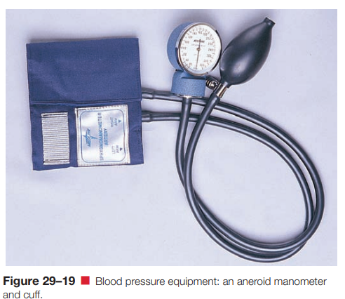
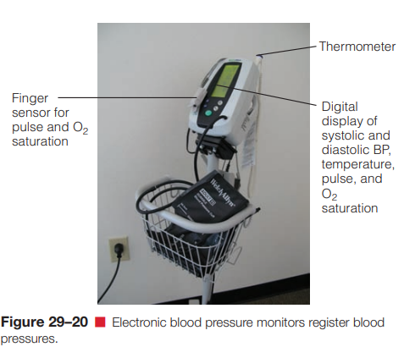
Types of Sphygmomanometer

Slide 10
Steps for Assessing Blood Pressure
1- Introduce Yourself and explain the procedure.
2- Hand Hygiene: Perform proper hand hygiene and follow infection prevention protocols.
3- Client Privacy: Ensure the client’s privacy is maintained.
4- Client Positioning:
The client should be seated, unless directed otherwise.
Both feet should be flat on the floor.
The elbow should be slightly flexed with the palm facing up, and the arm supported at heart level.
Blood pressure readings may vary by position but are generally similar in sitting, standing, and lying positions.

Slide 11
Steps for Assessing Blood Pressure
5- Cuff Placement:
Wrap the deflated cuff evenly around the upper arm, with the bladder centered over the brachial artery.
For initial readings, perform a palpatory determination of systolic pressure by palpating the brachial pulse, inflating the cuff until the pulse is no longer felt, and noting the pressure.
6- Stethoscope Positioning: Clean the earpieces, insert the stethoscope with the earpieces tilted slightly forward, and place the bell over the brachial artery, ensuring it is on bare skin, not clothing.

Slide 12
Steps for Assessing Blood Pressure
7- Auscultation:
Inflate the cuff to 30 mmHg above where the brachial pulse disappears.
Deflate the cuff slowly (2-3 mmHg per second), then release it completely.
Wait 1-2 minutes before remeasuring.
8- Repetition for Accuracy:
If the first reading is abnormal, repeat the measurement and average the results.
If there’s a difference of more than 5 mmHg between readings, take additional measurements.

Slide 13
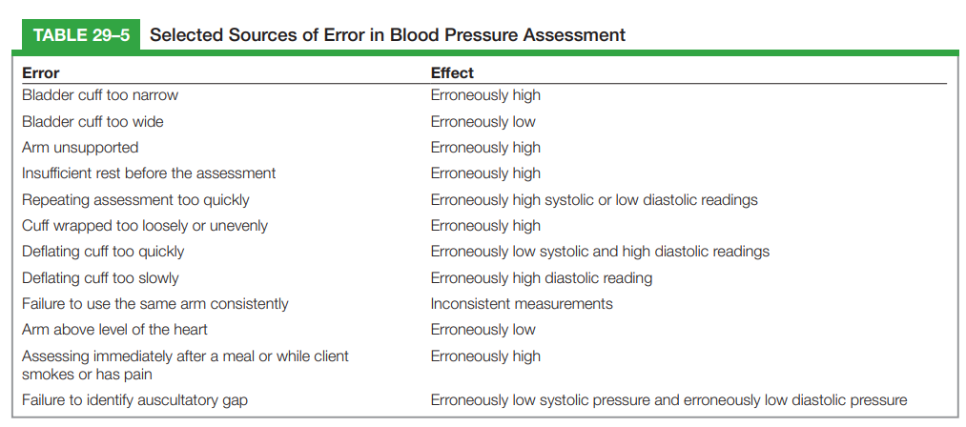

Slide 14


