Slide 1


Al-Mustaqbal university
Nursing college
Prof.dr.Saadya hadi humade

Slide 2
puberty:
Definition of Puberty:
  A period of rapid physical, psychological, and social changes.
  Boys and girls develop secondary sexual characteristics and mature reproductive systems.
Physical Changes:
  Boys:
    Growth of pubic hair.
    Deepening of voice.
    Increased muscle mass.
    Development of testes and production of sperm.
  Girls:
    Growth of pubic and underarm hair.
    Breast development.
    Widening of hips.
    Onset of menstruation.
End of Puberty:
  Puberty ends when:
    Mature sperm are formed in boys.
    Regular menstrual cycles begin in girls.
Ritual Circumcision:
  A rite of passage in some cultures and religions.
  Symbolizes the transition from childhood to adulthood.

Slide 3
Age of Onset Puberty :
  Hormonal changes typically begin between ages 10 and 16.
Physical Changes:
  Increase in penis and testes size.
  Growth spurts.
  Development of secondary sex characteristics like pubic hair, facial hair, and a deeper voice.
Testosterone:
  This primary male sex hormone causes boys to grow taller, become more muscular, and develop secondary sex characteristics.
  Testosterone levels are constant but may decrease with age, reaching about 50% of peak levels by age 80.
Voice Changes:
  The voice deepens, often characterized by squeaks or cracks before reaching its final pitch.
Nocturnal Emissions:
  "Wet dreams" can occur without sexual stimulation and usually don't contain sperm.

Slide 4
female puberty:
Female Puberty Changes:
Breast Development:
  The first outward sign of puberty in girls is the development of the breasts.
Menarche (First Menstrual Period):
  Occurs 1 to 2 years after breast development, typically between ages 11 to 15.
Reproductive Organ Maturation:
  Female reproductive organs mature in preparation for sexual activity and potential childbearing.
Growth Spurt:
  Girls experience a growth spurt, but it ends earlier than the growth spurt in boys.
Pelvic Changes:
  The pelvis broadens, assuming a wider, basin-like shape that is necessary for childbirth.
Hair Growth:
  Pubic and axillary (underarm) hair begin to appear.
  The quantity and pattern of hair vary from person to person, similar to male patterns of hair growth.

Slide 5
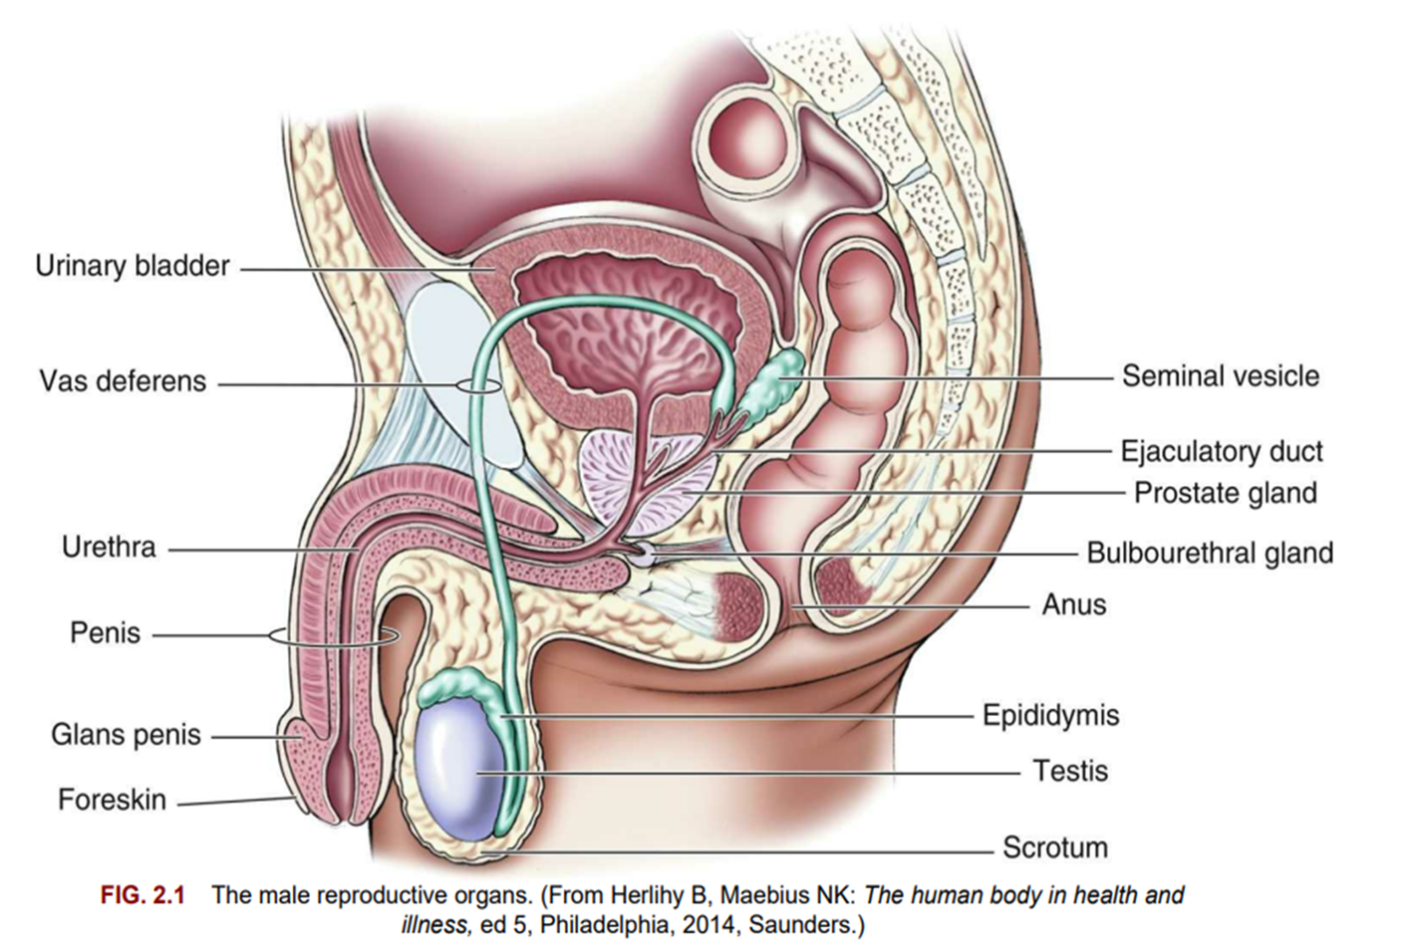

Slide 6
the male external genitalia and its components:
Male External Genitalia:
Penis:
  The penis is composed of the glans (rounded tip) and the body.
Glans:
  The glans is the visible tip of the penis. It is covered by the foreskin in an uncircumcised penis, and exposed in a circumcised penis.
Smegma:
  A cheese-like substance that may accumulate under the foreskin in uncircumcised males. It can be removed through proper hygiene.
Urethral Meatus:
  The opening at the tip of the glans where both urine and sperm exit the body.
Penis Body:
  Contains the urethra, which carries urine and sperm, and erectile tissues:
    Corpus Spongiosum: Surrounds the urethra.
    Corpora Cavernosa: Two columns of erectile tissue that fill with blood during arousal.
Functions of the Penis:
Urinary Function:
  Expels urine from the bladder through the urethra.
Reproductive Function:
  Deposits sperm into the vagina during sexual intercourse, aiding fertilization.

Slide 7
Scrotum:
Structure and Location:
  The scrotum is a sac that holds the testes.
  It is suspended from the perineum (the area between the anus and the genitals).
Function:
  The scrotum keeps the testes away from the body to maintain a lower temperature.
  This cooler temperature is crucial for normal sperm production (spermatogenesis), as sperm production requires temperatures lower than the body's normal temperature.

Slide 8
Internal Genitalia:
The internal genitalia of males include the testes, vas deferens, prostate, seminal vesicles, ejaculatory ducts, urethra, and accessory glands.
Testes:
Structure and Location:
  The testes (testicles) are a pair of oval glands housed within the scrotum.
Functions:
  Sperm Production: The testes manufacture male germ cells (spermatozoa or sperm) in the seminiferous tubules.
  Hormone Secretion: The testes secrete male hormones (androgens), with testosterone being the most abundant.
Sperm Production:
  Sperm production begins at puberty and continues throughout a male's life.
  Sperm is produced in the seminiferous tubules, which are coiled structures within the testes.
Testosterone Production:
  Testosterone is produced in the Leydig cells of the testes.
  Its production is regulated by the anterior pituitary gland, under the influence of the hypothalamus.
Hormonal Regulation in Males :
  In males, testosterone production is stimulated by luteinizing hormone (LH) from the anterior pituitary.
  the anterior pituitary secretes follicle-stimulating hormone (FSH) and luteinizing hormone (LH), which regulate the ovarian cycle.

Slide 9
Effects of Testosterone Not Directly Related to Sexual Reproduction:
Increases Muscle Mass and Strength:
  Testosterone promotes the development of muscle tissue and enhances muscle strength.
Promotes Growth of Long Bones:
  It stimulates the growth and lengthening of long bones, especially during puberty.
Increases Basal Metabolic Rate (BMR):
  Testosterone increases the rate at which the body expends energy, contributing to a higher BMR.
Enhances Production of Red Blood Cells:
  Testosterone stimulates the production of red blood cells, which improves oxygen transport in the body.
Produces Enlargement of Vocal Cords:
  It causes the vocal cords to enlarge, leading to a deeper voice, particularly in males during puberty.
Affects the Distribution of Body Hair:
  Testosterone influences the growth and distribution of body hair, including facial hair and chest hair.
Increases the Production of Sebum:
  Testosterone stimulates the sebaceous glands to produce more sebum (skin oil), which can contribute to acne development, especially during adolescence.

Slide 10
Ducts:
Each Epididymis:
  One from each testicle.
  Stores sperm.
  Sperm may remain in the epididymis for 2 to 10 days, during which they mature.
Each Vas Deferens:
  Passes upward into the body.
  Circles the bladder and passes downward.
  Forms the ejaculatory ducts with ducts from the seminal vesicles.
Ejaculatory Ducts:
  Enter the back of the prostate gland.
  Connect to the upper part of the urethra in the penis.
Urethra:
  Transports both urine from the bladder and semen from the prostate gland to the outside of the body.
  Urine and semen are not expelled at the same time.

Slide 11
Accessory Glands:
Seminal Vesicles, Prostate Gland, and Bulbourethral Glands (Cowper’s Glands):
  These are the accessory glands involved in male reproductive function.
Functions of the Secretions (Seminal Plasma):
  Nourish the sperm.
  Protect the sperm from the acidic environment of the woman’s vagina.
  Enhance the motility (movement) of the sperm.
Semen:
  The combined seminal plasma and sperm are called semen.
  Semen may be secreted during sexual intercourse before ejaculation.
  Pregnancy may occur even if ejaculation happens outside the vagina.
Heat and Sperm Motility:
  Increased heat around the testes boosts sperm motility but reduces their lifespan.
  Constant increased temperature around the testes can prevent spermatogenesis, leading to permanent sterility.

Slide 12
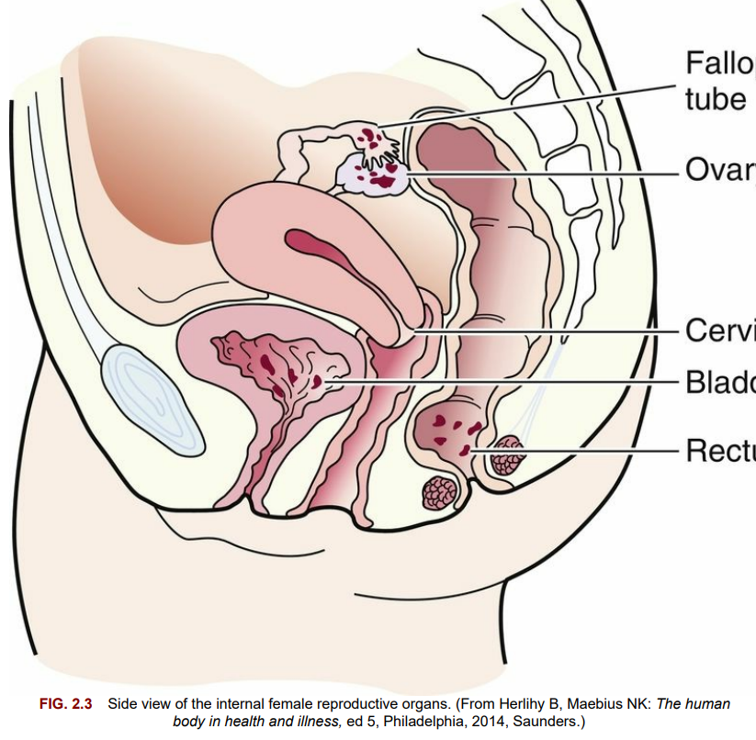

Slide 13
Female Reproductive System: consists of three main components:
External Genitalia:
  Vulva: The collective term for the external female genitalia, which includes:
    Mons Pubis: The fatty tissue located above the pubic bone, typically covered with pubic hair after puberty.
    Labia Majora: The outer, larger folds of skin that protect the inner genital structures.
    Labia Minora: The smaller, inner folds of skin located within the labia majora.
    Fourchette: The area where the labia minora meet posteriorly, located just below the vaginal opening.
    Clitoris: A highly sensitive organ located at the junction of the labia minora, primarily responsible for sexual arousal.
    Vaginal Vestibule: The area surrounding the vaginal opening that includes the external openings of the urethra and the vagina.
    Perineum: The area between the vaginal opening and the anus.
Internal Genitalia:
  The internal reproductive organs in females include the vagina, uterus, fallopian tubes, and ovaries, all essential for reproduction.
Accessory Structures:
  Mammary Glands (Breasts): These are specialized glands that produce milk after childbirth to nourish an infant.
2- Bony Pelvis:The bony pelvis plays a critical role in the childbearing process by providing structural support and forming the birth canal through which the baby passes during childbirth.

Slide 14
External Female Genitalia :
Mons Pubis: A fatty pad covered with coarse skin and hair, which protects the symphysis pubis and contributes to the rounded shape of the female body.
Labia Majora: Two fatty folds surrounding the vaginal vestibule, containing glands that provide lubrication and protection to the vulva.
Labia Minora: Thin, soft folds visible when the labia majora are separated, secreting bactericidal substances to prevent infection and protect the vulvar skin.
Fourchette: A fold of tissue at the bottom of the vaginal opening where the labia majora and labia minora meet, known as the obstetrical perineum, which may experience lacerations during childbirth.
These structures collectively protect the internal reproductive organs, maintain hygiene, and support functions such as childbirth and sexual activity.

Slide 15
Clitoris:
A small, erectile body located in the most anterior portion of the labia minora.
Similar in structure to the penis.
Functionally, it is the most erotic and sensitive part of the female genitalia.
Vaginal Vestibule:
The area seen when the labia minora are separated, which includes five structures:
  Urethral Meatus: Located approximately 2 cm below the clitoris, with a slit-like opening serving as the exit for urine.
  Skene Ducts (Paraurethral Ducts): Located on each side of the urethra, they provide lubrication for the urethra and vaginal orifice.
  Vaginal Introitus: The division between the external and internal female genitalia.
  Hymen: A thin elastic membrane that partially or fully closes the vagina, varying in degrees.
  Bartholin Gland Ducts (Vulvovaginal Glands): Provide lubrication for the vaginal introitus during sexual arousal, and are normally not visible.

Slide 16
The Female Reproductive System (Continued):
Perineum:
  A strong, muscular area between the vaginal opening and the anus.
  Contains elastic fibers and connective tissue, allowing stretching during childbirth.
  The site of episiotomies or potential tears during delivery.
  If tissue does not heal properly, it may result in pelvic weakness or painful intercourse (dyspareunia).
Internal Genitalia:
  Includes the vagina, uterus, fallopian tubes, and ovaries, all vital for reproduction.

Slide 17
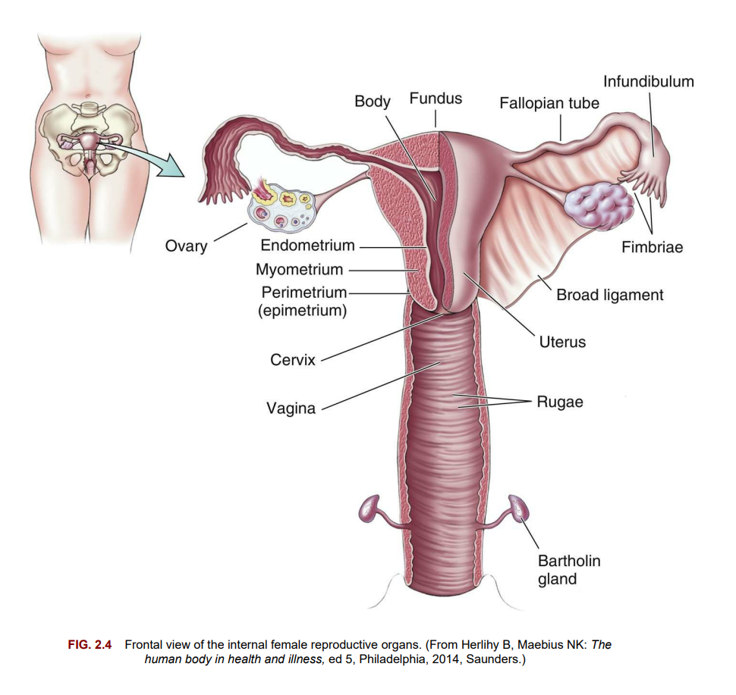

Slide 18
the Vagina and Pelvic Floor Muscles:
Vagina:
  A muscular, tubular structure connecting the external genitalia to the uterus.
  Self-cleansing with a normal acidic pH (4 to 5) during reproductive years.
  Factors that may alter self-cleansing:
    Antibiotic therapy
    Frequent douching
    Excessive use of vaginal sprays, deodorant sanitary pads, or deodorant tampons.
  Functions:
    Passageway for sperm to enter the uterus.
    Allows drainage of menstrual fluids and other secretions.
    Passageway for childbirth.
Pelvic Floor Muscles:
  Provide stability and support to both internal and external reproductive organs.
  Levator Ani: The key muscle, supporting the urethra, vagina, and rectum.

Slide 19
Uterus:
A hollow muscular organ where a fertilized ovum is implanted, an embryo forms, and a fetus develops.
Shaped like an upside-down pear or light bulb.
In a mature, nonpregnant woman, it weighs approximately 60 g and measures:
  7.5 cm (3 inches) long,
  5 cm (2 inches) wide,
  1 to 2.5 cm (0.4 to 1 inch) thick.
Lies between the bladder and rectum, above the vagina.
Ligaments Supporting the Uterus:
Broad Ligament: Provides stability to the uterus in the pelvic cavity.
Round Ligament: Surrounded by muscles that enlarge during pregnancy to keep the uterus in place.
Cardinal Ligaments: Prevent uterine prolapse.
Uterosacral Ligaments: Surrounded by smooth muscle and contain sensory nerve fibers, which may contribute to the sensation of dysmenorrhea (painful menstruation).
Discomfort:
Stretching of the uterine ligaments during pregnancy can cause minor discomfort for the mother.

Slide 20
Nerve Supply to the Female Reproductive System:
Autonomic Nervous System:
  The reproductive system is controlled by the autonomic nervous system, meaning its functions are involuntary and not consciously controlled.
  Even a paraplegic woman can experience normal labor contractions due to the autonomic nervous system’s role.
Sensory Pathways:
  Sensations related to uterine contractions are transmitted to the central nervous system via the 11th and 12th thoracic nerve roots.
  Pain from the cervix and vagina is carried through the pudendal nerves.
Motor Pathways:
  The motor fibers that control the uterus originate from the 7th and 8th thoracic vertebrae.
Local Anesthesia:
  The distinction between motor and sensory nerve pathways allows for the use of local anesthetics during labor without interrupting uterine contractions, which is critical for effective pain management.

Slide 21
Cervix Functions and Structure:
Structure of the Cervix:
  The cervix is the lower, narrow, and tubular part of the uterus that opens into the upper vagina.
  It consists of a cervical canal with two openings:
    Internal Os: The opening near the uterine body.
    External Os: The opening into the vagina.
Functions of the Mucosal Lining:
  Lubrication: Helps to lubricate the vagina, making intercourse and childbirth smoother.
  Bacteriostatic Action: Acts as a barrier against infections, reducing bacterial growth in the vagina.
  Alkaline Environment: Provides an alkaline environment that shelters sperm from the acidic conditions of the vagina, supporting fertilization.
  Mucous Plug: During pregnancy, it produces a mucous plug that seals the cervical canal, protecting the uterus from infections.

Slide 22
Fallopian Tubes:
General Structure:
  The fallopian tubes (also called uterine tubes or oviducts) extend laterally from the uterus, with one tube leading to each ovary.
  Length: 8 to 13.5 cm (3 to 5.3 inches).
Sections of the Fallopian Tubes:
  Interstitial Portion: This section extends into the uterine cavity and lies within the wall of the uterus.
  Isthmus: The narrow section of the tube closest to the uterus.
  Ampulla: The wider section, typically where fertilization occurs.
  Infundibulum: The funnel-shaped, enlarged distal end of the tube. The fimbriae (finger-like projections) from the infundibulum "capture" the egg (ovum) when it is released from the ovary during ovulation.

Slide 23
Functions of the Fallopian Tubes:
Passageway for Sperm and Ovum:
  The fallopian tubes provide a passageway where sperm can meet the ovum for fertilization.
Site of Fertilization:
  Fertilization typically occurs in the outer one-third of the fallopian tube, known as the ampulla.
Nourishing Environment:
  The tubes offer a safe and nourishing environment for the ovum or zygote (fertilized egg) to develop before moving to the uterus.
Transport of Ovum/Zygote:
  The fallopian tubes help transport the ovum or fertilized zygote toward the uterus for implantation.
Additionally:
Cilia Movement: Cells within the fallopian tubes have cilia (hair-like projections) that beat rhythmically, helping move the ovum toward the uterus.
Protein-rich Fluid: Other cells secrete a nourishing, protein-rich fluid to support the ovum after its release from the ovary.

Slide 24
Ovaries Overview:
Structure and Location:
  The ovaries are two almond-shaped glands, approximately the size of a walnut.
  Located in the lower abdominal cavity, one on each side of the uterus.
  Held in place by ovarian and uterine ligaments.
Primary Functions:
  Hormone Production:
    Produce hormones, chiefly estrogen and progesterone, which regulate the menstrual cycle and support reproductive health.
  Ovum Maturation:
    Stimulate the maturation of an ovum (egg) each menstrual cycle.
Oocyte Development:
  At birth, a female has all the oocytes (ova) she will have during her reproductive years—approximately 2 million oocytes.
  Over time, these oocytes degenerate, leaving only a few thousand by adulthood.
  Approximately 400 oocytes are released during the reproductive years, one per cycle.
  After menopause (the climacteric), any remaining oocytes no longer respond to hormonal stimulation for maturation.

Slide 25
Pelvis:
The bony pelvis occupies the lower portion of the trunk of the body.
Four bones attached to the lower spine form the pelvis:
  Two innominate bones
  Sacrum
  Coccyx
Innominate Bones:
  Each innominate bone is made up of the ilium, pubis, and ischium, which are separate during childhood but fuse by adulthood.
  Ilium: The lateral portion of the hip bone.
  Pubis: The anterior portion of the hip bone. The ilium and pubis join to form the symphysis pubis.
  The curved space under the symphysis pubis is called the pubic arch.
  Ischium: Located below the ilium, it supports the seated body. The ischial spines, one from each ischium, jut inward to varying degrees and serve as a reference point for the descent of the fetus during labor.
Sacrum and Coccyx:
  The sacrum consists of five fused, triangular vertebrae at the base of the spine.
  The sacrum may jut into the pelvic cavity, causing a narrowing of the birth passageway.
  The coccyx is the lowest part of the spine, located below the sacrum.

Slide 26
Functions of the Bony Pelvis:
Supports and Distributes Body Weight:
  The pelvis bears and transfers the weight of the upper body to the lower limbs while maintaining balance during standing and walking.
Supports and Protects Pelvic Organs:
  The bony structure of the pelvis surrounds and protects the internal pelvic organs such as the bladder, rectum, and reproductive organs (uterus, ovaries, and vagina).
Forms the Birth Passageway:
  The pelvis provides the structural framework for the birth canal, enabling the passage of the baby during childbirth.

Slide 27
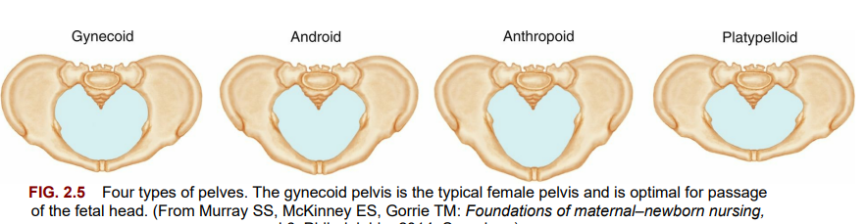

Slide 28
Types of Pelves:
Gynecoid Pelvis:
  The classic female pelvis with rounded anterior and posterior segments.
  Most favorable for vaginal birth.
Android Pelvis:
  Has a wedge-shaped inlet with a narrow anterior segment.
  Typical of the male anatomy.
Anthropoid Pelvis:
  Anteroposterior diameter equals or exceeds its transverse diameter.
  Long, narrow oval shape.
  Women with this type can usually deliver vaginally, but the infant is more likely to be born in the occiput posterior (back of the fetal head toward the mother’s sacrum) position.
Platypelloid Pelvis:
  Shortened anteroposterior diameter and a flat, transverse oval shape.
  Unfavorable for vaginal birth.

Slide 29
False and true pelves
The Pelvis is Divided into:
False Pelvis:
  The upper portion of the pelvis.
  Supports the enlarging uterus and guides the fetus into the true pelvis.
True Pelvis:
  The lower portion of the pelvis, consisting of:
    Pelvic inlet
    Pelvic cavity
    Pelvic outlet
  Dictates the bony limits of the birth canal, making it crucial for labor and delivery.
Division:
The false and true pelves are separated by an imaginary line called the linea terminalis, which extends from the sacroiliac joint to the anterior iliopubic prominence.

Slide 30
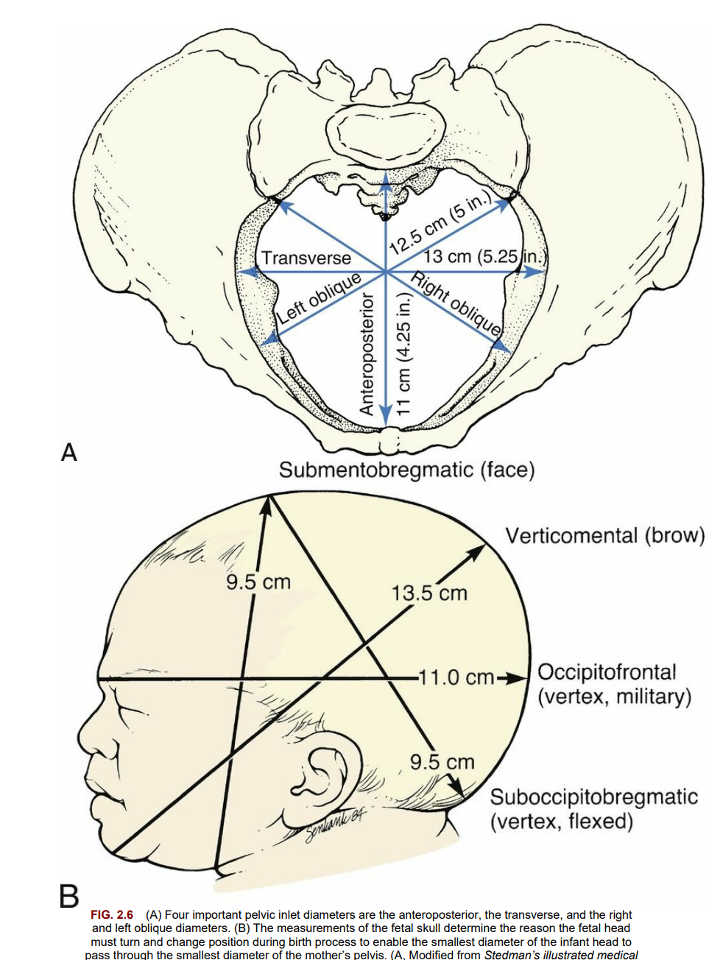

Slide 31
Pelvic Inlet:
Located just below the linea terminalis, the pelvic inlet has several obstetrically important diameters.
Anteroposterior Diameter:
  Measured between the symphysis pubis and the sacrum.
  This is the shortest inlet diameter.
Transverse Diameter:
  Measured across the linea terminalis.
  This is the largest inlet diameter.
Oblique Diameters:
  Measured from the right or left sacroiliac joint to the prominence of the linea terminalis.
Measurements of the Pelvic Inlet:
Diagonal Conjugate:
  The distance between the suprapubic angle and the sacral promontory.
  Assessed during a manual pelvic examination by a healthcare provider.
Obstetric Conjugate (the smallest inlet diameter):
  Estimated by subtracting 1.5 to 2 cm from the diagonal conjugate (approximate thickness of the pubic bone).
  This measurement determines whether the fetus can pass through the birth canal.
Transverse Diameter:
  The largest diameter of the inlet.
  It determines the shape of the inlet.

Slide 32
Pelvic Outlet:
Transverse Diameter:
  Measured as the distance between the inner surfaces of the ischial tuberosities.
  Known as the biischial diameter.
Anteroposterior Measurement:
  The distance between the lower border of the symphysis pubis and the tip of the sacrum.
  This can be measured by vaginal examination.
Sagittal Diameters:
  Measured from the middle of the transverse diameter to the pubic bone anteriorly and to the sacrococcygeal bone posteriorly.
Coccyx:
  The coccyx can move or break during the passage of the fetal head.
  An immobile coccyx can decrease the size of the pelvic outlet, potentially making vaginal birth difficult.
Pubic Arch:
  A narrow pubic arch can also affect the passage of the fetal head through the birth canal.
Importance of Adequate Pelvic Measurements:
Adequate pelvic measurements are essential for a successful vaginal birth.
Conditions like a history of pelvic fractures or rickets can result in a small pelvis, potentially necessitating a cesarean section for delivery.

Slide 33
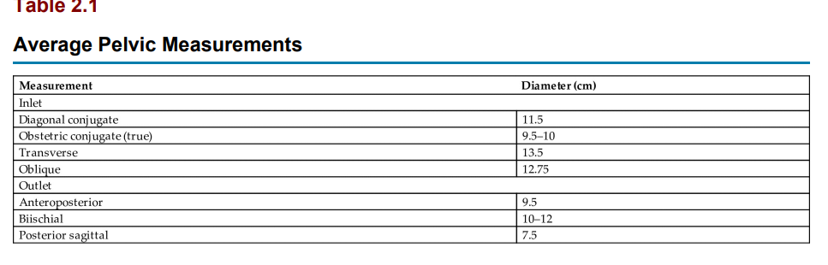

Slide 34
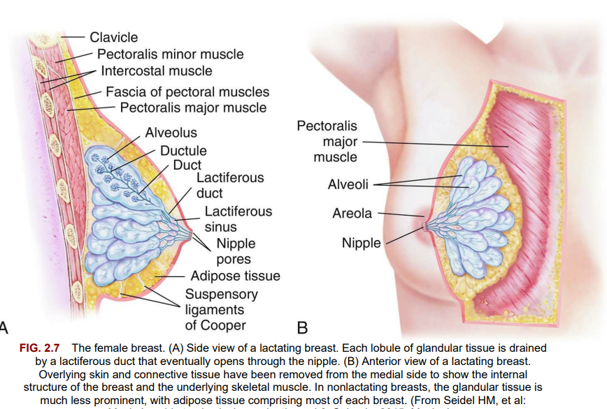

Slide 35
Female Breasts (Mammary Glands) :
Accessory Organs of Reproduction:
  Female breasts are considered accessory organs of reproduction.
  Their primary function is to produce milk after childbirth.
Milk Production:
  Breasts produce milk to nourish the infant.
  Milk contains maternal antibodies to protect the baby from infections.
Nipple and Areola:
  The nipple is located at the center of each breast.
  It is surrounded by a pigmented area known as the areola.
Montgomery Glands (Tubercles):
  Small sebaceous glands found in the areola.
  They secrete a substance that lubricates and protects the breasts during lactation.
Key Functions:
Nourishment and immune support for the infant.
Protection and lubrication of the breast during lactation through Montgomery glands.

Slide 36
Structure and Function of Female Breasts:
Lobes:
  Each breast contains 15 to 24 lobes, arranged like the spokes of a wheel.
  These lobes are separated by adipose (fatty) and fibrous tissues.
Adipose Tissue:
  The amount of adipose tissue influences the size and firmness of the breasts.
  It also gives the breasts a smooth outline.
  Breast size is primarily determined by the amount of fatty tissue, not by a woman’s ability to produce milk.
Alveoli (Lobules):
  The alveoli (or lobules) are the glands responsible for milk secretion.
Lactiferous Ducts:
  Milk from the alveoli empties into approximately 20 lactiferous (milk-carrying) ducts.
Milk Storage:
  Milk is briefly stored in widened areas of the ducts, called ampullae or lactiferous sinuses.
Key Points:
Lobes are the main structural units of the breast.
Adipose tissue determines size, while alveoli are responsible for milk production.
Milk is transported and briefly stored in lactiferous ducts and sinuses before being released.

Slide 37
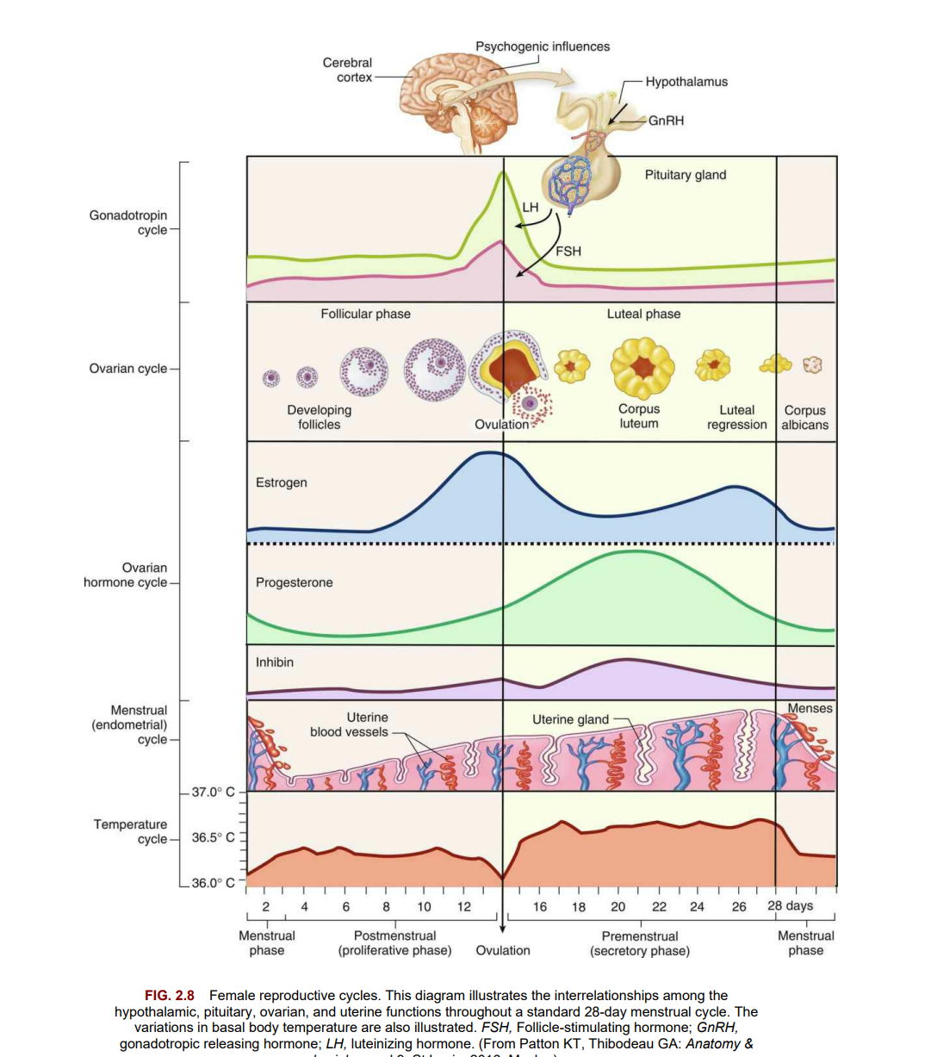

Slide 38
Reproductive Cycle and Menstruation:
The female reproductive cycle involves regular changes in the secretions of the anterior pituitary gland, the ovary, and the endometrial lining of the uterus.
In response to the hypothalamus, the anterior pituitary gland secretes:
  Follicle-stimulating hormone (FSH): Stimulates the maturation of a follicle in the ovary that contains a single ovum.
  Luteinizing hormone (LH): Plays a role in the final maturation and release of the ovum.
Follicle Development:
  Several follicles begin to mature during each cycle, but usually, only one reaches final maturity.
  The maturing ovum and the corpus luteum (the empty follicle after the ovum is released) produce increasing amounts of estrogen and progesterone, which cause the endometrium to enlarge.
Ovulation:
  A surge in LH triggers the final maturation of the ovum and its release (ovulation).
  Approximately 2 days before ovulation, there is an increase in vaginal secretions.

Slide 39
The female reproductive cycle is regulated by the interrelationships between the hypothalamus, pituitary gland, ovaries, and uterus, typically over a 28-day period:
Hypothalamus:
  Releases GnRH (gonadotropin-releasing hormone) to stimulate the pituitary gland. GnRH fluctuates rhythmically, leading to the release of FSH and LH.
Pituitary Gland:
  FSH promotes ovarian follicle maturation, and LH triggers ovulation. The secretion of FSH and LH is regulated by estrogen and progesterone feedback mechanisms.
Ovaries:
  Follicular Phase (Day 1-14): Several follicles mature, with one becoming dominant. The dominant follicle secretes estrogen, which helps prepare the uterus for potential pregnancy.
  Ovulation (Day 14): A surge in LH, triggered by rising estrogen levels, causes the release of a mature egg.
  Luteal Phase (Day 15-28): The ruptured follicle becomes the corpus luteum, which secretes progesterone to maintain the uterine lining for potential implantation.
Uterus:
  Menstruation (Day 1-5): Without fertilization, estrogen and progesterone levels drop, leading to the shedding of the endometrial lining.
  Proliferative Phase (Day 6-14): Estrogen thickens the endometrial lining in preparation for possible pregnancy.
  Secretory Phase (Day 15-28): Progesterone from the corpus luteum maintains the endometrial lining for implantation.

Slide 40
Basal body temperature (BBT) varies throughout the 28-day menstrual cycle due to hormonal changes:
Follicular Phase (Days 1-14):
  BBT is low, typically ranging from 36.1°C to 36.5°C (97°F to 97.7°F), influenced by estrogen.
Ovulation (Around Day 14):
  A slight BBT dip occurs just before ovulation, followed by a sharp rise after ovulation due to increased progesterone.
Luteal Phase (Days 15-28):
  BBT remains elevated (36.7°C to 37.0°C / 98.1°F to 98.6°F) due to progesterone production by the corpus luteum.
Menstruation (Days 1-5):
  BBT drops when progesterone levels fall, signaling the start of a new cycle.
Tracking BBT helps identify ovulation and the hormonal shifts that support pregnancy or menstruation.

Slide 41
Female Reproductive Cycles:
Ovulation:
  Ovulation occurs when a mature ovum is released from the follicle, about 14 days before the onset of the next menstrual period.
Corpus Luteum:
  After ovulation, the corpus luteum turns yellow (luteinizing) and begins to secrete increasing quantities of progesterone to prepare the uterine lining for the potential implantation of a fertilized ovum.
If Fertilization Does Not Occur:
  Approximately 12 days after ovulation, the corpus luteum degenerates if fertilization has not occurred.
  This causes a decrease in progesterone and estrogen levels.
Menstruation:
  The drop in estrogen and progesterone levels causes the endometrium to break down, resulting in menstruation.
Cycle Restart:
  The anterior pituitary gland secretes more FSH and LH, beginning a new cycle.
Menarche:
  The beginning of menstruation, known as menarche, typically occurs between the ages of 11 to 15 years.

Slide 42
This information outlines the typical menstrual cycle characteristics, particularly in the context of adolescents and young women. :
Irregular Cycles in Early Menstruation: In the initial years after menarche (the first menstrual period), cycles are often irregular, and ovulation may not occur regularly. This is due to hormonal fluctuations as the body adjusts to reproductive function.
Cycle Regularity Over Time: Most individuals will see their cycles become more regular within 6 months to 2 years of menarche. This means the frequency of periods, as well as ovulation, typically stabilizes during this period.
Average Menstrual Cycle: A typical menstrual cycle is around 28 days, although variations of plus or minus 5 to 10 days are common. Cycles can be shorter or longer, but the range of 21 to 35 days is considered normal.
Menstrual Flow: The menstrual flow typically lasts 2 to 5 days. On average, a person loses about 30 to 40 mL of blood, along with an additional 30 to 50 mL of serous fluid (which contains water, electrolytes, and some proteins).
Fibrinolysin Role: Fibrinolysin, an enzyme, is present in the tissue of the shedding endometrium. It prevents clot formation in the menstrual blood, ensuring that the flow remains liquid rather than forming clots, which helps in the smooth expulsion of the endometrial lining.

Slide 43
Key Points:Puberty:
Puberty:
  Marks the time when reproductive organs mature and secondary sex characteristics develop.
  A sexually active girl can become pregnant before her first menstrual period because ovulation occurs before menstruation.
  At birth, every female has all the ova that will be available during her reproductive years.
Hormones:
  Testosterone is the principal male hormone and continues to be secreted throughout a man's life.
  Estrogen and progesterone are the principal female hormones. Their secretion is very low after a woman reaches the climacteric (menopause).
Male External Genitalia:
  The penis and scrotum are the male external genitalia.
  The scrotum helps keep the testes cooler than the rest of the body, promoting normal sperm production.
  The two main functions of the testes are to manufacture sperm and to secrete male hormones (androgens), primarily testosterone.
Female Reproductive System:
  The myometrium is the middle muscular uterine layer, and it is functional during pregnancy and labor.
  The endometrium is the inner uterine layer, and it is functional in menstruation and implantation of a fertilized ovum.

Slide 44
Female Breasts:
  The female breasts are composed of fatty and fibrous tissue and glands that can secrete milk.
  The size of a woman’s breasts is determined by the amount of fatty tissue and does not influence her ability to secrete milk.
Female Reproductive Cycle:
  The female reproductive cycle consists of regular changes in hormone secretions from the anterior pituitary gland and the ovary.
  The cycle includes the maturation and release of an ovum, and the buildup and breakdown of the uterine lining.
Pelvic Shapes:
  There are four basic pelvic shapes, but women often have a combination of characteristics.
  The gynecoid pelvis is the most favorable for vaginal birth.
Pelvic Structure:
  The pelvis is divided into a false pelvis above the linea terminalis and the true pelvis below this line.
  The true pelvis is most important in the childbirth process.
  The true pelvis is further divided into the pelvic inlet, the pelvic cavity, and the pelvic outlet.
Fertilization Window:
  The egg lives for only 24 hours after ovulation, and fertilization must occur during that time.

Slide 45
Review Questions for the NCLEX® Examination
1- Spermatozoa are produced in the:
vas deferens.
seminiferous tubules.
prostate gland.
Leydig cells.
2. A woman can keep a diary of her menstrual cycles to help determine her fertile period. She understands that after ovulation she will remain fertile for:
1. 2 hours.
2. 24 hours.
3. 3 to 5 days.
4. 7 to 14 days.
3. Which data indicate that a woman may have pelvic dimensions that would be inadequate for a normal vaginal delivery? A woman with a(n):
anthropoid-shaped pelvis with a history of pelvic inflammatory disease
gynecoid-shaped pelvis with a history of rickets
anthropoid-shaped pelvis that previously delivered a 9-lb infant
gynecoid-shaped pelvis with a history of poor nutrition.

Slide 46
Q1-B. Seminiferous Tubules
Rationale: Sperm are made in the convoluted seminiferous tubules of the testes.
Q2--B. 24 hours
Rationale: The egg lives for only 24 hours after ovulation; therefore it is viable for fertilization only for 24 hours.
Q3-B. gynecoid-shaped pelvis with a history of rickets
Rationale: Although the gynecoid-shaped pelvis is considered most favorable for a vaginal delivery, a woman with a history of rickets (a disease in which normal bone formation is disturbed when bone fails to mineralize and becomes soft and distorted) would be the most likely of the choices for inadequate normal vaginal delivery.
An anthropoid-shaped pelvis with a history of PID, although not most favorable, allows for possible vaginal delivery, and history of PID might interfere with conception but not delivery.
Previous delivery of a large infant is evidence of adequate pelvic dimensions for a normal vaginal delivery.
Although poor maternal nutrition can affect the health of the newborn, delivery is not necessarily affected.

Slide 47
4. The muscular layer of the uterus that is the functional unit in pregnancy and labor is the:
1. perimetrium.
2. myometrium.
3. endometrium.
4. cervix.
5. During a prenatal clinic visit, a woman states that she probably will not plan to breastfeed her infant because she has very small breasts and believes she cannot provide adequate milk for a full-term infant. The best response of the nurse would be:
“Ask the physician if he or she will prescribe hormones to build up the breasts.”
“I can provide you with exercises that will build up your breast tissue.
“The fluid intake of the mother will determine the milk output.”
The size of the breast has no relationship to the ability to produce adequate milk.”

Slide 48
Q4- B. myometrium
Rationale: The myometrium is the middle muscular uterine layer and is functional in pregnancy and labor.
The perimetrium is the outermost, or serosal, layer that envelops the uterus.
The endometrium is the inner, or mucosal, layer that is functional during menstruation and implantation of the fertilized ovum.
The cervix is the lower part of the uterus that lubricates the vagina, acts as a bacteriostatic agent, provides an alkaline environment, and produces a mucous plug.
Q5-D. "The size of the breast has no relationship to the ability to produce adequate milk"
Rationale: Breast size is primarily determined by the amount of fatty tissue and is unrelated to a woman's ability to produce milk.
The other answer options are inaccurate.

Slide 49
6. The nurse is leading a class discussing ovulation and menstruation. The nurse explains that ovulation occurs:
14 days after the last menstrual period
14 days before the next menstrual period
at the 16th day of a 32-day menstrual cycle
. 1 week before menses occurs
b and d
a and c
b only 4.
d only
Critical Thinking Questions
A patient is admitted to the labor unit. She has not had any prenatal care. Her history shows that she sustained a fractured pelvis from an automobile accident several years previously. The patient states she is interested in natural childbirth. What is the nurse’s best response?
An adolescent boy fears he is becoming incontinent because he notices his pajama pants are wet on occasion when he awakes in the morning. He asks if there is medicine to stop this problem. What is the best response from the nurse?

Slide 50
Question:
1- What marks the end of puberty in boys and girls?
A) The development of secondary sexual characteristics
B) The onset of facial hair growth
C) The formation of mature sperm in boys and regular menstrual cycles in girls
D) The appearance of pubic and axillary hair
Answer:
C) The formation of mature sperm in boys and regular menstrual cycles in girls
2- At what age do hormonal changes typically begin in boys, and what is one of the primary effects of testosterone during puberty?
A) Between ages 10 and 16; it causes the penis and testes to shrink.
B) Between ages 10 and 16; it causes boys to grow taller and develop secondary sex characteristics.
C) Between ages 12 and 18; it causes the voice to remain high-pitched.
D) Between ages 12 and 18; it causes growth spurts without other secondary sex characteristics.
**Answer:**
B) Between ages 10 and 16; it causes boys to grow taller and develop secondary sex characteristics.

Slide 51
Leifer, G. (2019). Introduction to maternity and pediatric nursing.‏

Slide 52
Thanks for listening

