Slide 1
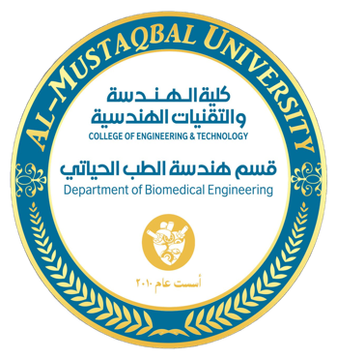


Subject Name: Biology
1st Class, First Semester
Subject Code: [Insert Subject Code Here]
Academic Year: 2024-2025
Lecturer: Assist lect. Zainab Sattar Jabbar
Email: zainab.sattar.jabbar@uomus.edu.iq
Lecture No.:- 1
Lecture Title: [Introduction to Biology]

Slide 2
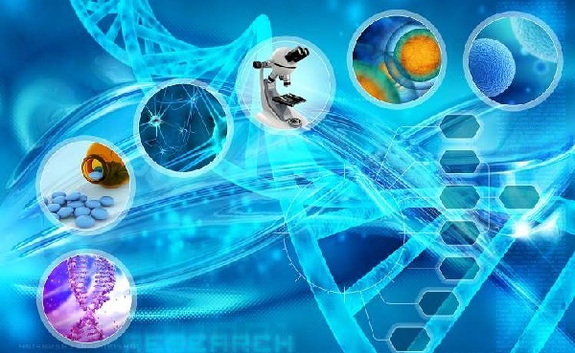
Introduction
Biology: is the scientific study of life and living organisms, focusing on their structure, function, growth, evolution, and distribution.
It is derivative from the Greek word “bio” means life and “logos” means study of.
It provides the foundation for all life sciences, including medicine, pharmacology, and biomedical engineering.
In the late1700s Pierre-Antoine de Monet and Jean-Baptiste de Lamarck coined the term biology.
Biological Sciences: is an extensive study covering the minute workings of chemical substances inside living cells to the broad scale concepts of ecosystems and global environmental changes.

Slide 3
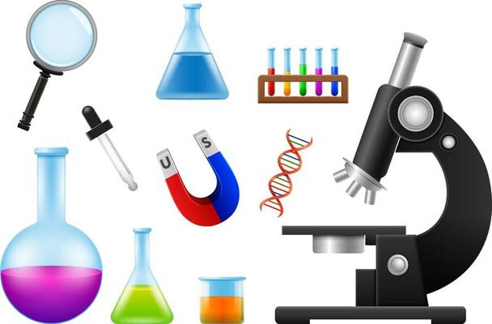
Importance of biology
Improved understanding on functions of organisms.
Finding treatment for diseases.
Improved understanding on ecology.
Better management on environment problems.
Improved quality and production of food.

Slide 4
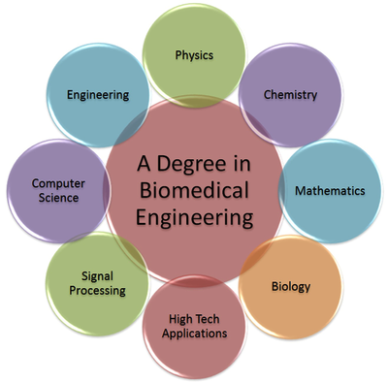
Relevance to Biomedical Engineering
Biomedical Engineering (BME) applies principles from biology and engineering to design medical devices, develop new therapies, and improve human health.
Knowledge of biology allows biomedical engineers to create devices that work harmoniously with the human body, enhancing medical treatment and improving patient outcomes.

Slide 5
Sub- disciplines or Branches of Biology
Biology is a vast field with many specialized areas of study. These sub-disciplines play key roles in advancing biomedical engineering.
Some of the branches of biology are as follows:
Cell Biology: Focuses on the structure and function of cells, the basic unit of life/Biomedical Engineering Link: Tissue engineering and stem cell research are grounded in cell biology, enabling the creation of artificial organs and tissues for transplants.
Genetics: Study of heredity, genes, and variation in organisms/Biomedical Engineering Link: Gene therapy and genetic engineering, such as CRISPR, are used in developing treatments for genetic diseases and disorders.
Physiology: Examines how the body functions, focusing on organs and systems (e.g., cardiovascular, nervous systems) /Biomedical Engineering Link: Essential for designing devices like pacemakers, prosthetics, and dialysis machines, which interact with biological systems.

Slide 6
Sub- disciplines or Branches of Biology
Ecology: Studies interactions between organisms and their environments/Biomedical Engineering Link: Ecological studies can inform the design of environmentally sustainable medical devices and technologies, including considerations for health impacts on ecosystems.
Anatomy: the study of the animal form, particularly the human body.
Biochemistry: the study of the structure and function of cellular components, such as proteins, carbohydrates, lipids, nucleic acids, and other biomolecules, and of their functions and transformations during life processes.
Molecular Biology: Focuses on the molecular mechanisms underlying biological processes, such as DNA replication and protein synthesis/Biomedical Engineering Link: Critical in developing diagnostic tools, drug delivery systems, and understanding disease at the molecular level.

Slide 7
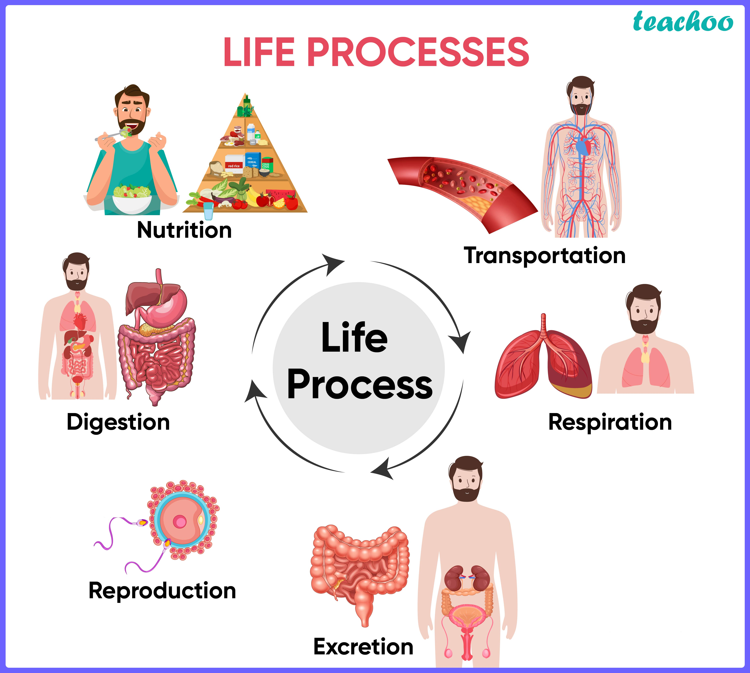
Life Processes in Biology
Life processes are fundamental activities required for an organism to survive and thrive. These processes are also crucial for designing biomedical solutions.
Life processes are the series of actions that are essential to determine if an animal is alive.
What are the Life Processes?
There are seven essential processes in common: movement, respiration, homeostasis, response to stimuli, sensitivity, growth, reproduction, Metabolism, excretion and nutrition.

Slide 8
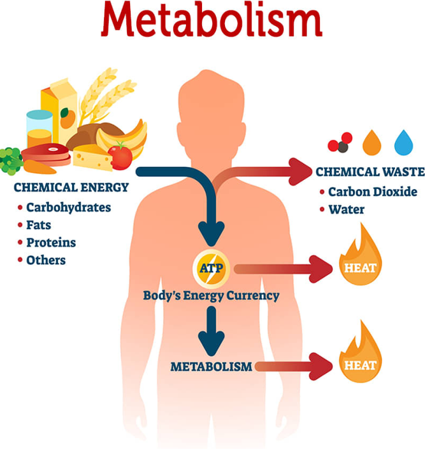
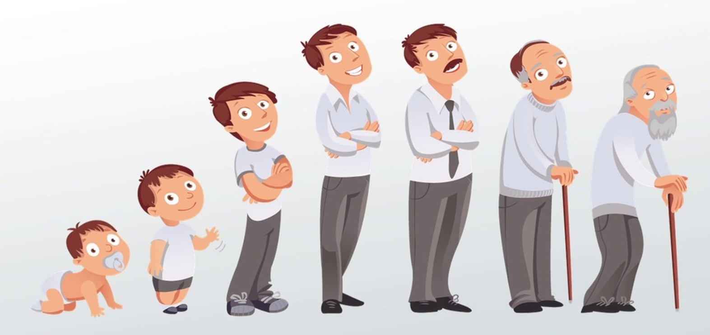
Life Processes in Biology
Metabolism: Chemical reactions that maintain life, including the breakdown of nutrients for energy/Biomedical Engineering Link: Knowledge of metabolism is essential in drug design and understanding how drugs are metabolized within the body.
Growth: The increase in size and complexity of organisms over time/Biomedical Engineering Link: Growth factors are crucial in tissue engineering, helping to regenerate or repair damaged tissues and organs.

Slide 9
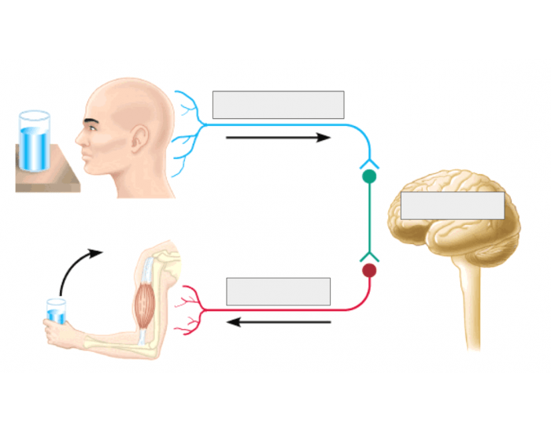

Life Processes in Biology
Reproduction: The process by which organisms produce offspring to ensure the survival of their species/Biomedical Engineering Link: Reproductive technologies, such as assisted reproductive technologies (ART), rely heavily on biological understanding to help treat infertility.
Response to Stimuli: Organisms respond to changes in their environment (e.g., light, temperature)/Biomedical Engineering Link: Biomedical sensors and devices (e.g., glucose monitors, ECGs) are designed to monitor and respond to biological signals from the body.
Homeostasis: The process by which organisms maintain a stable internal environment despite external changes (e.g., temperature regulation, blood sugar levels)/Biomedical Engineering Link: Homeostasis is critical in designing wearable medical devices like heart rate monitors, insulin pumps, and artificial organs that help regulate bodily functions.

Slide 10
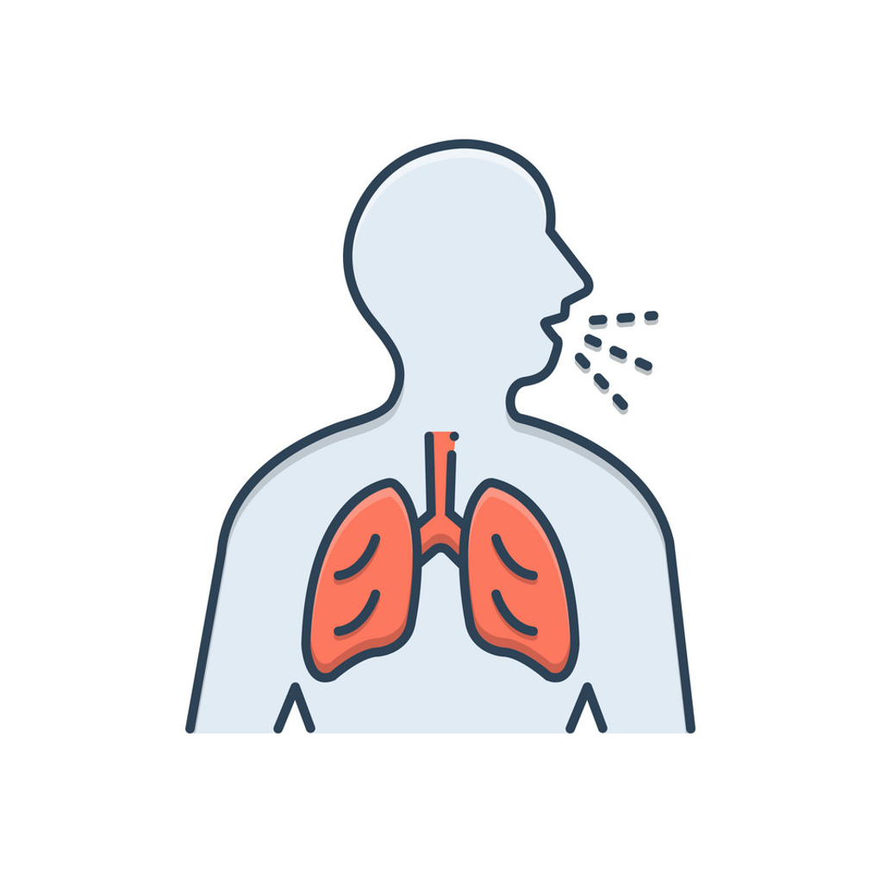
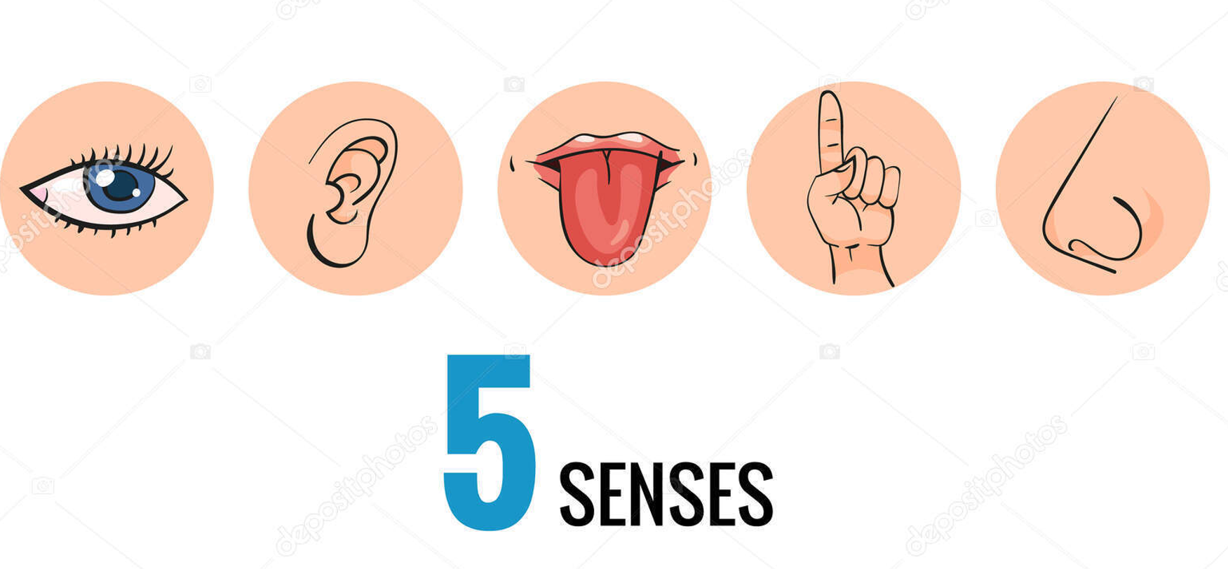
Life Processes in Biology
Respiration: The process by which nutrients taken in are converted to energy. Respiration is a chemical reaction and occurs in every cell in living things.
Sensitivity: Living things notice and react/respond to changes around them.
Animals use their five senses:
Sight (eyes)
Hearing (ears)
Smell (nose)
Touch (skin, feelers)
Taste (tongue)

Slide 11
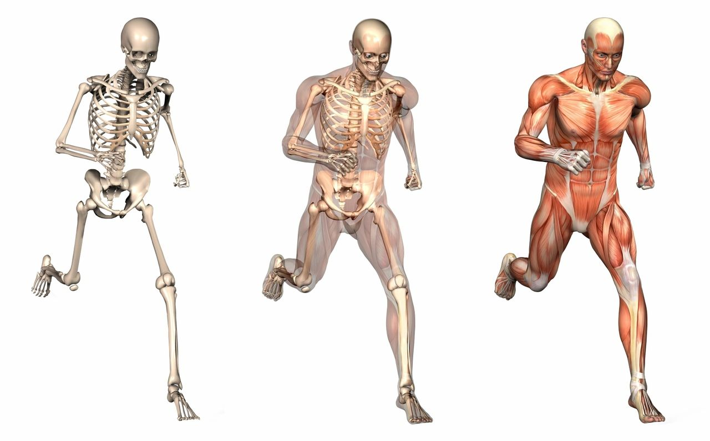

Life Processes in Biology
Movement: all living organisms show movement of one kind or another. All living organisms have internal movement ,which means that they have the ability of moving substance from one part of their body to another. Some living organisms show external movement as well-they can move from place to place by walking.
Nutrition: all living organisms need to take substances from their environment to obtain energy, to grow and to stay healthy.

Slide 12
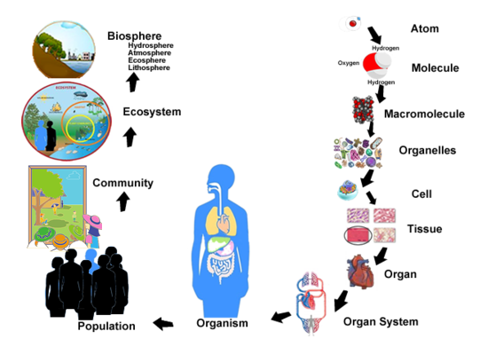
Hierarchical Structure of Life
Biology is organized into several levels of complexity, each building upon the previous one. Understanding this hierarchy is crucial for biomedical engineers when designing systems and devices to interact with living organisms.

Slide 13
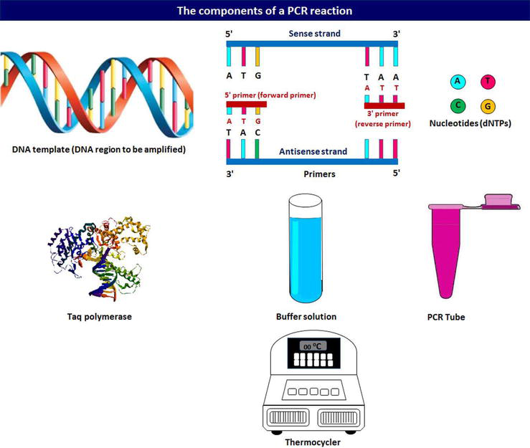
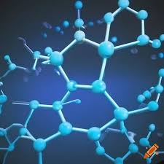
Molecular Level
Molecular Level: Life begins at the molecular level, with molecules such as DNA, proteins, and lipids that make up cells.
Biomedical Engineering Link: Biomedical engineering often works at the molecular level in drug design, genetic engineering, and diagnostic tools (e.g., PCR testing, gene sequencing).

Slide 14
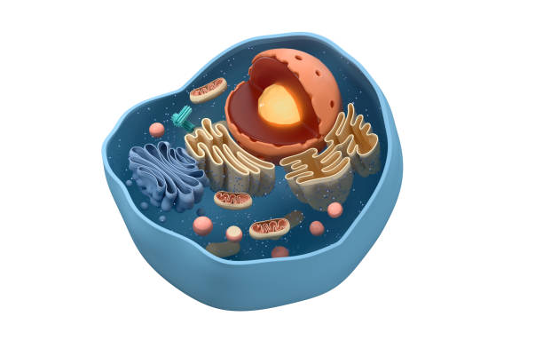
Cellular Level
Cellular Level: Cells are the basic units of life, performing all essential functions.
Biomedical Engineering Link: Innovations like cell-based therapies, drug testing on cell cultures, and cell scaffolding for tissue engineering rely heavily on cell biology.

Slide 15
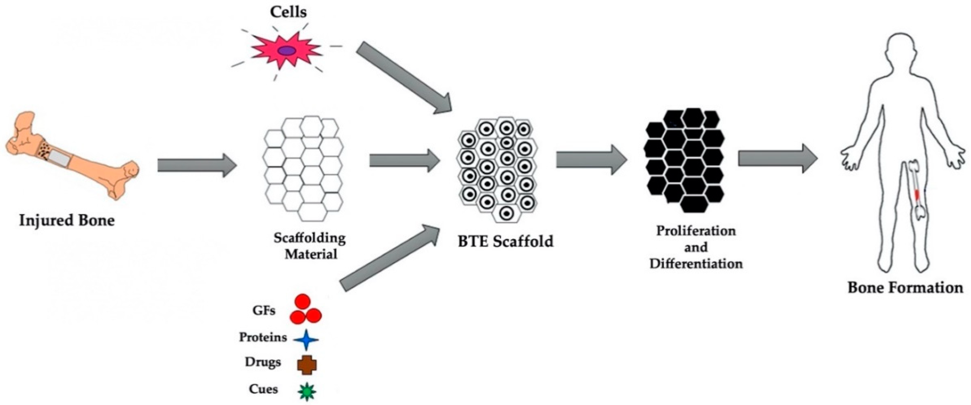
Tissue Level
Tissue Level: Tissues are groups of similar cells that work together to perform a specific function.
Biomedical Engineering Link: Tissue engineering uses scaffolds and growth factors to build new tissues that can be used in organ repair or replacement.

Slide 16
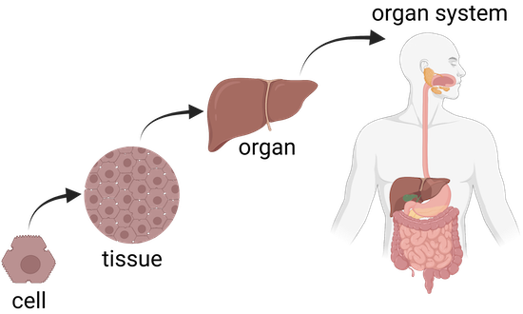
Organ Level
Organ Level: Organs are composed of different tissues working together to carry out specific functions (e.g., heart, lungs, kidneys).
Biomedical Engineering Link: Devices like pacemakers, artificial kidneys, and organ transplants require a deep understanding of organ systems and their functions.

Slide 17
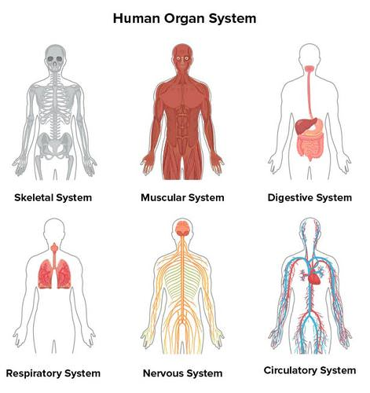
Organ System Level
Organ System Level: Organ systems consist of multiple organs working together to perform complex tasks (e.g., the circulatory system, respiratory system).
Biomedical Engineering Link: Biomedical engineers design systems to support or replace the function of these organ systems, such as ventilators, dialysis machines, and prosthetics.

Slide 18
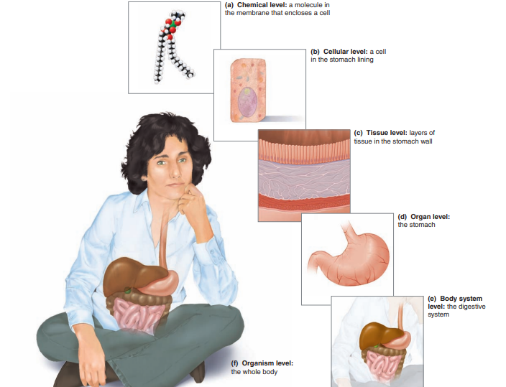
Organism Level
Organism Level: The organism is the highest level of biological organization, composed of various organ systems working together.
Biomedical Engineering Link: At the organism level, biomedical engineering focuses on holistic health solutions like personalized medicine, where treatments are tailored to individual biological needs.

Slide 19
Linking Biology to Biomedical Engineering
The intersection of biology and biomedical engineering is a vibrant and rapidly growing field. Here are several ways in which biology informs biomedical engineering:
Medical Imaging: Biological knowledge of tissues and organs enables the design of advanced imaging systems (MRI, CT, X-rays) to diagnose diseases and monitor health.
Prosthetics and Implants: Understanding the biological properties of bone, muscle, and tissue is crucial for developing prosthetic limbs, joint replacements, and implants that integrate with the human body.
Regenerative Medicine: Stem cells, tissue regeneration, and bio-printing are cutting-edge areas in biomedical engineering that rely on biological principles to regenerate damaged tissues and organs.
Drug Development: Biomedical engineers collaborate with biologists to design drug delivery systems that precisely target diseased cells or tissues, improving the efficacy of treatments.
Gene Therapy: Genetic engineering tools, such as CRISPR, are used to edit or replace defective genes, offering new treatments for genetic disorders.

Slide 20


