Slide 1



Subject Name: Biology
1st Class, First Semester
Subject Code: [Insert Subject Code Here]
Academic Year: 2024-2025
Lecturer: Assist lect. Zainab Sattar Jabbar
Email: zainab.sattar.jabbar@uomus.edu.iq
Lecture No.:- 2
Lecture Title: [The Cell and Cell Membrane Functions]

Slide 2
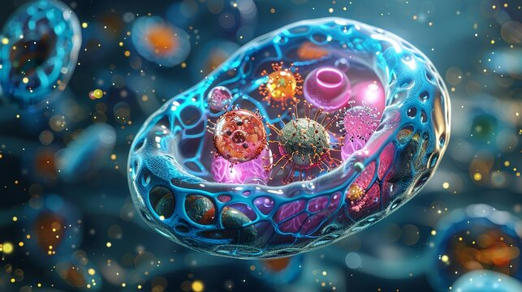
Introduction to the Cell
Definition of the cell: The fundamental unit of life.
Importance of the cell: All living organisms are made up of cells, and their functions are essential for the survival of the organism.
Cells are the fundamental units of life and are often referred to as the building blocks of all living organisms. In biomedical engineering, understanding the structure and function of cells is crucial for developing medical devices, therapies, and treatments that interact with the human body.

Slide 3
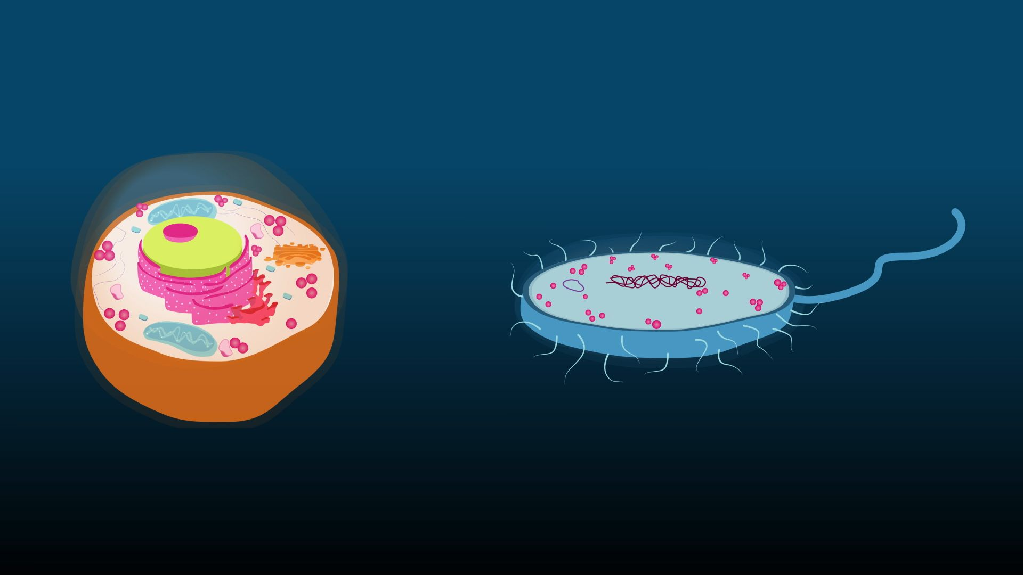
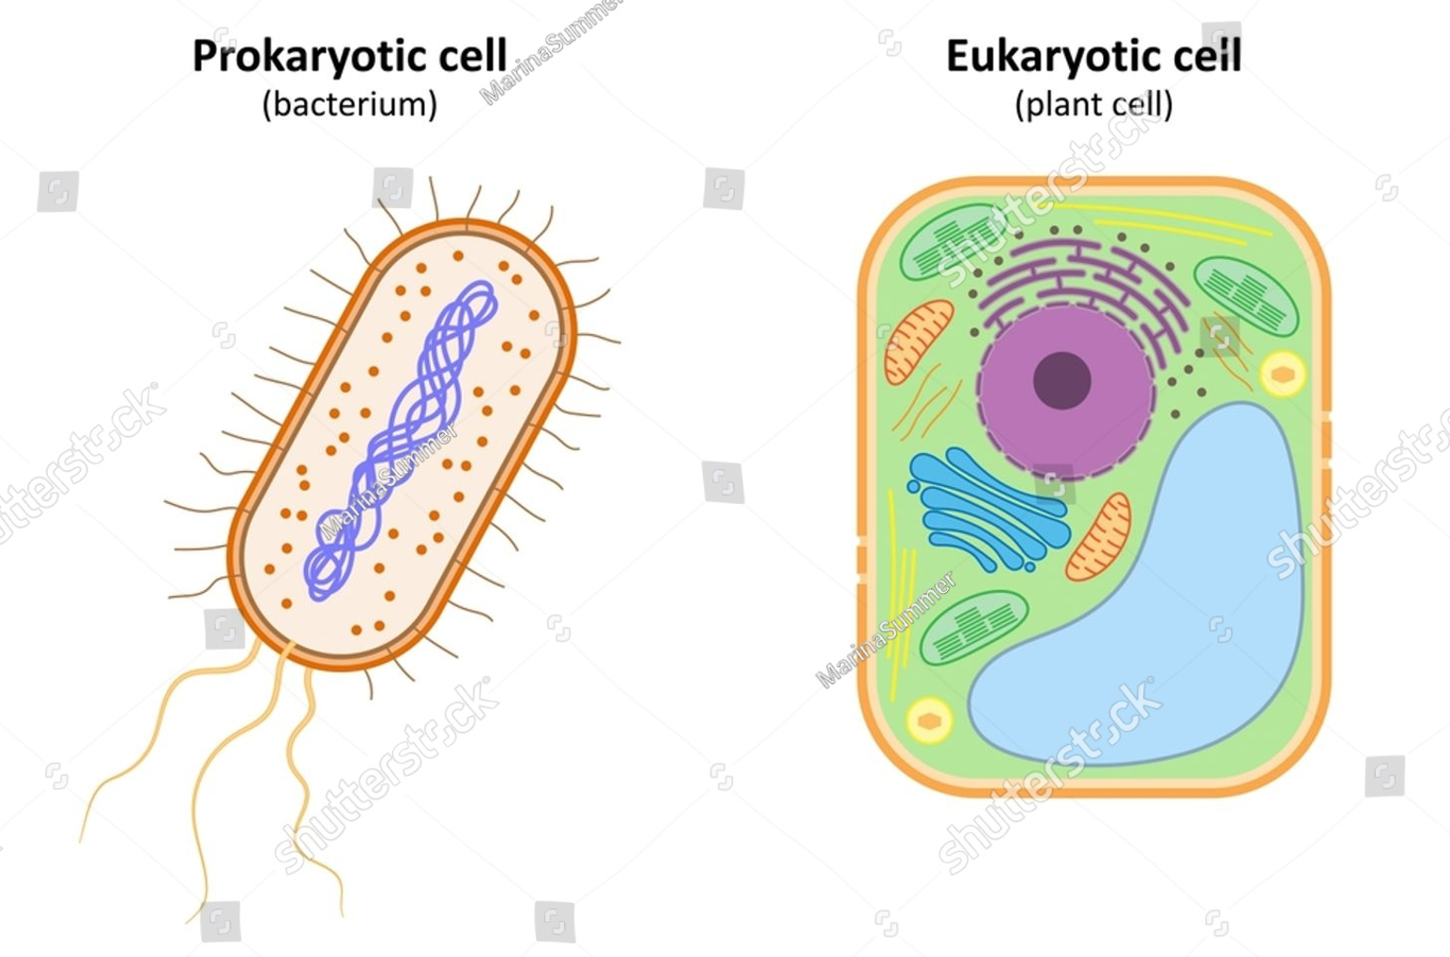
Introduction to the Cell
Cells can be classified into two main types:
Prokaryotic Cells: Simpler in structure, lack a nucleus, and are typically found in bacteria.
Eukaryotic Cells: More complex, contain a nucleus, and are found in plants, animals, fungi, and protists.

Slide 4
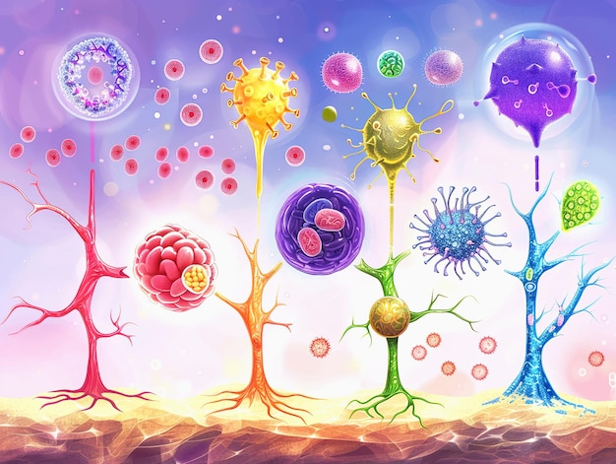
Cell Theory and Cellular diversity
Cell Theory
All living organisms are made of cells.
The cell is the basic unit of life.
All cells arise from pre-existing cells.
Cellular diversity
Cells are found in different organisms, and are very diverse in their size, shape and their internal structure and this also applies to cells found in the same organism. This diversity is influenced by their roles and function within organism's body.

Slide 5
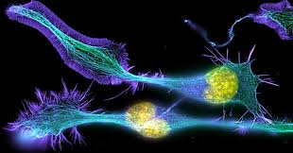
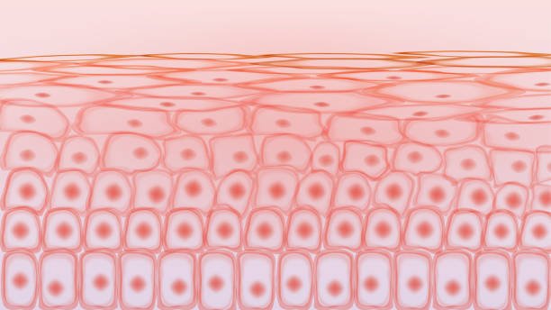
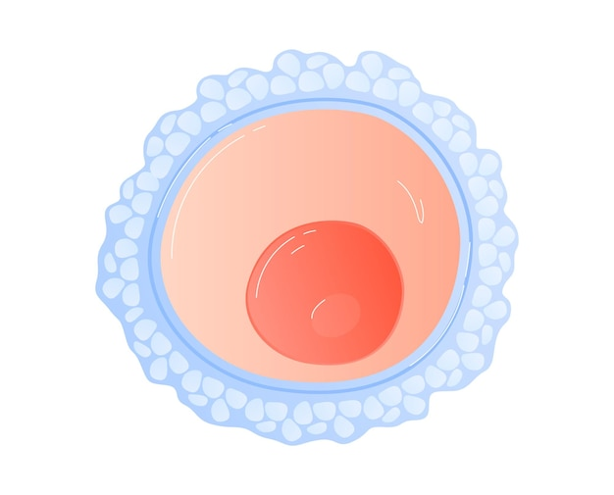
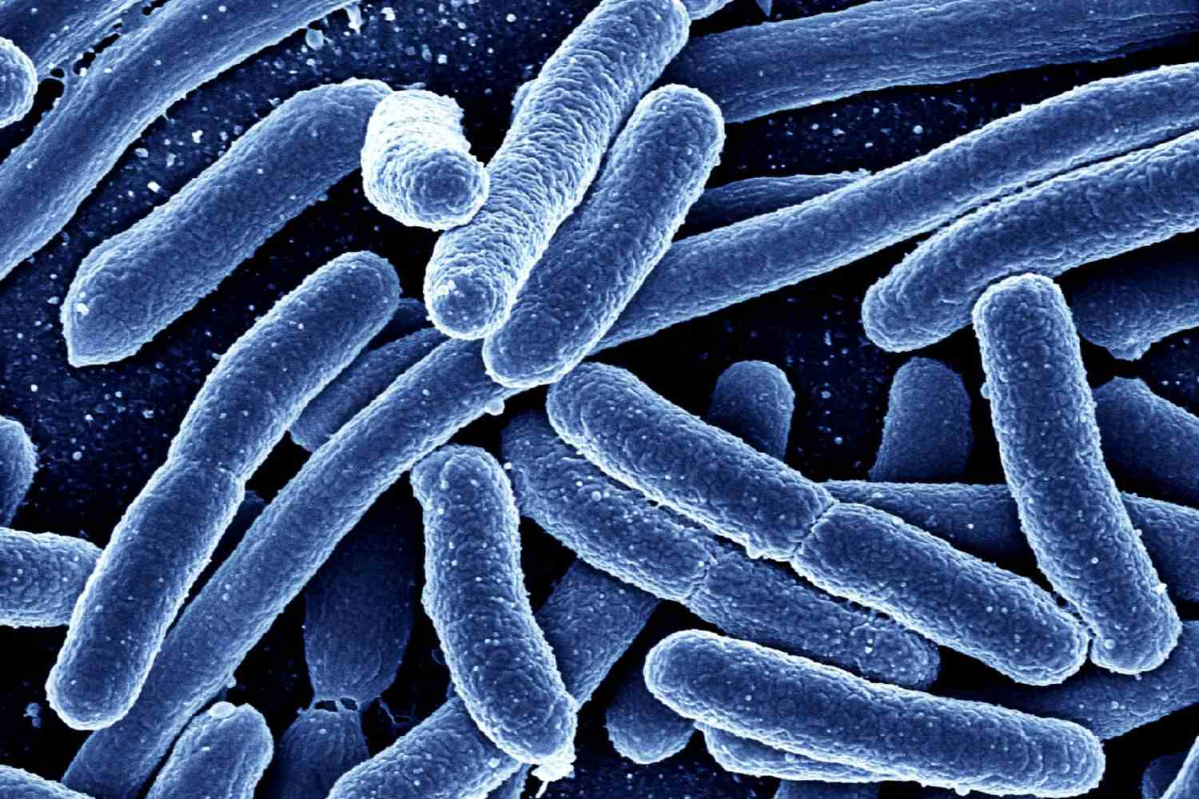
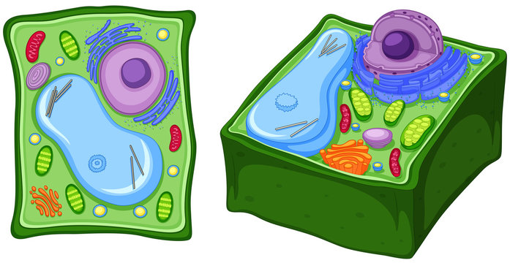
Cell Shape
Cells have different shapes due to appropriate function. It is possible to find other cells which are flat, most of these cells are body cells and their function is protecting and covering body surface. Nerve cells have long extensions. Skin cells have a shape which is flat. Egg cells have shape which is like sphere, and some bacteria are rod in shape. Some plant cells are rectangular.

Slide 6
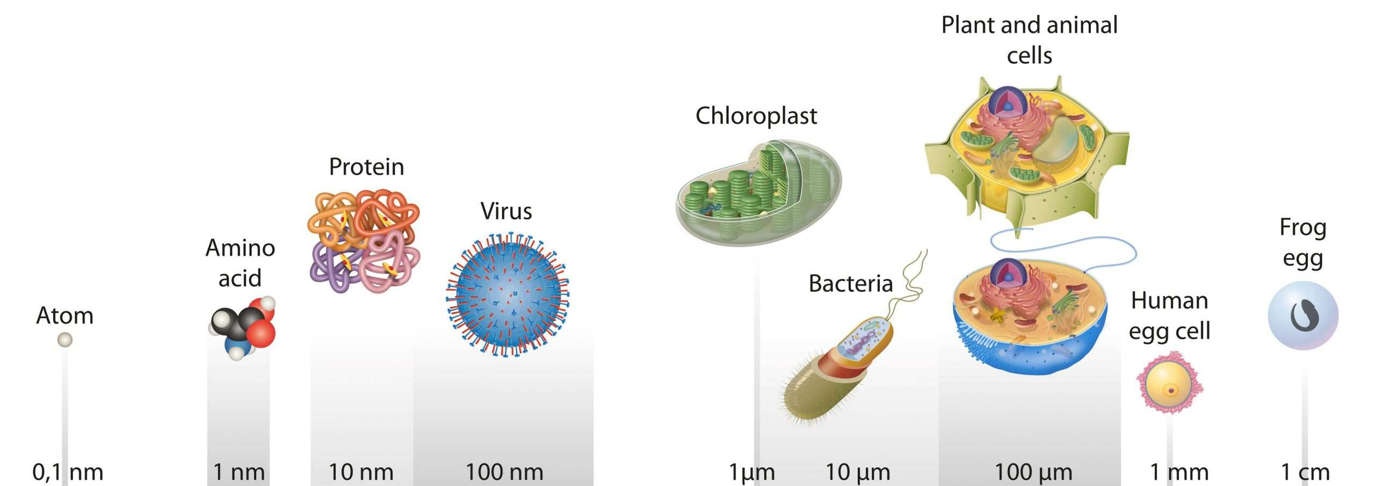
Structure and Size of Cell
Cell Size
Some cell can be seen without using magnification instruments as they are enough to be seen by the naked eye.
Structure of Cell
A typical cell under the light microscope show three distinct parts:
1. Plasma/cell membrane.
2. Cytoplasm.
3. Nucleus.

Slide 7
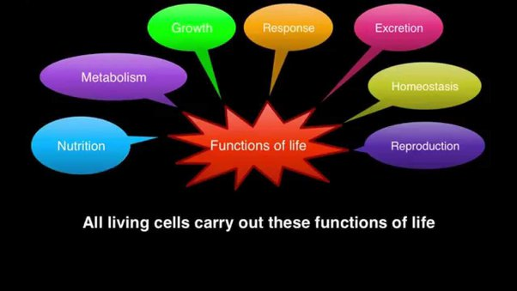
Basic Cell Functions
Metabolism: Cells perform metabolic processes to produce energy (ATP).
Protein Synthesis: Involves transcription and translation to build proteins needed for cellular functions.
Cell Division: Essential for growth, healing, and reproduction.

Slide 8
Plasma/cell membrane
The cell membrane, or plasma membrane, serves as a boundary between the cell and its external environment.
It is selectively permeable, meaning it controls the entry and exit of substances.
The plasma membrane is extremely thin layer of lipids and proteins forming outermost boundary of living cell and enclosing the intracellular fluid (ICF).
It serves as:
1. Mechanical barrier that traps needed molecules within the cell.
2. Plasma membrane plays an active role in determining the composition of cell by selective permeability of substances to pass between the cell and its extracellular fluid (ECF) environment.

Slide 9
Functions of the Cell Membrane
1. Selective Permeability: The membrane controls the movement of molecules into and out of the cell. This selective permeability is essential for maintaining homeostasis.
Passive Transport: Does not require energy. Includes diffusion (movement of molecules from high to low concentration) and osmosis (movement of water through a selectively permeable membrane).
Active Transport: Requires energy (ATP). Involves the movement of substances against their concentration gradient, facilitated by pumps (e.g., Na+/K+ pump).
2. Cell Signaling: The cell membrane plays a central role in cell communication. Receptors on the surface detect signals from other cells or the environment, triggering a cascade of events inside the cell (signal transduction). This is essential for processes such as immune response and hormone signaling.
G-protein coupled receptors (GPCRs): Involved in many physiological processes and are important in drug development.
Ion Channels and Transporters: Regulate the flow of ions and molecules, crucial for maintaining cellular function.
3. Endocytosis and Exocytosis:
Endocytosis: The process by which the cell engulfs external substances, forming vesicles. This can be in the form of phagocytosis (cell eating) or pinocytosis (cell drinking).
Exocytosis: The process by which cells expel materials, such as waste or proteins, by fusing vesicles with the plasma membrane.

Slide 10
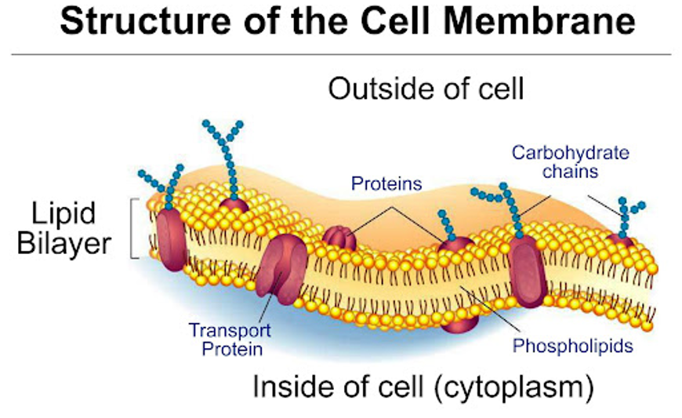
The Structure of Plasma Membrane
The plasma membrane is a fluid lipid bilayer embedded with proteins. It appears as ''trilaminar'' layer structure having two dark layers separated by a light middle layer as a result of specific arrangement of the constituent molecules.
All plasma membrane are made up of lipids and proteins plus small amount of carbohydrates.

Slide 11
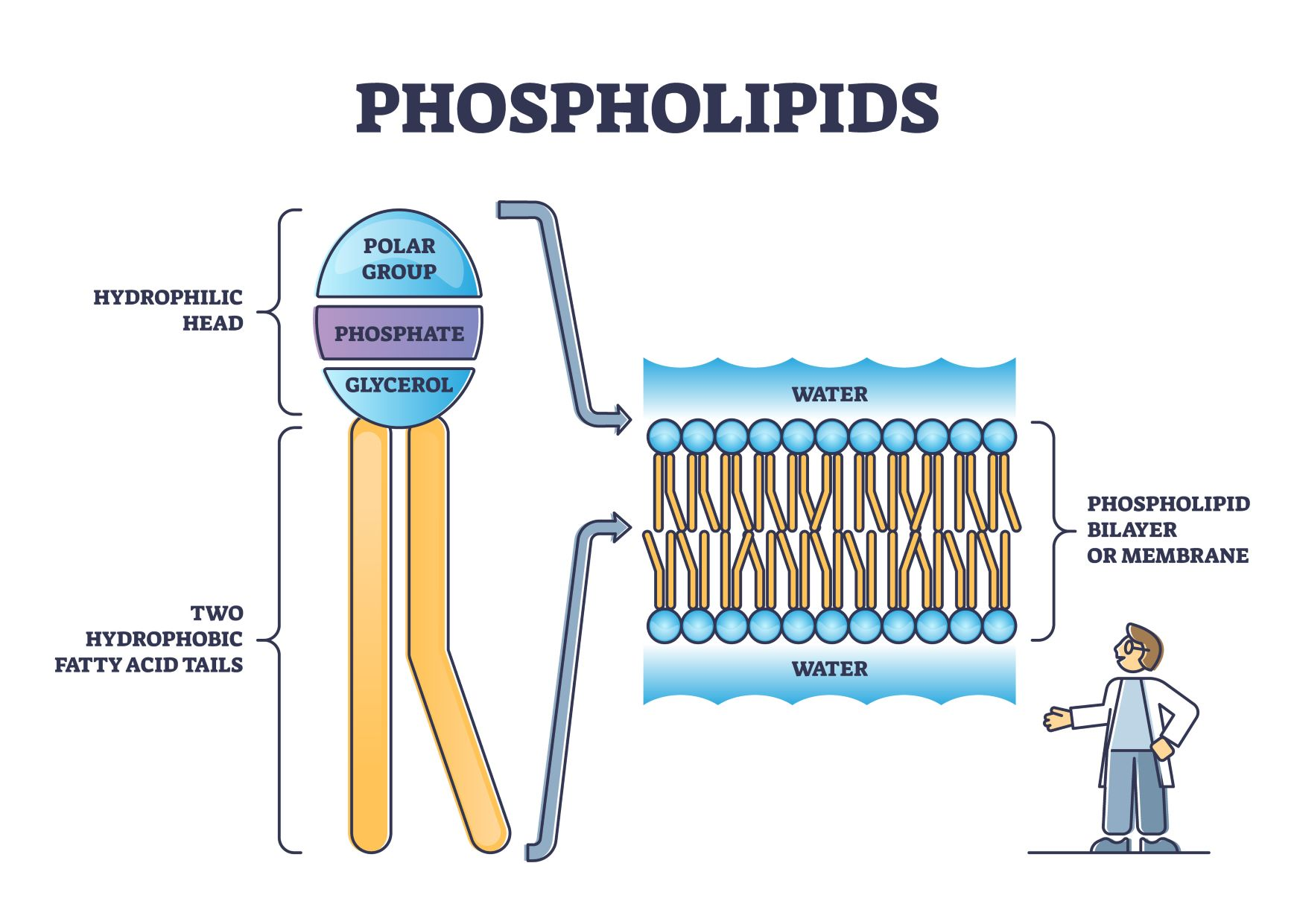
1. Lipids
Phospholipids: are the most abundant.
Phospholipids have a polar head having a negatively charged phosphate group and two non-polar fatty acid tails. The polar end is hydrophilic (water loving) because it can interact with water molecule, which is also polar; the non-polar end is hydrophobic (water fearing) and will not mix with water. The outer surface of the layer is exposed to (ECF), whereas the inner layer is in contact with the intracellular fluid (ICF). The lipid is fluid in nature like liquid cooking oil.

Slide 12
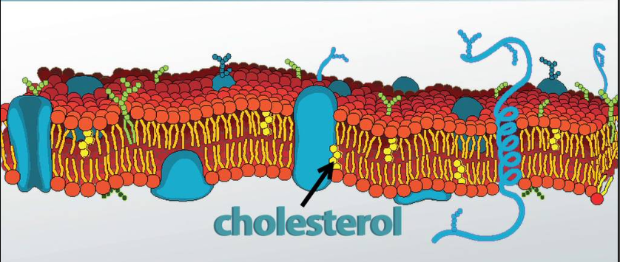
1. Lipids
Cholesterol: Found between the phospholipids, cholesterol regulates membrane fluidity, helping to maintain its integrity, stability and flexibility.
Cholesterol lies in between the phosphate molecules, preventing the fatty acid chain from packing together and crystallizing that could decrease fluidity of the membrane.
For fluidity of the membrane, it gives flexibility to the cell to change its shape; transport process are also dependent on the fluidity of the lipid bilayer.

Slide 13
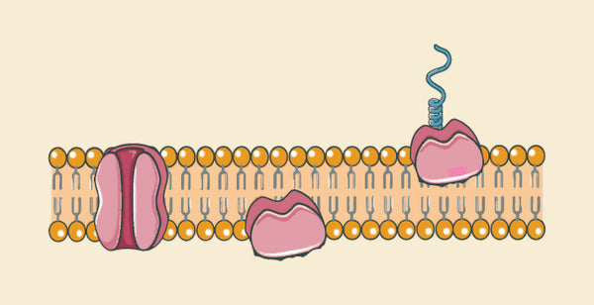
2. Proteins
Proteins: Integral and peripheral proteins are embedded within the membrane. They play roles in transport, signaling, and structural support.
The membrane proteins are either attached to or inserted within the lipid bilayer; some extending through the entire membrane thickness; they have polar region at both ends joined by a non-polar central portion. Other proteins are on either the outside or inner surface.

Slide 14
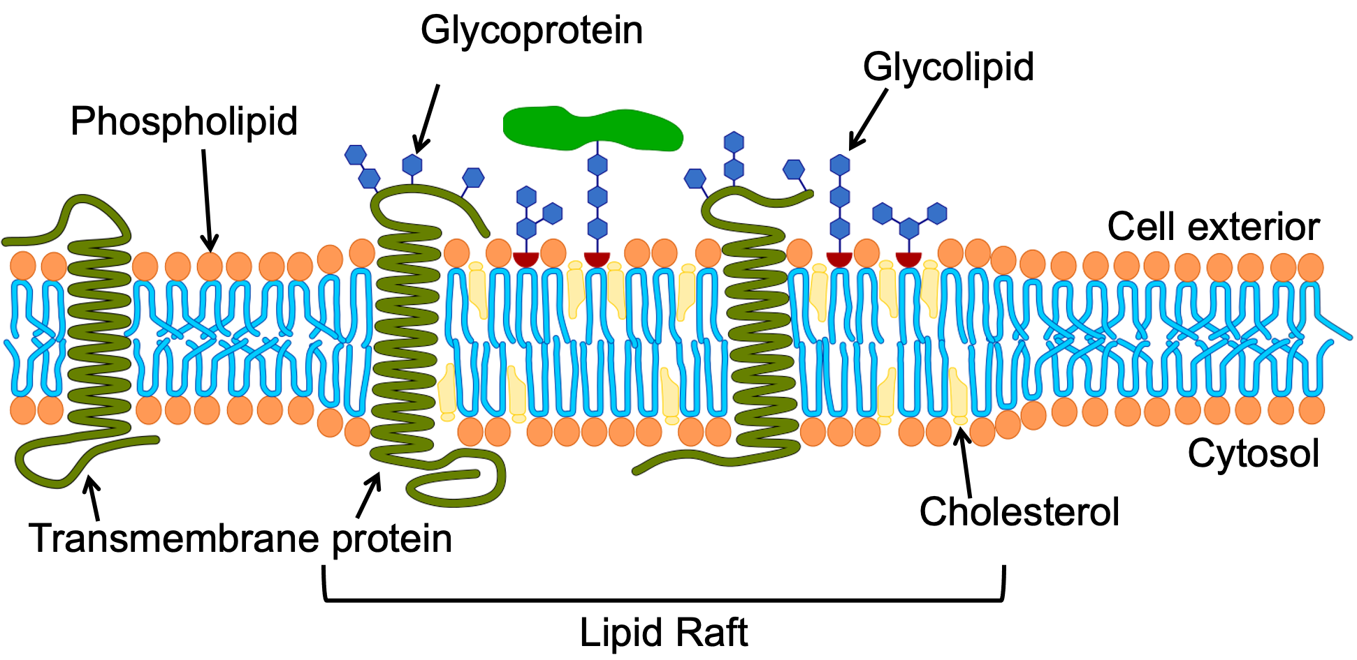
3. Carbohydrates
Only the outer surface of the plasma membrane contains a small amount of carbohydrate. Short-chain carbohydrates are bound primarily to membrane proteins and to a lesser extent to lipids, forming glycoproteins and glycolipids.
The plasma membrane is actually asymmetrical; the two surfaces are not the same; carbohydrate is only on the outer surface; different amount of different proteins are on the outer and inner surfaces and even the lipid structures of the outer and inner half is not the same.

Slide 15
Membrane Proteins and Their Functions
Types of Membrane Proteins:
Integral Proteins: Span the entire membrane and are involved in transport, acting as channels or carriers.
Peripheral Proteins: Attached to the exterior or interior surface of the membrane and are involved in signaling and maintaining the cell’s shape.
Glycoproteins and Glycolipids: These proteins and lipids have carbohydrate chains that play key roles in cell-cell recognition and communication.
Ion Channels and Pumps:
Ion Channels: Allow the passage of ions across the membrane, crucial for maintaining the cell's electrical charge.
Pumps: Actively transport ions across the membrane against their concentration gradients, using energy (ATP). Examples include the sodium-potassium pump (Na+/K+ pump), which is vital for maintaining cellular ion balance.
Receptor Proteins:
Receptors on the cell membrane bind to signaling molecules (ligands) such as hormones or neurotransmitters. This binding activates signal transduction pathways inside the cell, leading to various cellular responses.

Slide 16
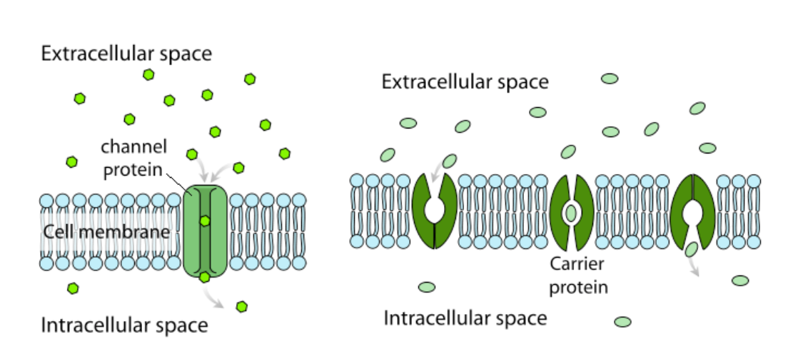
Membrane Proteins and Their Functions

Slide 17


