Slide 1


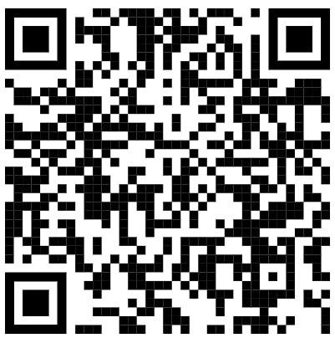
Subject Name: Practical Biology
1st Class, First Semester
Subject Code: [Insert Subject Code Here]
Academic Year: 2024-2025
Lecturer: Assist lect. Zainab Sattar Jabbar
Email: zainab.sattar.jabbar@uomus.edu.iq
Practical Biology Lecture No.:- 1
Practical Biology: [Biosafety and Biosecurity]

