Slide 1
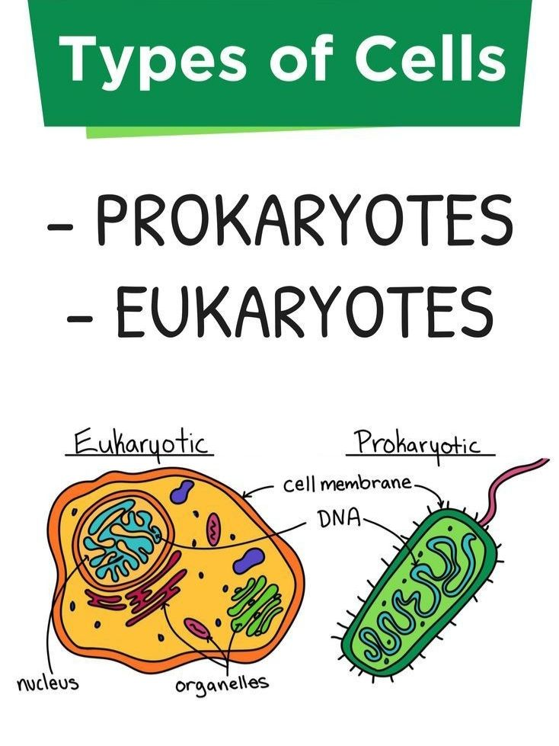
Lab …2
By :-Safa Amer Khalil

Slide 2
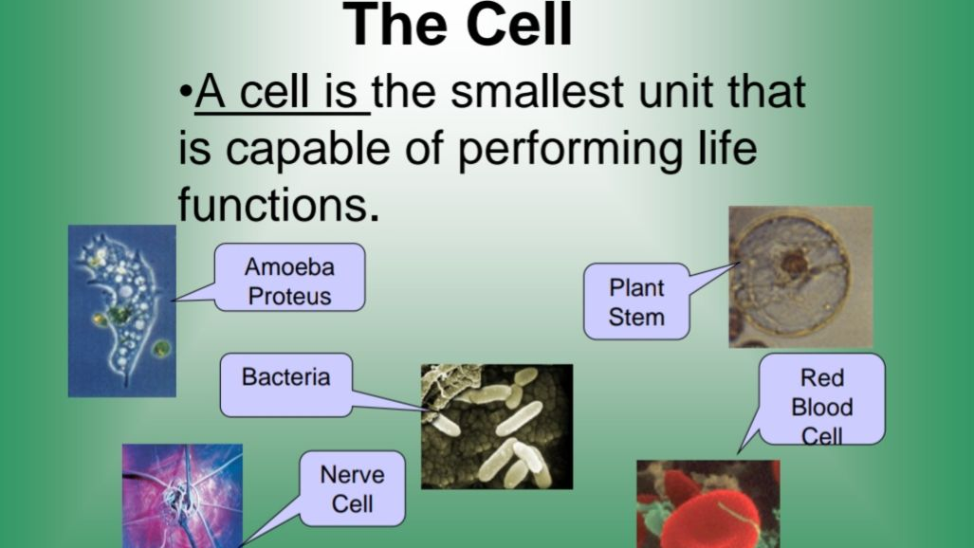

Slide 3
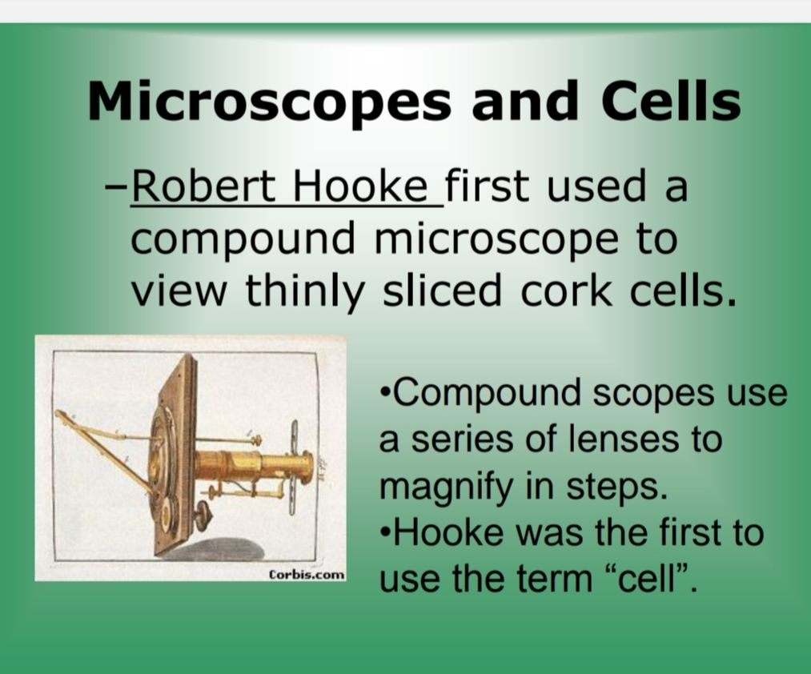


Slide 4
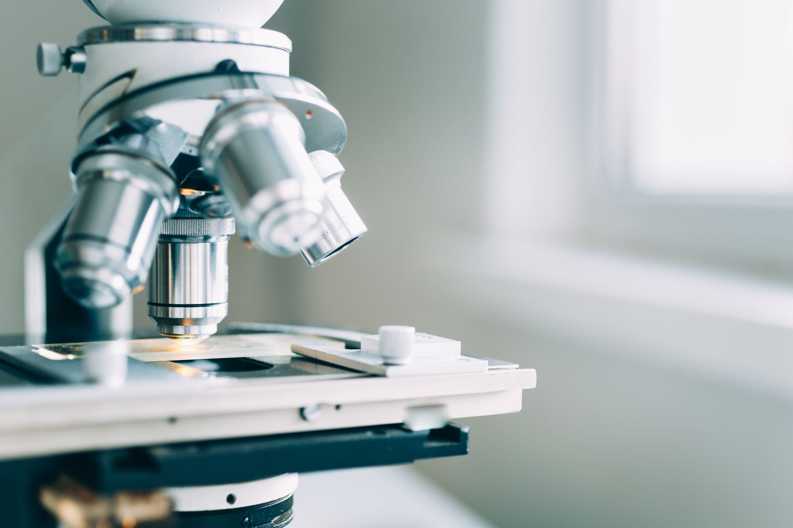
One of the most important tools used to study living things. “Micro” means very small “Scope” means to look at The microscope is an essential tool in the study of life science. It allows you to see things that are too small to be seen with the unaided eye.

Slide 5
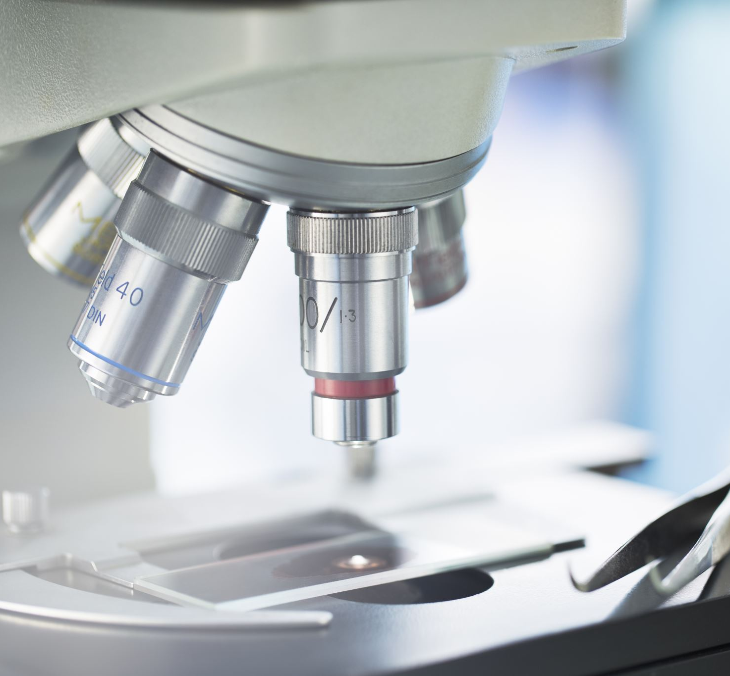
Types of Microscopes
1-The light microscope (compound microscope).
2- The fluorescent microscope.
3- The Electron microscope.
4-The dissecting microscope.

Slide 6
Microscopic parts
1- Base : It supports the microscope and gives the stability .
2- Arm : The part of the microscope that you carry the microscope with.
3- Body tube : The long tube that holds the eye piece and connects it to the objectives .
4- Ocular lenses (Eye pieces) : The lenses in the upper part of the microscope where you look through to see the image of your specimen .
5- Revolving nose piece : The rotating part of the microscope at the bottom of the body tube , it holds the objectives .
6- Objective lenses : The microscope may have 2,3 or more

Slide 7
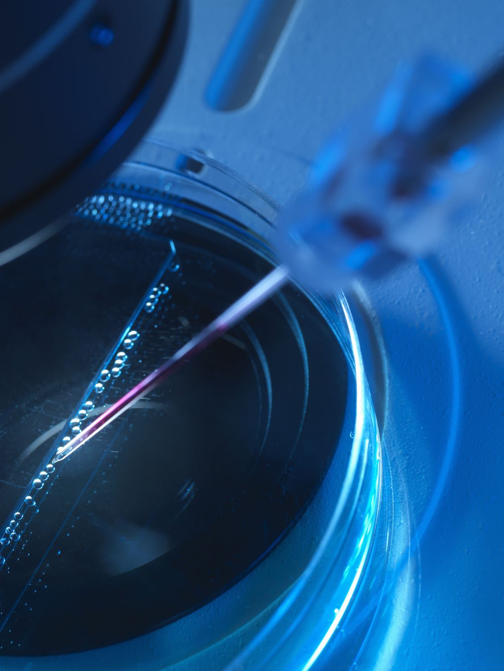
objectives attached to the nose piece, they vary in length
a Scanning lens (4X).
b Low power lens (10X).
c High power lens (40X).
d Oil lens (100).

Slide 8

The Function of Oil
The oil contributes to two characteristics of the image viewed through the microscope :
1- Finer resolution .
2- Finer brightness

Slide 9
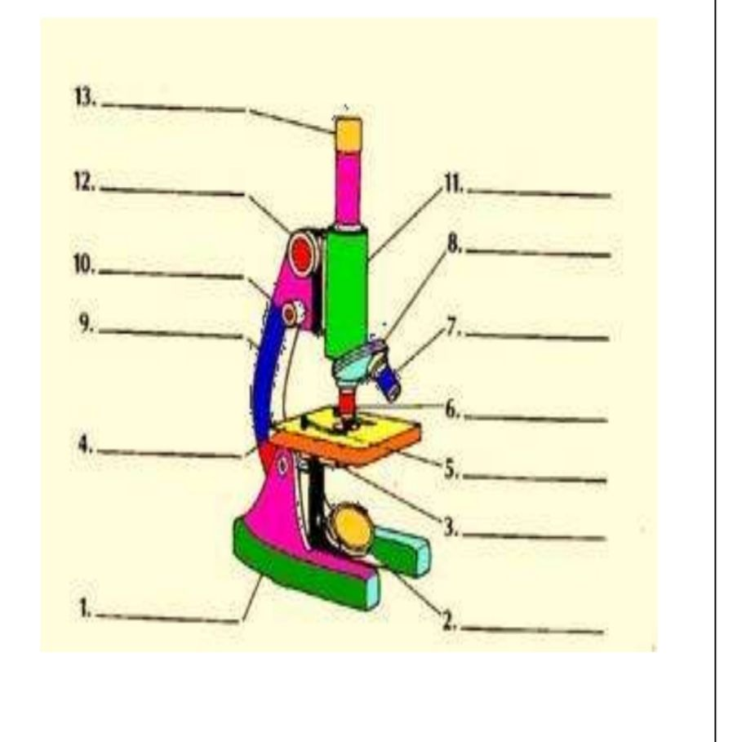
Basic Microscope Parts
1. Base
2. Light source
3. Diaphragm
4. Stage
5. Stage clips
6. Low power
7. High power
8. Nosepiece
9. Arm
10.Fine Focus
11.Body Tube
12.Course Focus
13.Eyepiece

Slide 10
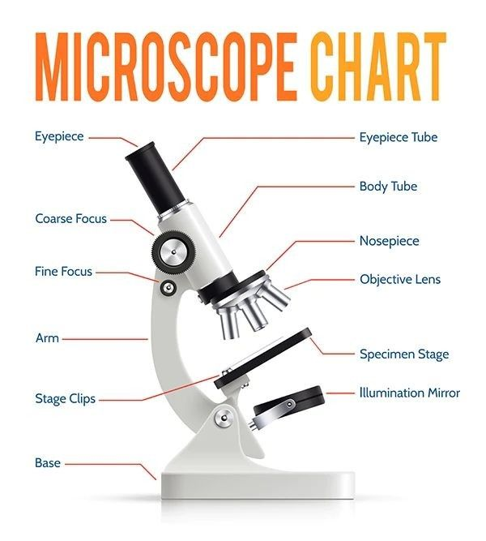

Slide 11
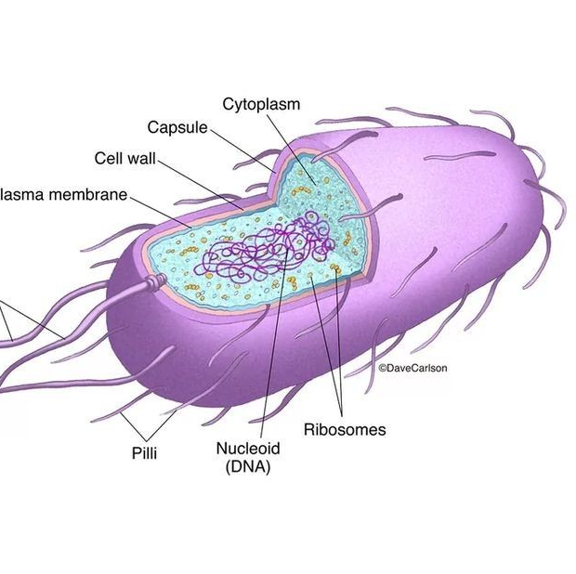
Any unicellular organism that does not contain a membrane bound nucleus or organelles(Prokaryotic cell)

Slide 12
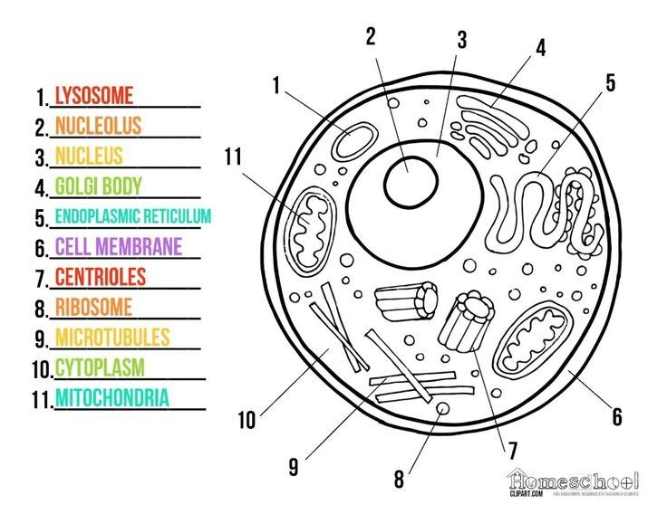
Any cell that contains a nucleus and membrane bound organelles(Eukaryotic cell)

Slide 13
Eukaryotic cell | Prokaryotic cell | Features
Multicellular | Unicellular | 1.type of cell
made of cellulose | Rigid made of lipids, carbohydrates, and protein. | 2. cell wall
More than one chromosome , multiple linear . | One chromosome, circular. | 3.chromosomes
A true nucleus . | nucleoid | 4.nucleus
80s (large). | 70s (small). | 5. size of ribosomes
Presents . | Absents. | 6. organelle
Complex flagella . | Simple flagella . | 7. flagella
Present | No known cytoskeleton | 8 .cytoskeleton
cell division is by mitosis or meiosis | cell division is by binary fission | 9. reproduction
Plants , animals | Bacteria cyanobacteria | 10.Examples

Slide 14
• Cocci:Staphylococcus
Bacilli: E. coli, Bacillus anthracis, Corynebacterium diphtheriae
Spirilla: Helicobacter pylori
Vibrio: Vibrio cholerae
Spirochete:Treponema pallidum
aureus

Slide 15
