Slide 1


Types Of Pronouns
Al-Mustaqbal University / College of Engineering & Technology
Department of Computer Techniques Engineering
Class (1)
Subject (English) / Code (UOMU000002)
1st term – Lecture No. 1
Dr. Noor AbdAlKarem Mohammedali
Email: noor.abdulkareem@uomus.edu.iq

Slide 2
Pronoun & Types of Pronoun
What is pronoun? The word which is used in place of a noun is called pronoun.
For example: he, she, it, I, we, you, they etc. There are different types of pronoun.
Examples of Pronoun
Stiffen is a good boy. He obeys his parents.
Einstein was a famous scientist. He was very genius.
What are you doing here?
I am good player of hockey.
Here in these sentences you can see that he, he, you, and I are used as pronouns respectively.

Slide 3
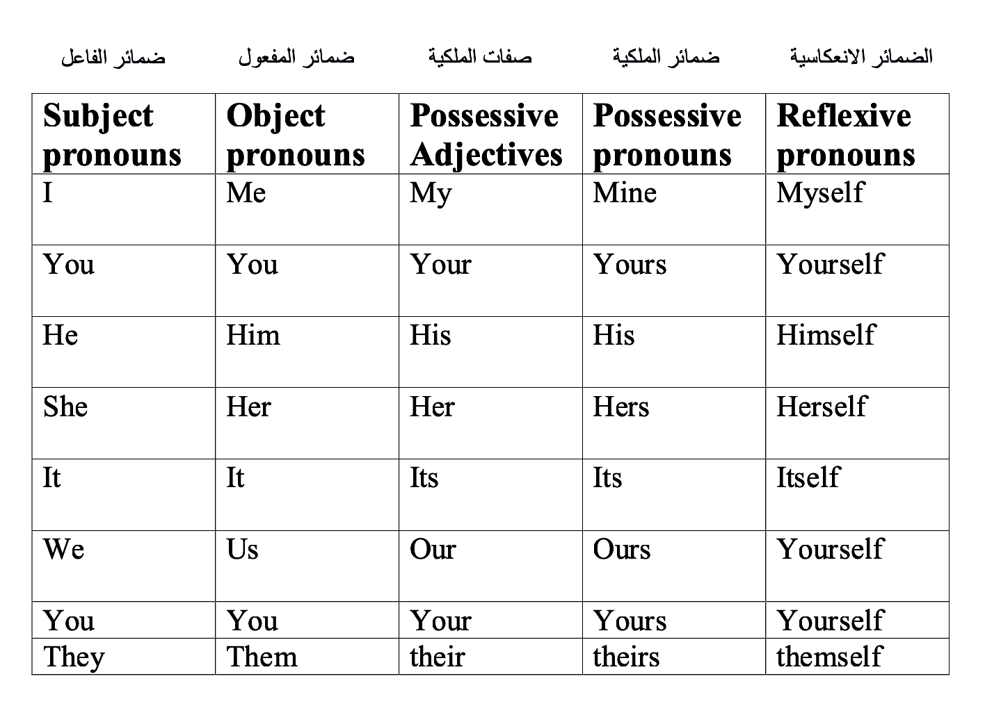

Slide 4
Types of Pronouns
There are different types of pronoun in English grammar all of these kinds of pronoun are described below
Personal pronoun (I, we, he, she, it, etc.)
Reflexive pronoun (Myself, ourselves, themselves etc.)
Possessive Pronoun (Yours, mine, hers, theirs etc.)
Object pronouns (me, him ,her ,us, etc.)
Possessive adjective (my ,your ,his, her, its, our, your, their)

Slide 5
Subject Pronouns
A personal pronoun is used for the name of a person or a thing. For example, I, we, you, they, he, she, it,etc.
The subject pronouns are:
First person (I, we, )
Second Person (you, you)
Third Person (he, she, it, they)
Examples
He is my friend.
It is a black cat.
They are animals.

Slide 6
Reflexive Pronouns
When the action done by the subject reflects upon the subject, it is called reflexive pronoun.
For example: myself, yourself, himself, herself, itself, ourselves etc.
Note. Reflexive pronouns are made by adding –self to the end of the personal pronoun.
Examples
They enjoyed themselves.
I will do it myself. You will hurt yourself.

Slide 7
Object Pronouns
We use an object pronoun after verb ,preposition, and at the middle or end of sentences.
For example: me, him, her, us, It, you, them.
Help me please.
He plays with her.
We saw them. Or They saw us.
Do you live near them.
After to or for with verbs like make, give, send, lend, pass, take, show. The little boy made it for her.

Slide 8
Possessive Adjective
There is a different between possessive pronoun and possessive adjective. We use possessive adjective before noun but possessive pronoun at the end of sentences.
For example:
My book is new.
His computer is old.
Its cat is nice.
Our house is big.
Your dog is small.

Slide 9
Possessive Pronouns
We use it at the end of sentences.
For example:
The new book is mine.
The new cat is his.
The new address is hers.
The new house is ours.
The new computer is theirs.

Slide 10
Thank you

Slide 11
Nouns
Al-Mustaqbal University / College of Engineering & Technology
Department of Computer Techniques Engineering
Class (1)
Subject (English) / Code (UOMU000002)
1st term – Lecture No. 2
  Dr. Noor AbdAlKarem Mohammedali
Email: noor.abdulkareem@uomus.edu.iq

Slide 12
What is a noun?
A noun is a person, place, thing or idea
In the following sentence, what are the nouns?
  Most children like ice cream.

Slide 13
Examples of Nouns
Cat
Mall
Atlanta
Oxford Middle School
Bag
Ahmed

Slide 14
Types of Nouns
Proper Nouns
Common Nouns
Plural Nouns
Possessive Nouns
Concrete Nouns
Abstract Nouns
Collective Nouns

Slide 15
Proper Nouns
A proper noun is a specific person, place or thing
A proper noun usually begins with a Capital Letter
Examples are days of the week, holidays, religions, months, organizations, institutions and names
Oxford Middle School is a proper noun, Monday, May

Slide 16
Common Nouns
A common noun refers to a person, place or thing in a general sense
Common nouns only begin with a capital letter when they are at the beginning of a sentence
Examples include: house, car, sidewalk, dog, school, work, book, newspaper, beach, towel

Slide 17
Plural Nouns
Plural nouns indicate more than one person or thing
Plural nouns end in ‘s’ or ‘es’
Examples include: boxes (plural for box), hats (plural for hat), pencils (plural for pencil)

Slide 18
Possessive Nouns
A possessive noun is a noun that changes its form to show it owns something else
Singular possessive– add ’s
Plural possessive & ends in an s– add ’
Plural possessive & doesn’t end in an s– ’s
Examples: Sophie’s, teacher’s, cats’

Slide 19
Concrete Nouns
A concrete noun is any object or person that can be experienced through your senses: sight, sound, taste, touch, smell
Example: teacher, dog, beach, wave, book

Slide 20
Abstract Nouns
An abstract noun cannot be experienced through the senses
Examples: thought, memory, childhood, daydream, justice, peace

Slide 21
Collective Nouns
Names a group of people or things.
Can be singular or plural
Singular when all members of the group act as a single unit – ex. The team shares the field with its opponent. – Singular
Plural when each member of the group acts separately – ex. The team share their jokes with each other.
Examples: team, group, committee, club, family, couple

Slide 22
Practice!
In the following sentences, identify the noun(s):
Nada has pretty hair.
On Monday Ali is going to the beach.
Ahmed did well on the math test.
English is the best class!

Slide 23
Thank you

Slide 24
Questions And Negatives
Al-Mustaqbal University / College of Engineering & Technology
Department of Computer Techniques Engineering
Class (1)
Subject (English) / Code (UOMU000002)
1st term – Lecture No. 4 & 5
Dr. Noor AbdAlKarem Mohammedali
Email: noor.abdulkareem@uomus.edu.iq

Slide 25
Yes/No questions
Are they working hard? Yes, They are working hard.
Will they be working hard? Yes, They will be working hard.
Had they worked hard? Yes, They had worked hard.
Have they been working hard? Yes, They have been working hard.
Might they have been working hard? Yes, They might have been working hard.

Slide 26
Negatives
They are not/aren't working hard.
They will not be working hard.
They had not worked hard.
They have not been working hard.
They might not have been working hard.

Slide 27
Present simple and past simple questions and negatives
Do they work hard?
  They work hard.
  They do not (don't) work hard.
Does he work hard?
  He works hard.
  He does not (doesn't) work hard.
Did they work hard?
  They worked hard.
  They did not (didn't) work hard.

Slide 28
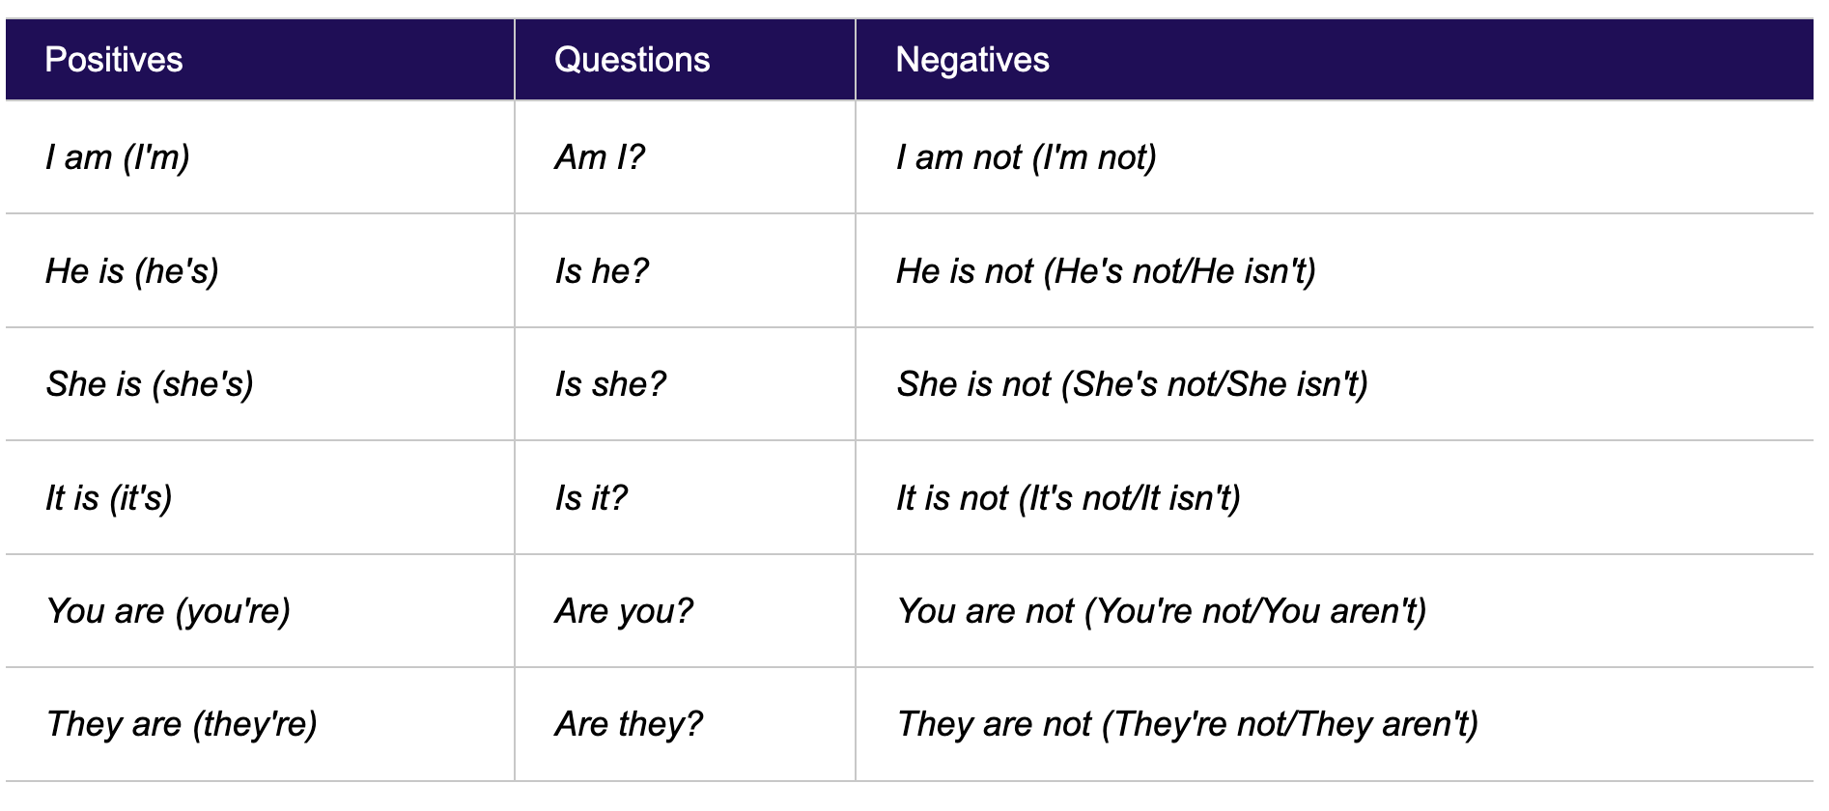

Slide 29
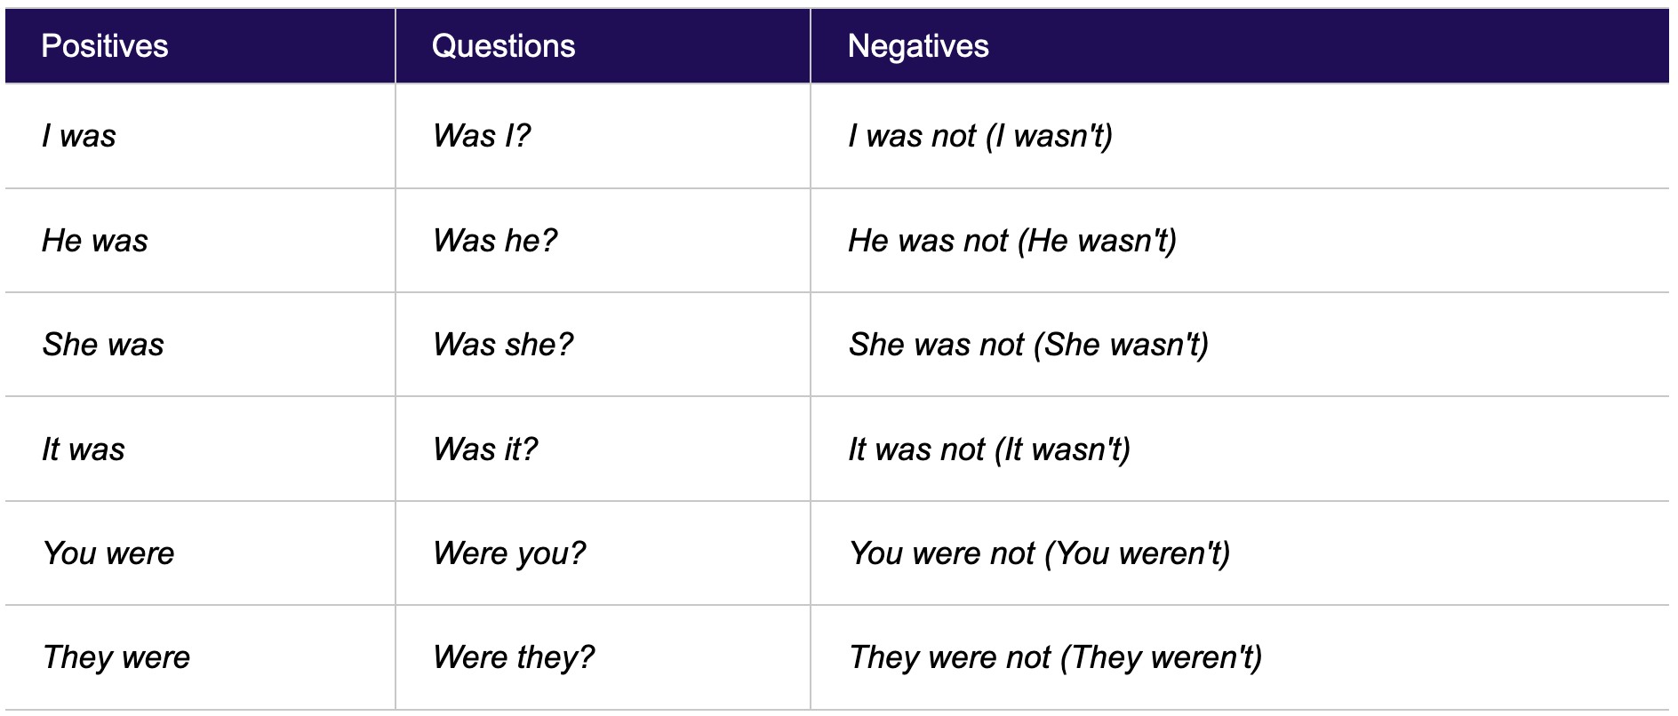

Slide 30
Questions with when, where, why
Where are they working?
  They are working in a shop.
Why have they been working hard?
  They have been working hard for their exams.
When did they arrive?
  They arrived at Four am.

Slide 31
Questions with who, what, which
Who is he seeing tomorrow?
  He is seeing Ahmed tomorrow.
What do you want for your birthday?
  I want a computer for my birthday.
Which would you prefer, tea or coffee?
  I'd prefer some tea.

Slide 32
Questions with verbs and prepositions
Who did you give the money to?
  I gave the money to my brother.
Where does she come from?
  She comes from Madrid.
How long were they waiting for?
  They were waiting for an hour.
Notes:
Prepositions == حروف الجر

Slide 33
Thank you

Slide 34
Possessive adjectives, Possessive ‘s, common verbs (1): has/have, love, like, work.
Al-Mustaqbal University
Computer Techniques Engineering Department
College of Engineering and Technology
Dr. Noor AbdAlKarem Mohammedali
Email: noor.abdulkareem@uomus.edu.iq

Slide 36
Thank you

