Slide 1


Analogue Electronic

Slide 2
Chapter One: Semiconductor Material
Lecture 2

Slide 3
    Energy Gap
Energy in an electron is of two types – kinetic (energy of motion) and potential (energy of position).
Each material has its own set of permissible energy levels for the electrons in its atomic structure.
Energy level in an atom is measured in electron volt (eV) = 1.602× 10-19 J
Electrons that orbit within an energy level will have similar energy. When an electron acquires sufficient additional energy, it can leave the valence shell, become a free electron, and exist in the condition band.
The energy difference between the valence and conduction band is called the energy gap. Energy gap: the amount of energy a valence electron must have to jump into the conduction band.
Figure 5 shows energy diagrams for insulators, semiconductors, and conductors. The gap for insulators can be crossed only when breakdown conditions occur. In semiconductors, the band gap is smaller, allowing an electron in the valence band to jump into the conduction band if it absorbs a photon. The band gap depends on the semiconductor material. The conduction band and valence band overlap in conductors, so there is no gap. This means that electrons in the valence band move freely into the conduction band, so there are always electrons available as free electrons.

Slide 4
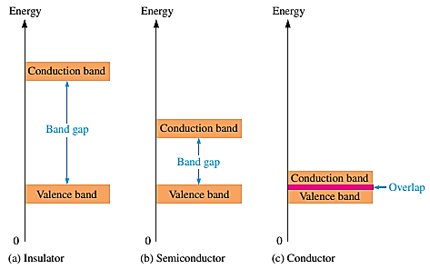
Figure 5: Energy diagrams for insulators, semiconductors, and conductors.

Slide 5
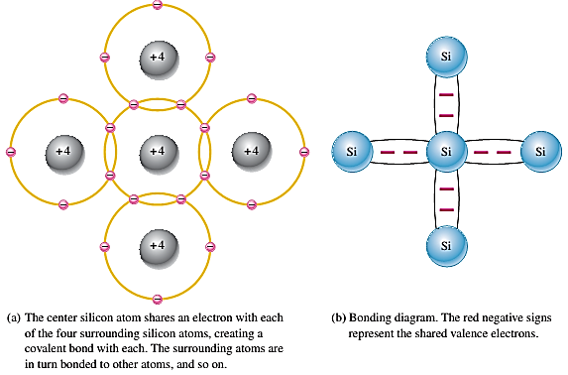
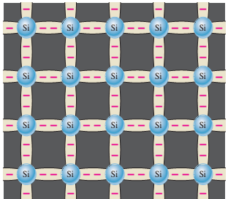
    Covalent Bonds
Figure 6 shows how each silicon atom positions itself with four adjacent silicon atoms to form a silicon crystal. A silicon (Si) atom with its four valence electrons shares an electron with each of its four neighbors. This creates eight shared valence electrons for each atom and produces a state of chemical stability. Also, this sharing of valence electrons produces the covalent bonds that hold the atoms together. Covalent bonding in an intrinsic silicon crystal is shown in Figure 6c. An intrinsic crystal is one that has no impurities. Covalent bonding for germanium is similar because it also has four valence electrons.
Figure 6: Illustration of covalent bonds in silicon.

Slide 6
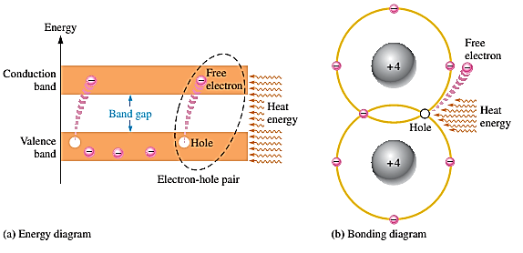
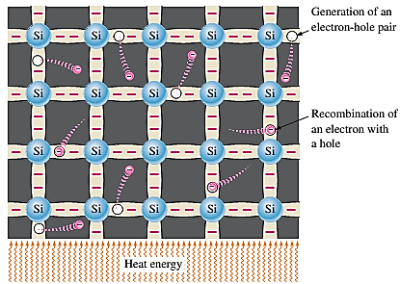
    Conduction Electrons and Holes
When an intrinsic silicon crystal gains sufficient heat (thermal energy), some valence electrons could break their covalent bonds to jump the gap into the conduction band, becoming free electrons. Free electrons are also called conduction electrons, (negative charge). This is illustrated in Figure 7.
The vacancy in the valence band is called a hole (positive charge). For every electron raised to the conduction band, there is 1 hole in the valence band, creating an electron-hole pair. There is an equal number of holes in the valence band created when these electrons jump into the conduction band, this is illustrated in Figure 8. Recombination is called when a conduction-band electron loses energy and falls back into a hole.
Figure 7: Creation of electron-hole
pairs in a silicon crystal.
Figure 8: Free electrons are being generated continuously while some recombine with holes.

Slide 7
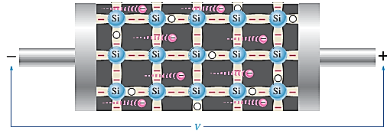
    Electron and Hole Current
In the conduction band, when a voltage is applied across a piece of intrinsic silicon, as shown in Figure 9, the thermally generated free electrons in the conduction band, are now easily attracted toward the positive end. This movement of free electrons is one type of current in a semiconductive material called electron current.
Figure 8:

Slide 8
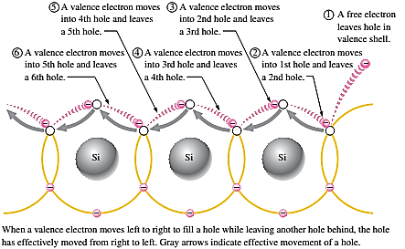
In the valance band, in valance band holes are generated due to free electrons. Electrons in the valance band are, although still attached to atom and not free to move,
However, they can move into the nearby hole with a little change in energy, thus leaving another hole where it came from.
Effectively, the hole has moved from one place to another in the crystal structure, as illustrated in Figure 9. Although current in the valence band is produced by valence electrons, it is called hole current to distinguish it from electron current in the conduction band.
Figure 9

Slide 9
    Doping
Since semiconductors are generally poor conductors,
Their conductivity can be increased by the controlled addition of impurities to the intrinsic (pure) semiconductive material.
This process, called doping, increases the number of current carriers (electrons or holes).
Two types of semiconductor materials are subjected to the doping process: N-type and P-type.
Two types of elements used doping: Trivalent element – with 3 valence electrons, and Pentavalent element – with 5 valence electrons.

Slide 10
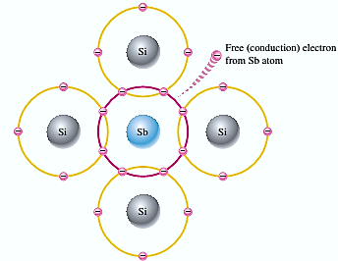
    N-type semiconductors
- In order for silicon crystal to conduct electricity, we need to introduce an impurity atom such as Arsenic (As), phosphorus (P), bismuth (Bi), or Antimony (Sb) into the crystalline structure, making it extrinsic (impurities are added).
- These atoms have five outer electrons in their outermost covalent bond to share with other atoms and are commonly called "Pentavalent" impurities. This allows four of the five electrons to bond with their neighboring silicon atoms, leaving one “free electron” to move about when an electrical voltage is applied (electron flow). As each impurity atom “donates” one electron, pentavalent atoms are generally known as “donors”.
In n-type material, electrons are the majority carrier and holes the minority carrier.
Figure 10: An antimony (Sb) impurity
atom is shown in the center.
The extra electron from the Sb
atom becomes a free electron.

Slide 11
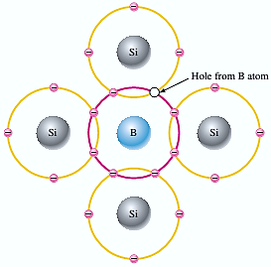
    P-type semiconductors
Trivalent (with 3 valence electrons) impurity atoms are added – Aluminum (Al), boron (B), indium (In), and gallium (Ga).
Trivalent is also known as acceptor atom since they accept electrons.
When a trivalent atom is added to an intrinsic, it will readily accept a free electron, which becomes a p-type extrinsic semiconductor. Each trivalent atom forms a covalent bond with 4 adjacent Si atoms.
Since 4 electrons are needed to form a covalent bond, it causes the existence of a hole in the covalent bonding. It also causes a lack of valence electrons in the B atoms. In p-type material, holes are the majority carrier, and electrons are the minority carrier.
Figure 11: Trivalent impurity atom
in a silicon crystal structure. A boron
(B) impurity atom is shown in the center.

