Slide 1


Al-Mustaqbal University / Nursing College
Academic Year 2023-2024 health promotion
Lecture 1
Introduction to health promotion
Prepared by: Dr. Ali Hussein. H.

Slide 2
Health promotion
Health:-
Health is a state of complete physical, mental and social well-being and not merely the absence of disease or infirmity.

Slide 3
Wellness
Wellness a term often used interchangeably with health, is an;
Active state of being health by living a lifestyle that promotes good physical, mental and social health.
Emotional.
Occupational.
Spiritual.
Intellectual.

Slide 4
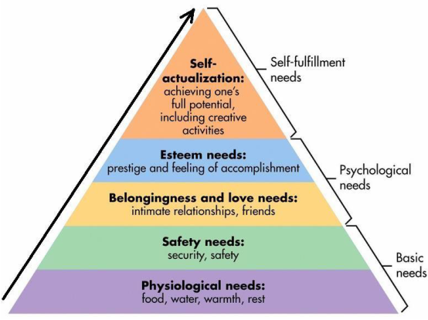
Maslow hierarchy of needs and health:

Slide 5
Maslow's Hierarchy of Needs
Maslow's Hierarchy of Needs is explains human motivation as a progression of needs, organized into five levels, typically depicted as a pyramid. Each level must be satisfied to some extent before individuals can move on to higher levels of motivation. Here's a breakdown:

Slide 6
1. Physiological Needs (Base of the Pyramid)
These are the most basic survival needs essential for human existence.
Examples: Food, water, shelter, air, sleep, and clothing.

Slide 7
2. Safety Needs
Once physiological needs are fulfilled, the focus shifts to security and safety.
Examples: Physical safety (protection from harm), financial stability, health security, and a stable environment.

Slide 8
3. Love and Belonging Needs
This level addresses the human desire for interpersonal relationships and community.
Examples: Friendships, family bonds, romantic relationships, and social connections.

Slide 9
4. Esteem Needs
Divided into two categories:
  Self-esteem: Confidence, mastery, and achievement.
  Recognition by Others: Respect, status, and appreciation.

Slide 10
5. Self-Actualization Needs (Top of the Pyramid)
Represents the fulfillment of personal potential and growth.
Examples: moral development, problem-solving, and personal achievements.

Slide 11
Disease
Is a medical term meaning that there is a pathologic change in the structure or function of the body or mind.
Illness
It is an abnormal process in which the persons level of functioning is changed when compared with a previous level.

Slide 12
Nursing
Is an art an science that collaboration with individuals, families, and communities to create the most favorable conditions for the expression of optimal health and high-level well-being.

Slide 13
Measurement of Health:
The health of the public is measured more globally by:
- morbidity (How frequently a diseases occurs)
- mortality (Number of deaths).
measurements of "health" (both individual and population) traditionally focused on morbidity or mortality.
@Thus, the health status of countries may be compared in terms of :
- Their death rates per thousand.
- Their average life expectancy.
- Infant and maternal mortality rates,
-Any of a range of indicators of morbidity such as (rates of reportable disease, hospital discharges, etc).

Slide 14
Disease Prevention
- Measures to prevent disease and injury, such as risk factors reduction.
- It also refers to measures to stop the progress and reduce the impact of disease and injury that might already exist.

Slide 15
Health Promotion
Health promotion is the process of enabling people to increase control over, and to improve, their health. To reach a state of complete physical, mental and social well-being, an individual or group.

Slide 16
Health Promotion Strategies
Health promotion and disease prevention programs can improve health at every stage of life.

Slide 17
The strategies are:
• Health Communication
• Health Education
• Policy, Systems, and Environmental Change
• Life style / behavioral approach changes
• Develop of the individual skills

Slide 18
HAVE A NICE DAY
Thank you

