Slide 1


Al-Mustaqbal University.
College of Engineering and Engineering Technologies.
Biomedical Engineering Department.
Subject: laboratory instrumentation
Class : 4th
Lecture: 2
By: Zainab Sattar Jabbar M.SC. IN BME
BME

Slide 2
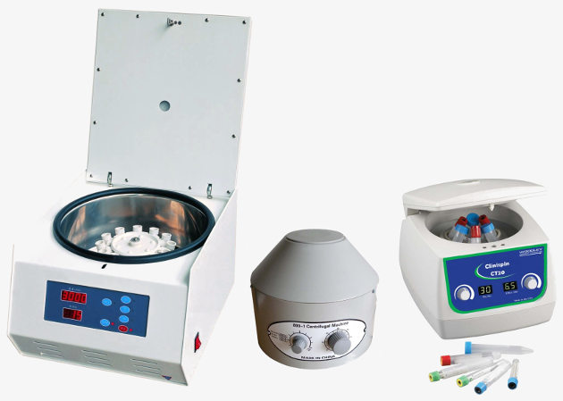
Laboratory Centrifuges
A centrifuge is a motor-driven equipment which is used in hospital laboratories. A centrifuge prepares body liquids from a patient for further examinations.

Slide 3
Principle of Centrifuges
For diagnosing diseases, the examination of the components of body liquids like blood and urine are important.
Each component has a specific use in the body and therefore a different test is required. But before particles of body fluids can be examined they first have to be extracted from the supporting fluid. This is what the centrifuge does.
The liquid samples are spun around at high speed, which causes large centrifugation forces and consequently the substances separate due to their different densities. The separated components can then be examined.

Slide 4
Types and applications
Laboratory centrifuges differ in size, sample capacity, speed and application.
First we distinguish between preparative and analytical centrifuges.
Their task is to separate the solids of a biological sample from the supporting fluid for further examinations.
Analytical centrifuges do both, extracting the components and doing an analysis at the same time. The analysis result is already given after centrifugation.
In hospital laboratories we mostly find small tabletop centrifuges. These centrifuges are called general purpose centrifuges, micro centrifuges or preparative centrifuges. They are used for separating cells, parasites and bacteria from body fluids like blood and urine.

Slide 5
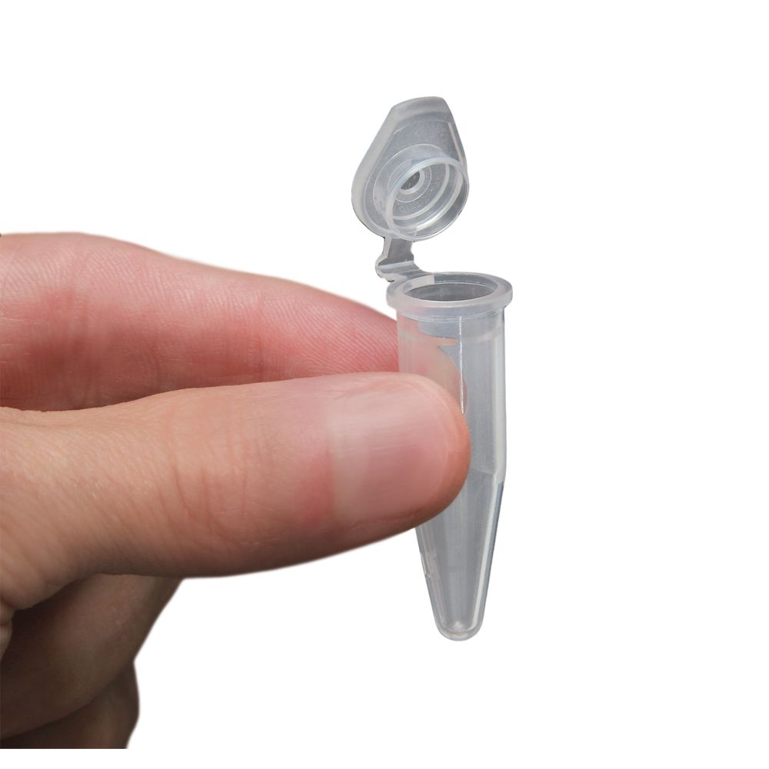
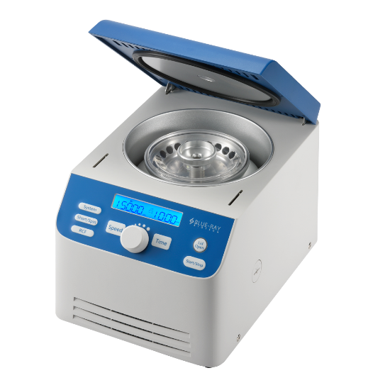
The Micro Centrifuge
The micro centrifuge is a small compact bench top centrifuge. They are designed for micro tubes of 0.2 ml to 2.0 ml size.
The maximum speed of a typical micro centrifuge ranges between 13,000 rpm and 15,000 rpm

Slide 6
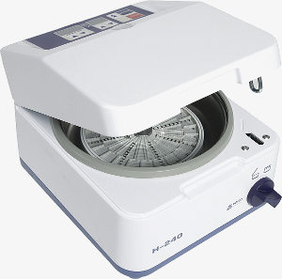

The Hematocrit Centrifuge
Hematocrit centrifuges are analytical centrifuges. The working principle is the same but the samples are much smaller. Thin capillary tubes contain only a small amount of blood so that the forces are relatively low.
The speed of hematocrit centrifuges ranges from 7,000 rpm to 15,000 rpm

Slide 7
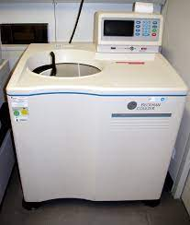
The Ultra-Centrifuge
The ultra-centrifuge are capable of speeds of 100,000 rpm. This speed can only be reached when the rotor spins in a vacuum and the centrifuge furthermore is cooled.

Slide 8
Using the centrifuge
Use only accessories and tubes which are designed for your type of centrifuge.
Before using the centrifuge, make sure the rotor is tightened.
Samples should be closed with a cap before centrifugation.
The rotor has to be balanced at all times.
Do not open the lid while the rotor is still spinning
Switch off the centrifuge immediately if it makes abnormal sounds or starts shaking or wobbling.
After a sample spillage clean the rotor and the buckets immediately with a mild multi-purpose cleaner

Slide 9
Centrifuge construction
Simple centrifuges consist just of a motor, an electromechanical timer and a brake.
Better centrifuges are provided with a speed control. Speed control means both, adjusting a desired speed with a knob and keeping the set speed stable over the centrifugation time. This can be done by a small electronic control unit.
When further safety features and an electronic timer instead of a mechanical one are wanted, the control gets a little more complex. Nowadays a little microprocessor does the managing of the sensors for speed, lid lock, imbalance, contains the timer function and controls the power amplifiers for the motor and the brake.

Slide 10
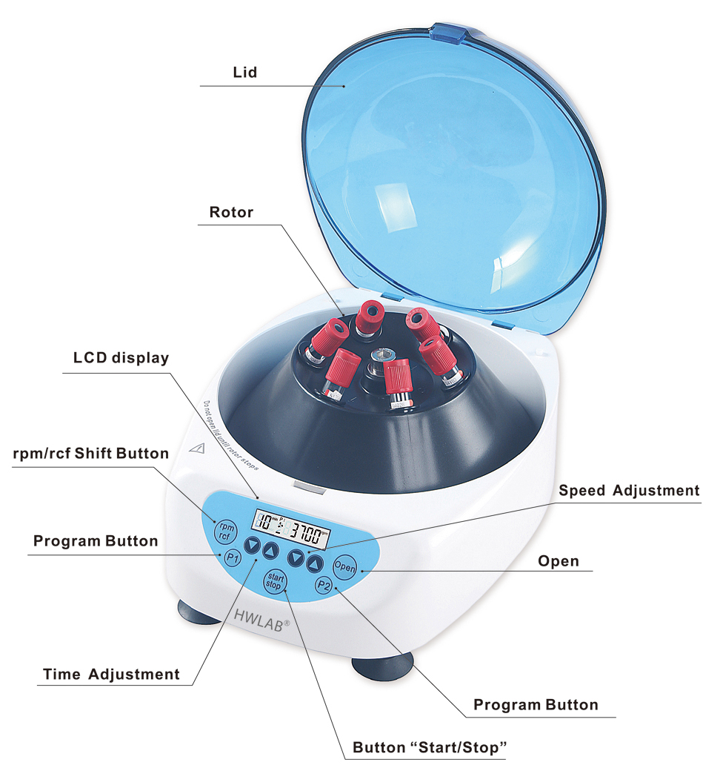
Design of centrifuges
The centrifuge consists of:
Lid.
A motor.
A holder for the tubes which is called rotor.
Control electronics.

Slide 11
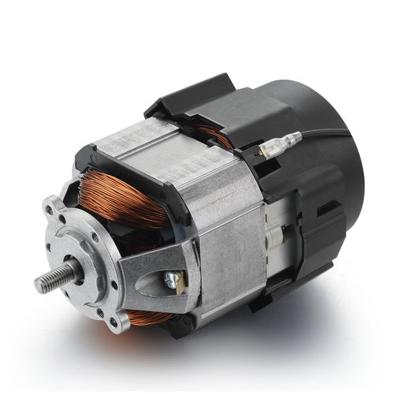
Motor
The centrifuges strong core component that generates the spin is the motor.
Most centrifuges run with a universal motor. That is a single-phase motor, where the stator's field winding and the rotor winding are connected in series through a commutator.

Slide 12
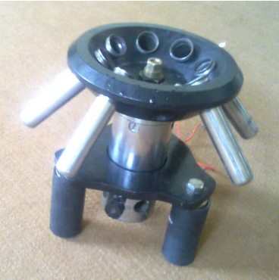
Rotor
The rotor is connected directly to the motor shaft.
The rotating components are supported by the motor shaft.
Rotors in centrifuges are the motor devices that house the tubes with the samples.
Centrifuge rotors are designed to generate rotation speed that can bring about the separation of components in a sample.

Slide 13
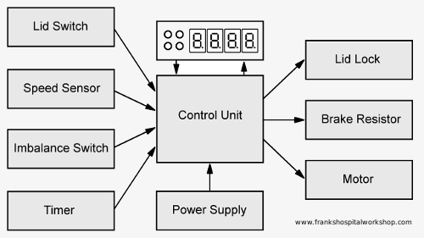
Control unit
The control unit is the heart of the centrifuge, which receives the settings from the control knobs for the speed and the centrifugation time. Also the sensors for the actual speed, an open lid or an imbalanced load are connected here. The control board processes all this information and then controls the motor, the brake and the lid lock.

Slide 14
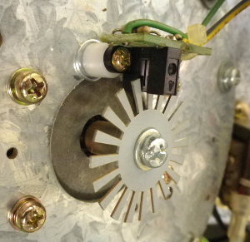
Speed sensor
The speed sensor is either a forked photoelectric sensor or a Hall-effect sensor.
In the first case a slotted disk is mounted on the shaft of the motor. The disk turns through the forked photoelectric sensor.
On one side of the fork the sensor contains a LED and on the opposite side a photo transistor. When the shaft turns, the slots create a pulsed output signal.
The frequency of this signal is dependent on the speed. The higher the speed, the higher the frequency.

Slide 15
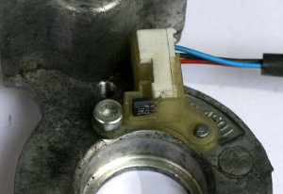
Speed sensor
The output signal of a Hall-sensor is similar to the signal of a photoelectric sensor. But instead of a slotted disk a magnet is mounted on the shaft.
A Hall-effect sensor responds to the magnetic field of this magnet. The output again is a square wave signal with a frequency depending on the speed.

Slide 16
Speed control
The speed control process happens in the control unit. The control unit does two things. First, it converts the square wave signal from the sensor and compares this with the set speed from the control panel and adjusts the voltage for the motor until the actual speed reaches the set value.
The speed signal is also needed for activating the safety lock. As long as the sensor delivers a signal the control unit knows that the centrifuge is spinning and it keeps the lid locked

Slide 17
Brake
When the centrifugation time is over the rotor slows down and comes to a complete stop after a few seconds.
This is only possible if the motor is decelerated actively by a brake.
The brake is nothing else but a resistor that bypasses the rotating motor. The rotating motor then acts as a generator and produces energy which is absorbed by the resistor. The 'generator' then runs under heavy load and slows down.
The electrical energy is transformed in the resistor into heat. Because the generated power is quite big, the resistor also has to be big. Indeed it is the biggest resistor inside the centrifuge and it is easy to find. Sometimes it is mounted with some distance on the control board and sometimes somewhere else away from the board where it is better cooled by the surrounding air.

Slide 18
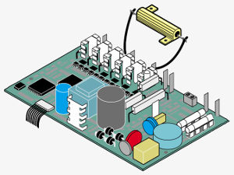
Brake
A control board with an external brake resistor

Slide 19
Imbalance detector
An imbalance sensor detects an unbalanced rotor and lets the motor stop immediately.
The sensor is nothing more than a micro switch which is attached close to the shaft. If the load is not balanced the shaft starts to wobble and finally touches the micro switch. The activated switch gives a signal to the control board which stops the motor.

Slide 20
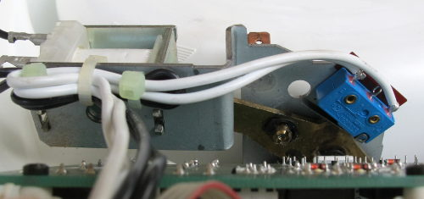
Lid sensor
For safety reasons it should not be possible to start the centrifuge when the lid is open. A micro switch mounted at the lock mechanism detects an open lid and passes this information to the control board.

Slide 21

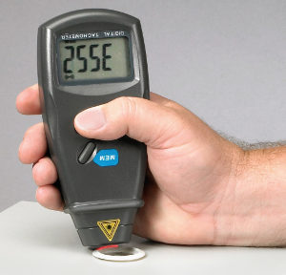
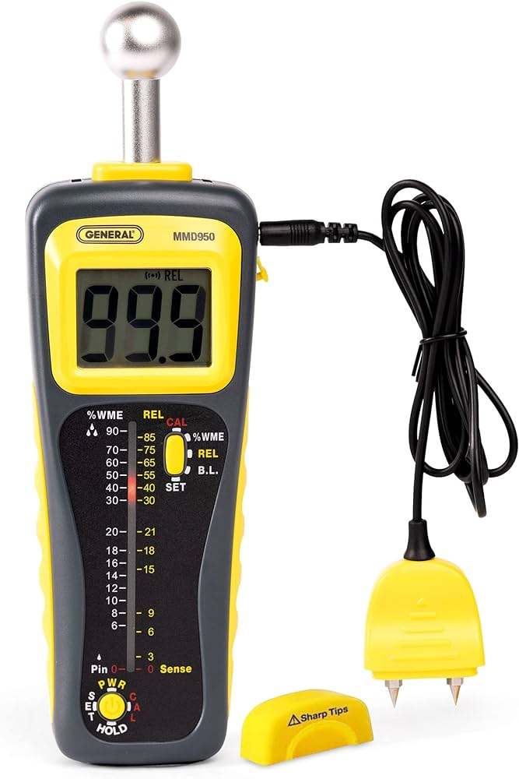
Needed tools for Performance test
Beside the normal tool set, cleaning material and a clean and bright workplace we will need the following equipment for the performance check:
Stop watch.
Tachometer.
Thermometer.

Slide 22
Thank you

