Slide 1
Al-Mustaqbal University
Biomedical Engineering Department
Class: 3th
Subject: Physiology II
Lecturer: M.SC. ZAINAB SATTAR JABBAR
1st term – Lect. 4: Endocrine System
Email: zainab.sattar.jabbar@uomus.edu.iq

Slide 2
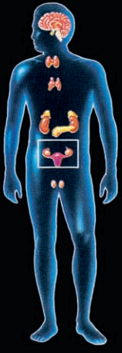
Endocrine System
Endocrine glands release hormones, blood-borne chemical messengers that act on target cells located a long distance from the endocrine gland.
Most target-cell activities under hormonal control are directed toward maintaining homeostasis.
The central endocrine glands, which are in or closely associated with the brain, include the hypothalamus, the pituitary gland, and the pineal gland.

Slide 3
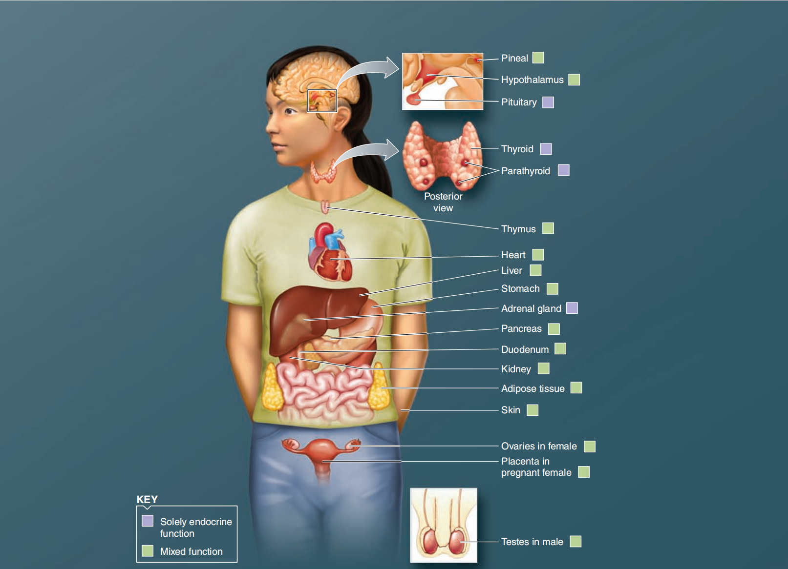

Slide 4
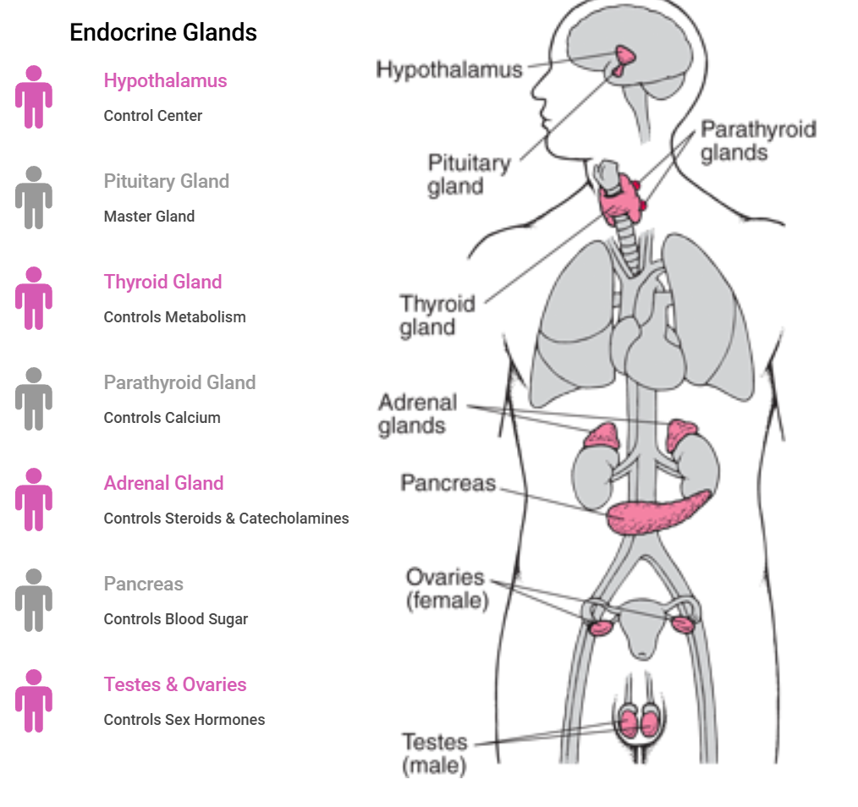
Function of hormones

Slide 5
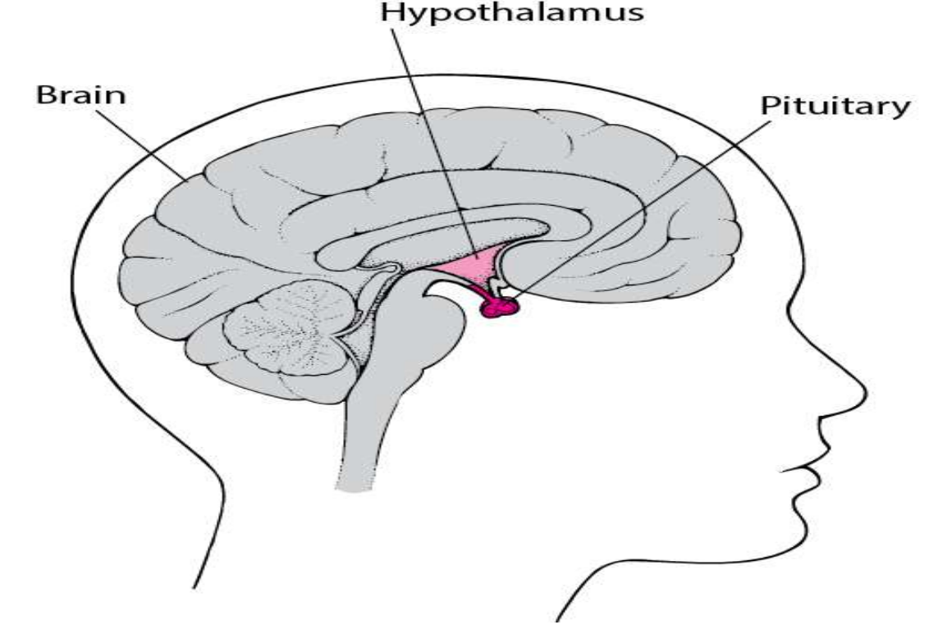
Pituitary gland and hypothalamus
The Pituitary Gland Links the Nervous and Endocrine Systems.
The hypothalamus receives information from nerves and brain then it initiates signals (hormones) in response, which travel to the pituitary.Pituitary releases additional hormones that travel to target cells in body.
The pituitary gland, also called the hypophysis, is a small gland about 1 centimeter in diameter and 0.5 to 1 gram in weight.
Physiologically, the pituitary gland is divisible into two distinct portions: the anterior pituitary, also known as the adenohypophysis, and the posterior pituitary, also known as the neurohypophysis.

Slide 6
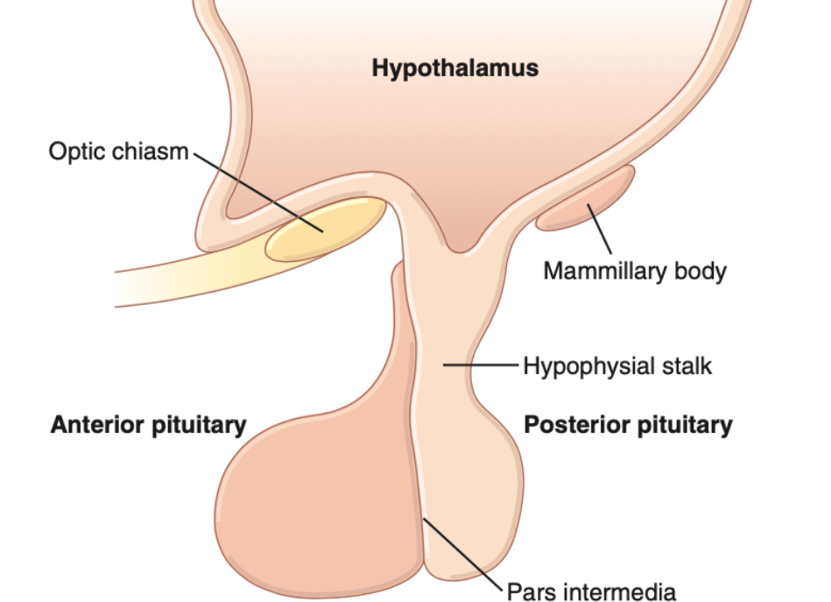
Six major peptide hormones plus several other hormones of lesser importance are secreted by the anterior pituitary, and two important peptide hormones are secreted by the posterior pituitary.
Pituitary gland and hypothalamus

Slide 7
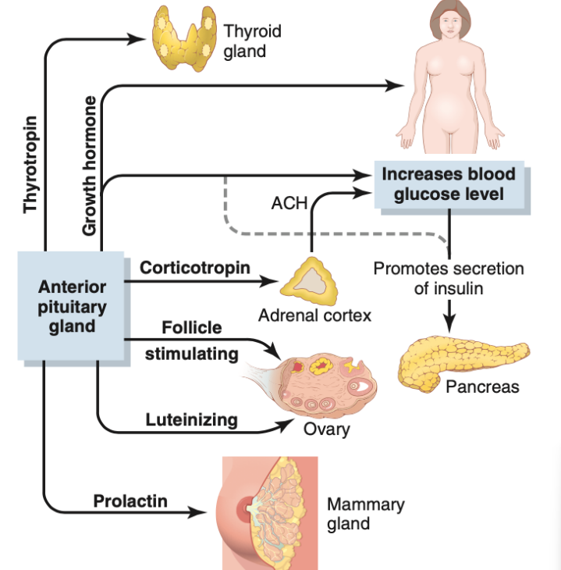
The hormones of the anterior pituitary
Growth hormone (hGH) promotes growth of the entire body by affecting protein formation, cell multiplication, and cell differentiation.
Adrenocorticotropin (corticotropin) (ACTH) controls the secretion of some of the adrenocortical hormones, which affect metabolism of glucose, proteins, and fats.
Thyroid-stimulating hormone (thyrotropin) (TSH) controls the secretion rate of thyroxine and triiodothyronine by the thyroid gland, and these hormones control the rates of most intracellular chemical reactions in the body.
Prolactin (PRL) promotes mammary gland development and milk production.
Two separate gonadotropic hormones, follicle stimulating hormone (FSH) and luteinizing hormone (LH), control growth of the ovaries and testes, as well as their hormonal and reproductive activities.

Slide 8
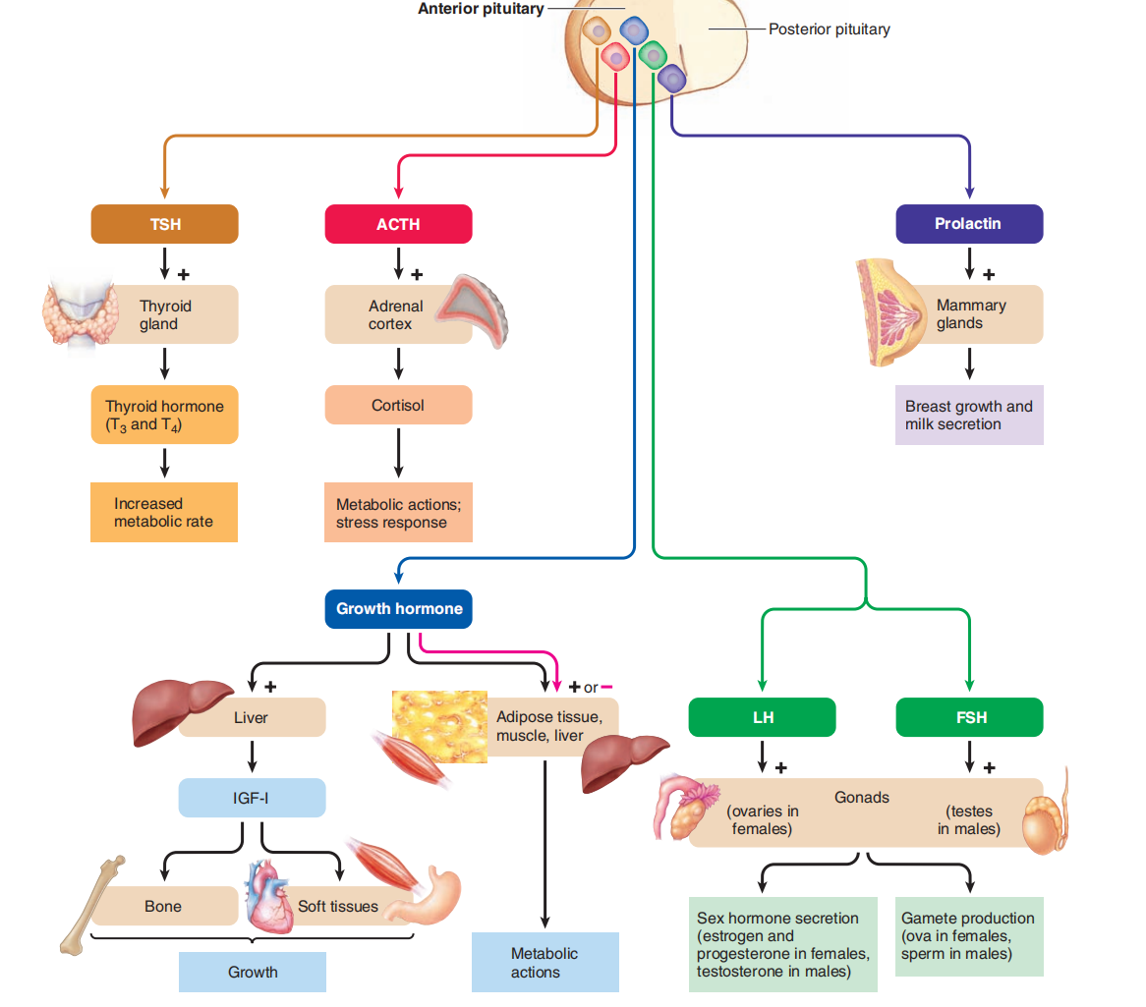
The hormones of the anterior pituitary

Slide 9
The two hormones secreted by the posterior pituitary play other roles.
Antidiuretic hormone (ADH) controls the rate of water excretion into the urine, thus helping to control the concentration of water in the body fluids.
Oxytocin helps express milk from the glands of the breast to the nipples during suckling and helps in the delivery of the baby at the end of gestation.
The hormones of the posterior pituitary

Slide 10
Endocrine System
The multiple activities of the cells, tissues, and organs of the body are coordinated by the interplay of several types of chemical messenger systems:
1. Neurotransmitters are released by axon terminals of neurons into the synaptic junctions and act locally to control nerve cell functions.
2. Endocrine hormones are released by glands or specialized cells into the circulating blood and influence the function of cells at another location in the body. The endocrine hormones are carried by the circulatory system to cells throughout the body where they bind with receptors and initiate many reactions.
1) Some endocrine hormones affect many different types of cells of the body; for example, growth hormone (from the anterior pituitary gland) causes growth in most parts of the body, and thyroxin (from the thyroid gland) increases the rate of many chemical reactions in almost all the body’s cells.
2) Other hormones affect only specific target tissues, because only these tissues have receptors for the hormone. For example, adrenocorticotropic hormone (ACTH) from the anterior pituitary gland specifically stimulates the adrenal cortex, causing it to secrete adrenocortical hormones.
3. Neuroendocrine hormones are secreted by neurons into the circulating blood and influence the function of cells at another location in the body. The neuroendocrine cells, located in the hypothalamus, have axons that terminate in the posterior pituitary gland and secrete several neurohormones, including antidiuretic hormone (ADH), and oxytocin.

Slide 11
Endocrine System
4. Paracrine are secreted by cells into the extracellular fluid and affect neighboring cells of
a different type.
5. Autocrines are secreted by cells into the extracellular fluid and affect the function of the same cells that produced them by binding to cell surface receptors.
6. Cytokines are peptides (protein) secreted by cells into the extracellular fluid and can function as autocrines, paracrines, or endocrine hormones. Examples of cytokines include the interleukins and other lymphokines that are secreted by helper cells and act on other cells of the immune system. Cytokine hormones (e.g., leptin) produced by adipocytes are sometimes called adipokines.

Slide 12
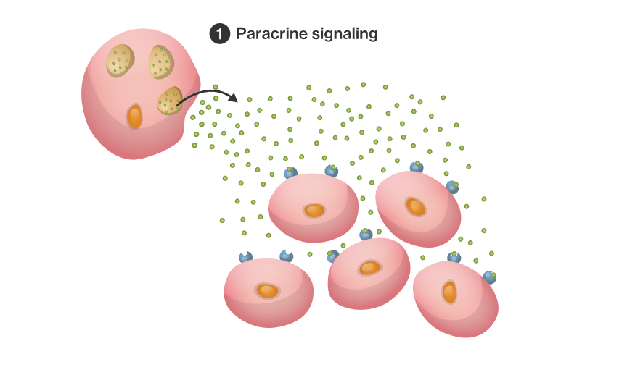
Paracrine signals

Slide 13
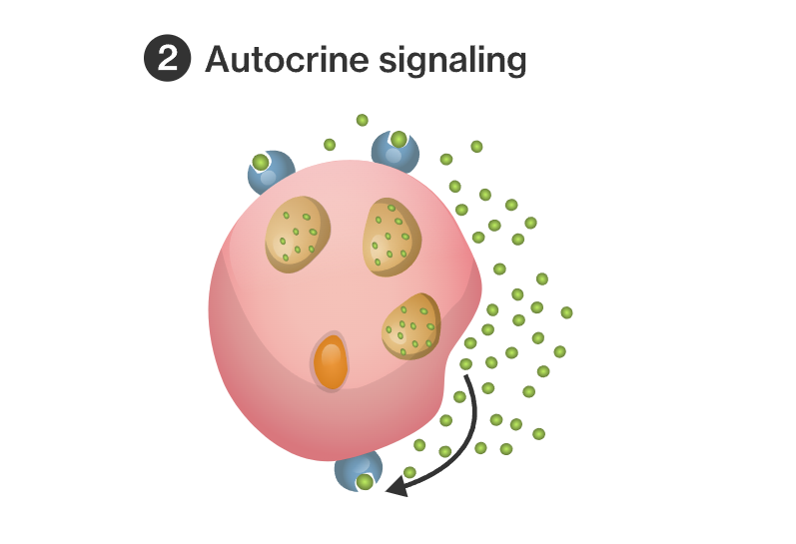
Autocrine signals

Slide 14
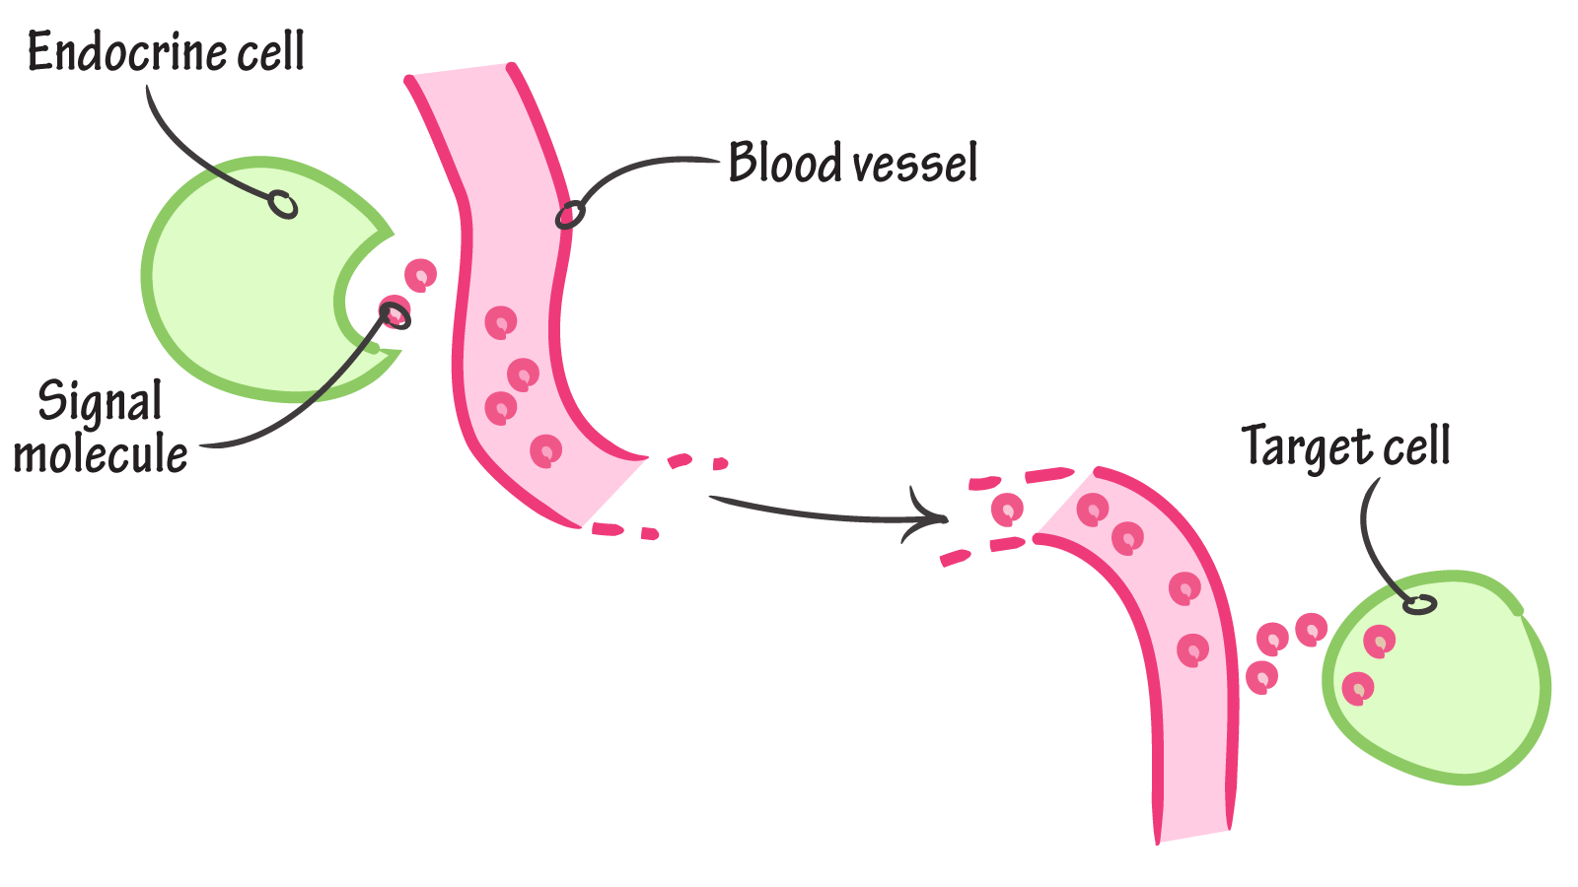
Endocrine signals

Slide 15
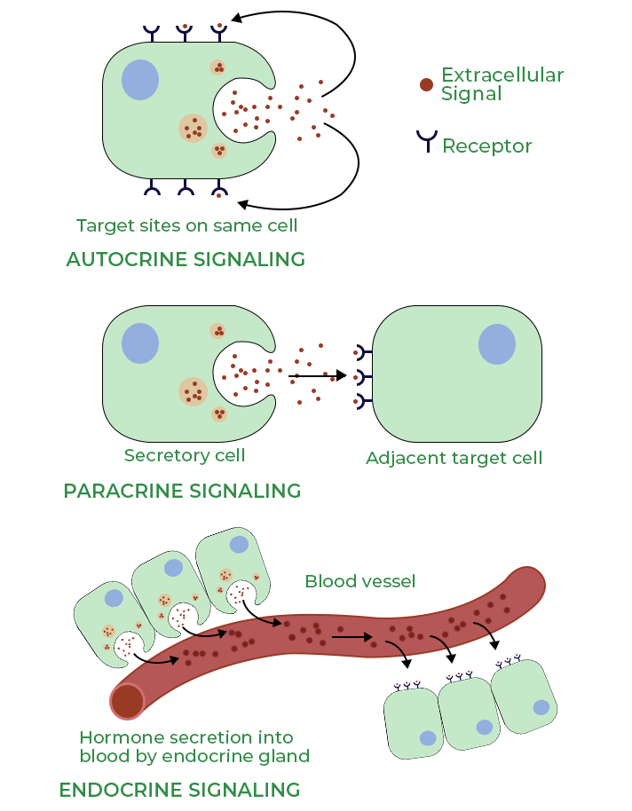
Endocrine System

Slide 16
Chemical Structure of Hormones
There are three general classes of hormones:
1.Proteins and polypeptides, including hormones secreted by
the anterior and posterior pituitary gland,
the pancreas (insulin and glucagon),
the parathyroid gland (parathyroid hormone), and many others.
2.Steroids secreted by
the adrenal cortex (cortisol and aldosterone),
the ovaries (estrogen and progesterone),
the testes (testosterone),
the placenta (estrogen and progesterone).
3.Derivatives of the amino acid tyrosine, secreted
by the thyroid (thyroxin and triiodothyronine) (T3,T4)
the adrenal medullae (epinephrine and norepinephrine).

Slide 17
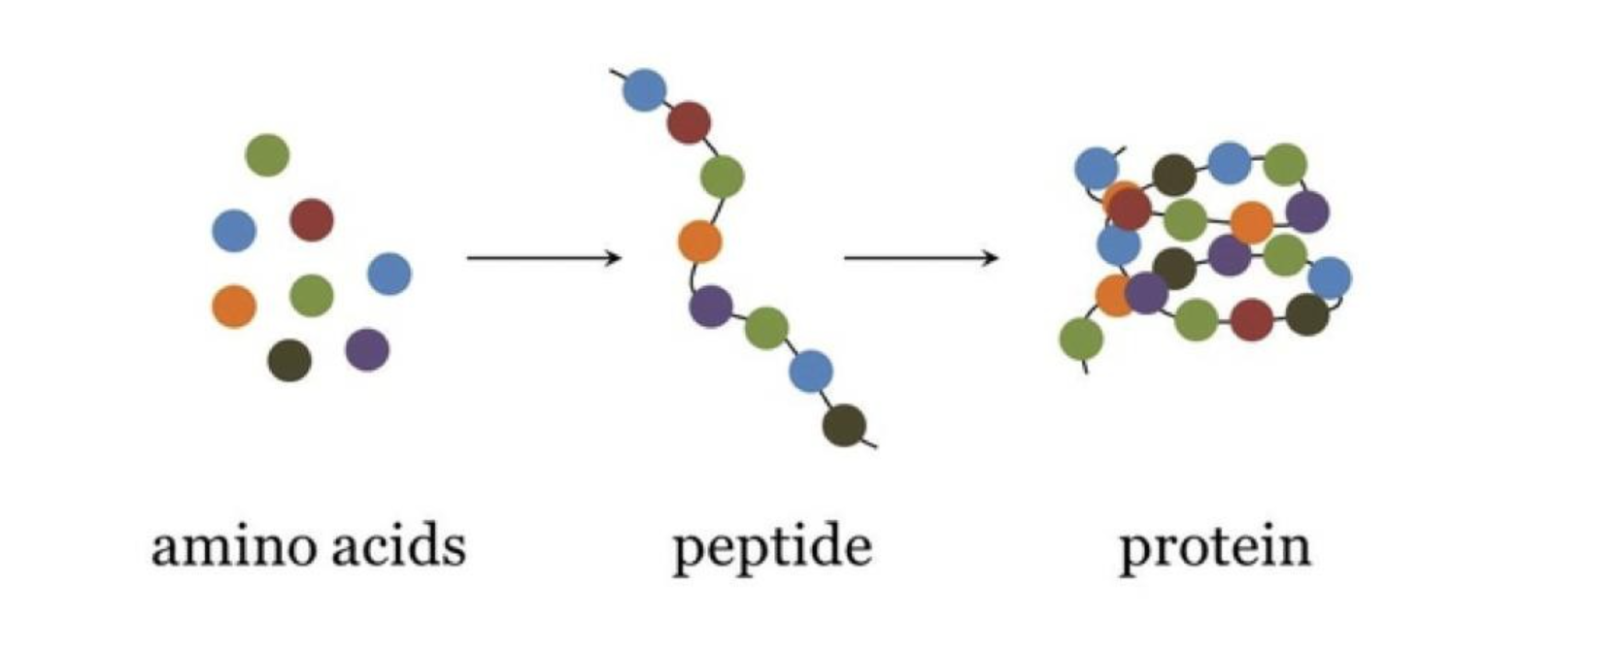
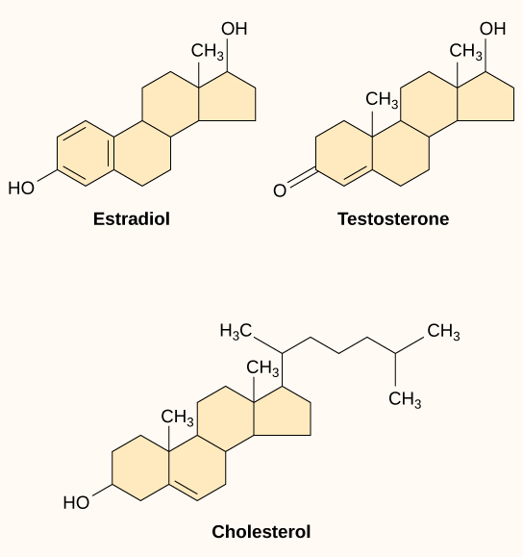
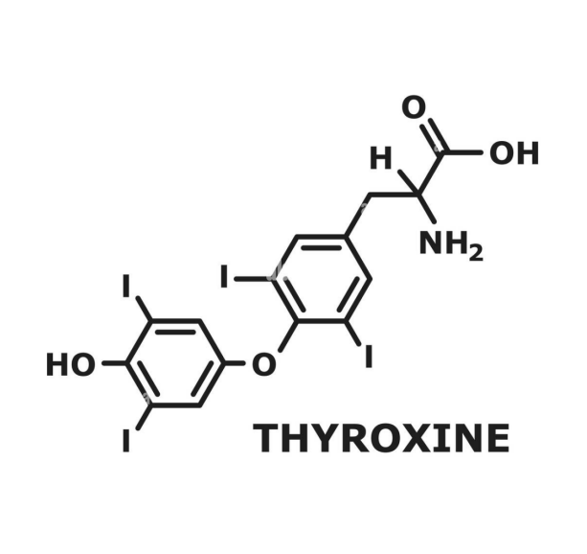
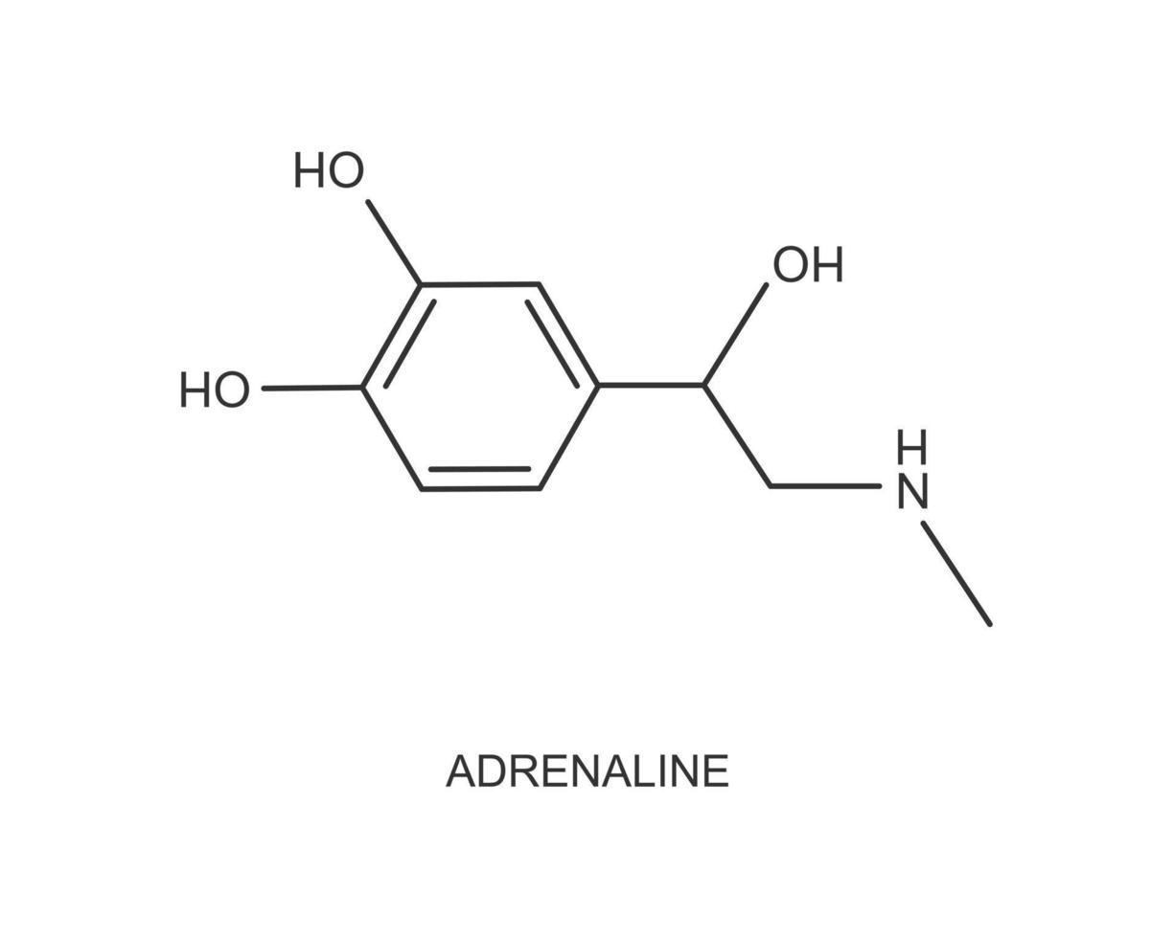
Chemical Structure of Hormones

Slide 18
Transport of Hormones in the Blood
1. Water-soluble hormones (peptides and catecholamines) are dissolved in the plasma and transported from their sites of synthesis to target tissues, where they diffuse out of the capillaries, into the interstitial fluid, and ultimately to target cells.
2. Steroid and thyroid hormones, in contrast, circulate in the blood mainly bound to plasma proteins. Protein-bound hormones cannot easily diffuse across the capillaries and gain access to their target cells and are therefore biologically inactive until they dissociate from plasma proteins.

Slide 19
Mechanisms of Action of Hormones
1. Hormone Receptors and their Activation
The first step of a hormone’s action is to bind to specific receptors at the target cell. Cells that lack receptors for the hormones do not respond. Hormonal receptors are large proteins, and are usually highly specific for a single hormone; this determines the type of hormone that will act on a particular tissue. The locations for the different types of hormone receptors are generally the following:
1) In or on the surface of the cell membrane. The membrane receptors are specific mostly for the protein, peptide, and catecholamine hormones.
2) In the cell cytoplasm. The primary receptors for the different steroid hormones are found mainly in the cytoplasm.
3) In the cell nucleus. The receptors for the thyroid hormones are found in the nucleus and are believed to be located in direct association with one or more of the chromosomes.
The number of receptors in a target cell usually does not remain constant from day to day, or even from minute to minute. For instance, increased hormone concentration and increased binding with its target cell receptors sometimes cause the number of active receptors to decrease (down-regulation) which decreases the target tissue’s
responsiveness to the hormone. In contrast, some hormones cause (up-regulation) of receptors and the target tissue becomes progressively more sensitive to the stimulating effects of the hormone.

Slide 20
Hormones Receptors
The first step of a hormones action is to bind to specific receptor at the target cell.
large protien
highly specific for a single hormone
cell to be stimulated usually has 2000 to 100000 receptors
when the hormone combines with its receptor, this action usually initiates a cascade of reaction in the cell.
Most hormones operate in cascades that are regulated by negative feedback.

Slide 21
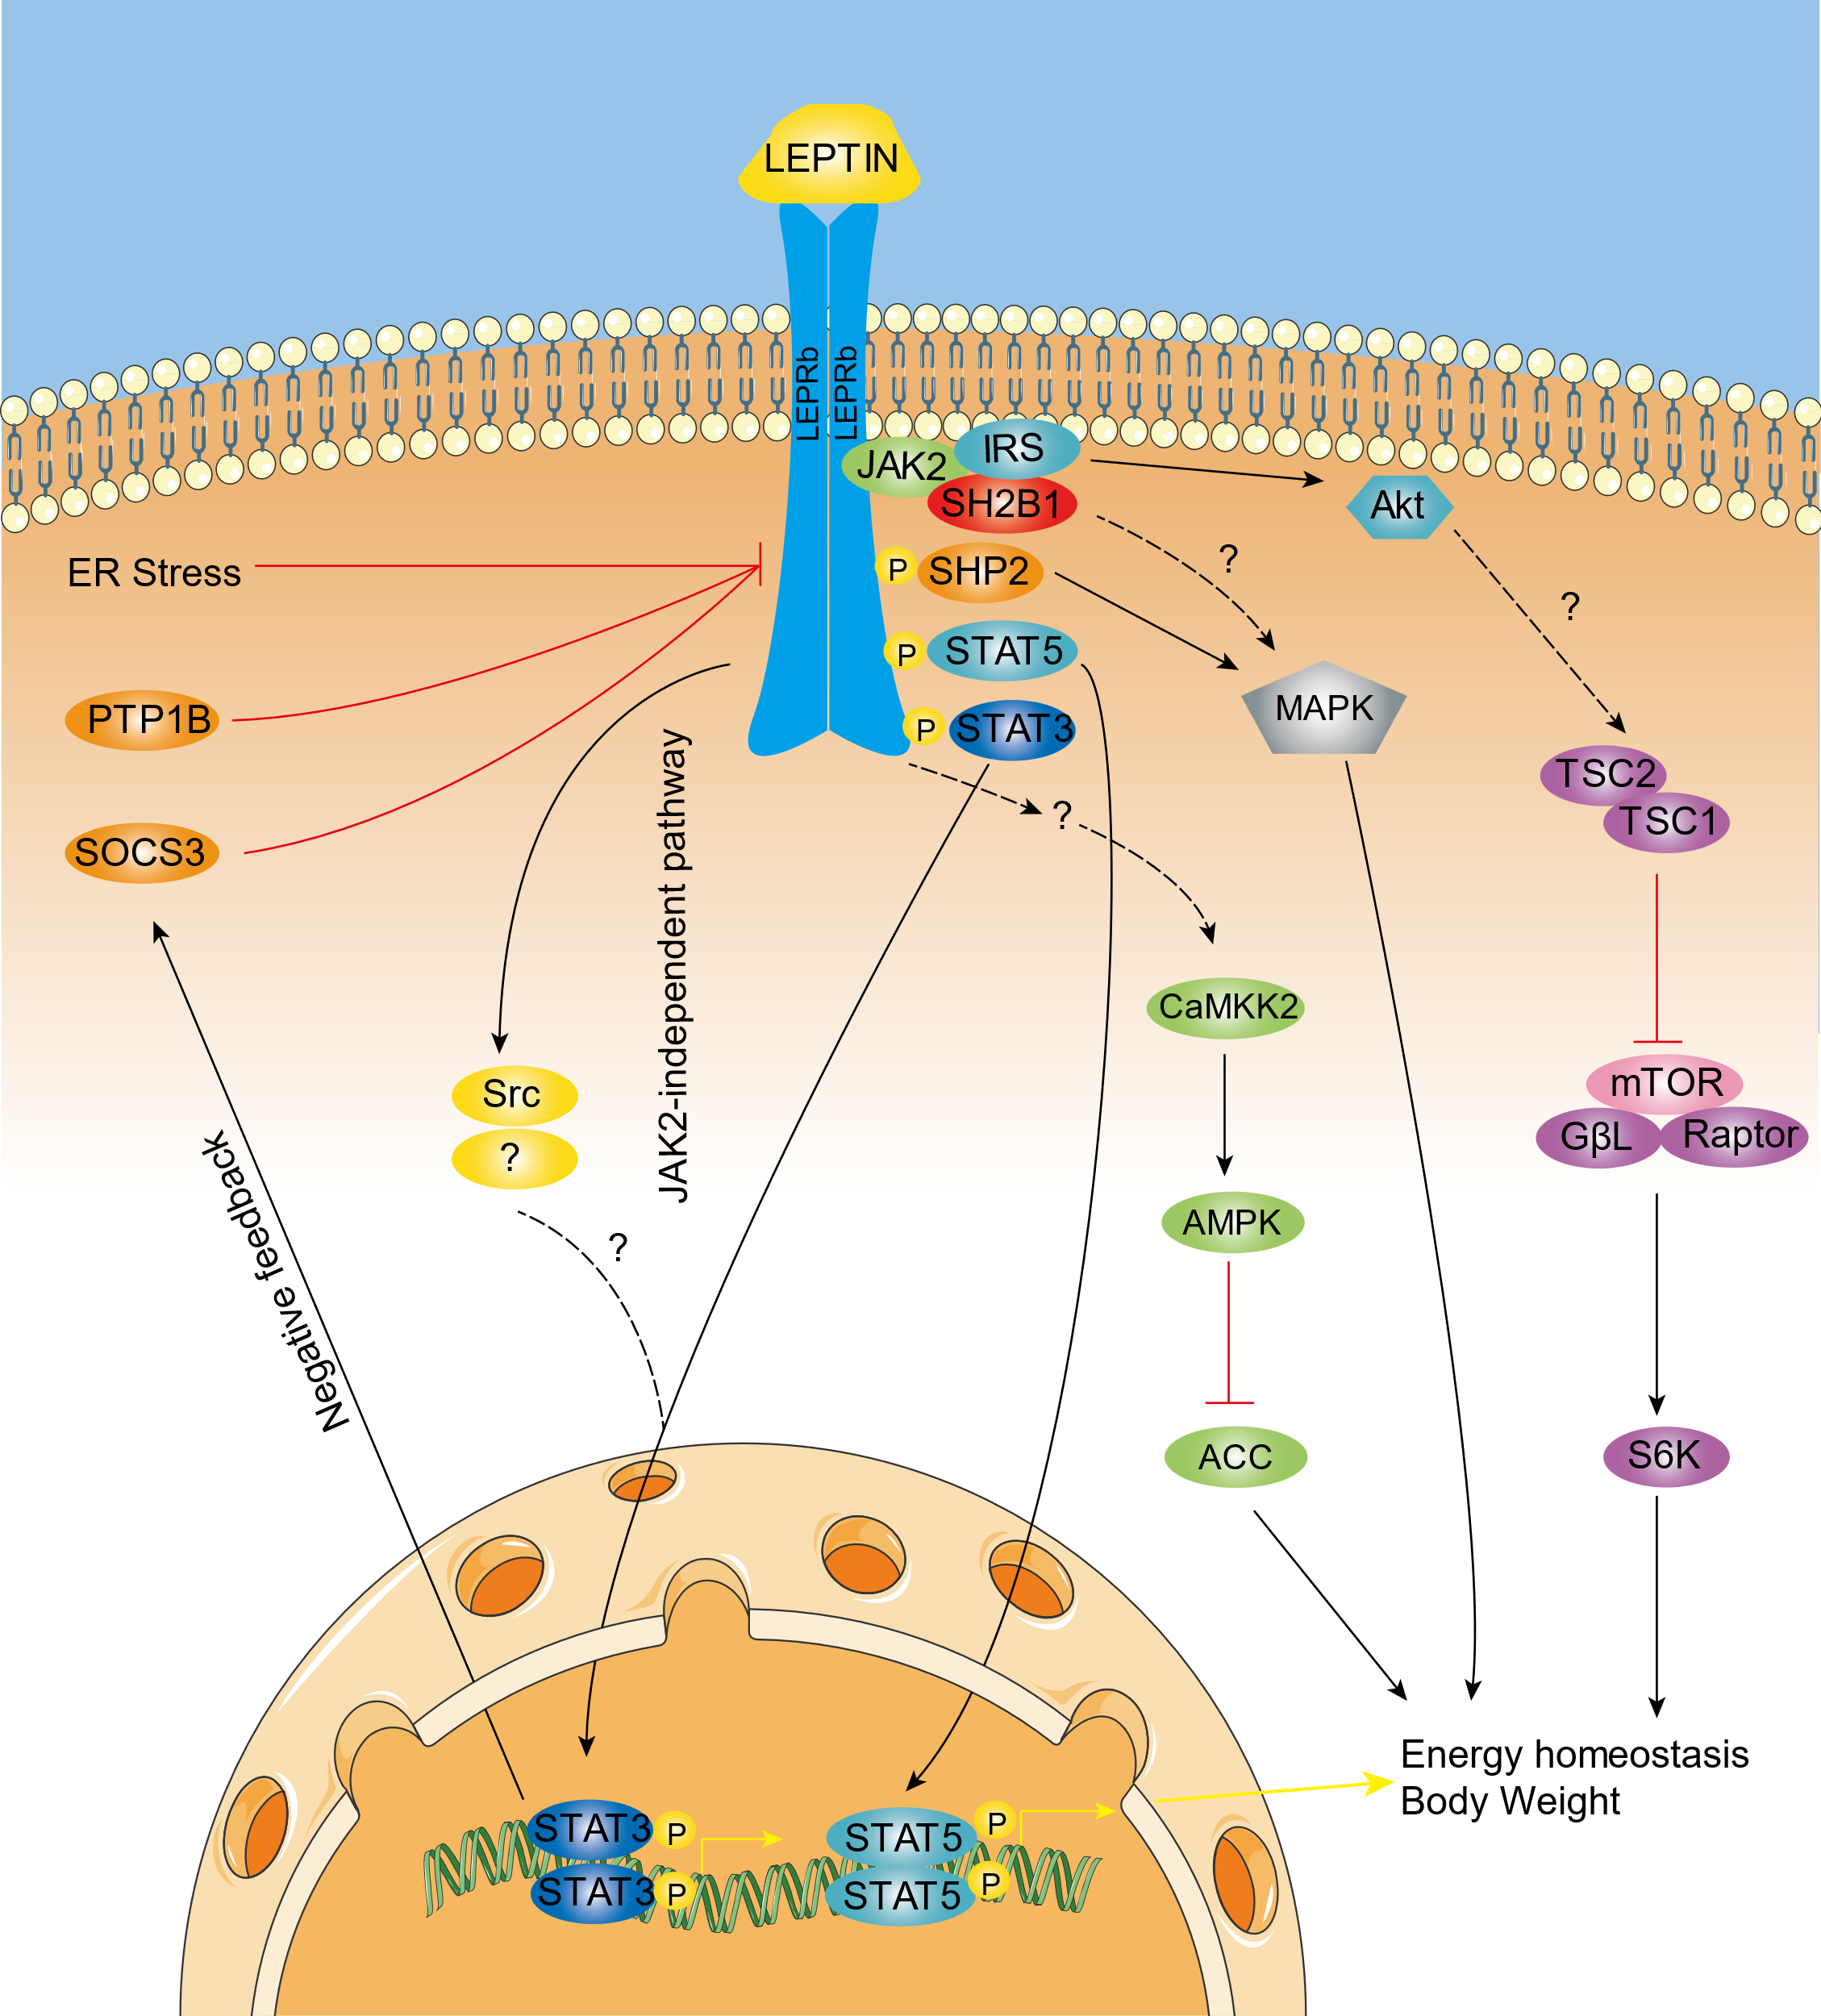
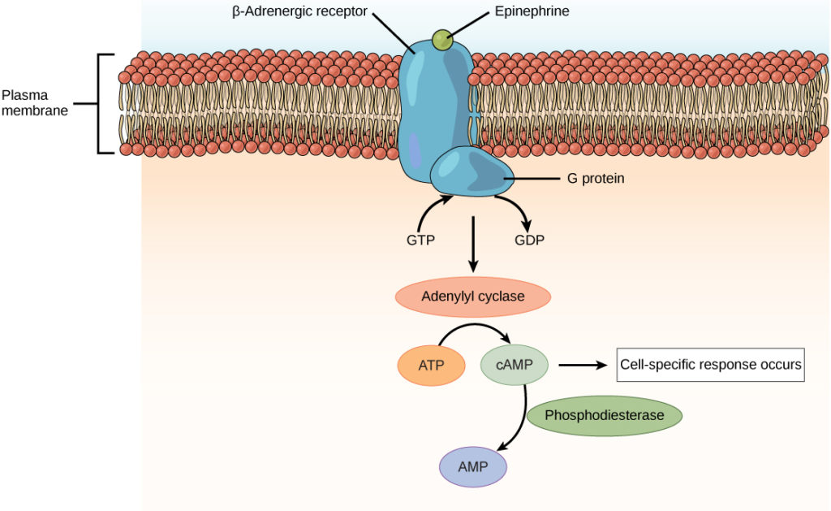
Hormones Receptors
The locations for the different types of hormone receptors are generally the following:
In or on the surface of the cell membrane.The membrane receptors are specific mostly for the protein, peptide, and catecholamine hormones

Slide 22
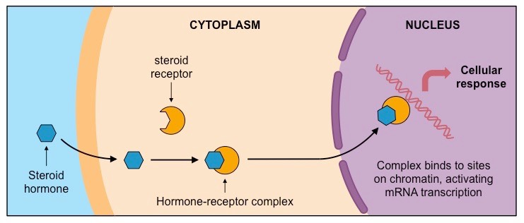
Hormones Receptors
In the cell cytoplasm. The primary receptors for the different steroid hormones are found mainly in the cytoplasm.

Slide 23
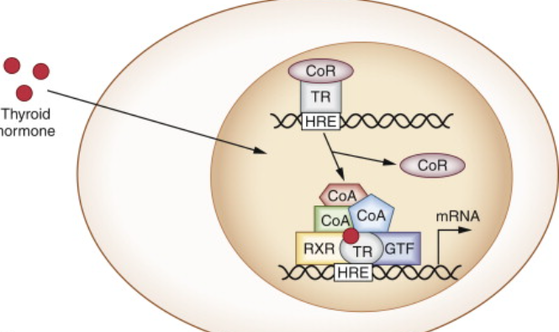
Hormones Receptors
In the cell nucleus. The receptors for the thyroid hormones are found in the nucleus and are believed to be located in direct association with one or more of the chromosomes.

Slide 24
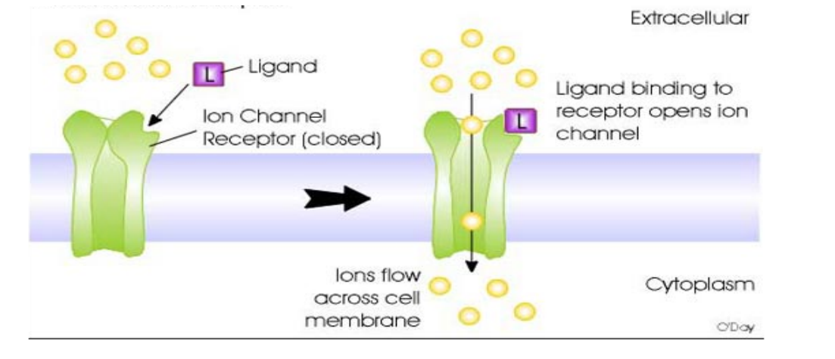
Mechanisms of Action of Hormones
2. Intracellular Signaling
Hormone affects its target tissues by first forming a hormone-receptor complex. This alters the function of the receptor itself, and the activated receptor initiates the hormonal effects via different types of interactions:
1) Ion Channel–Linked Receptors.
Few hormones may exert some of their actions through activation of ion channel receptors. Some of these ion channel–linked receptors open (or close) channels for sodium ions, others for potassium ions, others for calcium ions, and so forth. The altered movement of these ions through the channels causes the subsequent effects in the target cells.

Slide 25
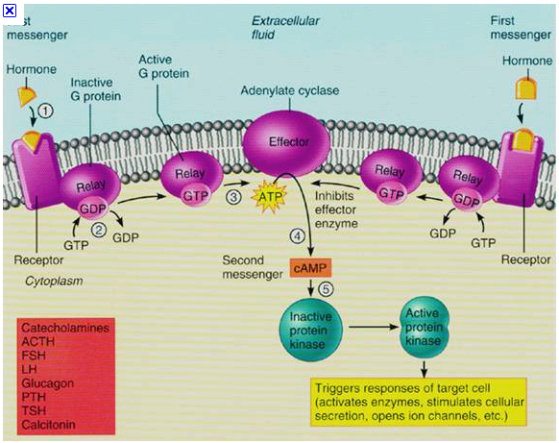
Mechanisms of Action of Hormones
2) G Protein–Linked Hormone Receptors.
Many hormones activate receptors that indirectly regulate the activity of target proteins by coupling with groups of cell membrane proteins called (G proteins) and induce intracellular signals that either (1) open or close cell membrane ion channels or (2) change the activity of an enzyme in the cytoplasm of the cell such as stimulate formation of the second messenger cAMP inside the cell membrane. The cAMP then causes subsequent intracellular effects of the hormone.
Some hormones are coupled to inhibitory G proteins, whereas others are coupled to stimulatory G proteins. Thus, depending on the coupling of a hormone receptor to an inhibitory or stimulatory G protein, a hormone can either increase or decrease the activity of intracellular enzymes.

Slide 26
Mechanisms of Action of Hormones
3) Enzyme-Linked Hormone Receptors.
Some receptors, when activated, function directly as enzymes or are closely associated with enzymes that they activate. Enzyme-linked receptors have their hormone-binding site on the outside of the cell membrane and their catalytic or enzyme-binding site on the inside. When the hormone binds to the extracellular part of the receptor, an enzyme immediately inside the cell membrane is activated (or occasionally inactivated).
4) Steroid Hormones Increase Protein Synthesis
Another means by which steroid hormones is to cause synthesis of proteins in the target cells. The sequence of events in steroid function is essentially the following:
a) The steroid hormone diffuses across the cell membrane and enters the cytoplasm of the cell, where it binds with a specific receptor protein.
b) The receptor–hormone then diffuses into or is transported into the nucleus and binds at specific points on the DNA strands in the chromosomes, which activates the transcription process of specific genes to form mRNA.
c) The mRNA diffuses into the cytoplasm, where it promotes the translation process at the ribosomes to form new proteins.

Slide 27
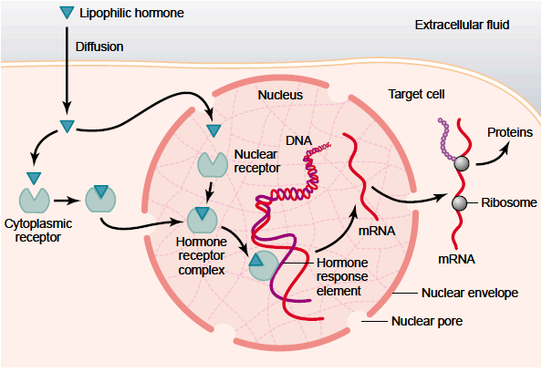
Mechanisms of Action of Hormones

Slide 28
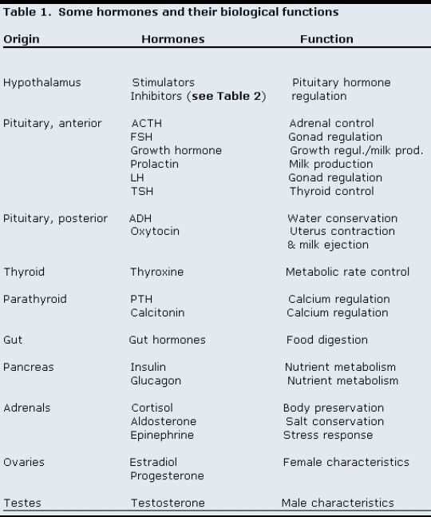
Some hormones and their biological functions

Slide 29
Thank you

