Slide 1
Al-Mustaqbal University
Biomedical Engineering Department
Class: 3th
Subject: Physiology II
Lecturer: M.SC. ZAINAB SATTAR JABBAR
1st term – Lect. 2: Muscle Physiology part1
Email: zainab.sattar.jabbar@uomus.edu.iq

Slide 2
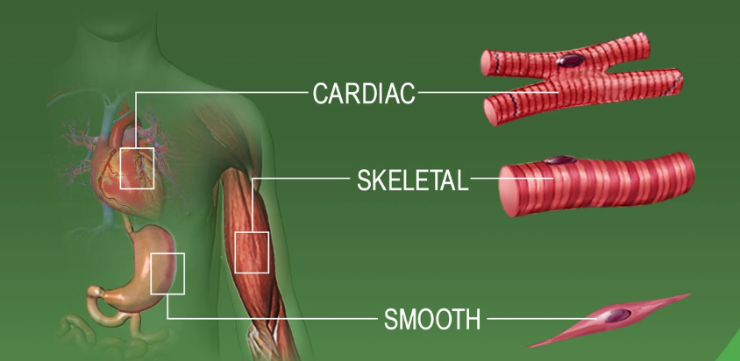
Muscles
Muscles are contraction specialists. The three types of muscle are skeletal, smooth, and cardiac.
Skeletal muscle is composed of bundles of very long, cylindrical, multinucleated cells that show cross-striations.
Cardiac muscle also has cross-striations and is composed of elongated, branched individual cells that lie parallel to each other. At sites of end-to-end contact are the intercalated disks, structures found only in cardiac muscle. Contraction of cardiac muscle is involuntary, vigorous, and rhythmic.
Smooth muscle consists of collections of fusiform cells that do not show cross-striations. Their contraction process is slow and not subject to voluntary control.

Slide 3
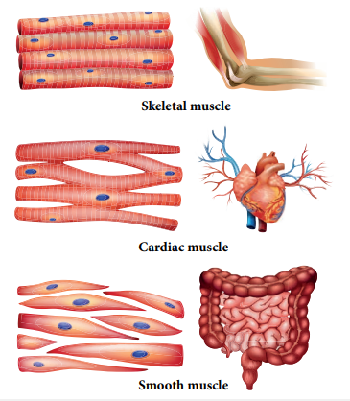
Muscles
Muscles are categorized as striated (skeletal and cardiac muscle) or unstriated (smooth muscle),depending on whether alternating dark and light bands, or striations (stripes), can be seen when the muscle is viewed under alight microscope.
Muscles are categorized as voluntary (skeletal muscle) or involuntary (cardiac and smooth muscle), depending on whether they are innervated by the somatic nervous system and subject to voluntary control or are innervated by the autonomic nervous system and not subject to voluntary control, respectively.

Slide 4
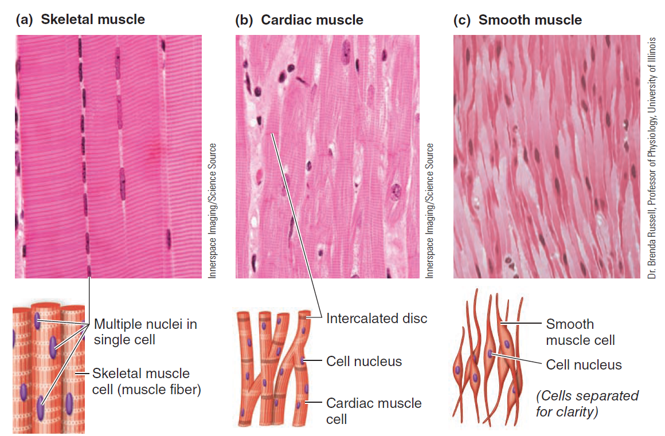
Types of Muscles

Slide 5
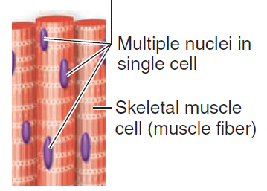
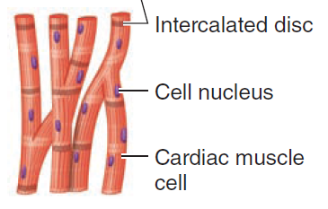
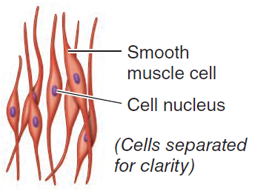
Characteristics of three types of muscle (Comparison)
Type of muscle | Classification | Description | Typical location | Function
Skeletal muscle | Striated muscle, voluntary muscle | Bundles of long, thick, cylindrical, striated, contractile, multinucleate cells that extend the length of the muscle | Attached to bones of skeleton | Movement of body in relation to external environment
Cardiac muscle | Striated muscle, involuntary muscle | Interlinked network of short, slender, cylindrical, striated, branched, contractile cells connected cell to cell by intercalated discs | Wall of heart | Pumping of blood out of heart
Smooth muscle | Un striated muscle, involuntary muscle | Loose network of short, slender, spindle shaped, Un striated, contractile cells that are arranged in sheets | Walls of hollow organs and tubes, such as stomach and blood vessels | Movement of contents within hollow organs

Slide 6
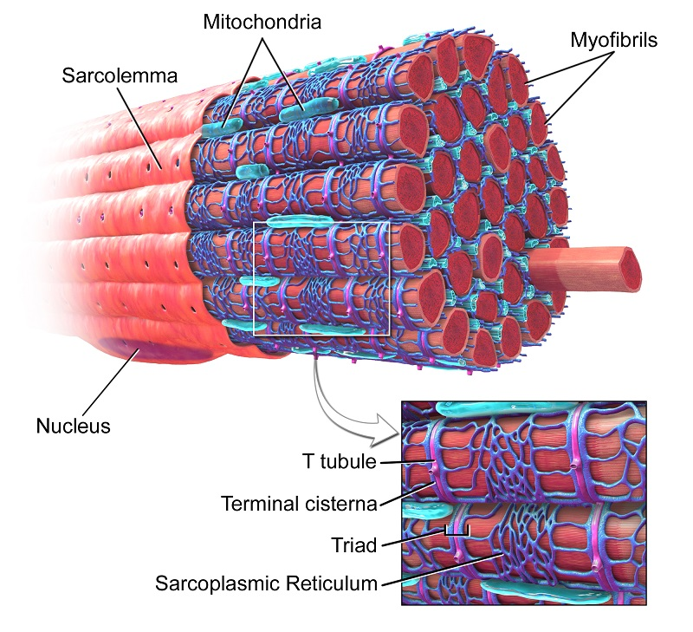
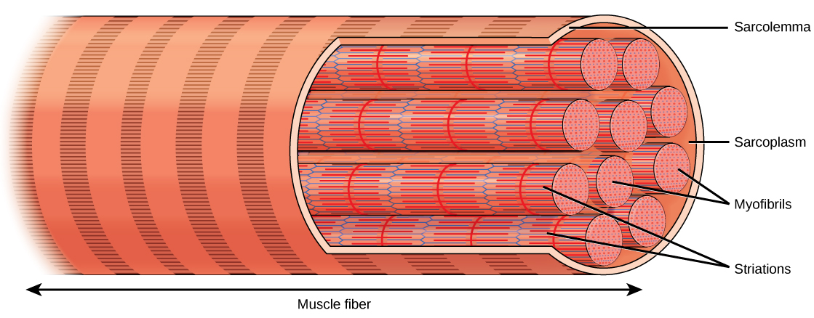
Muscle Cell Organelles
Some muscle cell organelles have names that differ from their counterparts in other cells.
The cytoplasm of muscle cells (excluding the myofibrils) is called sarcoplasm, and the smooth endoplasmic reticulum is called sarcoplasmic reticulum.
The sarcolemma is the cell membrane.

Slide 7
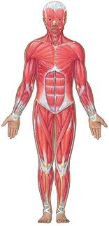
Skeletal Muscle
A single skeletal muscle cell, known as a muscle fiber, is relatively large, elongated, and cylinder shaped.
Most of skeletal muscle are attached to the bone.
Some skeletal muscle are not attached to the bones, such as ocular muscles, muscle of the face, the tongue, pharynx and the upper two thirds of the esophagus.
A skeletal muscle consists of a number of muscle fibers lying parallel to one another and bundled together by connective tissue.
All skeletal muscles are composed of numerous bundles (fascicle) of muscle fibers; that are made up of successively smaller subunits called myofibrils. Except for about 2% of the fibers, each fiber is usually innervated by only one nerve ending, located near the middle of the fiber.
A skeletal muscle fiber contains numerous myofibrils, which are cylindrical intracellular structures 1 mm in diameter that extend the entire length of the muscle fiber.

Slide 8
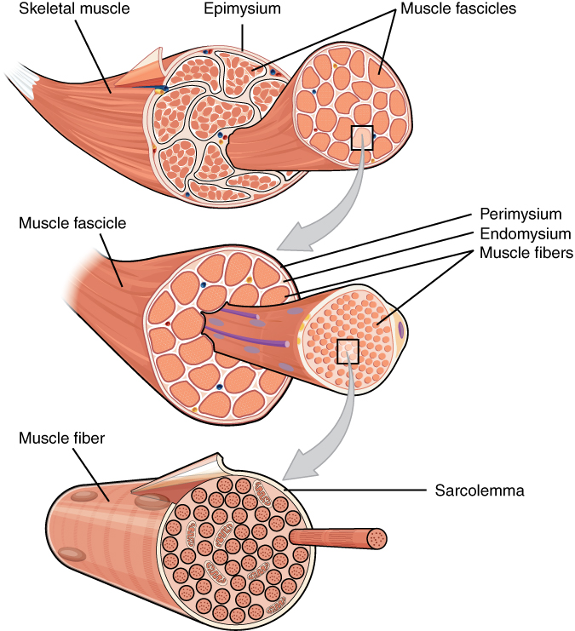
Skeletal Muscle

Slide 9
A and I Bands (Cross-Striation)
Muscle fibers show cross-striations of alternating light and dark bands. The darker bands are called A bands; the lighter bands are called I bands. In the electron microscope, each I band is bisected by a dark transverse line, the Z line. The unit extends from Z line to Z line called the sarcomere(The area between two Z lines is called a sarcomere),which is the functional unit of skeletal muscle
The bands of all the myofibrils lined up parallel to one another collectively produce the striated appearance of a skeletal muscle fiber visible under a light microscope.
Alternate stacked sets of thick and thin filaments that slightly overlap one another are responsible for the A and I bands. The lighter area within the middle of the A band, where the thin filaments do not reach, is the H zone. Only the central portions of the thick filaments are found in this region.
Supporting proteins that hold the thick filaments together vertically within each stack can be seen as the M line, which extends vertically down the middle of the A band within the center of the H zone.

Slide 10
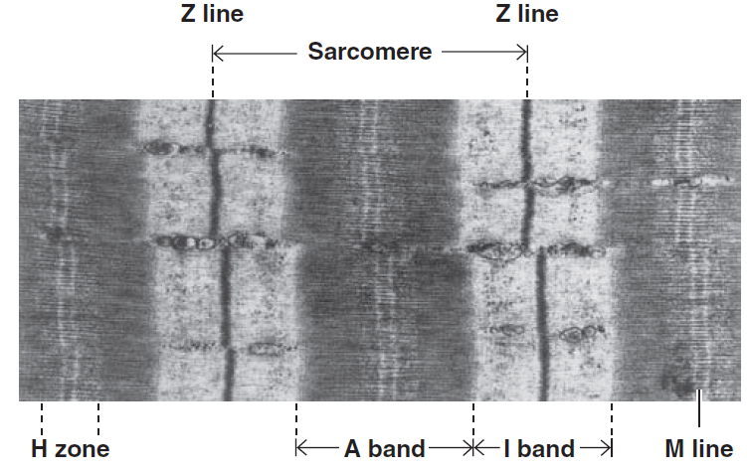
A and I Bands (Cross-Striation)

Slide 11
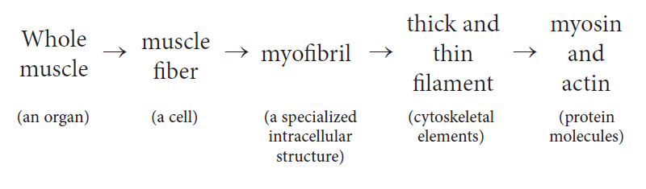
Structure of Myofibrils
Electron microscope shows that each myofibril consists of two types of filaments, thick and thin myofilaments.
The thick filaments are special assemblies of the protein myosin, whereas the thin filaments are made up primarily of the protein actin. The levels of organization in a skeletal muscle can be summarized as follows:

Slide 12
Structure of Myofibrils (Thick filaments)
An A band is made up of a stacked set of thick filaments along with the portions of the thin filaments that overlap on both ends of the thick filaments. The thick filaments lie only within the A band and extend its entire width.
1. Thick filaments :
Each thick filament contains several hundred myosin molecules; each molecule has two globular heads and a long tail. The heads of the myosin molecules form cross-bridges with actin. Myosin contains heavy chains and light chains, and its heads are made up of the light chains and the amino terminal portions of the heavy chains. These heads contain an actin-binding site and a catalytic site that hydrolyzes ATP. The M line is the site of cross connections that hold the thick filaments in proper array.
Myosin forms the thick filaments

Slide 13
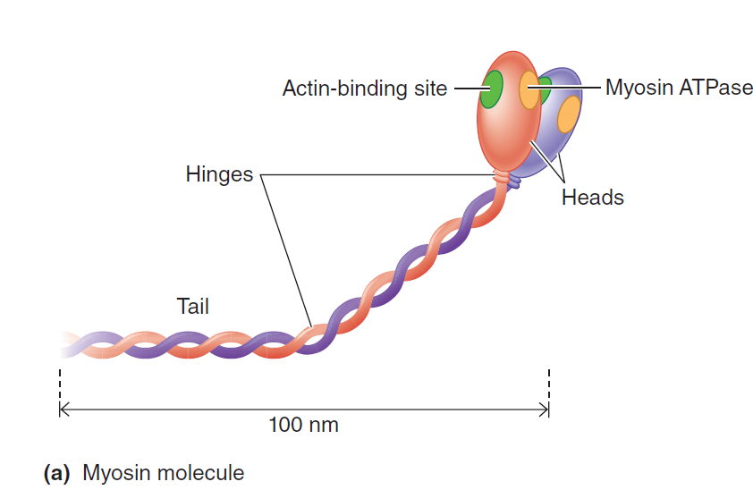
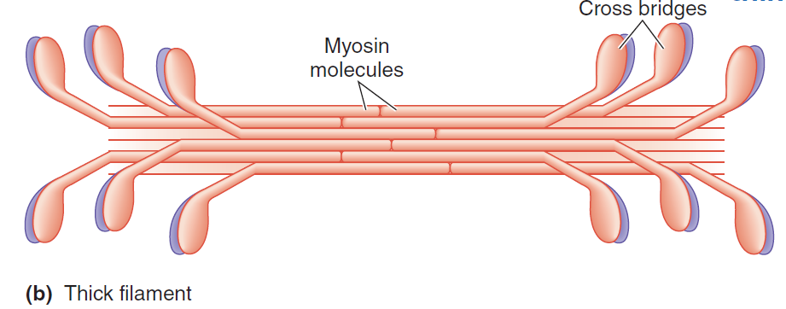
Structure of Myofibrils (Thick filaments)

Slide 14
Structure of Myofibrils (Thin Filament)
2. Thin Filament:
The thin filaments are polymers made up of two chains of actin that form a long double helix. Tropomyosin molecules are long filaments located in the groove between the two chains in the actin. Troponin molecules are small globular units located at intervals along the tropomyosin molecules. Each of the three troponin subunits has a unique function: Troponin T binds the troponin components to tropomyosin; troponin I inhibits the interaction of myosin with actin; and troponin C contains the binding sites for the Ca2+ that helps to initiate contraction.
Actin is the main structural component of the thin filaments

Slide 15
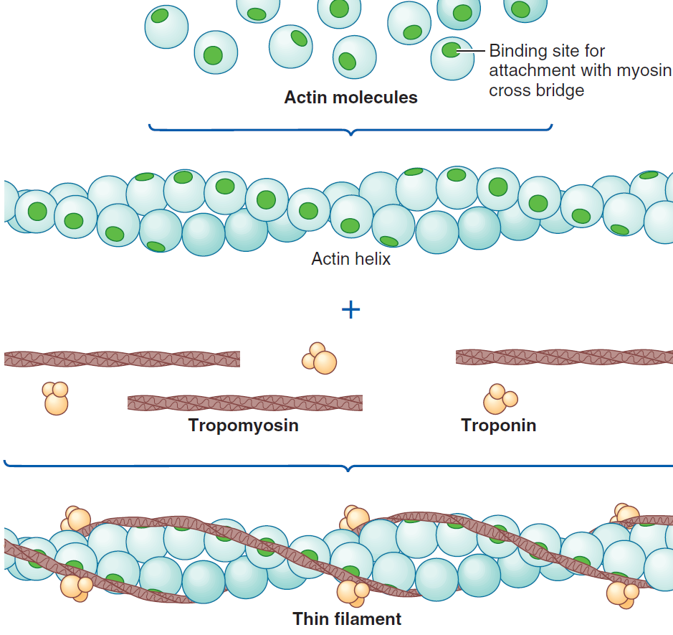
Structure of Myofibrils (Thin Filament)

Slide 16
Structure of Myofibrils
The contractile mechanism in skeletal muscle largely depends on the proteins myosin, actin, tropomyosin, and troponin. Troponin is made up of three subunits: troponin I, troponin T, and troponin C. These proteins are collectively known as contractile proteins.
The function of these proteins is regulated by other proteins called regulatory proteins which include:
1. Actinin: That binds actin to the Z lines.
2. Titin: Which is the largest known protein serves to connect the Z lines to the M lines.
3. Desmin: That binds the Z lines to the plasma membrane.

Slide 17
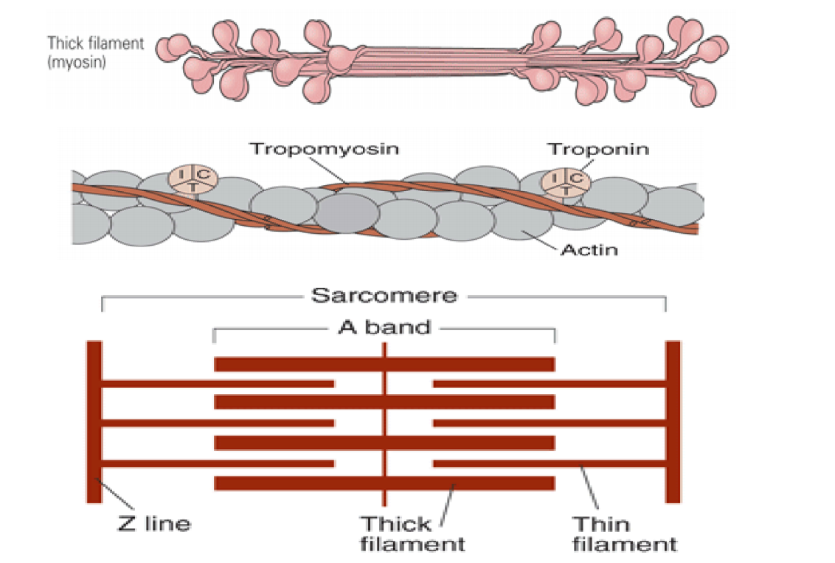
Structure of Myofibrils

Slide 18
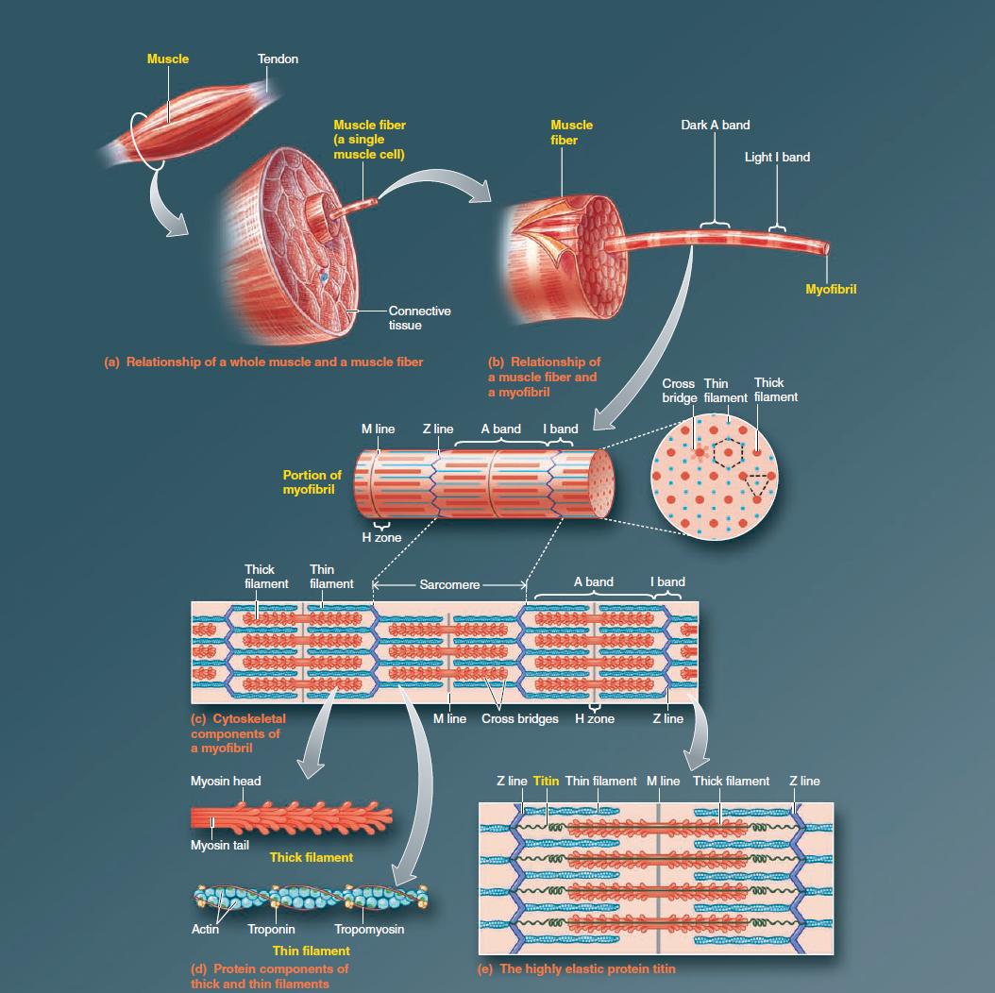

Slide 19
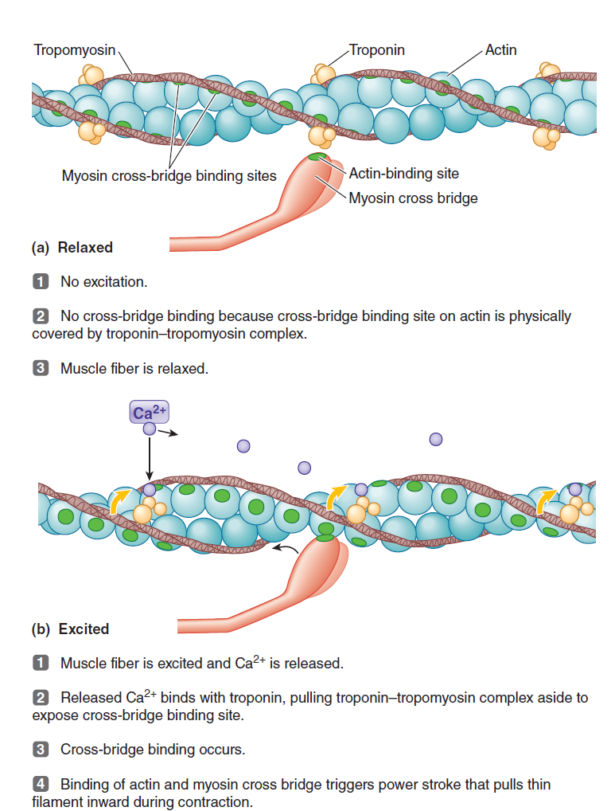

Slide 20
Sliding Filament Mechanism
The thin filaments on each side of a sarcomere slide inward over the stationary thick filaments toward the A band’s center during contraction. As they slide inward, the thin filaments pull the Z lines to which they are attached closer together, so the sarcomere shortens. As all sarcomeres throughout the muscle fiber’s length shorten simultaneously, the entire fiber shortens. This is the sliding filament mechanism of muscle contraction.
During muscle contraction, each sarcomere shortens as the thin filaments slide closer together between the thick filaments so that the Z lines are pulled closer together. The width of the A bands does not change as a muscle fiber shortens, but the I bands and H zones become shorter.

Slide 21
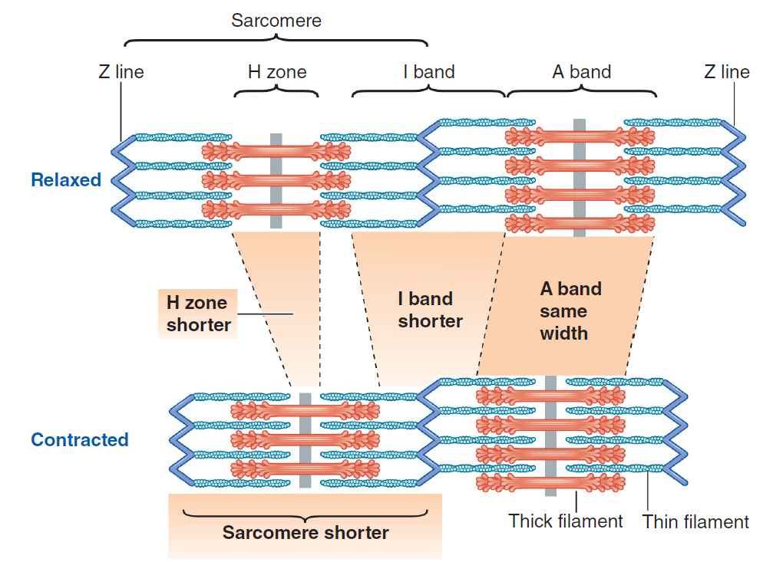
Sliding Filament Mechanism

Slide 22
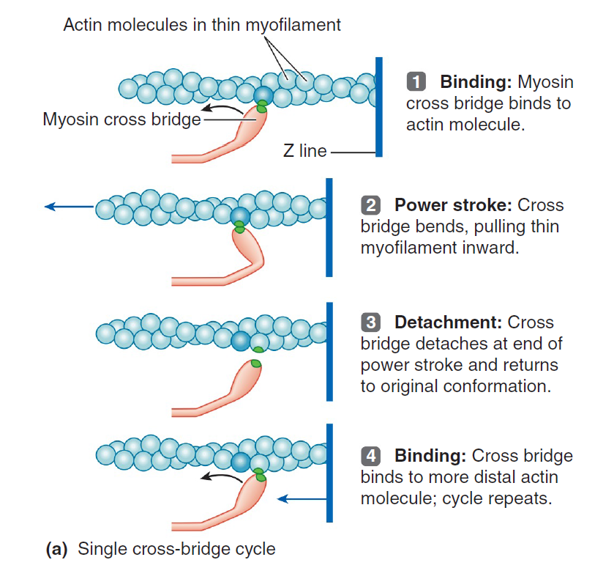
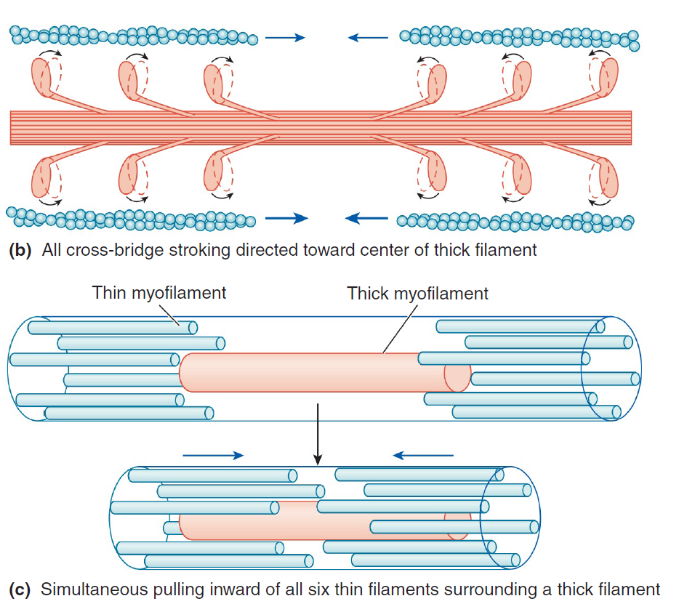
Sliding Filament Mechanism

Slide 23
Sarco-tubular System
The muscle fibrils are surrounded by structures made up of membranes that appear in electron photomicrographs as vesicles and tubules. These structures form the sarcotubular system, which is made up of T system and a sarcoplasmic reticulum.
1. The T system:
It is a transverse tubule continuous with the sarcolemma of the muscle fiber, forms a grid perforated by the individual muscle fibrils. The space between the two layers of the T system is an extension of the extracellular space. The T system provides a path for the rapid transmission of the action potential from the cell membrane to all the fibrils in the muscle.
2. The sarcoplasmic reticulum:
It forms irregular enlarged terminal cisterns around each of the fibrils, in close contact with the T system at the junctions between the A and I bands. The sarcoplasmic reticulum is an important store of Ca2+ and also participates in muscle metabolism. At these points of contact, the arrangement of the central T system with a cistern of the sarcoplasmic reticulum on either side has led to the use of the term triads to describe the system.

Slide 24
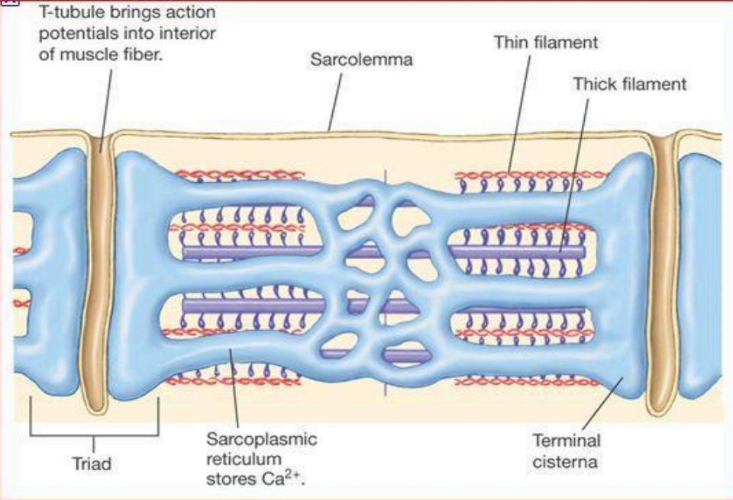
Sarco-tubular System

Slide 25
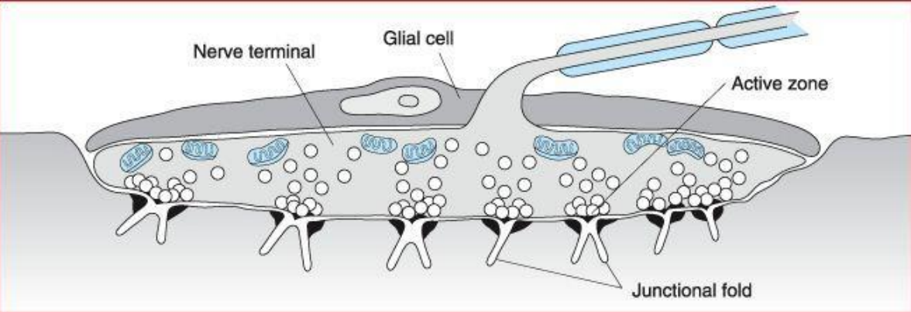
Neuro-Muscular Junction
As the axon supplying a skeletal muscle fiber approaches its termination, it loses its myelin sheath and divides into a number of terminal buttons, or end-feet.
The end-feet contain many small, clear vesicles that contain acetylcholine, the transmitter at these junctions. The endings fit into junctional folds, which are depressions in the thickened portion of the muscle membrane at the junction. The space between the nerve and the thickened muscle membrane is comparable to the synaptic cleft. The whole structure is known as the neuromuscular junction or motor end plate.

Slide 26
