Slide 1


Al-Mustaqbal University.
College of Engineering and Engineering Technologies.
Biomedical Engineering Department.
Subject: laboratory instrumentation
Class : 4th
Lecture: 3
By: Zainab Sattar Jabbar M.SC. IN BME
BME

Slide 2
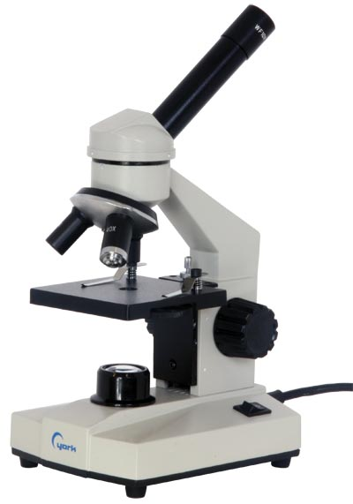
Optical (light)Microscope
Micro : small
Scope: to look (at)
The Microscope: is an instrument which is used to observe tiny objects.
Microscope uses compound (2) lenses to magnify objects. The lenses bend or refract light to make the object beneath them appear closer.
They are often used in laboratories.

Slide 3
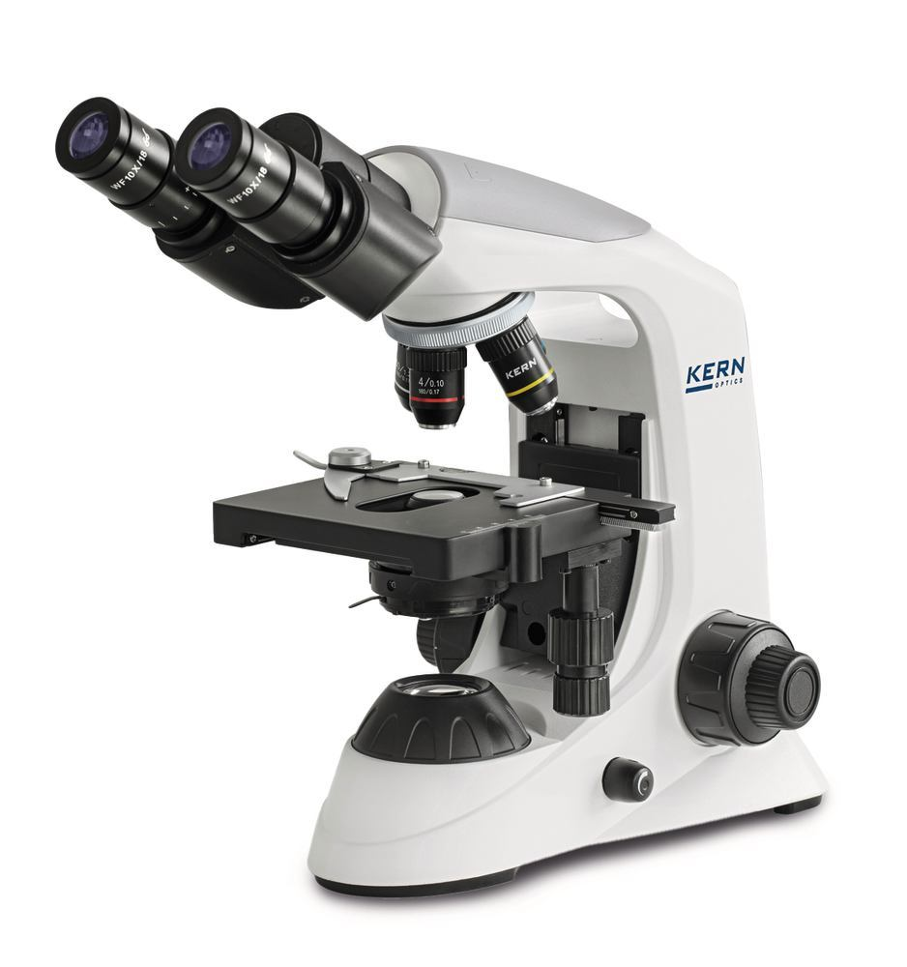
Optical (light)Microscope
light microscope as the name implies, uses light to visualize a specimen.
light microscope is the most common microscope used in microbiology. It consists of two lens systems (combination of lenses) to magnify the image. Each lens has a different magnifying power.
A compound light microscope with a single eye-piece is called monocular; one with two eye-pieces is said to be binocular.

Slide 4
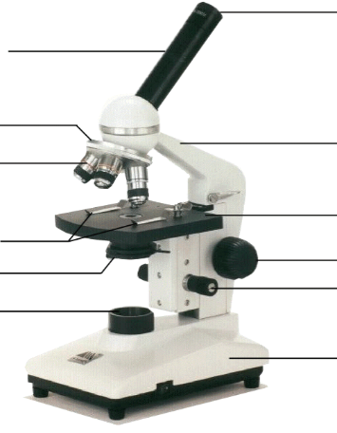
Optical Microscope
Eyepiece
Body Tube
Nosepiece
Arm
Objective Lens
Stage
Stage Clips
Coarse Focus adjustment knob
Diaphragm
Fine Focus adjustment knob
Light
Base
Notes:
This is the microscope used in class. Students will be identifying the parts on the microscopes at their desks as we go along and what their functions are.

Slide 5
Components of Microscope
Eyepiece (ocular lens).
Body tube.
Nosepiece.
Arm.
Objective Lens.
Stage.
Stage Clips
Focus adjustment knob
Diaphragm
Light
Base

Slide 6
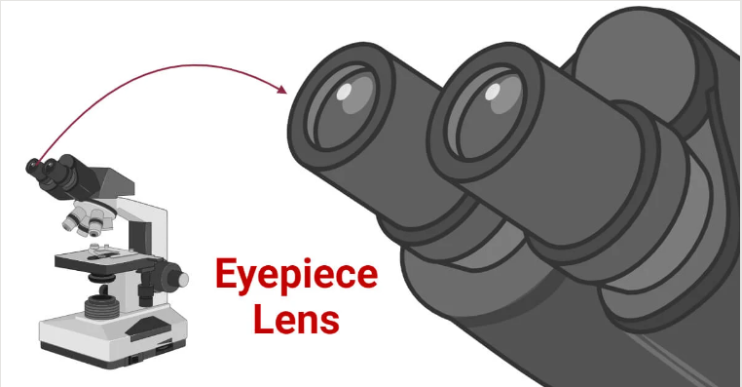
Eyepiece
Eyepiece (ocular lens): is a cylinder containing two or more lenses; its function is to bring the image into focus for the eye. The eyepiece is inserted into the top end of the body tube. Eyepieces are interchangeable and many different eyepieces can be inserted with different degrees of magnification. Typical magnification values for eyepieces include 5×, 10× (the most common), 15× and 20×.

Slide 7
Body tube
The microscope body tube separates the objective and the eyepiece and assures continuous alignment of the optics.
The microscope tube is attached on top of the arm.
It can be of the monocular or binocular type. It supports the eye-piece on the upper end.

Slide 8
Nosepiece
Nosepiece or objective turret, revolver, or revolving nose piece: is the part that holds the set of objective lenses.
The nose-piece is attached under the arm of the microscope tube
It allows the user to switch between objective lenses.
The objectives are arranged in sequential order of their magnifying power, from lower to higher.
This helps to prevent the immersion oil from getting onto the intermediate objectives.

Slide 9
Arm
The whole of the optical assembly is traditionally attached to a rigid arm, which in turn is attached to a robust U-shaped foot to provide the necessary rigidity. The arm angle may be adjustable to allow the viewing angle to be adjusted.
The frame provides a mounting point for various microscope controls. Normally this will include controls for focusing, typically a large knurled wheel to adjust coarse focus, together with a smaller knurled wheel to control fine focus. Other features may be lamp controls and/or controls for adjusting the condenser.

Slide 10
Objective Lens
At the lower end of a typical compound optical microscope, there are one or more objective lenses that collect light from the sample.
The objective is usually in a cylinder housing containing a glass single or multi-element compound lens.
Typically there will be around three objective lenses screwed into a circular nose piece which may be rotated to select the required objective lens. These arrangements are designed to be parfocal, which means that when one changes from one lens to another on a microscope, the sample stays in focus.

Slide 11
Objective Lens
The image of the specimen first passes through the objective.
Objectives with magnifying powers 4x, 10x, 40x and 100x are commonly used.
To provide the best image at high magnification, immersion oil is placed between the slide and the oil immersion objective (100x).
Unlike air, immersion oil has the same refractive index as glass. Therefore, it improves the quality of the image. If immersion oil is not used, the image appears blurred or hazy

Slide 12
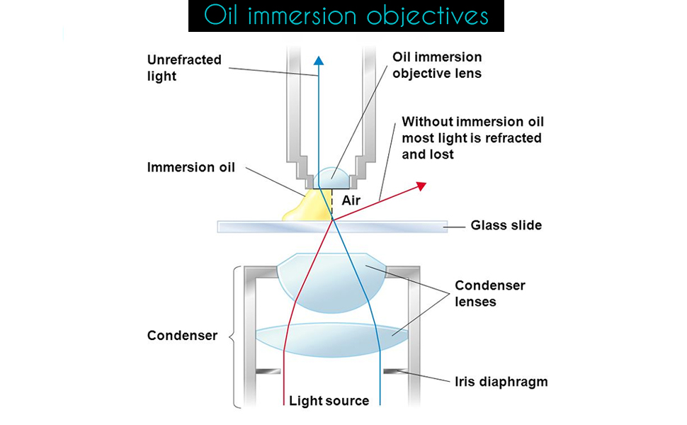
Objective Lens
Immersion oil must be used with objectives having NA more than 1.0. This increases the resolving power of the objective..
An immersion oil of medium viscosity and refractive index of 1.5 is adequate.

Slide 13
Stage and Stage Clips
The stage is a platform below the objective lens which supports the specimen being viewed.
In the center of the stage is a hole through which light passes to illuminate the specimen.
All stages move up and down for focus.
The stage usually has arms to hold slides (rectangular glass plates with typical dimensions of 25×75 mm, on which the specimen is mounted).

Slide 14
Focus adjustment knob
Adjustment knobs move the stage up and down with separate adjustment for coarse and fine focusing.
The same controls enable the microscope to adjust to specimens of different thickness. In older designs of microscopes, the focus adjustment wheels move the microscope tube up or down relative to the stand and had a fixed stage.

Slide 15
Diaphragm
The diaphragm of a microscope is the mechanical part located beneath the stage of the microscope.
It functions to control the amount of light reaching the specimen being observed.
By adjusting the diaphragm's aperture size, you can increase or decrease the light intensity.

Slide 16
Light and Base
Many sources of light can be used. At its simplest, daylight is directed via a mirror.
Most microscopes, however, have their own adjustable and controllable light source – often a halogen lamp, although illumination using LEDs and lasers are becoming a more common provision.

Slide 17
Magnification
The actual power or magnification of a compound optical microscope is the product of the powers of the eyepiece and the objective lens.
For example a 10x eyepiece magnification and a 100x objective lens magnification gives a total magnification of 1,000×.

Slide 18
Functioning of the microscope
There are three main optical pieces in the compound light microscope. All three are essential for a sharp and clear image. These are:
Diaphragm : illuminates the object by converging a parallel beam of light on it from a built-in or natural source
Objectives : forms a magnified inverted (upside down) image of the object.
Eye-pieces : magnifies the image formed by the objective. This image is formed below the plane of the slide.

Slide 19
Routine Operation of the Microscope
Turn on the light source of the microscope.
With the light intensity knob , decrease the light while using the low magnification objective.
Place a specimen slide on the stage. Make sure the slide is not placed upside down. Secure the slide to the slide holder of the mechanical stage.
Rotate the nose-piece to the 10x objective, and raise the stage to its maximum.
Move the stage with the adjustment knobs to bring the desired section of the slide into the field of view.
Focus the specimen under 10x objective using the coarse focusing knob and lowering the stage.

Slide 20
Routine Operation of the Microscope
Focus the image with the right eye by looking into the right eye-piece and turning the focusing knob.
Focus the image with the left eye by looking into the left eye-piece by turning the diopter ring.
Put one drop of immersion oil on the specimen then change to 100x objective and increase the light by turning the intensity knob until a bright but comfortable illumination is achieved.
Focus the specimen by turning the fine focusing knob.
When the reading/observation has been recorded, rotate the objective away from the slide.
Release the tension of the slide holder, and remove the slide.
Turn off the light.

Slide 21
Thank you

