Slide 1
Al-Mustaqbal University
Biomedical Engineering Department
Class: 3th
Subject: Physiology II
Lecturer: M.SC. ZAINAB SATTAR JABBAR
1st term – Lect. 2: Muscle Physiology part2
Email: zainab.sattar.jabbar@uomus.edu.iq

Slide 2
Excitation-Contraction Coupling
It is important to distinguish between the electrical and mechanical events in muscle. Muscle fiber membrane depolarization normally starts at the motor end plate then the action potential is transmitted along the muscle fiber and initiates the contractile response. The sliding theory is the most acceptable theory that explain contraction and relaxation response of skeletal muscle in sequence events as follow:
A. Steps in contraction:
(1) The impulse arriving in the end of the motor neuron increases the permeability of its endings to Ca2+ that enter the endings and triggers the exocytosis of the acetylcholine-containing vesicles. Lambert–Eaton syndrome (muscle weakness) is caused by antibodies against one of the Ca2+ channels in the nerve endings at the neuromuscular junction and decreases acetylcholine release.
(2) The acetylcholine diffuses to the muscle fiber receptors, which are concentrated at the tops of the junctional folds of the membrane in the motor end plate and Binds with them. Myasthenia gravis is a serious fatal disease in which skeletal muscles are weak and tire easily. It is caused by the formation of circulating antibodies to the acetylcholine receptors that destroy some of these receptors.
(3) Binding of acetylcholine to these receptors initiates influx of Na+ that produce a depolarizing potential in the end plate. Acetylcholine is then removed from the synaptic cleft by acetylcholine-esterase, which is present in high concentration at the neuromuscular junction.

Slide 3
Excitation-Contraction Coupling
(4) Action potentials are conducted away from the end plate in both directions along the muscle fiber until reach to the sarco-tubular system (triad) and initiate the cisternae of sarcoplasmic reticulum to release their storage of calcium ions into sarcoplasm.
(5) When the Ca2+ released by the action potential binds to troponin C, the binding of troponin I to actin is weakened, and this permits the tropomyosin to move laterally. This movement uncovers binding sites for the myosin heads. ATP is then split and contraction occurs by formation of cross-linkages between actin and myosin and sliding of thin on thick filaments, producing movement.
B. Steps in Relaxation:
(1) Ca2+ pumped back into sarcoplasmic reticulum by active transport.
(2) Once the Ca2+ concentration outside the reticulum has been lowered sufficiently, chemical interaction between myosin and actin ceases and the muscle relaxes.
Note that ATP provides the energy for both contraction and relaxation. If transport of Ca2+ into the reticulum is inhibited, relaxation does not occur even though there are no more action potentials; the resulting sustained contraction is called a contracture.

Slide 4
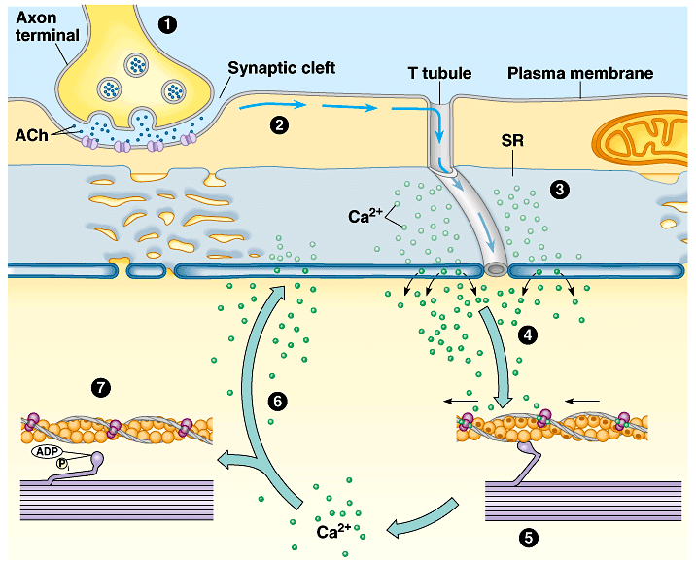
Excitation-Contraction Coupling

Slide 5
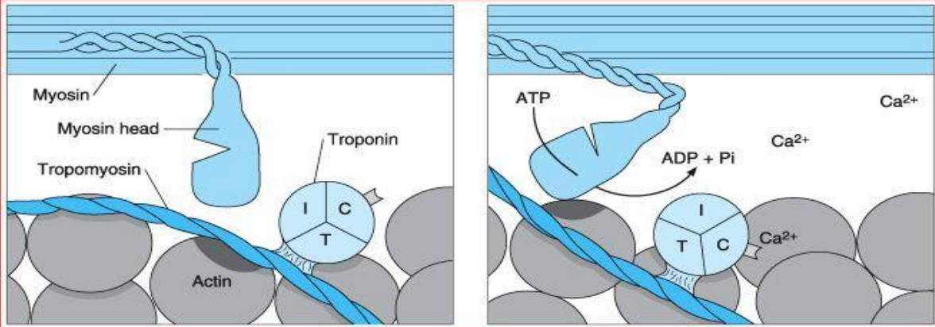
Excitation-Contraction Coupling

Slide 6
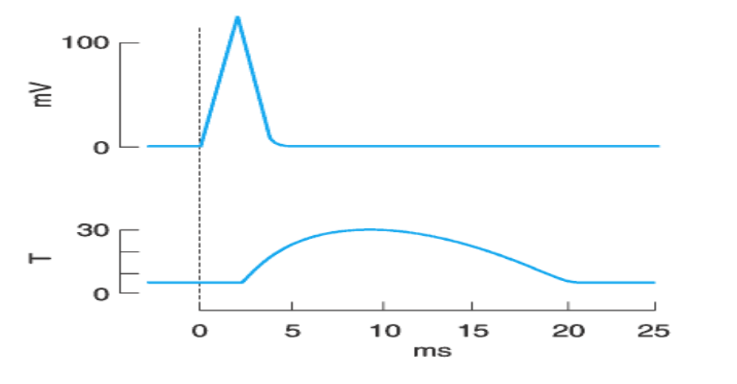
The Muscle Twitch
A single action potential causes a brief contraction followed by relaxation. This response is called a muscle twitch. The twitch starts about 2 ms after the start of depolarization of the membrane, before repolarization is complete. The duration of the twitch varies with the type of muscle being tested. "Fast" muscle fibers have twitch durations as short as 7.5 ms. "Slow" muscle have twitch durations up to 100 ms.

Slide 7
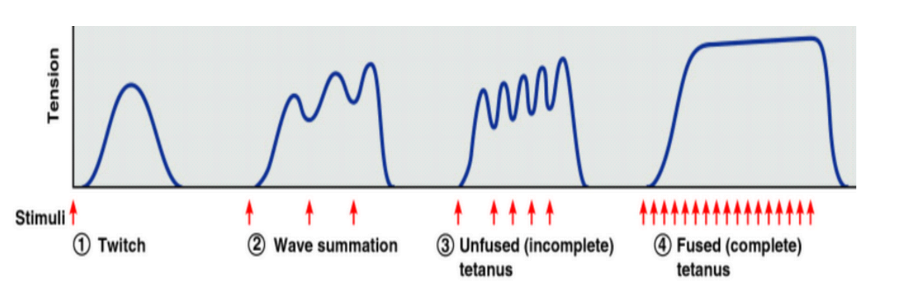
Summation of Contractions
Because the contractile mechanism does not have a refractory period, repeated stimulation before relaxation has occurred produces additional activation of the contractile elements and a response is known as summation of contractions.
With rapidly repeated stimulation, activation of the contractile mechanism occurs repeatedly before any relaxation has occurred, and the individual responses fuse into one continuous contraction. Such a response is called tetanus (tetanic contraction). It is a complete tetanus when no relaxation occurs between stimuli and an incomplete tetanus when periods of incomplete relaxation take place between the summated stimuli.

Slide 8
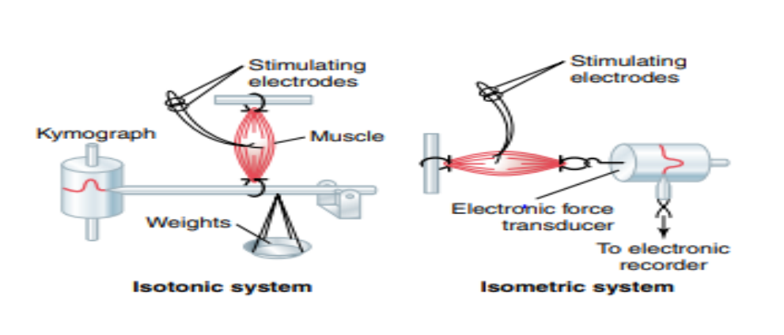
Types of Contraction
1. Isometric Contraction: It occurs without an appreciable decrease in the length of the whole muscle. Since work is the product of force times distance, isometric contraction do not do work.
2. Isotonic Contraction: Contraction against a constant load, with approximation of the ends of the muscle, isotonic contractions do work.

Slide 9
Muscle Types
Skeletal muscle is a very heterogeneous tissue made up of fibers that vary in myosin ATPase activity, contractile speed, and other properties. The fibers fall roughly into two types, type I and type II.
1. Red muscles: They contain many type I fibers which are darker than other muscles due to their high containing of myoglobin. They respond slowly and have a long latency, thus they are adapted for long, slow, posture-maintaining contractions. The long muscles of the back are red muscles.
2. White muscles: They contain mostly type II fibers with less content of myoglobin and have short twitch durations. They are specialized for fine, skilled movement. The extra-ocular muscles and some of the hand muscles contain many type II fibers and are generally classified as white muscles.

Slide 10
Energy Sources
Muscle contraction requires energy, and muscle has been called "a machine for converting chemical energy
into mechanical work." The immediate source of this energy is ATP.
ATP + H2O → ADP + Phosphate + 7.3 Kcal
ATP molecules are formed by the metabolism of carbohydrates and lipids which include:
Aerobic metabolism of glucose:
Glucose + 2 ATP (or glycogen + 1 ATP) oxygen 6 CO2 + 6 H2O + 40ATP
2. Oxidation of free fatty acids:
FFA Oxygen CO2 + H2O + ATP
3. Hydrolysis of phosphoryl creatine:
Phosphoryl Creatine + ADP Creatine + ATP
4. Anaerobic metabolism of glucose
Glucose + 2 ATP (or glycogen + 1 ATP) Anaerobic 2 Lactic acid + 4 ATP

Slide 11
The Oxygen Debt Mechanism
Use of the anaerobic pathway causes enough accumulation of lactate in the muscles and produces an enzyme-inhibiting decline in PH. After a period of exertion is over, extra O2 is consumed to remove the excess lactate, replenish the ATP and phosphoryl creatine stores, which is known oxygen debt.
Trained athletes are able to increase the O2 consumption of their muscles to a greater degree than untrained individuals and are able to utilize FFA more effectively. Because of this, they contract smaller oxygen debts for a given amount of exertion.
When muscle fibers are completely depleted of ATP and phosphoryl creatine, they develop a state of rigidity called rigor. When this occurs after death, the condition is called rigor mortis.

Slide 12
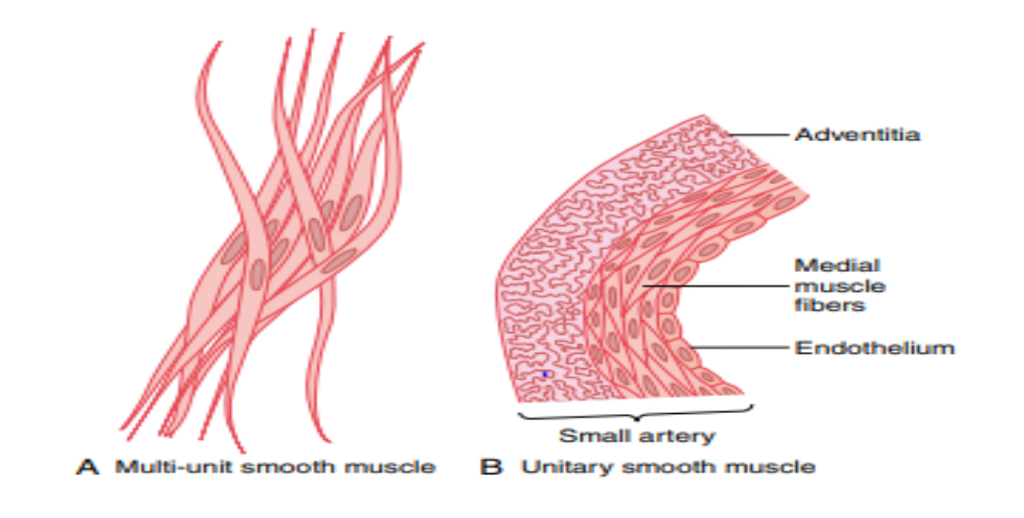
Types of Smooth Muscle
The smooth muscle of each organ is distinctive from that of most other organs in several ways:
Physical dimensions
Organization into bundles or sheets
Response to different types of stimuli
Characteristics of innervation
Function.
Yet for the sake of simplicity, smooth muscle can generally be divided into two major types:
Multi-unit smooth muscle.
Unitary (or single-unit) smooth muscle.

Slide 13
Regulation of Contraction by Calcium Ions
As is true for skeletal muscle, the initiating stimulus for most smooth muscle contraction is an increase in intracellular calcium ions. This increase can be caused in different types of smooth muscle by nerve stimulation of the smooth muscle fiber, hormonal stimulation, stretch of the fiber, or even change in the chemical environment of the fiber. Yet smooth muscle does not contain troponin, the regulatory protein that is activated by calcium ions to cause skeletal muscle contraction. Instead, smooth muscle contraction is activated by an entirely different mechanism, as follows.
Calcium Ions Combine with Calmodulin to Cause Activation of Myosin Kinase and Phosphorylation of the Myosin Head.
In place of troponin, smooth muscle cells contain a large amount of another regulatory protein called calmodulin. Although this protein is similar to troponin, it is different in the manner in which it initiates contraction. Calmodulin does this by activating the myosin cross-bridges. This activation and subsequent contraction occur in the following sequence.
1-The calcium ions bind with calmodulin.
2. The calmodulin-calcium complex then joins with and activates myosin light chain kinase, a phosphorylating
enzyme.
3. One of the light chains of each myosin head, called the regulatory chain, becomes phosphorylated in
response to this myosin kinase. When this chain is not phosphorylated, the attachment-detachment cycling of
the myosin head with the actin filament does not occur.

Slide 14
Regulation of Contraction by Calcium Ions
Intracellular calcium ion (Ca++) concentration increases when Ca++ enters the cell through calcium channels in
the cell membrane or the sarcoplasmic reticulum (SR). The Ca++ binds to calmodulin to form a Ca++-calmodulin complex, which then activates myosin light chain kinase (MLCK). The MLCK phosphorylates the myosin light chain (MLC) leading to contraction of the smooth muscle. When Ca++ concentration decreases, due to pumping of Ca++ out of the cell, the process is reversed and myosin phosphatase removes the phosphate from MLC, leading to relaxation.

Slide 15


