Slide 1
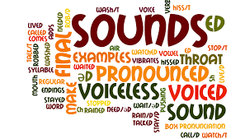
Phonetics and Phonology
Assistant lecturer . Estabraq Waleed AL-Rikabi

Slide 2

Phonetics: is the scientific study of speech sounds.it concerned with how sounds are produced; transmitted and perceived we will only look at the production of sounds. its a natural science that deals with human speech sounds in general without reference to any particular language.
Phonology: is a branch of linguistics that refers to the scientific study of the system or pattern of speech sounds used in particular language or in language in general .

Slide 3
Phonetics | Phonology
Is concerned with how sounds are produced, transmitted and perceived ( we will only look at the production of sounds). for example: Articulation, acoustics and auditory. Descriptive linguistics . Covers all speech sounds (universal ) . Limited scope . The study of the phonetics of a foreign language gives us a much better ability both to hear and to correct mistakes that we make, and also to teach pronunciation of the foreign language(in this case English) to others. | Phonology is concerned with how sounds function in relation to each other in a language. For example: Phonemes, Allophones, Syllable, Intonation and Stress. Theoretical linguistics . Sounds of a particular language Broader scope . Phonology gives us insight into how the human mind works.

Slide 4
English pronunciation is also divided into two main accent groups, the rhotic and the non-rhotic, depending on when the phoneme /r/ is pronounced. Rhotic speakers pronounce written "r" in all positions. They will pronounce the "r" in stork, whereas non-rhotic speakers won't, making no distinction between stork and stalk. Non-rhotic speakers pronounce "r" only if it is followed by a vowel - right, rain, room, Robert, far away, etc.

Slide 5
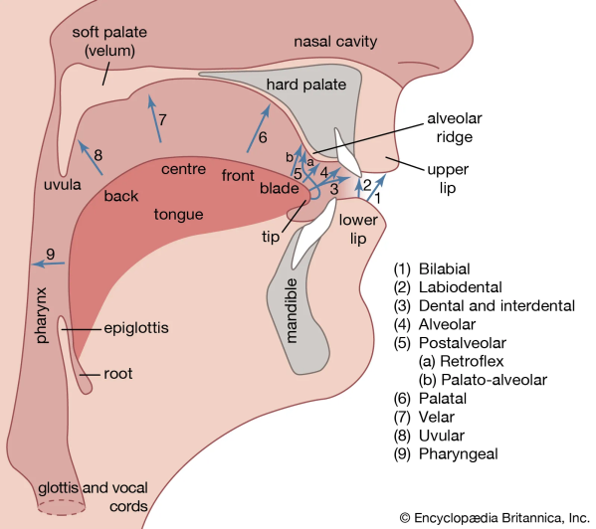
The spoken language can be broken down into a string of sound units (phonemes) A phoneme is the smallest 'distinctive unit sound of a language, It distinguishes one word from another in a given language, This means changing a phoneme in a word, produces another word that has a different meaning. In the pair of words (minimal pairs) hat' and 'bat' the distinguishing sounds/h and by are both phonemes. (They capable making a difference in meaning of the word) .
They are 44 sounds( phonemes)

Slide 6
Phoneme : is the smallest unit of phonology or the minimal unit in the sound system . The complete set of phonemes is called the ( phonemic system ) of the language . No two languages have the same phonemic system .
Allophones : are different realizations of the same phoneme . For example , the aspirated / p / of pin and the unaspirated / p / of spin are allophones of the same phoneme /p / .
Phonetic transcription: the representation of each phoneme by a single symbol. Play /plei/
  F4 XGc 2
e

Slide 7
Comparison :
Phonemes | Allophones
- Abstract sound types . - The number in a language is limited . - It can change the meaning : " Ball - Call " '' Car - Cat '' | - Real speech sounds , realizations of phoneme in speech . - The number is unlimited . - It cannot change the meaning .

Slide 8
Voiceless Sounds : are the sounds that are produced when the vocal cords are open , the air can pass through them freely and therefore don't vibrate ./s , t, f/
Voiced Sounds : are the sounds that are produced when the vocal cords are gently held together, they vibrate as the air forces the vocal cords away then they close quickly and the process is repeated continuously . /z, d, v/

Slide 9
Letters and Sounds
In writing, words are made of letters. In speech, words are made of sounds. These must never be in mixed up. Letters are written whereas sounds are spoken. Written letters cannot make us pronounce sounds which we already do not know; they remained us of corresponding sounds. As phonetics and phonology both deal with sounds, and as English spelling and English pronunciation are two very different things, it is important that you keep in mind that we are not interested in letters here, but in sounds.

Slide 10
English short vowels
English has a large number of vowel sounds; the first ones to be examined are short vowels . Short vowels are only relatively short , they can have quite different lengths in different contexts.
1- / i / (example words: 'bit; 'pin, 'fish') it is more open nearer in to the center. The lips are slightly spread.
2- / e / (example words: 'bet, 'men, 'yes') This is a front vowel. The lips are slightly spread.
3- / æ / (example words: 'bat, 'man , 'gas') This vowel is front. The lips are slightly spread.
4- / ^ / (example words: 'cut, come, 'rush') This is a central vowel. The lip position is neutral.
5- / o / (example words: 'pot, 'gone 'cross') This vowel is not quite fully back . The lips are slightly rounded.
6- / u / (example words: 'put , pull , 'push') . The lips are rounded

Slide 11
English long vowels :
English has five long vowels , they tend to be longer than the short vowels in similar contexts.
The long vowels differ from short vowels in length and quality . Differences in quality occur because of ( differences in tongue shape and position , and lip position ) . The length mark is made of two dots ( : ) . Long vowels include :
/ i: / This is a close – front vowel .The lips are slightly spread . Example words : ( beat , mean , peace , heat )
/ 3: / This is a mid- central vowel which is used in many English accents as a hesitation sound . The lip position is neutral . Example words : ( bird , fern , purse )
/ a: / This is an open vowel . The lip position is neutral . Example words : ( card , half , pass , March )
/ o: / This vowel is almost fully back and has quite string lip- rounding. Example words : ( board , torn , horse )
/ u: / This is a close – back vowel , and the lips are only moderately rounded . Example words : ( food , soon , loose , moon , spoon )

Slide 12
Notes
1- we didn’t make any transcription for each letter that we didn’t pronounce it.
2- A capital letter is never written in phonemic transcription.
3- the phonemic transcription for these two letters (er) are ə
Reader --- /ri:də/
4- if the letter (a) comes in the middle of the word and this word consist of three letters , the phonemic transcription for (a) will be (æ).
Hat --- /hæt/, car /cær/
5- if (re) comes together in the beginning of the verb , the phonemic transcription will be /rɪ/ .. Reread /rɪri:d/ .
6- call /kɔ:l/ , center/sentə/
7- a+ll --- the phonemic transcription will become /ɔ:/ --- ball/bɔ:/
8- the phonemic transcription for( aw) will be /ɔ:/-- saw/sɔ:/
9- (ar) if its comes in the middle of the word, the phonemic transcription will be /а:/ --- card /kа:d/
10- (i) if its comes in the middle of the word and this word end with letter e , the phonemic transcription for letter I will become /аɪ/.
Side/sаɪd/ , fine/fаɪn/.

Slide 13
(ew) if its comes in the end of the word, the phonemic transcription will be /ju:/.
Few /fju:/ , new /nju:/ , dew /dju:/
(ir) (ur) if its comes in the middle of the wors, the phonemic transcription will be /ʒ:/ bird /bʒ:d/ , purse /pʒ:s/
(oi) if its comes in the begging or middle of the word, the phonemic transcription will be /ɔɪ/ , join /ʤɔɪn/ , oil /ɔɪl/
(ure) if its comes in the end of the word, the phonemic transcription will be /ə/ , lecture /lekʧə/ , picture /pɪkʧə/.
Tu / ʧ/
(y) if its comes in the end of the word will pronunciation (long (i)). the phonemic transcription will be /аɪ/ , fly /flаɪ/ , cry/krаɪ/
(ay) if its comes in the end of the word, the phonemic transcription will be /еɪ/ , play/plеɪ/ , pray/prеɪ/
Qu /kw/ , quite/kwаɪt/
Sh /ʃ/ , tion /ʃn/
(a) if its comes in the middle of the word and this word ended by letter e, the phonemic transcription will be /еɪ/ , name/nеɪm/.

Slide 14
/f/
  Fall / fɔ:l/
2. /v/
Voice / vɔɪs/
Consonants
3. /ɵ/
Thin /ɵɪn/
4. /ơ/
Then /ðen/
5. /s/
So / səʊ/
6. /z/
Zoo /zu:/

Slide 15
7. /ʃ/
  She /ʃi:/
8. /Ʒ/
Vision /vɪƷn/
9. /p/
Pen /pen/
10. /b/
Bad /bæd/
11. /t/
Tea / ti:/
12. /d/
Did /dɪd/

Slide 16
13. /k/
  Cat /kæt/
14. /g/
Got /gɒt/
15./ʧ/
Chin /ʧɪn/
16./ʤ/
Jug /ʤʌg/
17./m/
Man /mæn/
18./n/
no /nəʊ/

Slide 17
19./ŋ/
  Sing /sɪŋ/
20./j/
Yes /jes/
21./w/
Wet /wet/
22. /r/
Red /red/
23. /l/
Leg /leg/
24./h/
how /hᶏʊ/

Slide 18

1./$i: /$
  See /si:/
2./ɪ/
Sit /sɪt/
Vowels
3./е/
Ten /ten/
4./æ/
Hat /hæt/
5./ᶏ:/
Arm /ᶏ:m/
6./ɒ/
got /gɒt/

Slide 19
7./ɔ:/
  Saw /sɔ:/
8./ʊ/
Put /pʊt/
9./u:/
Too /tu:/
10./ʌ/
Cup /kʌp/
11./Ʒ:/
Fur /fƷ:/ ,bird /bƷ:d/
12./ə/
ago /əgəʊ/

Slide 20
13./əʊ/
  Go /gəʊ/
14./аʊ/
Now /nаʊ/
Consonants
Diphthongs: it two sounds comes together and its product a new sounds
15./еɪ/
Take /tеɪk/
16./аɪ/
Five /fаɪv/
17./ɔɪ/
Boy /bɔɪ/
18./ɪə/
near /nɪə/

Slide 21
19./еə/
  Hair /hеə/
20./ʊə/
Poor /pʊə/

