Slide 1

Ethical dimensions of nursing and health care
Mahdi Al-Anawy

Slide 2
Outline:
• Introduction.
• Definition of ethical action.
• Definition of ethical principle.
• Ethical principles used in nursing.
• When to use ethical principles?
• Summary.

Slide 3
Introduction:
Ethical principles are useful strategies for members of the health care team (e.g., nurse, physician, pharmacist) and include standards or truths on which ethical actions are made.

Slide 4
Definition of ethical action:
Ethical action means how that person or group acts according to ethics.

Slide 5
Definition of ethical principle:
An ethical principle is a sort of "rule of thumb" on how one should or shouldn't behave. It's like a general rule that defines good or bad behavior.

Slide 6
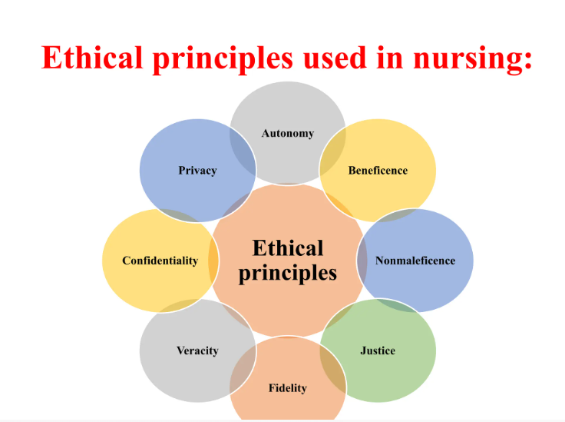

Slide 7
Autonomy:
Definition:
The patient has the right to make his/her own decision.
Role of nurse:
The nurse helps the patient understand the nature and extent of his disease process and the possible outcomes of treatment. This will enable the patient to make the best possible decision about his health care based on all available information.

Slide 8
Beneficence:
Definition:
The nurse wants to do good for the patient; the potential benefit to the patient is weighed against the potential risk.
Role of nurse:
The nurse will provide the patient with the information that will help him reduce the risk of harm by making choices based on all available information.

Slide 9
Non-maleficence:
Definition:
Avoiding doing harm to the patient.
Role of nurse:
The nurse will make every effort to protect the well-being of the patient and will not allow actions that could cause harm to the patient.

Slide 10
Justice:
Definition:
Fair and equitable treatment to all patients.
Role of nurse:
The nurse must treat all people fairly without considering socioeconomic status, personal characteristics, or the basis for the patient's health problems.

Slide 11
Fidelity:
Definition:
Being loyal to commitments and accountable for responsibilities.
Role of nurse:
The nurse will stay faithful to the nurse-patient relationship that has been forged with the patient.
Notes:
الاخلاص

Slide 12
Veracity:
Definition:
Avoiding misleading patients.
Role of nurse:
The nurse provides the patient with truthful information; this will allow the patient to make evidence-based decisions about his health care.
Notes:
الصدق

Slide 13
Confidentiality:
Definition:
Pertains to the amount of information that can be disclosed about a patient without his/her consent.
Role of nurse:
The nurse will not allow protected health information to be released about the patient.

Slide 14
Privacy:
Definition:
Limiting the amount of information to disclose about oneself.
Role of nurse:
The patient expects the nurse to guard his privacy, and the nurse protects him from harm that could result from a breach of his privacy.

Slide 15
When to use ethical principles?
When facing decisions that have no easy answers, nurses can consider options against each of the principles of health care ethics.

Slide 16
Have a nice day

