Slide 1
Lecture# 1
Anatomy and physiology of The Heart
:by
lecturer
M.Sc.N: Ali J. Mohammed

Slide 2
The Heart
The heart is a cone-shaped, hollow, muscular pump.
Size: the adult heart has a mass of between 250- 350 gram and is about the size of a clenched fist, around 14 cm long and 9 cm wide.
Location:
The heart is in the mediastinum of the thoracic cavity, between the lungs.
Approximately two-thirds of the heart is situated to the left of the midline.

Slide 3
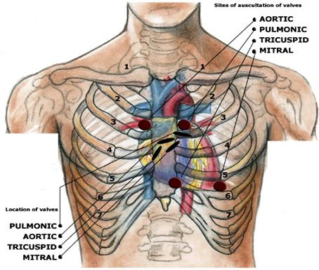

Slide 4
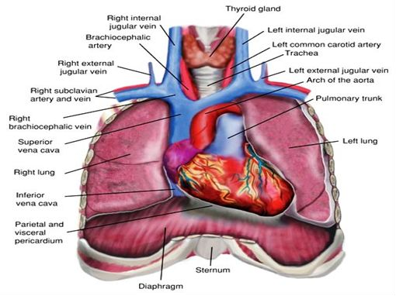

Slide 5
Pericardium
A sac called pericardium covers the heart. The pericardium is composed of 2 parts:
Fibrous pericardium: is the outer part of pericardium and it composed of tough dense connective tissue.
The serous pericardium: is the inner layer of the pericardium, consisting of:
Pericardial cavity: A thin space between the parietal and visceral layers, containing serous fluid. This fluid lubricates the membranes and reduces friction during heartbeats.

Slide 6
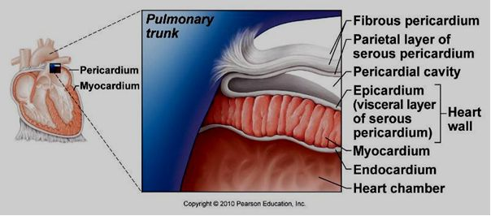

Slide 7
Heart wall Structure
The heart wall consists of three layers:
The epicardium: is the outer layer of the heart.
The myocardium: Is the middle layer of the heart wall .and, is composed of cardiac muscle tissue. The myocardium is the thickest of the three heart wall layers.
The endocardium: is the inner layer of the heart wall . The endocardium also covers the surface of valves and continues as the endothelium of blood vessels.

Slide 8
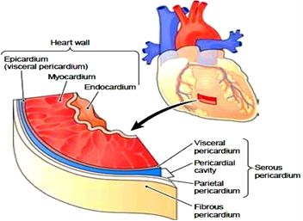
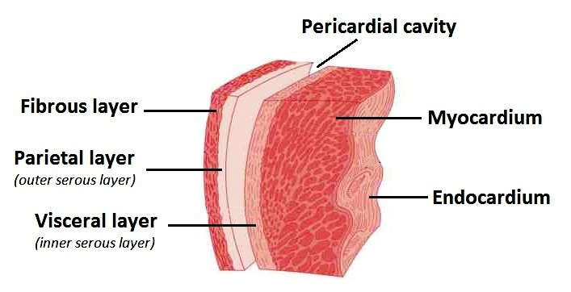
Pericardium & cardiac wall structure

Slide 9
Chambers of the Heart
The heart has four chambers that play specific roles in circulating blood throughout the body. These chambers are divided into two atria and two ventricles:
Right Atrium:
Receives deoxygenated blood from the body through the superior and inferior vena cava.
Passes this blood into the right ventricle through the tricuspid valve.
Right Ventricle:
- Pumps the deoxygenated blood it receives from the right atrium to the lungs via the pulmonary artery.
This process is essential for gas exchange, allowing carbon dioxide to be expelled and oxygen to be absorbed.

Slide 10
3- Left Atrium:
- Receives oxygenated blood from the lungs through the pulmonary veins.
- Passes this oxygen-rich blood to the left ventricle through the mitral (bicuspid) valve.
4- Left Ventricle:
Pumps oxygenated blood it receives from the left atrium to the rest of the body via the aorta.
This chamber has the thickest walls because it needs to generate high pressure to propel blood throughout the entire body.

Slide 11
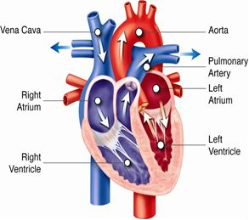
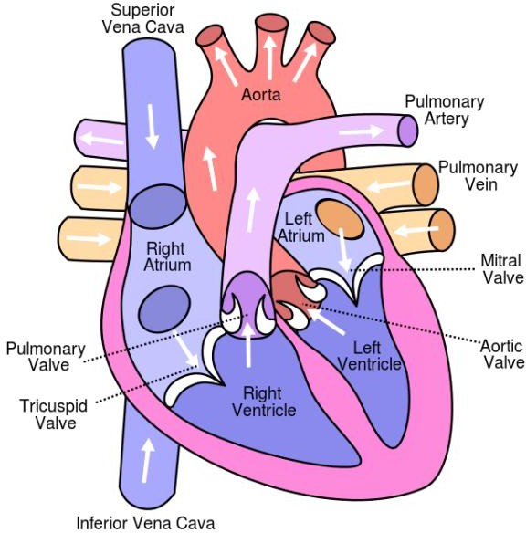

Slide 12
The valves
1- Tricuspid Valve (Right Atrioventricular Valve):
Located between the right atrium and the right ventricle.
Prevents backflow of blood into the right atrium when the right ventricle contracts.
Has three cusps (flaps) that open to allow blood to flow from the atrium to the ventricle and close to prevent backflow.
2- Pulmonary Valve (Right Semilunar Valve):
Located between the right ventricle and the pulmonary artery.
Prevents blood from flowing back into the right ventricle after it is pumped into the pulmonary artery.
Has three crescent-shaped cusps that open when the right ventricle contracts and close when it relaxes.

Slide 13
3- Mitral Valve (Left Atrioventricular Valve or Bicuspid Valve):
Located between the left atrium and the left ventricle.
Prevents backflow of blood into the left atrium when the left ventricle contracts.
Has two cusps that function similarly to the tricuspid valve but in the left side of the heart.
3- Aortic Valve (Left Semilunar Valve):
Located between the left ventricle and the aorta.
Prevents blood from flowing back into the left ventricle after it is pumped into the aorta.
Also has three cusps that open during ventricular contraction and close when the ventricle relaxes.

Slide 14
Papillary muscles: these muscles are cone shaped which originated from the ventricular wall. There apex are connected to cordae tendineae.
Cordae tendineae: are fine tendinous cords which are attached from papillary muscles to the border of cusps.
This attachment is to prevent the bulging of the valves into the atria during ventricles contract.

Slide 15
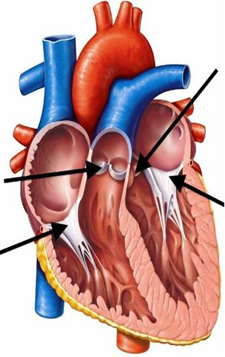
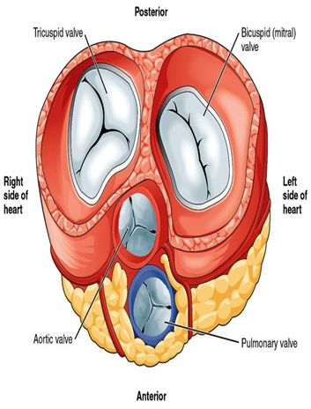

Slide 16
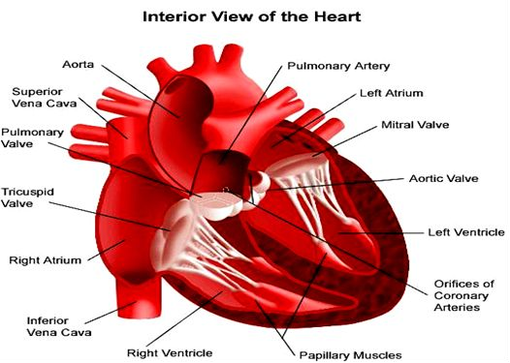

Slide 17
Blood supply to the heart
Arteries
1- Right coronary artery it supplies the right border of the heart.
2- Left coronary artery it gives the following branches:

Slide 18
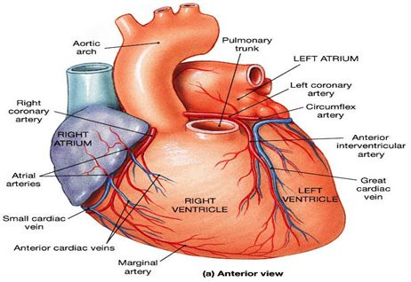

Slide 19
Nerve Supply to the heart
Sympathetic: derived from thoracic spinal cord T1-T2.
Stimulation of the heart by sympathetic nervous system leads to
increase heart rate (tachycardia), increase force of contraction, and dilation of coronary arteries.
Parasympathetic: branches of vagus nerve (cranial nerve X)
Stimulation of the heart by parasympathetic nervous system leads to:
Slowing of the heart (bradycardia), reduction in the force of contraction, and constriction of coronary arteries.

Slide 20
Physiology of the Heart

Slide 21
The Conduction System
1- Sinoatrial (SA) Node:
Located in the right atrium.
Acts as the natural pacemaker of the heart.
Generates electrical impulses that initiate each heartbeat.
2- Atrioventricular (AV) Node:
Located at the junction between the atria and ventricles.
Receives the impulse from the SA node.
Delays the impulse briefly to allow the ventricles to fill with blood before they contract.

Slide 22
3- Bundle of His:
Located in the septum between the ventricles.
Transmits the electrical impulse from the AV node to the ventricles.
4- Right and Left Bundle Branches:
Carry the impulse down the interventricular septum.
Direct the impulse towards the apex of the heart.
5- Purkinje Fibers:
Conduct the impulse rapidly to the ventricular muscle, causing it to contract.

Slide 23
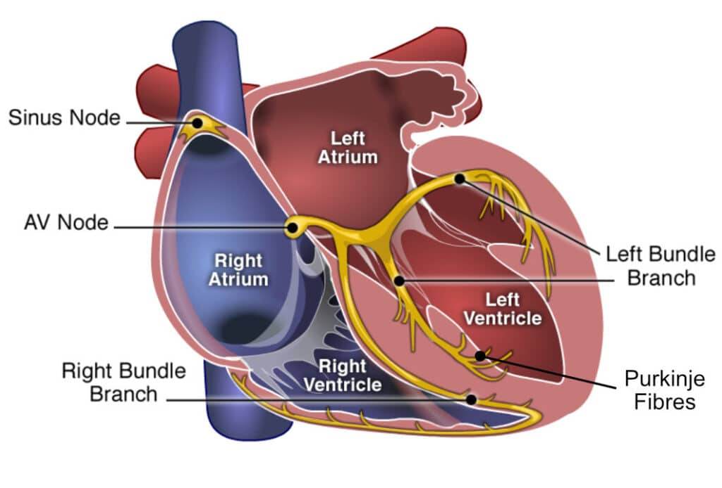

Slide 24
cardiac properties
1-Excitability :
The ability of cardiac cells to respond to stimuli (usually electrical signals).
2. Automaticity:
The heart’s ability to generate its own electrical impulses without external stimuli.
3-Conductivity:
The ability of cardiac cells to transmit electrical impulses from one cell to another.
4. Contractility:
The ability of cardiac muscle fibers to shorten and generate force in response to electrical stimulation.

Slide 25
Cardiac cycle
It is the inclusive period of time from the start of one heartbeat to the initiation of the next.
In each cardiac cycle, there are alternate contractions and relaxation of all chambers.
Each contraction is called systole and each
relaxation is called diastole.

Slide 26
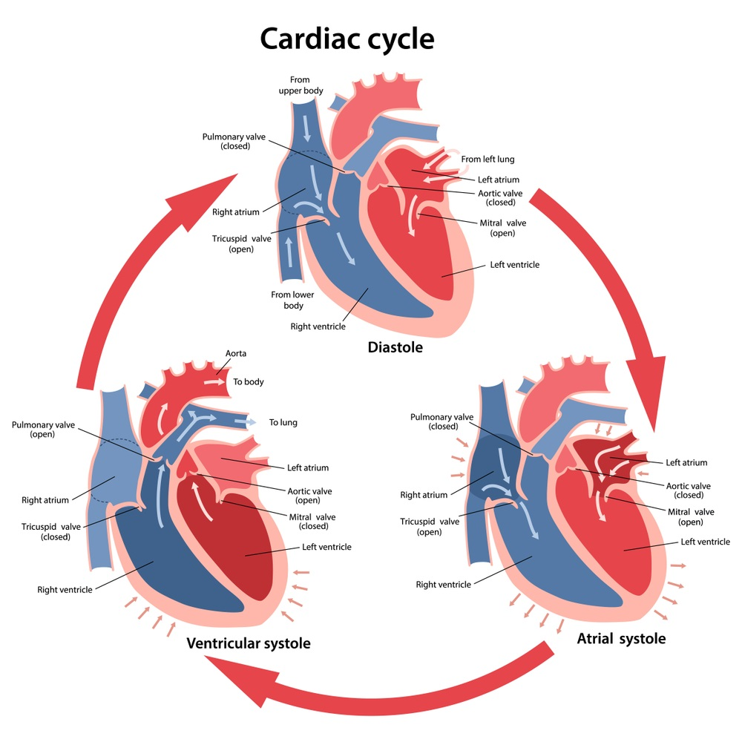

Slide 27
Blood Flow Pathway
The heart pumps blood through two main circuits:
Pulmonary circulation (right heart):
  Deoxygenated blood flows from the body → right atrium → right ventricle → pulmonary artery → lungs for oxygenation.
Systemic circulation (left heart):
  Oxygenated blood from the lungs → left atrium → left ventricle → aorta → distributed to the body.
Heart Sounds
Heart sounds are produced by valve closures:
S1 (Lub): Closure of the atrioventricular valves (tricuspid and mitral) during ventricular systole.
S2 (Dub): Closure of the semilunar valves (pulmonary and aortic) during ventricular diastole.

Slide 28
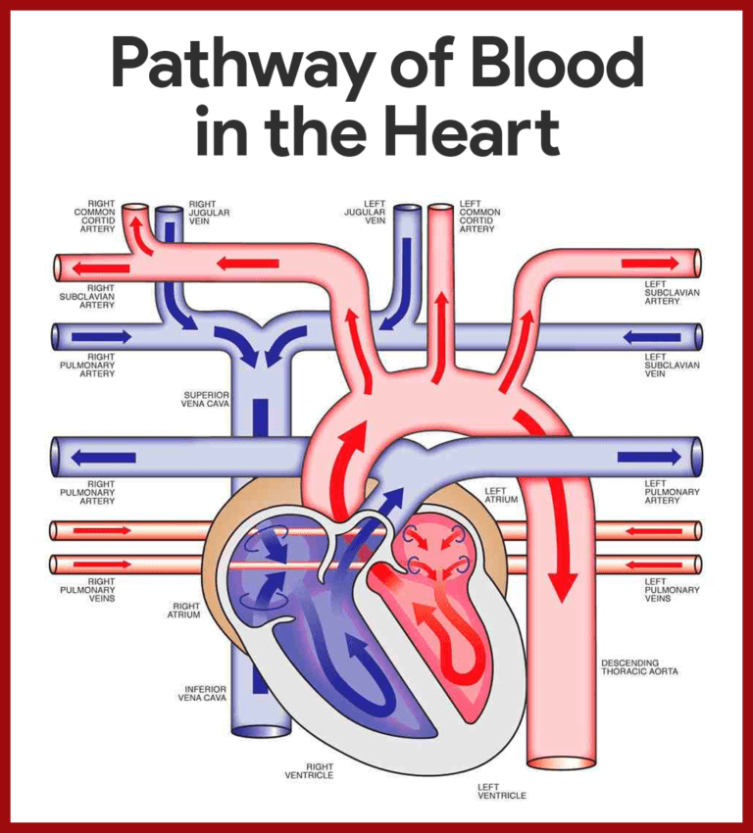

Slide 29
Cardiac Output
Cardiac Output (CO) refers to the volume of blood pumped by the heart per minute. It is a key indicator of the heart's efficiency and overall circulatory health.
Formula:
Cardiac Output=Heart Rate (HR)×Stroke Volume (SV)
Heart Rate (HR): Number of heartbeats per minute.
Stroke Volume (SV): Volume of blood pumped by one ventricle per beat (average ~70 mL/beat).
Normal Range:
At rest: 4-6 L/min
During exercise: Can increase up to 20-30 L/min in healthy individuals.

Slide 30


