Slide 1
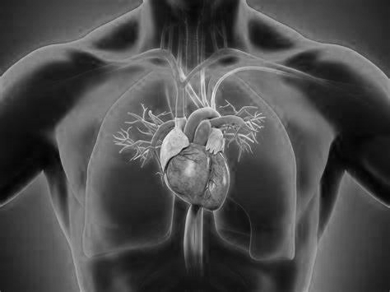
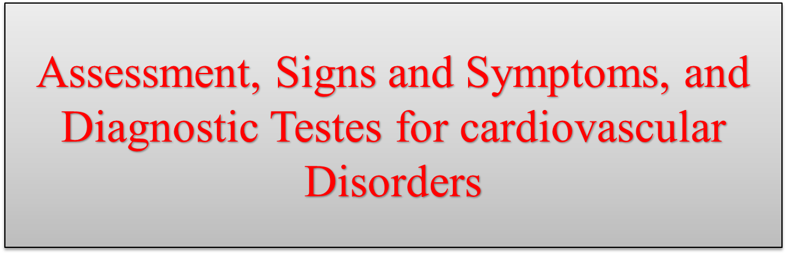
M.Sc.N: Ali Jassim

Slide 2
Assessment of Cardiovascular Function
Health History
1- Common signs and symptoms of cardiovascular disease
Chest pain or discomfort (IHD, dysrhythmias, valvular heart disease,…..).
Shortness of breath or dyspnea (IHD, HF, valvular heart disease,…..).
Peripheral edema, weight gain, ascites (HF).
Palpitations (IHD, caffeine or other stimulants, electrolyte imbalances, stress, valvular heart disease,…….).
fatigue (IHD, HF, or valvular heart disease,…..).
Dizziness, syncope, or changes in level of consciousness (cardiogenic shock, dysrhythmias, hypotension,……)

Slide 3
2- Past Health, Family, and Social History : The past health history provides an opportunity for the nurse to assess patients’ understanding of their personal risk factors for cardiovascular disease.
Risk Factors
Non-modifiable Risk Factors
• Family history: (first-degree relative with cardiovascular disease at 55 years of age or younger for men and at 65 years of age or younger for women)
• Increasing age : (more than 45 years for men; more than 55 years for women)
• Gender (men develop CAD at an earlier age than women)
• Race (higher incidence of heart disease in African Americans than in Caucasians)
Modifiable Risk Factors
- Hypertension - Diabetes
- Hyperlipidemia - Obesity
- Metabolic syndrome - Smoking, tobacco use
- Physical inactivity

Slide 4
Medications : Nurses collaborate with other health care providers, including pharmacists, to obtain a complete list of the patient’s medications, including dose and frequency.
Nutrition : Diets that are restricted in sodium, fat, cholesterol, or calories are commonly prescribed. The nurse obtains the following information.
Elimination: Typical bowel and bladder habits need to be identified. Nocturia
(awakening at night to urinate) is common in patients with HF.
Activity and Exercise: The nurse determines if there are recent changes by comparing the patient’s current activity level with that performed in the past 6 to 12 months. New symptoms or a change in the usual symptoms during activity is a significant finding.
Sleep and Rest: Patients with worsening HF often experience orthopnea, a term used to indicate the need to sit upright or stand to avoid feeling short of breath.

Slide 5
Self-Perception and Self-Concept: Patients’ beliefs and feelings about their health are key determinants of adherence to self-care recommendations and recovery after an acute cardiac event.
Roles and Relationships: patients with lower levels of social support have an increased risk for cardiac-related mortality and stroke, compared with others having higher levels of support.
Sexuality and Reproduction: In men, erectile dysfunction may develop as a side
effect of cardiac medications (e.g., beta-blockers); The nurse can help patients by initiating discussions about sexuality and encouraging them to discuss problems with their primary provider or cardiologist.
Coping and Stress Tolerance: Patients who are depressed are less motivated to adhere to recommended lifestyle changes and medical regimens necessary to prevent future cardiac events, such as an MI.

Slide 6
Physical Assessment
1- General Appearance
Level of consciousness (alert, lethargic, stuporous, comatose)
Mental status (oriented to person, place, time)
Body Mass Index (BMI greater than 30 kg/m2 indicate obesity)
2- Assessment of the Skin and Extremities
Skin color, temperature, and texture
S & S of acute obstruction of arterial blood flow in the extremities, referred to as the 6 P’s, are pain, pallor, pulselessness, paresthesia, poikilothermia (coldness), and paralysis.
Clubbing of the fingers and toes indicates chronic hemoglobin desaturation and is associated with congenital heart disease.
capillary refill time

Slide 7
3- Blood Pressure : A normal BP in adults is considered a systolic BP less than 120 mm Hg over a diastolic BP less than 80 mm Hg
Pulse Pressure
The difference between the systolic and the diastolic pressures
normally is 30 to 40 mm Hg
Postural (orthostatic) hypotension : is a sustained decrease of at least 20 mm Hg in systolic BP or 10 mm Hg in diastolic BP within 3 minutes of moving from a lying or sitting to a standing position. It is usually accompanied by dizziness, lightheadedness, or syncope.

Slide 8
4- Arterial Pulses
- Pulse Rate (The normal pulse rate varies between 60-100 bpm )
- Pulse Rhythm (The rhythm of the pulse is normally regular)
- Pulse Amplitude (The simplest method characterizes the pulse as absent, diminished, normal, or bounding. Scales are also used to rate the strength of the pulse. The following is an example of a 0-to-4 scale:
0: absent , +1 : weak, +2: Normal, +3: Moderately increased, +4: strong, bounding pulse
5- Jugular Venous Pulsations: The jugular veins are normally visible in the supine position only with the head of the bed elevated to 30°. Obvious pulse and distention of the veins with the patient’s head elevated 45° to 90° may indicates a right-side heart failure.
6- Heart Inspection, Palpation, and Auscultation.

Slide 9
Diagnostic Evaluation
Laboratory Tests
Cardiac Biomarker
Troponin : Elevated Troponin is an indicator of MI (most specific lab test )
Creatine kinase (CK-MB) :Elevated CK-MB is an indicator of acute MI
Lipid Profile: A lipid profile measures cholesterol levels (total, HDL, LDL) and triglycerides in the blood to assess heart disease risk. High levels of LDL or triglycerides can indicate a higher risk.
Total cholesterol: <200 mg/dL (desirable)
LDL (bad cholesterol): <100 mg/dL (optimal)
HDL (good cholesterol): ≥60 mg/dL (optimal)
Triglycerides: <150 mg/dL (normal)
Brain (B-Type) Natriuretic Peptide: A BNP level greater than 100 pg/mL is suggestive of HF

Slide 10
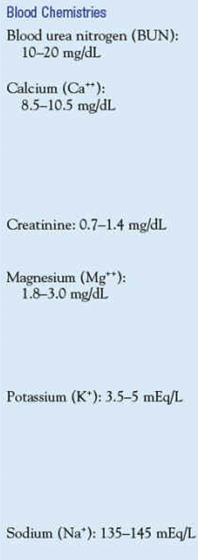
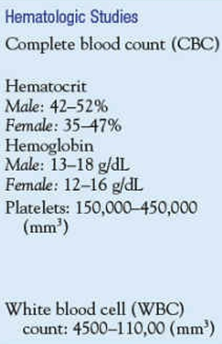
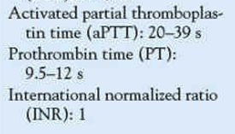
Blood Chemistry, Hematology, and Coagulation Studies

Slide 11
C-Reactive Protein : CRP is a protein produced by the liver in response to systemic inflammation.
Homocysteine: Homocysteine, an amino acid, is linked to the development of atherosclerosis.
2- Chest X-Ray
3- Radionuclide Imaging ( CT scan, MRI , ….. )
4- Echocardiography
5- Electrocardiography : The 12-lead ECG is used to diagnose dysrhythmias, conduction
abnormalities, and chamber enlargement, as well as myocardial ischemia.
Continuous Ambulatory Monitoring (Holter) : small portable recorders are connected to chest electrodes (number varies based on model used) that record the ECG using several leads onto a digital memory device. The patient wears the recorder for 24 to 48 hours and in certain cases up to 2 weeks.

Slide 12
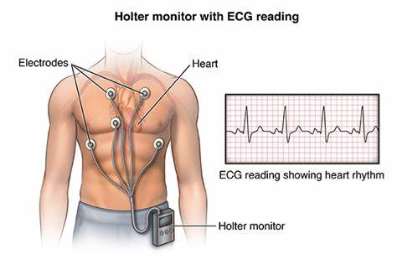

Slide 13
6- Exercise Stress Testing: In an exercise stress test, the patient walks on a treadmill (most common) . Exercise intensity progresses according to established protocols.
The Bruce protocol, for example, is a common treadmill protocol in which the speed and grade of the treadmill are increased every 3 minutes. The goal of the test is to increase the heart rate to the “target heart rate.” This is 80% to 90% of the maximum predicted heart rate and is based on the age and gender of the patient. During the test, the following are monitored: two or more ECG leads for heart rate, rhythm, and ischemic changes; BP; skin temperature; physical appearance; perceived exertion; and symptoms including chest pain, dyspnea, dizziness, leg cramping, and fatigue.
The test is terminated when the target heart rate is achieved or when the patient experiences chest pain, extreme fatigue, a decrease in BP or pulse rate, serious dysrhythmias or ST segment changes on ECG, or other complications. When significant ECG abnormalities occur during the stress test (ST segment depressions), the test result is reported as positive and further diagnostic testing is required.

Slide 14
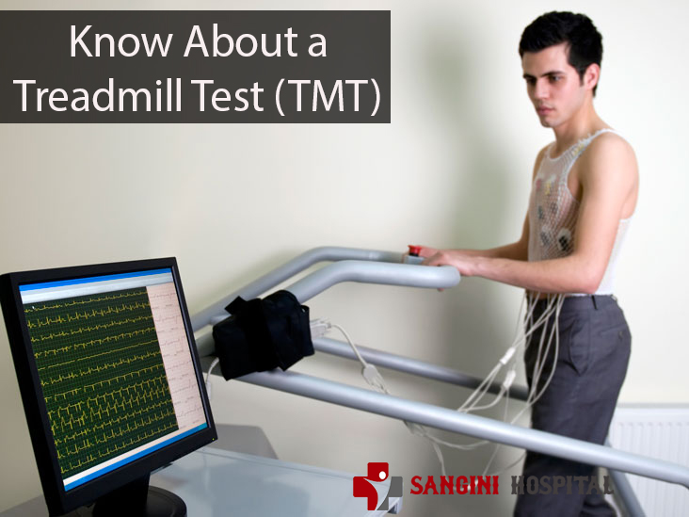

Slide 15
Nursing Interventions for Exercise Stress Test:
Instruct patient to fast for 4 hours and avoid stimulants (tobacco, caffeine).
Medications can be taken with small sips of water; some cardiac meds (e.g., beta-blockers) may be withheld.
Wear suitable clothes and rubber-soled shoes; women should wear supportive bras.
Nurse explains equipment, sensations, and experiences during the test.
Explain monitoring equipment, IV line placement, and symptoms to report.
Review type of exercise and encourage best effort.
If using echocardiography or radionuclide imaging, provide relevant information.
After the test, monitor for 10-15 minutes; resume usual activities once stable

Slide 16
7- Cardiac Catheterization: is an invasive diagnostic procedure in which radiopaque arterial and venous catheters are introduced into selected blood vessels of the right and left sides of the heart. Catheter advancement is guided by fluoroscopy. Most commonly, the catheters are inserted percutaneously through the blood vessels. Pressures and oxygen saturations in the four heart chambers are measured. Cardiac catheterization is used to diagnose CAD, assess coronary artery patency, and determine the extent of atherosclerosis based on the percentage of coronary artery obstruction.
These results determine whether revascularization procedures including PTCA or coronary artery bypass surgery may be of benefit to the patient .
During cardiac catheterization, the patient has an intravenous line in place for the administration of sedatives, fluids, heparin, and other medications.
Noninvasive hemodynamic monitoring that includes BP and multiple ECG tracings is necessary to continuously observe for dysrhythmias or hemodynamic instability.

Slide 17
Staff must be prepared to provide advanced cardiac life support measures as necessary. Radiopaque contrast agents are used to visualize the coronary arteries; some contrast agents contain iodine.
The patient is assessed before the procedure for previous reactions to contrast agents or allergies to iodine-containing substances (eg, seafood). If the patient has a suspected or known allergy to the substance, antihistamines or methylprednisolone (Solu-Medrol) may be administered before the procedure. In addition, the following blood tests are performed to identify abnormalities that may complicate recovery:
BUN and creatinine levels, INR or PT, a PTT, hematocrit and hemoglobin values, platelet count, and electrolyte levels. Diagnostic cardiac catheterizations are commonly performed on an outpatient basis and require 2 to 6 hours of bed rest before ambulation. For most patients, bed rest for 6 hours compared to 2 hours has no advantage with regard to groin bleeding complications. However, variations in time to ambulation are most often related to the size of the catheter used during the procedure, the anticoagulation status of the patient, other patient variables (eg, advanced age, obesity, bleeding disorder), the method used for hemostasis of the arterial puncture site after the procedure, and institutional policies.

Slide 18
The use of smaller (4 or 6 Fr) catheters, which are more amenable to shorter recovery times, is common in diagnostic cardiac catheterizations. There are several methods available to achieve arterial hemostasis after catheter removal, including manual pressure, mechanical compression (placed over puncture site for 30 minutes).
Patients hospitalized for angina or acute MI may also require Patients hospitalized for angina or acute MI may also require cardiac catheterization. After the procedure, these patients usually return to their hospital rooms for recovery. In some cardiac catheterization laboratories, an angioplasty may be performed immediately after the catheterization if indicated.

Slide 19
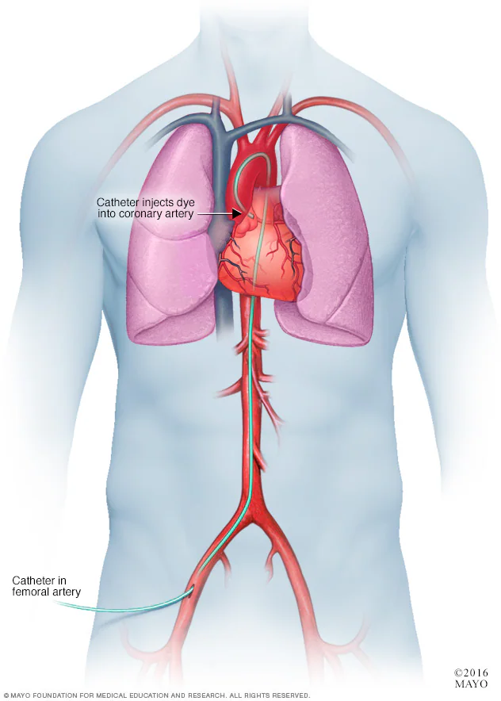

Slide 20
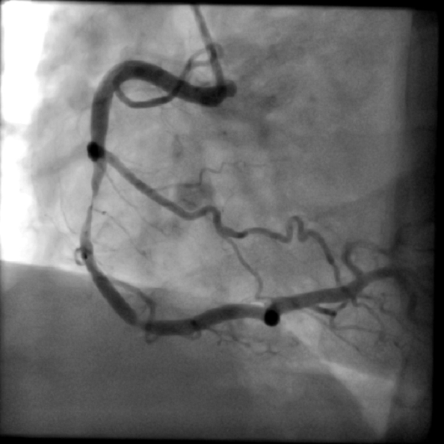

Slide 21
Nursing Interventions Before Cardiac Catheterization:
Instruct patient to fast for 8-12 hours before procedure; arrange for transport home if outpatient.
Inform patient of the procedure's expected duration (less than 2 hours) and lying on a hard table.
Reassure that mild or moderate sedation will be given intravenously.
Prepare patient for sensations during the procedure, including palpitations, coughing, deep breathing, and the flushed feeling from contrast agent injection.
Encourage patient to express fears and anxieties, offering teaching and reassurance to reduce apprehension.

Slide 22
Nursing Responsibilities After Cardiac Catheterization:
Observe catheter access site for bleeding/hematoma; assess peripheral pulses every 15 minutes for 1 hour, then every 1-2 hours until stable.
Evaluate temperature, color, and assess for pain, numbness, or tingling to detect signs of arterial insufficiency; report changes.
Monitor for dysrhythmias by observing the cardiac monitor or assessing pulses; manage vasovagal reactions with prompt intervention (raise legs, administer fluids, atropine).
If femoral artery used, keep patient on bed rest for 2-6 hours, leg straight, head elevated 30 degrees; less restriction if deployed devices used.
Instruct patient to report chest pain, bleeding, or discomfort from catheter insertion sites immediately.
Encourage fluids to increase urinary output and flush out dye.
7. Ensure safety by instructing the patient to ask for help when getting out of bed the first time after the procedure.

Slide 23
Patient education after catheterization
After discharge for cardiac catheterization, self-care guidelines include:
For 24 hours, avoid bending at the waist, straining, or lifting heavy objects.
Avoid tub baths, but shower as desired.
Discuss with your physician when to return to work, drive, or resume strenuous activities.
Contact your physician if you experience bleeding, swelling, new bruising, pain at the puncture site, or a temperature of 101.5°F (38.6°C) or more.
If diagnosed with coronary artery disease, discuss treatment options, including local cardiac rehabilitation programs.
Consult your physician and nurse about lifestyle changes to lower future heart problem risks, such as quitting smoking, lowering cholesterol, changing your diet, exercising, or losing weight.

Slide 24


