Slide 1
Aortic Valve
Prepared by:
M.Sc.N: Ali Jassim

Slide 2
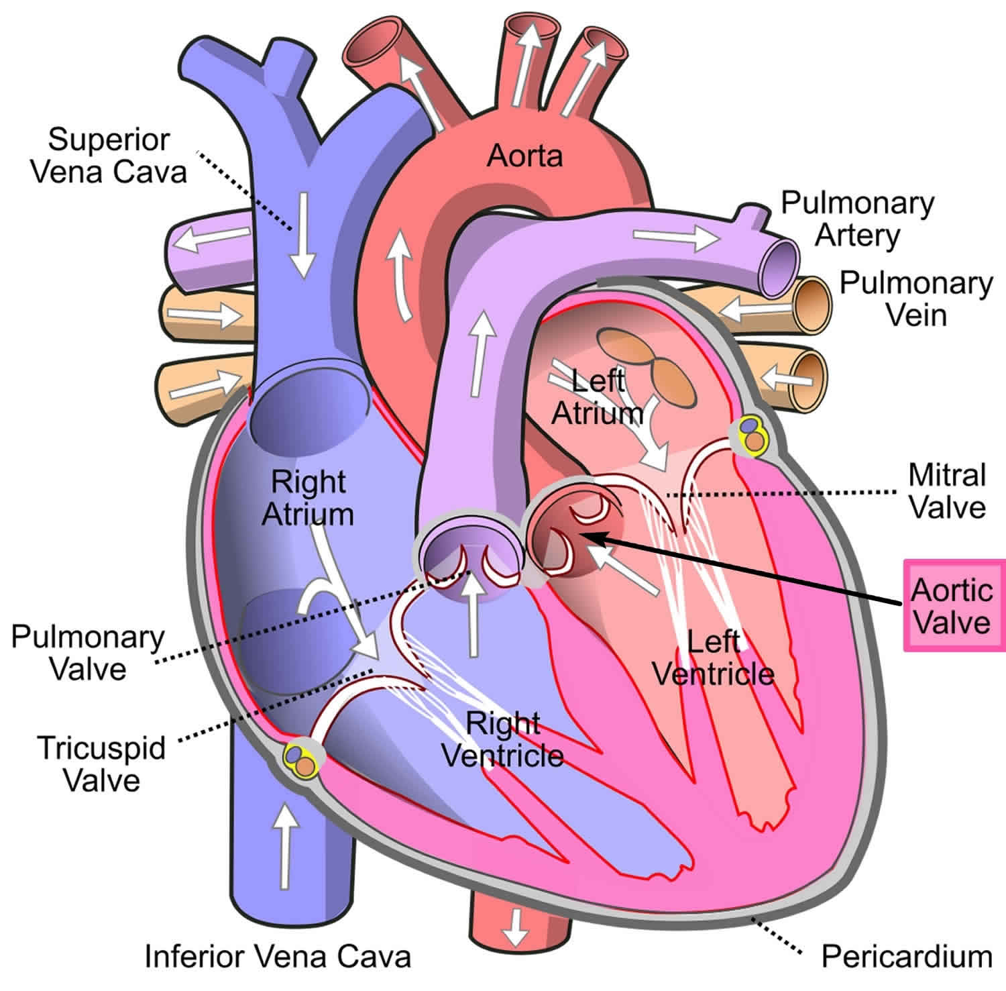

Slide 3
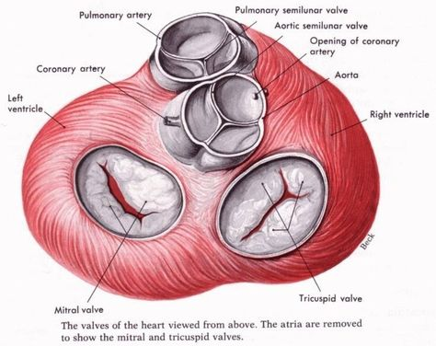

Slide 4
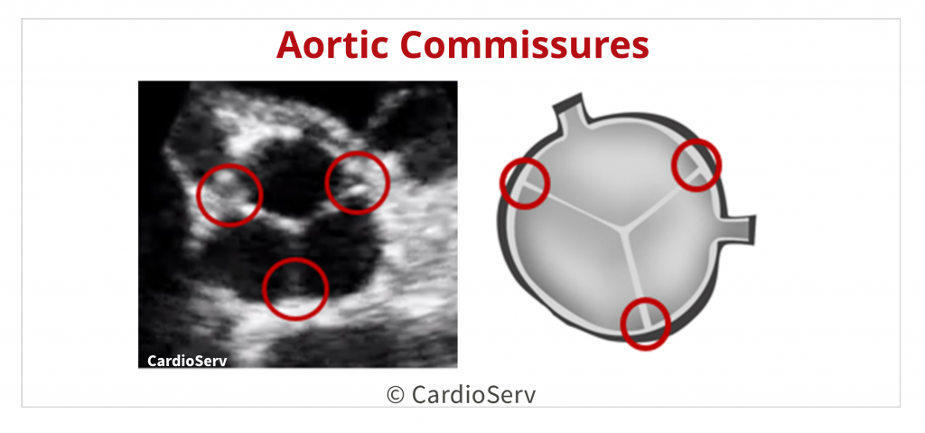

Slide 5
Aortic valve stenosis
Aortic valve stenosis is narrowing of the orifice between the left ventricle and aorta.
In adults, stenosis often is a result of degenerative calcifications. Calcifications may be caused by proliferative and inflammatory changes that occur in response to years of normal mechanical stress.
Congenital leaflet malformations or an abnormal number of leaflets (i.e., one or two rather than three) may be involved. Rheumatic endocarditis may cause adhesions or fusion of the commissures and valve ring, stiffening of the cusps, and calcific nodules on the cusps.

Slide 6
Pathophysiology
Valve orifice narrows progressively over time.
The left ventricle compensates by contracting more slowly but with increased force to push blood through the smaller opening.
Increased pressure on the left ventricle causes hypertrophy of the ventricular wall.
Eventually, when these compensatory mechanisms fail, clinical symptoms emerge.

Slide 7
Clinical Manifestations
Dyspnea on exertion (due to pulmonary venous hypertension)
Paroxysmal nocturnal dyspnea (PND)
Orthopnea
Dizziness and syncope due to reduced blood flow to the brain.
Angina pectoris , it results from increased oxygen demand of the hypertrophied left ventricle with decreased blood supply due to decreased blood flow into the coronary arteries.
Narrow pulse pressure less than 30 mmHg .

Slide 8
Assessment and Diagnostic Findings
1. On physical examination, a loud, harsh systolic murmur may be heard over
the aortic area (i.e., right second intercostal space).
Note : The systolic murmur is low pitched, crescendo–decrescendo, rough, rasping, and vibrating
2 Echocardiography, cardiac MRI, and computed tomography (CT) scanning are used to diagnose and monitor progression of aortic stenosis.
3. Electrocardiography (ECG)
4. Exercise testing
5. Cardiac catheterization

Slide 9
Medical and Surgical Management
1 . Vasodilators Purpose: decrease resistance the heart works against.
Example: Nitrates.
2. Beta blockers: decrease the force contractions of the heart muscles, and reduce blood vessel contraction e.g: Bisoprolol .
3. Calcium channel blockers: are prescription medications that relax blood vessels and increase the supply of blood and oxygen to the heart while also reducing the heart workload e.g: Amlodipine.
4. Diuretics e.g: Lasix
5. Digoxin only for end-stage heart failure.

Slide 10
Prevention
Prevention of aortic stenosis is primarily focused on controlling risk factors for proliferative and inflammatory responses—namely, through treating diabetes, hypertension, hypercholesterolemia, and elevated triglycerides and avoiding tobacco products.

Slide 11
Aortic Regurgitation
Aortic Regurgitation is flow of blood back into the left ventricle from the aorta during diastole.
It may be caused by inflammatory lesions that deform aortic valve leaflets or dilation of the aorta, preventing complete closure of the aortic valve. This valvular defect also may result from infective or rheumatic endocarditis, congenital abnormalities, diseases such as syphilis, a dissecting aneurysm that causes dilation or tearing of the ascending aorta, blunt chest trauma, or deterioration of a surgically replaced aortic valve.

Slide 12
Pathophysiology
Blood from the aorta returns to the left ventricle during diastole, increasing volume.
The left ventricle dilates and hypertrophies to pump more blood with greater force.
Systolic blood pressure rises, while arteries compensate with vasodilation.
Peripheral arterioles relax, lowering peripheral resistance and diastolic blood pressure.

Slide 13
Clinical Manifestation
Aortic insufficiency develops without symptoms in most patients.
Forceful heartbeat (especially in head or neck)
Visible/palpable arterial pulsations (carotid/temporal)
Exertional dyspnea and fatigue
Breathing difficulties (orthopnea, PND) due to left ventricular failure

Slide 14
Assessment and Diagnostic Findings
High-pitched, blowing diastolic murmur at the third or fourth intercostal space, left sternal border.
Widened pulse pressure (difference between systolic and diastolic pressures).
Water hammer (Corrigan’s) pulse: quick, sharp stroke followed by sudden collapse.
Diagnosis confirmed by echocardiography (preferably transesophageal), cardiac MRI, or cardiac catheterization.
Symptomatic patients have echocardiograms every 6 months; asymptomatic patients every 2-5 years.

Slide 15
Medical Management
The symptomatic patient, or patient with decreased left ventricular function, is advised to avoid physical exertion, competitive sports, and isometric exercise . Dysrhythmias and heart failure are treated as described in aortic valve stenosis.

Slide 16
Surgical Management: Valvular Heart Disorders
Valve replacement
Type of artificial valve
Mechanical
Tissue
Bioprosthesis
Homografts
Autografts
Valvuloplasty (Repair cardiac valve)
Commissurotomy
Balloon valvuloplasty
Annuloplasty
Leaflet repair
Chordoplasty
ملاحظة ( 1) : اذا كان الصمام متضيق او يعاني من ارتجاع وكانت درجة الضرر متوسطة فيمكن تصليحه جراحيا بتداخلات مختلفة كما في أعلاه
ملاحظة (2) : اذا كان الصمام متضيق او يعاني من ارتجاع وكانت درجة الضرر شديدة فيتم استبدال الصمام ب صمام صناعي (ميكانيكي , نسيجي , .......) أنواع الصمامات الصناعية في أعلاه

Slide 17
Surgical Management: Valvular Heart Disorders
Valve Annuloplasty Involves making the valve ring (annulus) smaller with sutures. Leaflets are repaired to provide good closure of the valve at systole.
Valve replacement: Using mechanical (prosthetic) or biologic (tissue from cadavers) valves. If mechanical, pt. needs anticoagulant therapy for their lifetime due to clot formation. Mechanical valves are more durable. The aortic valve is always replaced with mechanical valve due to high pressure in aorta.
Biologic valves require no anticoagulants, but may wear out in 15 years, requiring additional surgery.

Slide 18


