Slide 1

Lecture# 14
semester# 2
Eye Disorders
I. Cataract
Al-Mustaqbal University
College of Nursing
2nd Class
Adult Nursing

Slide 2
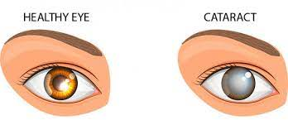
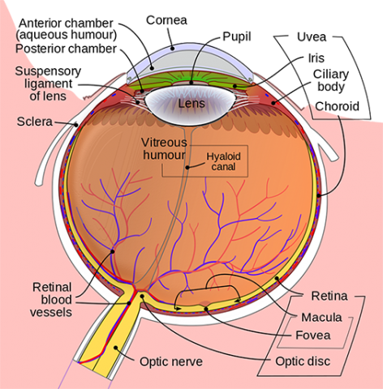
Cataract

Slide 3
Cataract
A cataract :is a lens opacity or cloudiness.
A cataract is a cloudy or opaque lens.
On visual inspection, the lens appears gray or milky.
Cataracts are a leading cause of blindness in the world.
The three most common types are traumatic, congenital, or senile cataract.

Slide 4
Pathophysiology
Cataract can develop in one or both eyes at any age.
Three common type of cataract are define by their location in the lens:
1. Nuclear
2. Cortical
3. Posterior subcapsular

Slide 5
RISK FACTORS
Aging:
Accumulation of a yellow-brown pigment due to the breakdown of lens protein
Decreased oxygen uptake
Decrease in levels of vitamin C, protein, and glutathione (an antioxidant)
Increase in sodium and calcium
Loss of lens transparency

Slide 6
Associated Ocular Conditions
Infection (e.g., herpes zoster, uveitis)
Myopia
Retinal detachment and retinal surgery
Retinitis pigmentosa.

Slide 7
Toxic Factors
Ionizing radiation
Aspirin use
Corticosteroids
Alkaline chemical eye burns, poisoning
Cigarette smoking
Calcium, copper, iron, gold, silver, and mercury

Slide 8
CONT.
Nutritional Factors:
Obesity
Poor nutrition
Reduced levels of antioxidants
Systemic Diseases and Syndromes:
Diabetes
Disorders related to lipid metabolism
Down syndrome
Musculoskeletal disorders
Renal disorders

Slide 9
CONT.
Physical factors:
Dehydration
Blunt trauma
Electrical shock
Perforation of the lens with sharp object or foreign body
Ultraviolent radiation in sunlight and x-ray

Slide 10
Clinical Manifestation
Painless
Blurred vision
Diplopia
Reduce visual acuity
Astigmatism: refractive error due to an irregularity in the curvature of the cornea.

Slide 11
Medical Management
Treatment cures cataract or prevents age-related cataract.
Medications
Eye drops
eye glasses
In the early stage of cataract development the vision may improve by:
Glasses
Contact lenses

Slide 12
Assessment and Diagnostic Methods
1- The Snellen visual acuity test.
2- Ophthalmoscope
3- Slit lamp examination.

Slide 13
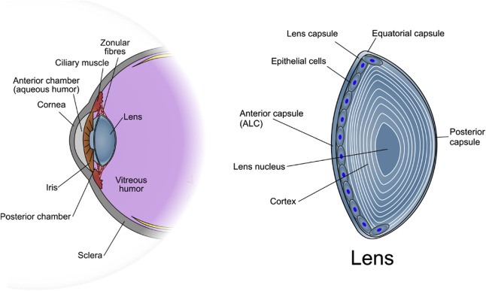
Surgical Management
Intracapsular cataract Extraction
Extracapsular cataract Extraction
Phacomulisification
Lens Replacement

Slide 14
Nursing management
Providing preoperative care:
Withhold any anticoagulation(e.g. aspirin, warfarin) to reduce the risk of hemorrhage.
Dilating drops are administer every 10 minutes for 4 doses at least one hour before surgery.

Slide 15
CONT.
Providing postoperative care:
The patient receive verbal and written instruction about how protect the eye.
Administer medication.
Recognizes the signs of complications and obtain emergency care.
Instruct the patient to take a mild analgesia agent, as needed.
Anti-inflammatory and corticosteroid eye drops or ointment.

Slide 16
Promoting home and community-based care
Teaching patient self care:
Eye patch for 24 hrs after surgery.
Followed by eye glasses worn during the day.
Sunglasses should be worn.
A clean , damp wash cloth may be used to remove eye discharge.
Continuity care
Eye patch remove after the first follow up appointment .
Vision is stabilized when the eye healed, usually within 6-12 weeks.

Slide 17
1- Healthy human ear can hear frequencies in the range from
20Hz to 20,000 Hz
20Hzto 25,000Hz
30Hz to 30,000Hz
25Hz to 30Hz

Slide 18
2- The instrument to examine the ear is
a- Ophthalmoscope
b- Otoscope
c- Thermometer
d- Stethoscope

Slide 19
3- Sinusitis is inflammation of the mucosa of one or more sinuses. Chronic sinusitis is diagnosed if symptoms are present for
a- More than one month
b- More than two month
c- More than two week
d- Recurrent every years

Slide 20
4- After the tonsillectomy, put the patient in-------- to reduce swelling and promote drainage
a- Supine position
b- Prone position
c- sitting position
d- semi-Fowler’s position

Slide 21
5- nurse examine the patient show the bleeding from the nose that mean:
a- Rhinorrhea
b- Epistaxis
c- Anosmia
d- dysphagia

