Slide 1

Multiplexer & De-Multiplexer
1st stage
وزارة التعليم العالي والبحث العلمي
جامعة المستقبل
كلية الهندسة والتقنيات الهندسية
قسم تقنيات الهندسة الكهربائية
المحاضرة السادسة
م.م رقيه احمد مطر الجادري

Slide 2
What is a Flip-Flop?
A flip-flop is a digital circuit used to store one bit of data (0 or 1). It is a fundamental component of sequential logic, meaning that its output depends not only on the current input but also on its previous state.

Slide 3
What is a Flip-Flop?
Flip-flops are synchronous, meaning they change their state only in response to a clock signal (Clock Pulse). They are widely used in memory units, registers, counters, and various digital systems.

Slide 4
Flip-Flop Work
A flip-flop consists of:
Inputs: Control the data stored in the flip-flop.
Clock Signal: Determines when the stored value is updated.
Outputs: Represent the stored data.

Slide 5
Flip-Flop Work
Flip-flops operate on clock pulses, updating their state only when a clock edge occurs.

Slide 6
Types of Flip-Flops
SR Flip-Flop (Set-Reset Flip-Flop)
The SR Flip-Flop is the simplest type and is used to store ON or OFF states. It has two main inputs:
S (Set): Sets the output to "1".
R (Reset): Resets the output to "0".Clock:

Slide 7
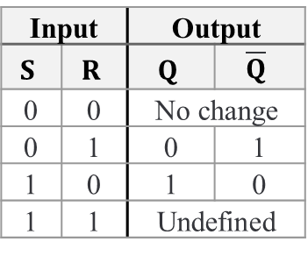
SR Flip Flop
The output only changes when a clock pulse is received.
Main issue: If both S and R are active at the same time, it leads to an undefined state, making it unsuitable for some applications.
Input |  | Output
$$S$$ | $$R$$ | $$Q$$ | $$\overline{Q}$$
0 | 0 | No change
0 | 1 | 0 | 1
1 | 0 | 1 | 0
1 | 1 | Undefined

Slide 8
D Flip-Flop (Data Flip-Flop)
Also called a "Delay Flip-Flop", it is used to store and transfer data reliably.
It has a single input, D (Data).
When the clock pulse arrives, the value of D is copied to the output.
It eliminates undefined states seen in the SR Flip-Flop.

Slide 9
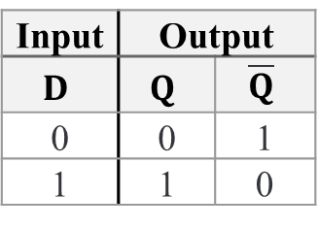
D Flip-Flop (Data Flip-Flop)
Applications: Used in memory registers, data storage, and synchronization circuits.
Input | Output
$$D$$ | $$Q$$ | $$\overline{Q}$$
0 | 0 | 1
1 | 1 | 0

Slide 10
JK Flip-Flop
An improved version of the SR Flip-Flop, which prevents the undefined state when S and R are both active.
J input acts like the Set input (S).
K input acts like the Reset input (R).
When J = 1 and K = 1, the output toggles (switches between 0 and 1).

Slide 11
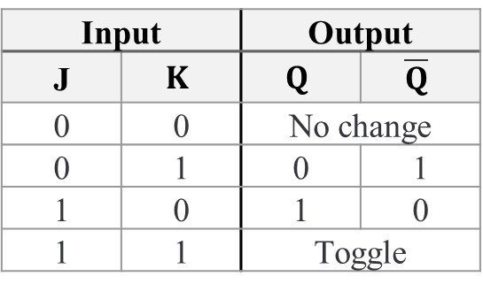
JK Flip-Flop
Applications: Used in counters and digital registers.
Input |  | Output
J | $$K$$ | $$Q$$ | $$\overline{Q}$$
0 | 0 | No change
0 | 1 | 0 | 1
1 | 0 | 1 | 0
1 | 1 | Toggle

Slide 12
T Flip-Flop (Toggle Flip-Flop)
The T Flip-Flop operates in toggle mode, meaning that it switches states on each clock pulse if the input T = 1.
If T = 0, the output remains unchanged.
If T = 1, the output toggles (switches from 0 to 1 or from 1 to 0).
Applications: Used in binary counters and clock dividers.

Slide 13
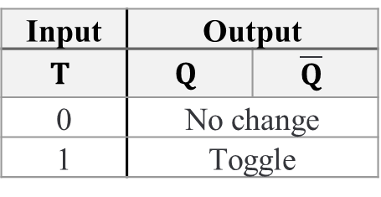
T Flip-Flop (Toggle Flip-Flop)
Input | Output
$$T$$ | $$Q$$ | $$\overline{Q}$$
0 | No change
1 | Toggle

Slide 14
Applications of Flip-Flops in Digital Systems
✅Data Storage: Used in registers and memory units.
✅Digital Counters: Helps in timing and frequency division.
✅Control Systems: Used in microcontrollers and state machines.
✅Data Transfer: Converts serial data to parallel and vice versa.

Slide 15
Comparison of Flip-Flop Types
Flip-Flop Type | Inputs | Function | Applications
SR Flip-Flop | S, R | Stores or resets data | Basic storage control
D Flip-Flop | D | Directly stores data | Memory and registers
JK Flip-Flop | J, K | Stores data and can toggle | Counters and registers
T Flip-Flop | T | Toggles state on each clock pulse | Counters and time-related circuits

Slide 16
THANKS

