Slide 1
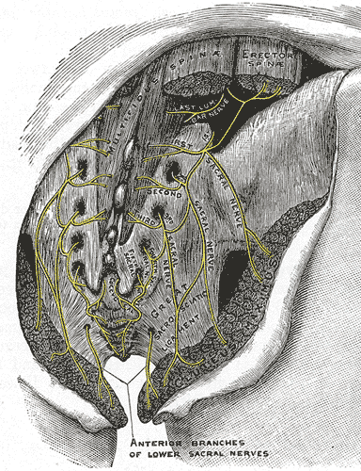

Nerves of Gluteal Region
Part 2
د. ميثم الأعرجي

Slide 2
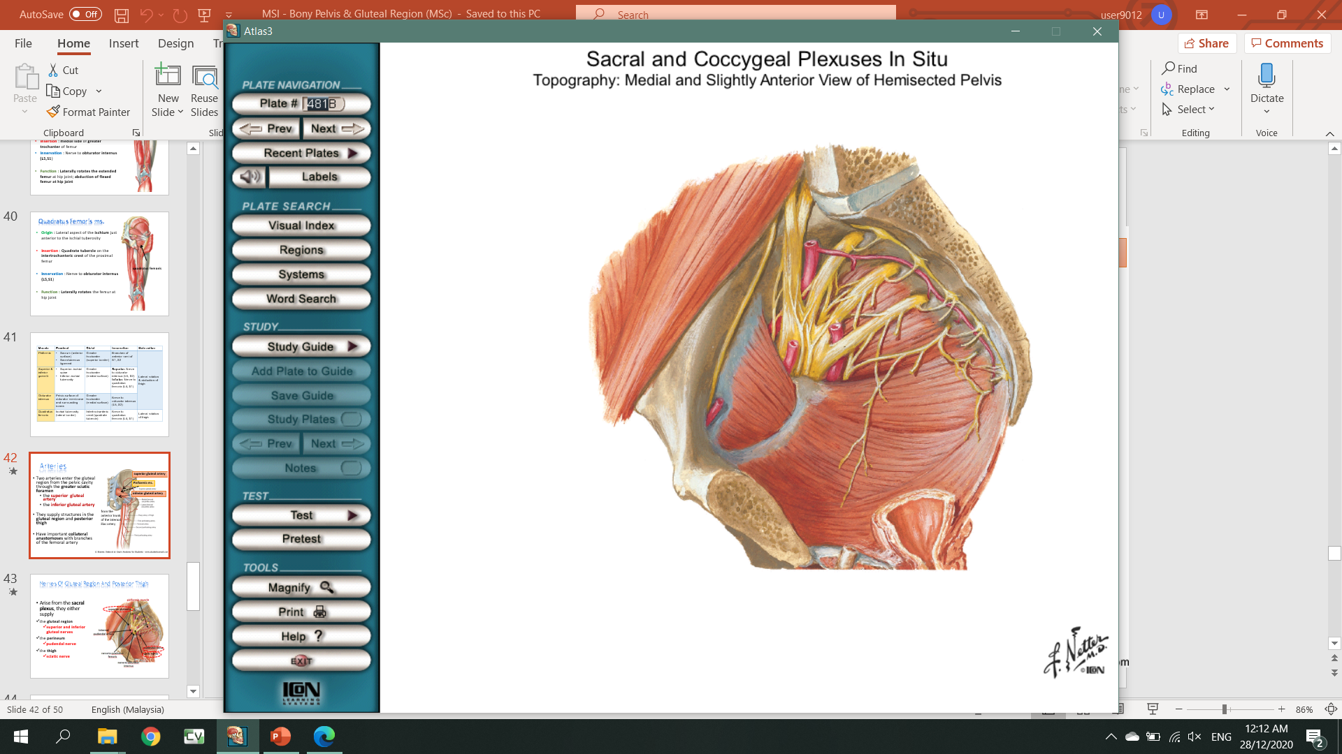
Nerves of gluteal region
Arise from the sacral plexus, they either supply:
Gluteal region - superior and inferior gluteal nerves
Perineum - pudendal nerve
Thigh - sciatic nerve
Sacral and coccygeal plexuses

Slide 3
Nerves of gluteal region
Clunial nerves
Deep gluteal nerves
Superior, middle, inferior clunial nerves
(cutaneous nerves)
Superior gluteal n.
Inferior gluteal n.
Sciatic n.
Pudendal n.
Nerve to quadratus femoris
Nerve to obturator internus
Posterior cutaneous nerve of thigh
*clunial = cluneal

Slide 4
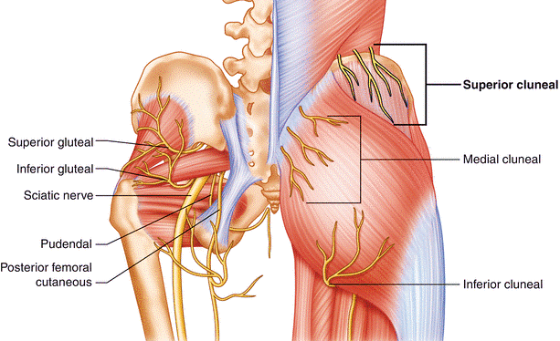
Clunial nerves
Nerve | Course | Innervation
Superior clunial n. | Origin: L1-L3 (post. rami) Pass inferolaterally across iliac crest | Skin of superior buttock (inferior to iliac crest)
Middle clunial n. | Origin: S1-S3 (post. rami) Exit through sacral foramina & pass laterally to gluteal region | Skin over sacrum
Inferior clunial n. | Origin: S2-S3 (ant. rami) Emerges from inferior border of gluteus maximus | Skin of inferior half of buttock (superior to greater trochanter)

Slide 5
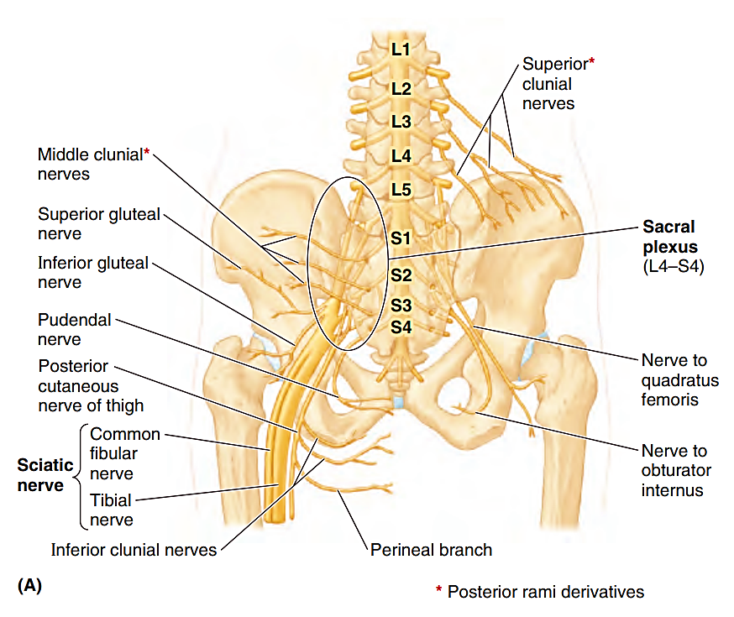

Slide 6
Deep gluteal nerves
These nerves are branches of sacral plexus and leave the pelvis through greater sciatic foramen
The deep gluteal nerves all emerge inferior to the piriformis muscle EXCEPT for superior gluteal nerve
Pudendal nerve supplies no structures in the gluteal region, ONLY structures in the perineum

Slide 7
Deep gluteal nerves
Superior gluteal n.
Inferior gluteal n.
Sciatic n.
Pudendal n.
Nerve to quadratus femoris
Nerve to obturator internus
Posterior cutaneous nerve of thigh
Superior gluteal n.
Nerve to quadratus femoris (lateral)
Nerve to obturator internus (medial)
Pudendal n.

Slide 8
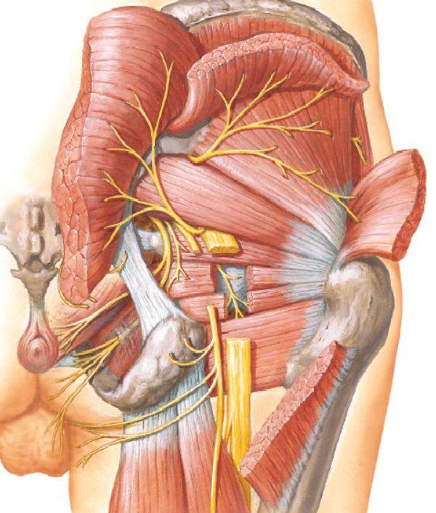
Deep gluteal nerves
Superior gluteal n.
Inferior gluteal n.
Sciatic n.
Pudendal n.
Nerve to quadratus femoris
Nerve to obturator internus
Posterior cutaneous nerve of thigh
Superior gluteal n.
Inferior gluteal n.
Posterior cutaneous nerve of thigh
Piriformis
Pudendal n.
Nerve to obturator internus (medial)
Nerve to quadratus femoris (lateral)
Sciatic n. (cut)

Slide 9
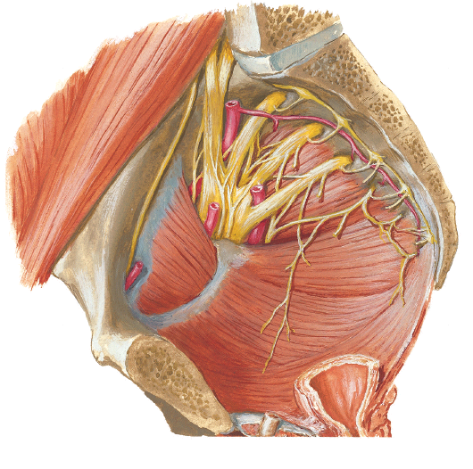
Pelvic nerves
Obturator nerve
Lumbosacral trunk
Sacral plexus
Coccygeal plexus
Pelvic autonomic nerves
Mainly innervated by sacral and coccygeal nerves + pelvic part of ANS
The nerves rest on piriformis and coccygeal muscles
  Anterior rami of S2 & S3 merges between those muscles
2
5
1
Nerves that pass through the true pelvis
No pelvic structures are supplied by obturator nerve
P

Slide 10
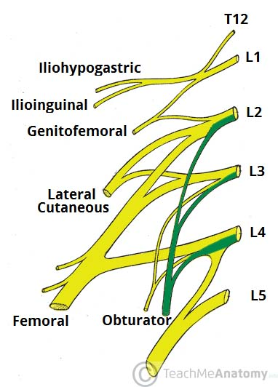
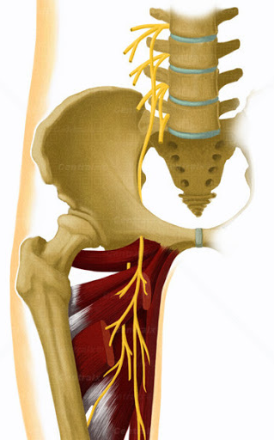
1. Obturator nerve
Arises from anterior rami of L2-L4 (lumbar plexus)
Runs along lateral wall of pelvis to the obturator canal (ischial area)
Divides into anterior & posterior parts → leave pelvis to supply medial thigh muscles

Slide 11
2. Lumbosacral trunk
Collection of anterior rami of L4 & L5
Descends to form a thick, cord-like trunk
Runs inferiorly on anterior surface of sacral ala → joins sacral plexus

Slide 12
Sacral plexus
Originates from ventral rami of spinal nerves (L4 – S3)
Location: posterolateral wall of lesser pelvis
2 main nerves: sciatic n. & pudendal n.
Most of branches leaves pelvis via greater sciatic foramen
Sciatic nerve = LARGEST nerve in body

Slide 13
Sciatic nerve
Formed by convergence of L4-S3 (anterior rami)
Enters gluteal region by passing through greater sciatic foramen (inferior to piriformis)
Continue to innervate posterior part of thigh

Slide 14
Pudendal nerve
Mainly innervate the perineum + main sensory nerve of external genitalia
Exits pelvic area through greater sciatic foramen
Then hooks around ischial spine & sacrospinous ligament to enter the lesser sciatic foramen

Slide 15
Superior & inferior gluteal n. (exits superior and inferior to piriformis respectively)
Supply muscles of gluteal region

Slide 16
Structures passing through
Greater sciatic foramen | Lesser sciatic foramen
Superior gluteal n. (above piriformis) Sciatic n. Inferior gluteal n. Posterior cutaneous n. of thigh Nerve to obturator internus Nerve to quadratus femoris Pudendal n. | Pudendal n. Nerve to obturator internus
Superior gluteal vessels Inferior gluteal vessels Internal pudendal vessels | Internal pudendal vessels Tendon of obturator internus msl

Slide 17
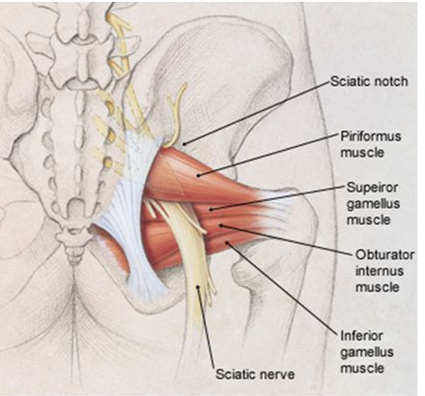
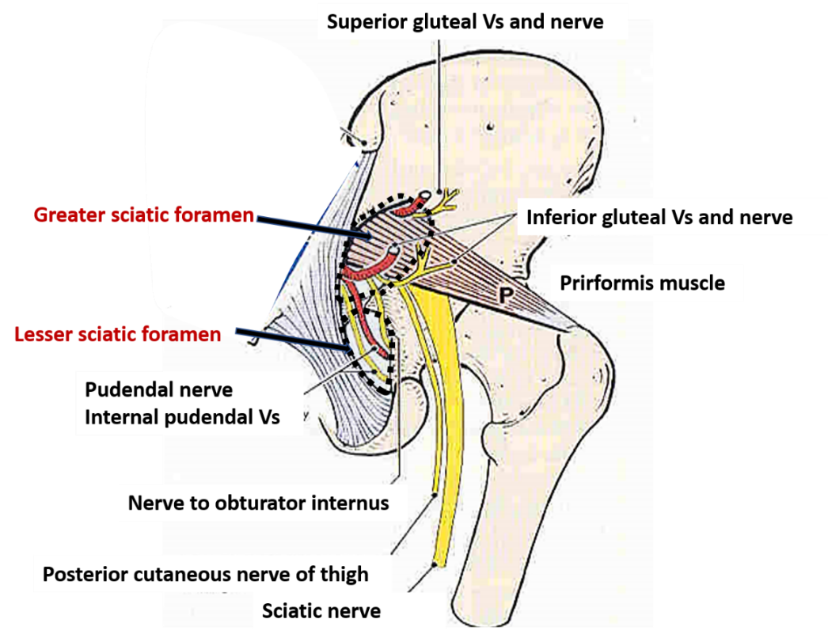

Slide 18
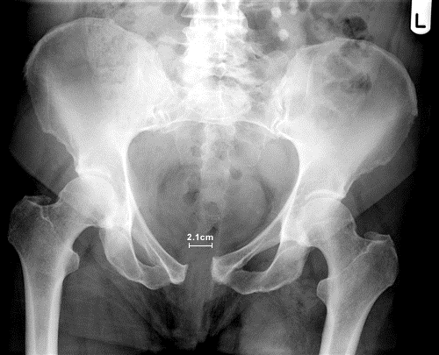
Clinical correlation

Slide 19
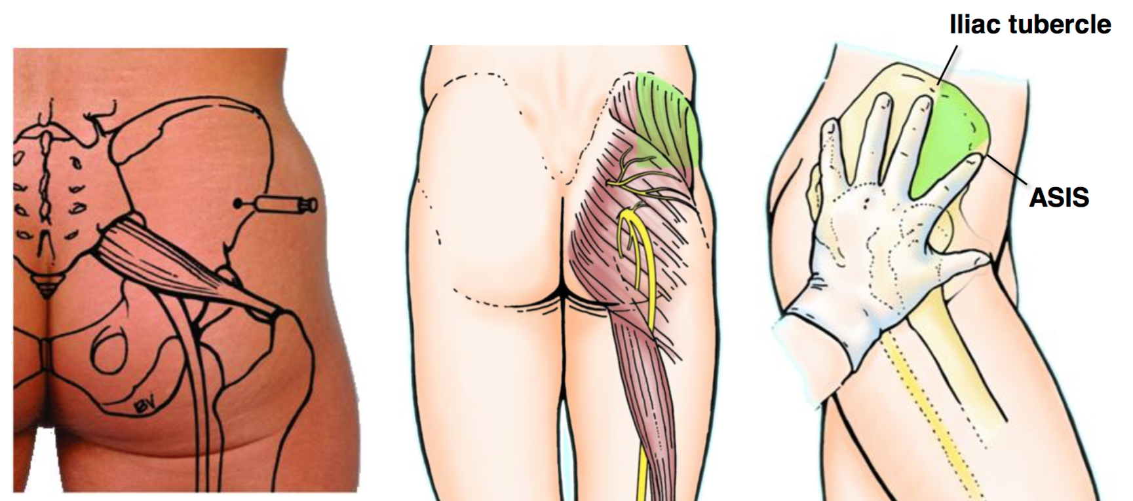
Intragluteal injections
Gluteal region is a common site for intramuscular (IM) injection of drugs because muscles are thick and large
Gives better and faster absorption of injected drugs by intramuscular veins
2 safe areas = supero-lateral quadrant of buttocks (superior part of gluteus maximus or on the gluteus medius & anterolateral part of the thigh (fasciae latae)

Slide 20
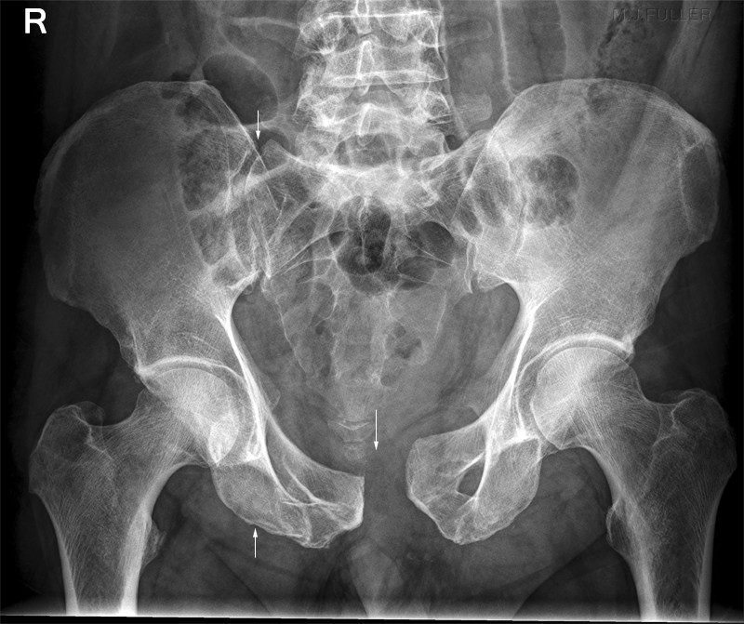
Open book fracture
Breech in anterior and posterior joint, the pubic symphysis and sacroiliac joint respectively.
Mechanism of injury commonly due to high impact injury such as motor-vehicle accident (MVA),

