Slide 1


Skeletal Muscle
Dr.Zahraa Tariq Hasson
Lec.5

Slide 2
Muscle cells, like neurons, can be excited chemically, electrically, and mechanically to produce an action potential that is transmitted along their cell membranes.
Unlike neurons, they respond to stimuli by activating a contractile mechanism.
Muscle is generally divided into three types: skeletal, cardiac, and smooth

Slide 3
Skeletal muscle makes up the great mass of the somatic musculature. It has well-developed cross-striations, does not normally contract in the absence of nervous stimulation.
It lacks anatomic and functional connections between individual muscle fibers, and is generally under voluntary control.
About 40% of our body is skeletal muscle and 10% is smooth muscle.

Slide 4
Skeletal Muscle Morphology
Skeletal muscle is made up of individual muscle fibers that are the "building blocks" of the muscular system. Most skeletal muscles begin and end in tendons, and the muscle fibers are arranged in parallel between the tendinous ends, so that the force of contraction of the units is additive.
The muscle surrounded by a layer of connective tissue continuous with that surrounds the tendon, called the epimysium.

Slide 5
Each muscle fiber runs the full length of the muscle and is encased in a thin sheath of connective tissue, called endomysium.
Bundles of muscle fibers form fascicles, that surrounded by connective tissue called perimysium and bundles of fascicles form muscle tissue.
Unlike most cells, which have a single nucleus, muscle fibers have many because each muscle fiber is formed during embryonic life from the fusion of several cells.

Slide 6
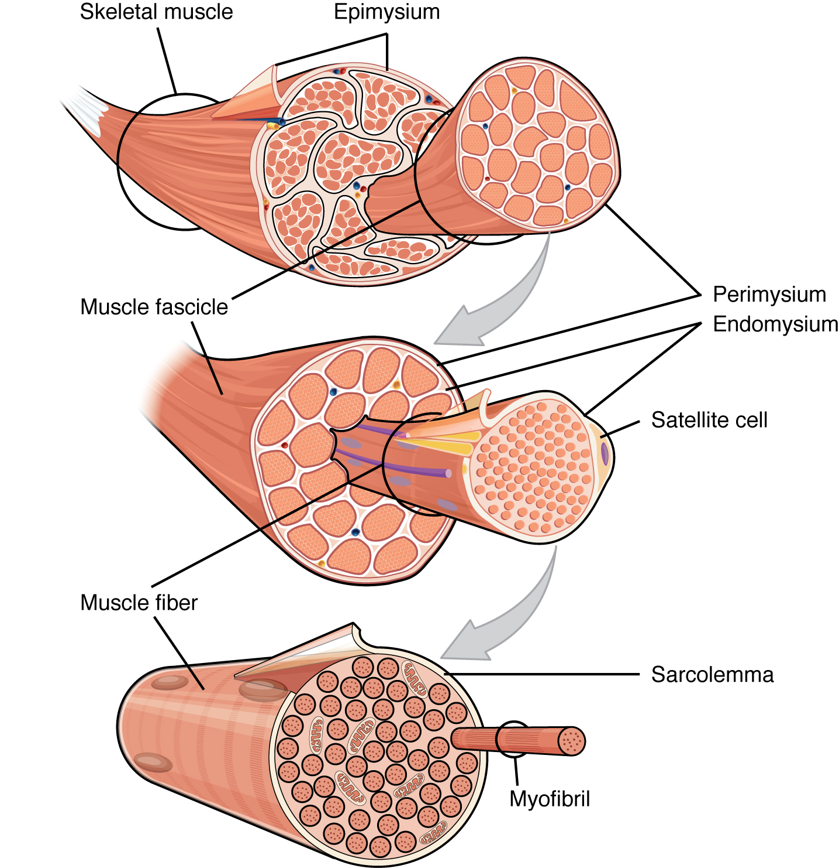

Slide 7
These nuclei lie immediately below the muscle fiber’s plasma membrane, which is called the sarcolemma.
A muscle fiber’s semifluid cytoplasm, called sarcoplasm, is packed with mitochondria and hundreds of banded, rod-like elements called myofibrils, which are divisible into individual filaments called myofilaments, which are responsible for the fiber’s contractile machinery.
Each myofibril contains contractile proteins, described as thick and thin filaments, which are arranged longitudinally into units called sarcomeres.

Slide 8
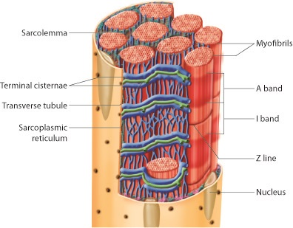

Slide 9
A saclike membranous network called the sarcoplasmic reticulum surrounds each of the myofibrils and is closely associated with other structures called transverse tubules (T tubules), which are continuous with the sarcolemma and penetrate into the cell’s interior.
Near the T tubule, the sarcoplasmic reticulum has enlargements called lateral sacs or terminal cisternae, which store calcium. The function of the sarcoplasmic reticulum is to store calcium ions (Ca).

Slide 10
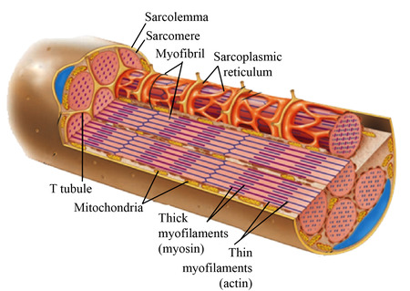
Each T tubule is associated with two lateral sacs, forming a triad.
The sarcoplasmic reticulum and T tubules play important roles in the activation of muscle contractions: T-tubules help transmit signals from the sarcolemma to the myofibrils, enabling a muscle cell to respond to neural input.

Slide 11
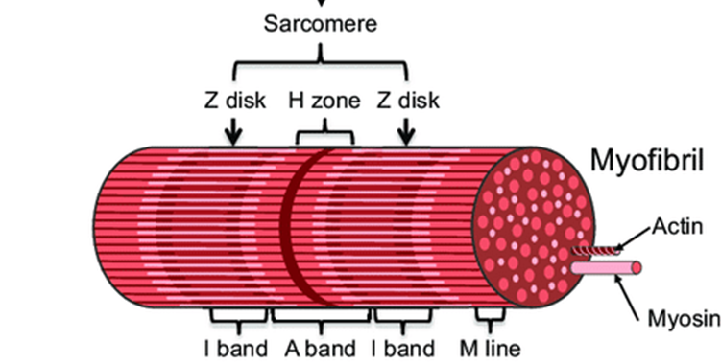
Structure at the Molecular Level
When viewed under a microscope, skeletal muscle cells have a striped appearance; for this reason, such muscle (and also cardiac muscle) is referred to as striated muscle.
A close-up view shows that these striations are created by the orderly arrangement of protein fibers in the myofibrils called thick filaments and thin filaments, which run parallel to the muscle cell’s long axis.

Slide 12
The thin and thick filaments are made up of two proteins called actin and myosin, respectively, which are referred to as contractile proteins because they constitute the machinery that generates contractile force.
The ends of actin filaments are attached to Z discs and from this disc actin extend in both directions to interdigitate with myosin. The area of muscle between two Z discs are called sarcomere which constitute contractile unit of the muscle.
Each thick (myosin) filament is made of 200 of myosin molecules, each of which looks a bit like two golf clubs wrapped around each other.
Each myosin molecule is a dimer consisting of two intertwined subunits, each having a long tail and a fat, protruding head.

Slide 13
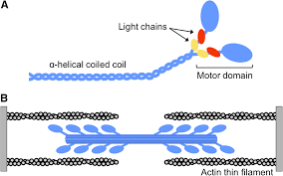
Also myosin head functions as adenosin triphosphate enzyme (ATPase) that cleaves the ATP molecule and provide energy necessary for muscle contraction.

Slide 14
The Mechanism of Force Generation in Muscle
The Sliding-Filament Model
Previously, it was thought that muscle contraction is brought by shortening of the contractile proteins themselves (thick and thin filaments), but now it is well known that muscles contract because the thin filaments of the myofibrils slide past the thick filament bringing either end of a sarcomere move closer together, thereby shortening the sarcomere.
As sarcomeres shorten, myofibrils also shorten, as do muscle fibers and ultimately whole muscles.
Appropriately, this is called the sliding-filament model of muscle contraction.

Slide 15
