Slide 1


Kidney Dialysis Technique Department
Biology Lecture 3 - 2nd course
Title: Human Body's Defense, Hormones, and Enzymes
Prof. Dr. Younis A. Alkhafaji
An Introduction to Immunity, Antigens, Antibodies, Hormones, and Enzymes
Human Body’s Defense System
Immunity
Antigens
Antibodies
Hormones
Enzymes

Slide 2
Human Body’s Defense System
What is the Immune System?
The body's defense mechanism against harmful invaders (e.g., bacteria, viruses).
Two types of immunity:
Innate Immunity: General defense (skin, mucus, white blood cells, gastric acid ….etc.).
Adaptive Immunity: Specific defense (antibodies and cell mediated immunity).
What are Antigens?
Foreign substances that trigger an immune response.
Examples: Bacteria, Viruses, Pollen, Fungus, Protozoa
***Antigens are recognized by the immune system as "non-self."
What are Antibodies?
Proteins produced by the immune system to neutralize antigens. Also called Immunoglobulins (Ig) .

Slide 3
Functions: Bind to antigens. Mark them for destruction.
Types of Antibodies: IgG, IgM, IgA, IgE, IgD.
Hormones
What are Hormones?
Chemical messengers secreted by glands into the bloodstream. Regulate body functions such as growth, metabolism, and reproduction.
Examples of Hormones:
Insulin (regulates blood sugar).
Thyroxine (controls metabolism).
Adrenaline (prepares the body for stress).
What are Enzymes?
Proteins that speed up chemical reactions in the body. Work as catalysts to break down or build molecules.

Slide 4
Examples of Enzymes:
Amylase (breaks down carbohydrates).
Protease (breaks down proteins).
Lipase (breaks down fats).
Importance in Food Technology: Used in food processing (e.g., cheese production, brewing).
In genetic engineering DNA ligases and in Nucleic acid transcription
Summary:
The immune system protects the body using innate and adaptive immunity.
Antigens are foreign substances; antibodies neutralize them.
Hormones regulate body functions.
Enzymes are essential for speeding up chemical reactions.

Slide 5
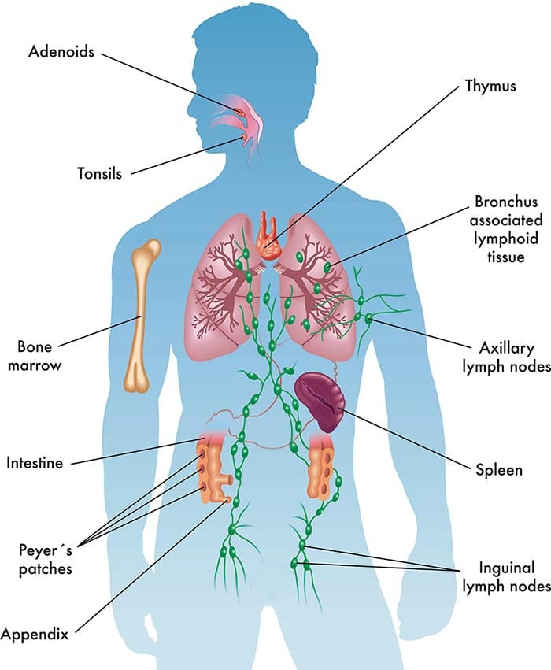
Questions & Discussion
Any one has Discussion?

Slide 6
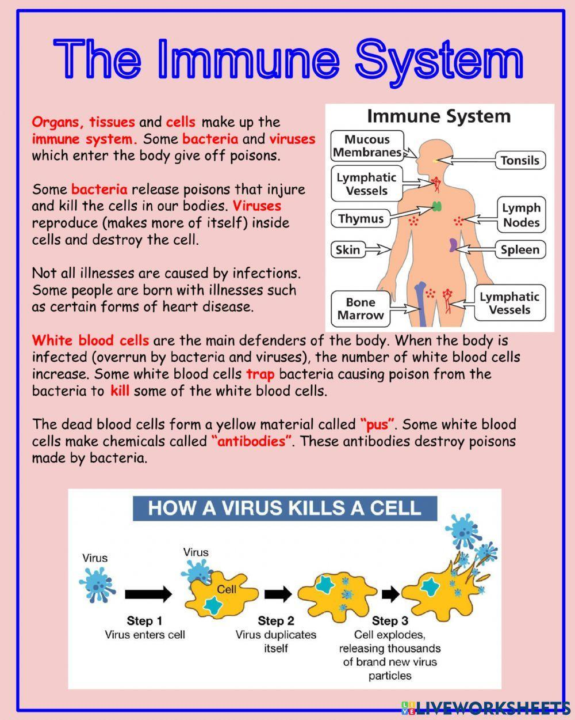

Slide 7
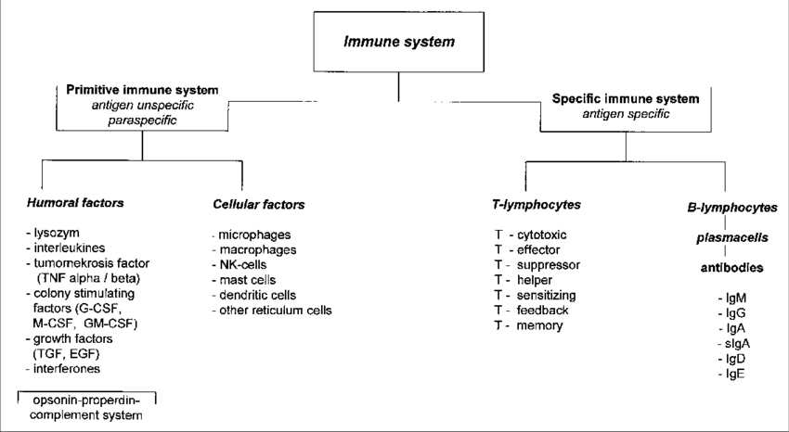

Slide 8
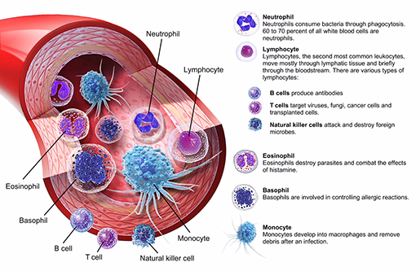

Slide 9
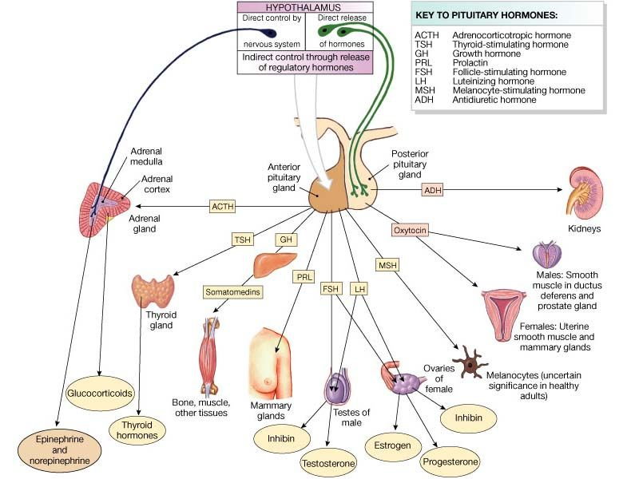

Slide 10
